Slide 1
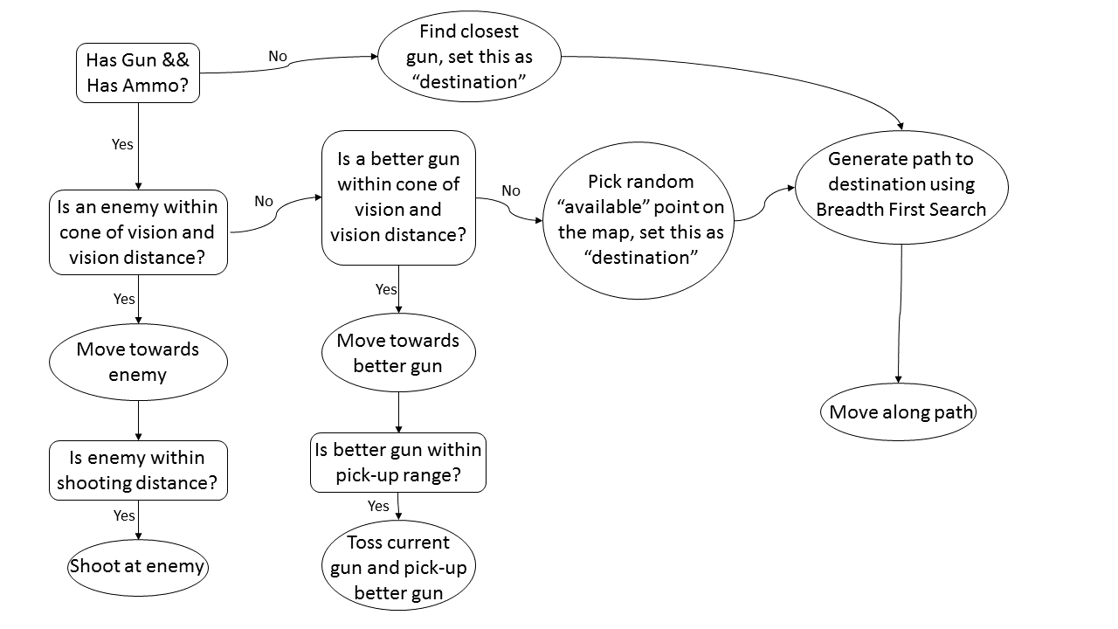
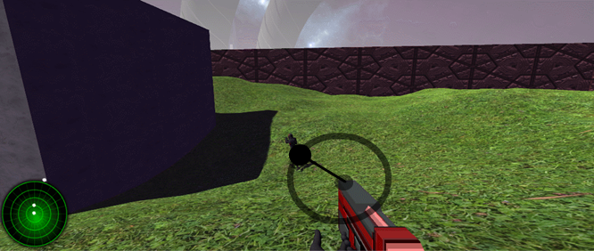
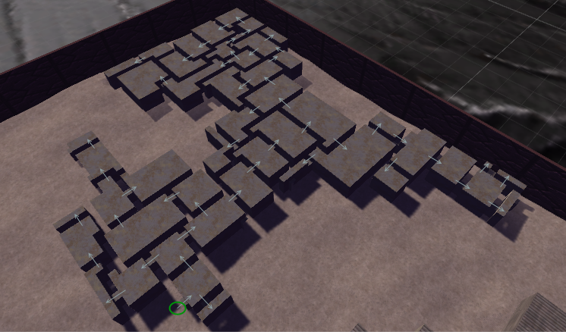
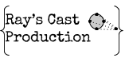
Grunk’s Arena
Aaron Camm, Jeff Huggins, Steve Moskal, Patrick Cardwell
Department of Computer Science & Engineering, The Ohio State University, 2015 Neil Avenue, Columbus, OH 43210
AI
Bullet Logic
Radar Handling
The AI bot logic works as follows:
When the terrain is first generated it is covered in a 2D node array. These nodes are listed as “available” if they are not occupied by a wall; this leaves the area outside of buildings, the area inside of buildings, and doorways. These nodes are the ones taken into consideration when searching for a random destination as well as when generating a path to that destination. It should also be noted that if a bot is following the path generated by the breadth first search, it will not search for another destination or generate a new path until that destination is reached, or until an enemy or better gun enters its cone of vision.
The process of finding a better gun was done by assigning rank values to each gun. The Bit Gun has a rank of 1, the AK47, UMP and M4 have ranks of 2, and the Bazooka and Sonic Guitar have ranks of 3. If a gun in a bot’s cone of vision has a higher rank than its current gun, then that is determined to be a better gun and the bot will move towards it.
Another element that was added to the bots was a random degree of inaccuracy when shooting a gun. Since a bot would always be aiming directly at the enemy when they fired, the only inaccuracy they would have would come from the gun itself. Since not even the best player can always have their reticule on their target when they shoot, when a bot gets created they are given a random degree of inaccuracy that adds on to the standard gun inaccuracies.
The radar system in the game is done by utilizing some simple linear algebra to map the position of other players in the game in relation to where you are on the map. This is drawn onto to the radar image in the gui.
First thing it does before the game starts, for each person playing on every gui, it will generate a radar dot that will only be used to represent that player. In game, after each LateUpdate, it checks to see if the player that was assigned to the radar dot is in range and alive. If not, it stops the radar dot from being shown on the screen.
If the other player is in range and alive, then it gets the x and z position of the other player and the x and z position of the current player. It takes the difference of the other player's position from the current player's position, which gives us a vector that shows the distance and direction in relation from current player to the other player. We then normalize the vector and then rescale by the distance * (radar image size / the radar's max range) and we have position of where to put the dot from the center of the radar Image.
Then we simply rotate all the dots on the z axis based on the player's y rotation axis to show the radar dots rotating with the player's rotation
The above picture shows roughly how the game handles bullet logic. When a user shoots it will first create a circle of random radius (the max radius being dependant on the gun). Once that circle is created it will find a random point on that circle between 0 and 2Pi. From there it will create a raycast from the gun muzzle to that point on the circle. Then if it hits a player or bot it will destroy that gameobject.
Level Generation
Each map’s terrain is created using a heightmap. The heightmap is generated using multiple octaves of Perlin noise. The octaves are summed together and scaled to get reasonable height values. The buildings are also generated with noise, using a single octave to mark locations on the map where buildings should be generated. Each building is then recursively given a door on a random wall, then the other side of the wall will become the location of a room. This process is repeated for every room, so there becomes a deep sequence of connected rooms. The rooms are then randomly populated with crates to add some interior detail. The picture below shows an example path of the room generation.
CONTACT
Game State Management
Aaron Camm – camm.10@buckeyemail.osu.edu
Jeff Huggins –
Huggins.65@osu.edu
Steve Moskal-
Moskal.11@osu.edu
Patrick Cardwell-
Cardwell.64@osu.edu
WIthin the Unity Game Engine, normally all game objects and variables are destroyed upon loading a new scene or changing between scenes. Since the main menu and the gameplay are done in separate scenes, data needs to pass through the two scenes through some method, so that the transfer settings that were done in the main menu, can be utilized in the parameters used to create the game.
To allow this, we utilize a special GameObject that is persistent and will not get destroyed when changing scenes. In this GameObject is also a special class that holds all the variables that are needed to be transferred. The main menu has its many gui elements and controller detection set to change and set the data in this class, and once the gameplay state starts, it will read the same variables and used them to generate the parameters for the game.

