Slide 1
Lecture 3
Strength of Weak Ties and Modular Structure (Communities)
Srinivasan Parthasarathy
Adapted and Extended Slides from Ymir Vigfusson and Jure Leskovec
Who in turn adapted it from several others (details in individual slides)

Slide 2
Networks: Flow of Information
How does information flows through the network?
How do different nodes play structurally distinct roles in this process?
How do different links (short range vs. long range) play different roles in diffusion?

Slide 3
Strength of Weak Ties
[Granovetter ‘73]
How people find out about new jobs?
  Mark Granovetter, part of his PhD in 1960s
  People find the information through personal contacts
But: Contacts were often acquaintances
rather than close friends
  This is surprising:
    One would expect your friends to help you out more than casual acquaintances when you are between the jobs
Why is it that distant acquaintances are most helpful?

Slide 4
Granovetter’s Answer
[Granovetter ‘73]
Two perspectives on friendships:
  Structural:
    Friendships span different portions
    of the network
  Interpersonal:
    Friendship between two people is either strong or weak

Slide 5
Triadic Closure
Which edge is more likely to form, a-b or a-c?
Triadic closure: If two people in a
network have a friend in common
there is an increased likelihood
they will become friends themselves
a
b
c

Slide 6
Triadic Closure
Triadic closure == High clustering coefficient
Reasons for triadic closure:
If B and C have a friend A in common, then:
  B is more likely to meet C
    (since they both spend time with A)
  B and C trust each other
    (since they have a friend in common)
  A has incentive to bring B and C together
    (as it is hard for A to maintain two disjoint relationships)
Empirical study by Bearman and Moody:
  Teenage girls with low clustering coefficient are
  more likely to contemplate suicide

Slide 7
Granovetter’s Explanation
Bridge
Define: Bridge edge
  If removed, it disconnects the graph
Define: Local bridge
  Edge of Span>2
  (i.e., Edge not in a triangle)
Two types of edges:
  Strong (friend) and
  weak ties (acquaintance)
Strong triadic closure:
  Two strong ties imply a third edge
Claim: If strong triadic closure satisfied
then local bridges are weak ties!
a
b
Local bridge
a
b
Edge:
W or S
S
S
W
S
S
S
W
S
a
b
S

Slide 8
Tie strength in real data
For many years the Granovetter’s
theory was not tested
But, today we have large
who-talks-to-whom graphs:
  Email, Messenger, Cell phones, Facebook
Onnela et al. 2007:
  Cell-phone network of 20% of country’s population
  Edge strength: # phone calls

Slide 9
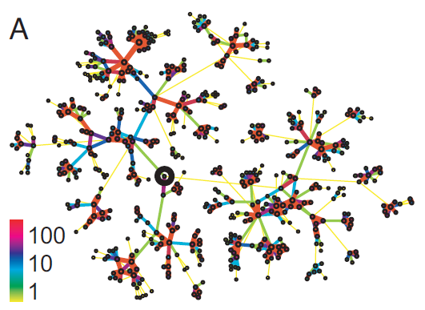
Real Network, Real Tie Strengths
Real edge strengths in mobile call graph
  Strong ties are more embedded (have higher overlap)

Slide 10
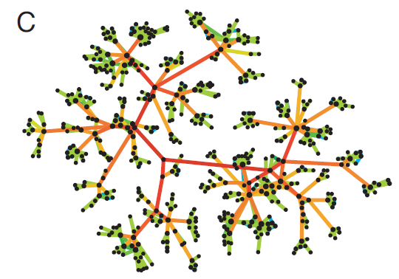
Edge Betweenness Centrality
b=16
b=7.5
Edges strength is labeled based on betweenness centrality (number of shortest paths passing through an edge)

Slide 11
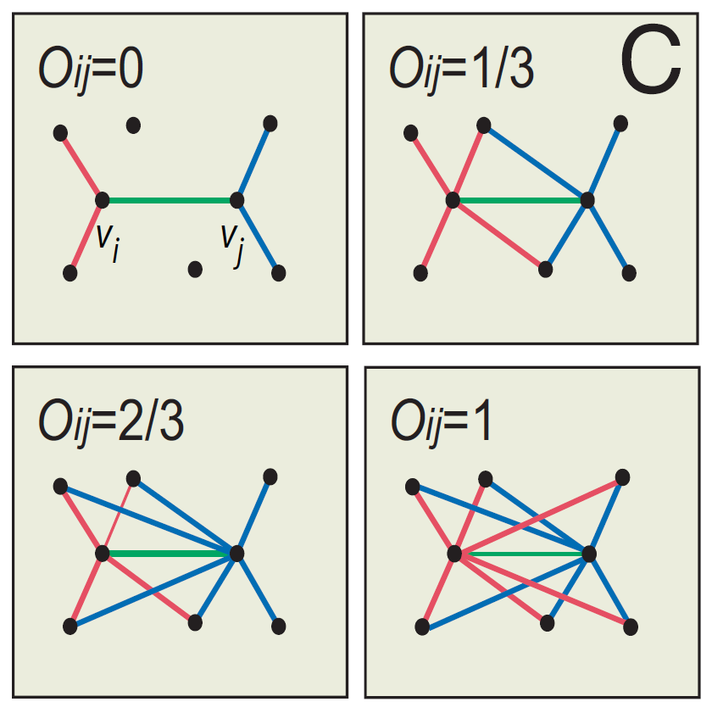
Neighborhood Overlap
Measure of tie strength
Does this look familiar?
Jaccard Similarity
Can estimate efficiently
  Using MinHash Procedure

Slide 12
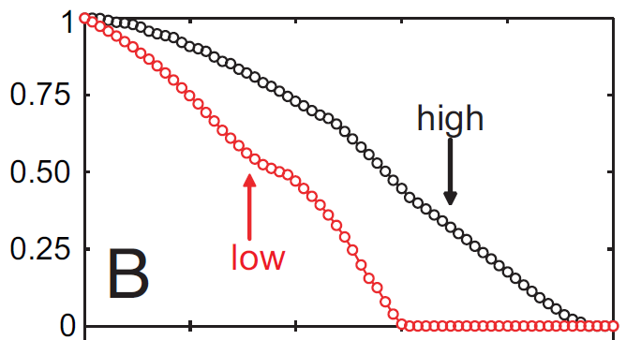
Link Removal by Overlap
Low disconnects
the network sooner
[Satuluri, Parthasarathy, Ruan 2011]
Size of largest component
Fraction of removed links
Removing links based on overlap
  Low to high
  High to low
Conceptual picture
of network structure

Slide 13
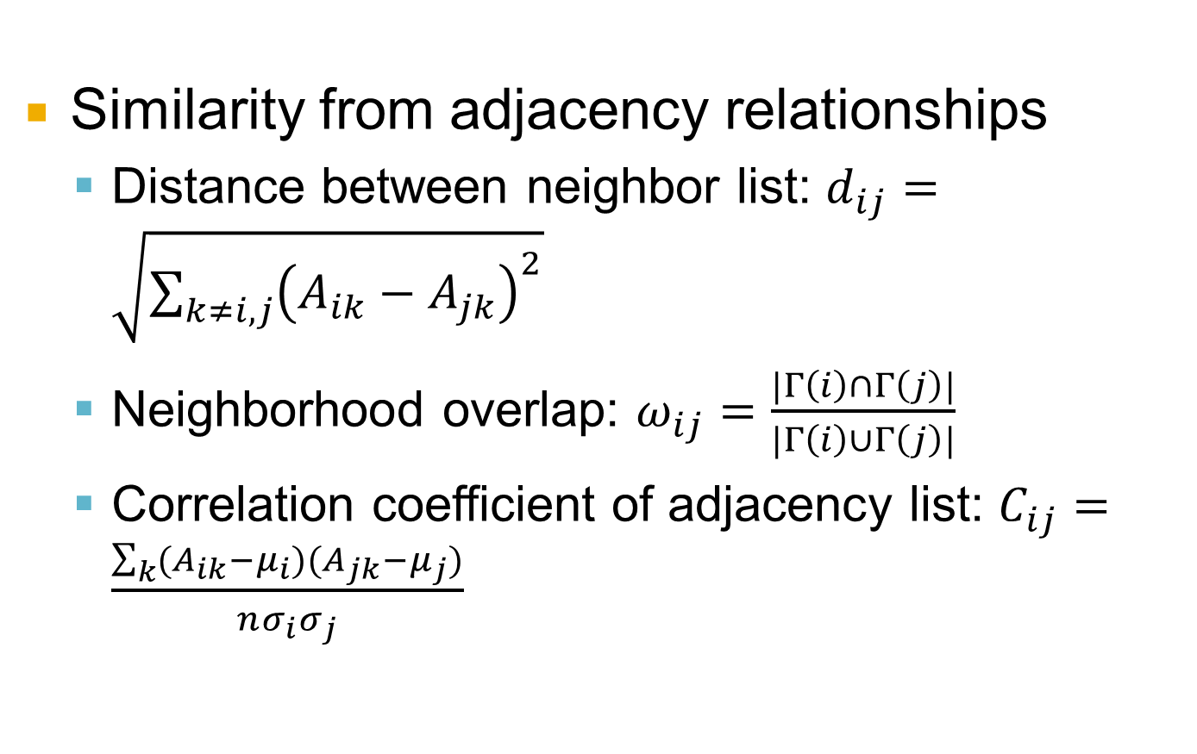
Other Measures of Tie Strength
Similarity from adjacency relationships
  Distance between neighbor list: $d_{ij}=\sqrt{\sum_{k≠i,j}{{\left(A_{ik}−A_{jk}\right)}^{2}}}$
  Neighborhood overlap: $ω_{ij}=\frac{|Γ\left(i\right)∩Γ\left(j\right)|}{|Γ\left(i\right)∪Γ\left(j\right)|}$
  Correlation coefficient of adjacency list: $C_{ij}=\frac{\sum_{k}{(A_{ik}−μ_{i})(A_{jk}−μ_{j})}}{nσ_{i}σ_{j}}$

Slide 14
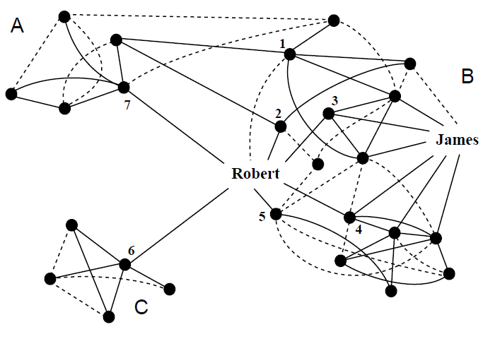
Small Detour: Structural Holes
[Ron Burt]

Slide 15
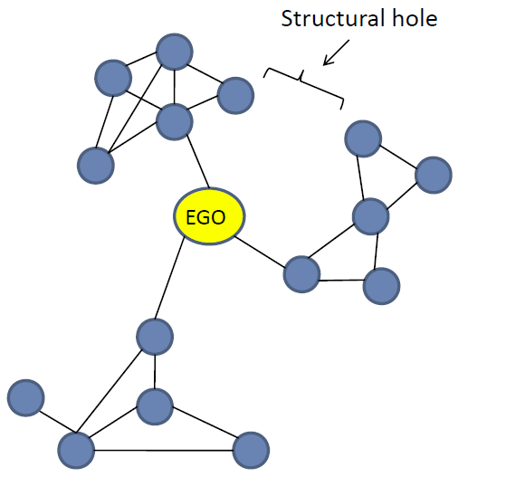
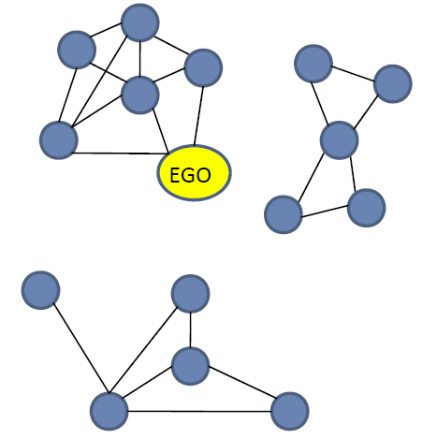
Structural Holes
Major structural holes
Spanning structural holes
Structural Holes provide ego with access
to novel information, power, freedom

Slide 16
Structural Holes: Network Constraint
The “network constraint” measure [Burt]:
  To what extent are person’s contacts redundant
    Low: disconnected contacts
    High: contacts that are
    close or strongly tied
k
p_{uv}=1/d_{u}
p_{ik}
k
2
p₂₅=½
p_{ij}
p₁₂=¼
i
j
i
3
1
5
p₁₅=¼
j
4
p
1 2 3 4 5
1 .00 .25 .25 .25 .25
2 .50 .00 .00 .00 .50
3 1.0 .00 .00 .00 .00
4 .50 .00 .00 .00 .50
5 .33 .33 .00 .33 .00
p_{uv} … prop. of u’s “energy” invested in relationship with v
Notes:
Cost of ties in part of the concept.

Slide 17
Example: Robert vs. James
Constraint: To what extent are person’s contacts redundant
  Low: disconnected contacts
  High: contacts that are close or strongly tied
Network constraint:
  James: c_{j}=0.309 (candidate for spanning)
  Robert: c_{r}=0.148 (mod degree, low NC – spans communities)

Slide 18
Network Communities

Slide 19
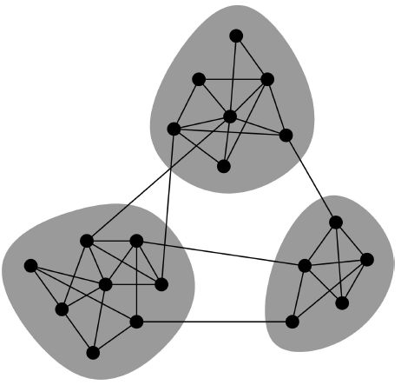
Network Communities
Networks of tightly connected groups
Network communities:
  Sets of nodes with lots of connections inside and few to outside (the rest of the network)
Communities, clusters, groups, modules

Slide 20
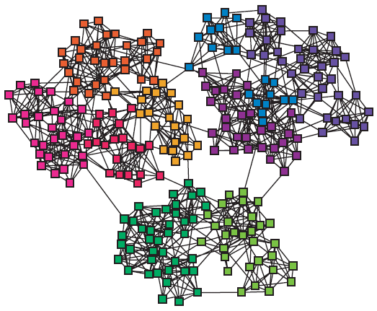
Finding Network Communities
How to automatically find such densely connected groups of nodes?
Ideally such automatically detected clusters would then correspond to real groups
For example:
Communities, clusters, groups, modules

Slide 21
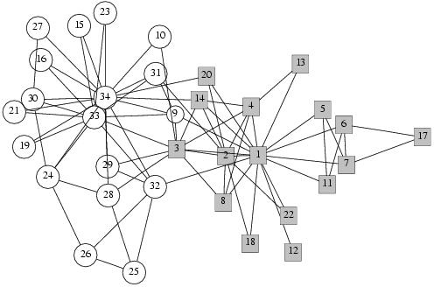
Social Network Data
Zachary’s Karate club network:
  Observe social ties and rivalries in a university karate club
  During his observation, conflicts led the group to split
  Split could be explained by a minimum cut in the network
Why would we expect such clusters to arise?

Slide 22
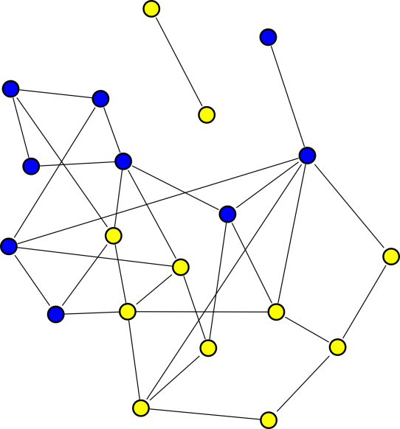
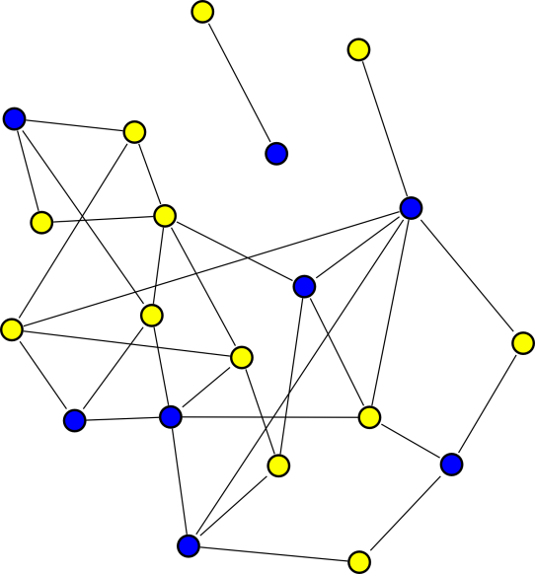
Group Formation in Networks
[Backstrom et al. KDD ‘06]
In a social network nodes explicitly declare group membership:
  Facebook groups, Publication venue
Can think of groups as node colors
Gives insights into social dynamics:
  Recruits friends? Memberships spread along edges
  Doesn’t recruit? Spread randomly
What factors influence a person’s decision to join a group?

Slide 23
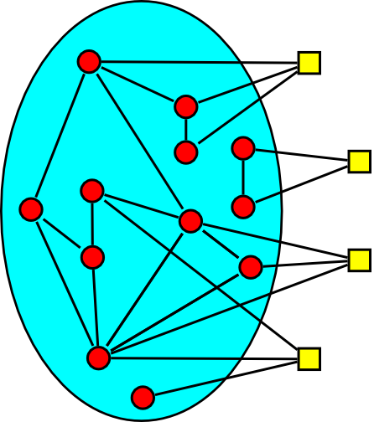
Group Growth as Diffusion
Analogous to diffusion Group memberships spread over the network:
  Red circles represent
  existing group members
  Yellow squares may join
Question:
  How does prob. of joining
  a group depend on the number of friends already
  in the group?

Slide 24
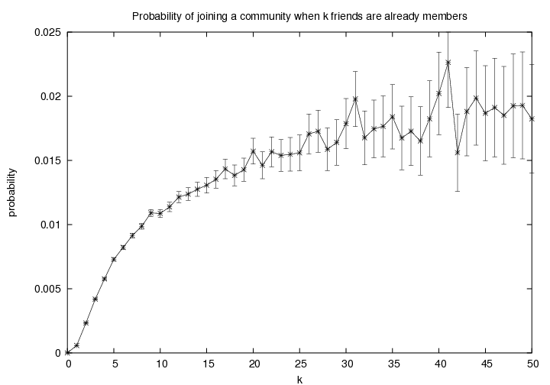
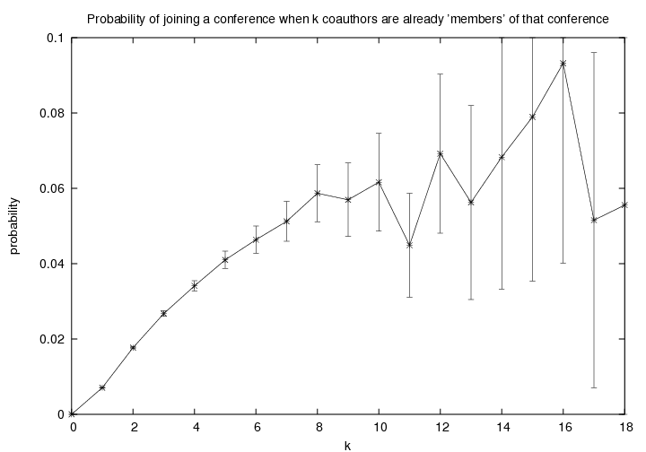
P(join) vs. # friends in the group
[Backstrom et al. KDD ‘06]
LiveJournal:
1 million users
250,000 groups
DBLP: 400,000 papers
100,000 authors
2,000 conferences
Diminishing returns:
  Probability of joining increases with the
  number of friends in the group
  But increases get smaller and smaller
Notes:
Very different data sets, same threshold sort of thing

Slide 25
Groups: More Subtle Features
Connectedness of friends:
  x and y have three friends in the group
  x’s friends are independent
  y’s friends are all connected
Who is more likely to join?
x
y

Slide 26
Connectedness of Friends
[Backstrom et al. KDD ‘06]
Competing sociological theories:
  Information argument [Granovetter ‘73]
  Social capital argument [Coleman ’88]
Information argument:
  Unconnected friends give independent support
Social capital argument:
  Safety/trust advantage in having friends
  who know each other
x
y

Slide 27
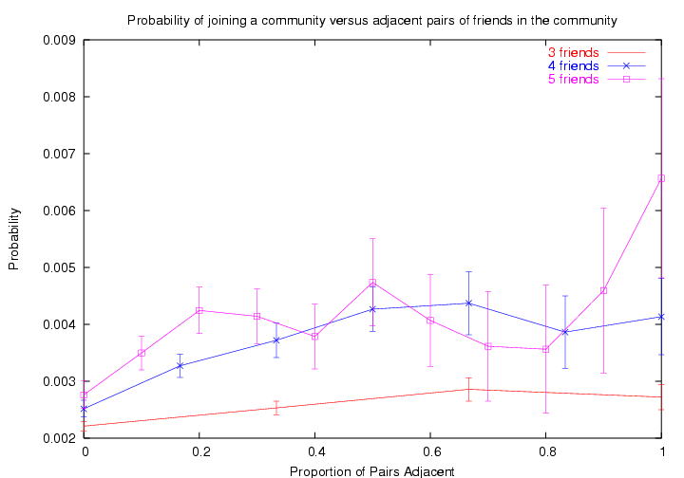
Connectedness of Friends
LiveJournal: 1 million users, 250,000 groups
Social capital argument wins!
Prob. of joining increases with the number of adjacent members.
Notes:
Going to a party/protest
Believing a rumor

Slide 28
So, This Means That
[Backstrom et al. KDD ‘06]
A person is more likely to join a group if
  she has more friends who
  are already in the group
  friends have more connections between themselves
So, groups form clusters of tightly connected nodes

Slide 29
Group Formation: Other Theories
[Purohit et. al. ICWSM 2014]
Social Cohesion Theory
  Joins group because (s)he perceives self to be similar to others in the group.
  At some level subsumes capital/information argument
Social Identity Theory
  User self identifies with perceived goals of the group
  Person joins peace-core because of what it represents rather than who joined it.
Study [Purohit et al 2014] concludes that both have a role

Slide 30
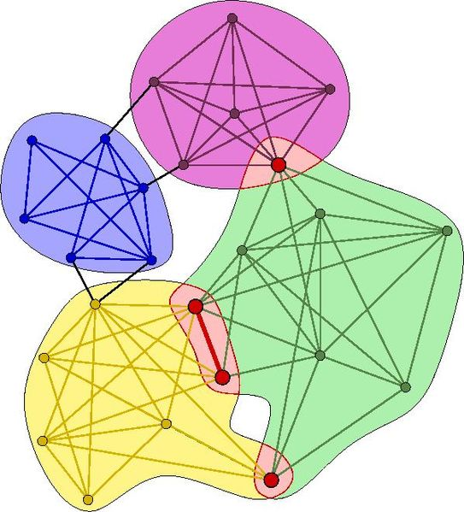
Community Detection
How to find communities?
We will work with undirected (unweighted) networks

Slide 31
Clustering and Community Finding
How to extract groups?
Many methods:
Hierarchical methods:
  Top-down/ bottom-up
Graph partitioning methods:
  Define “edge counting” metric – conductance, expansion, modularity, etc. – and optimize!
Spectral methods:
  Based on eigenvector decomposition of modified graph adjacency matrix
Clique percolation method:
  To extract overlapping communities in networks
No community overlaps

Slide 32
Method 1: Strength of Weak Ties
Intuition:
Edge strengths (call volume)
in real network
Edge betweenness
in real network

Slide 33
Method 1: Girvan-Newman
[Girvan-Newman ‘02]
Divisive hierarchical clustering based on the notion of edge betweenness:
  Number of shortest paths passing through the edge
Girvan-Newman Algorithm:
        Undirected unweighted networks
  Repeat until no edges are left:
    Calculate betweenness of edges
    Remove edges with highest betweenness
  Connected components are communities
  Gives a hierarchical decomposition of the network

Slide 34
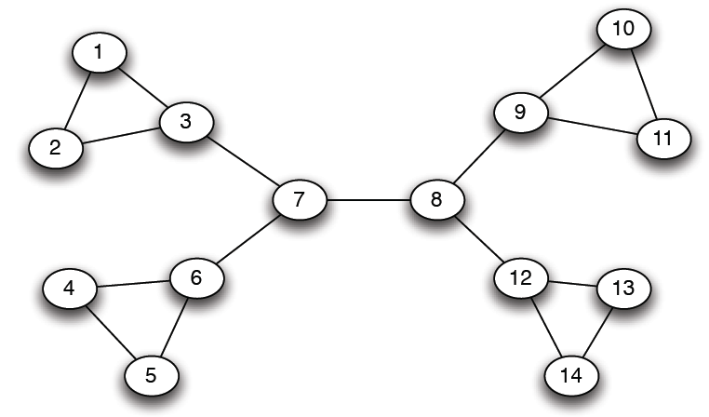
Girvan-Newman: Example
12
1
33
49
Need to re-compute betweenness at every step

Slide 35
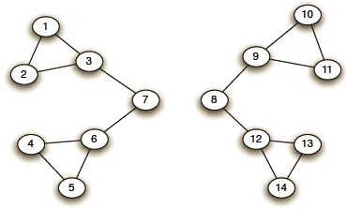
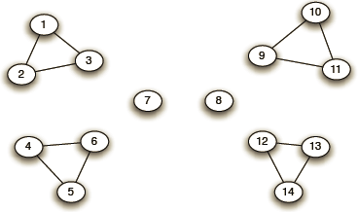
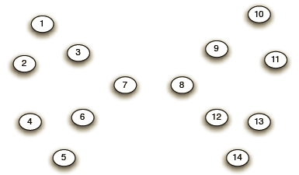
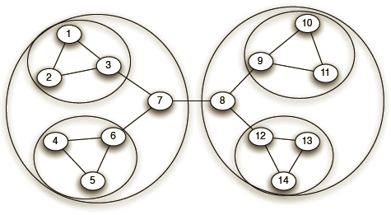
Girvan-Newman: Example
Step 1:
Step 2:
Step 3:
Hierarchical network decomposition:

Slide 36
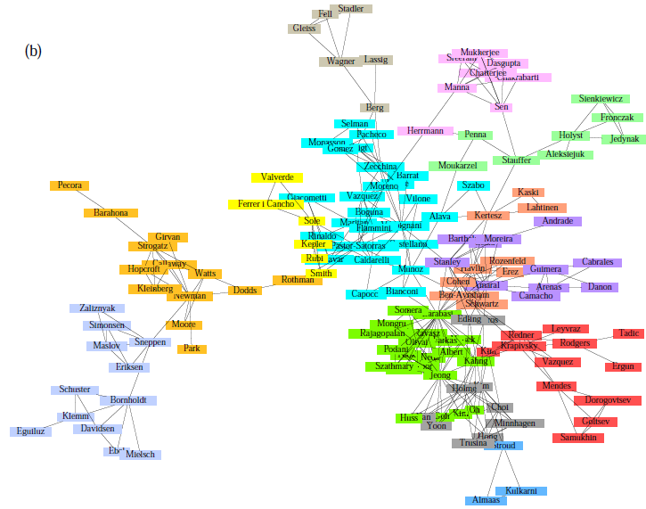
Girvan-Newman: Results
Communities in physics collaborations

Slide 37
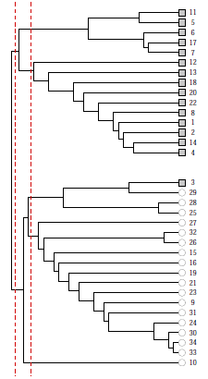
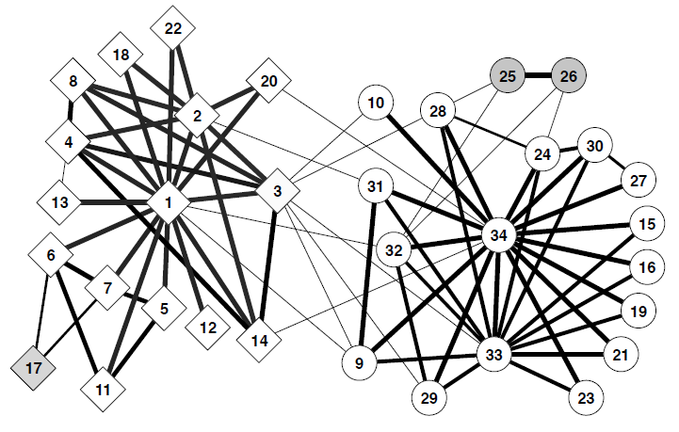
Girvan-Newman: Results
Zachary’s Karate club:
hierarchical decomposition

Slide 38

How to evaluate – Modularity!
Define modularity to be
Q = (number of edges within groups) – (expected number within groups)
Actual number of edges between i and j is
Expected number of edges between i and j is
m…number of edges
Notes:
Ki and Kj are degrees of vertices
And m is the total number of edges in the network
Aij = adjacency matrix
Q can be +ve or –ve
+ve values means presence of community structure

Slide 39
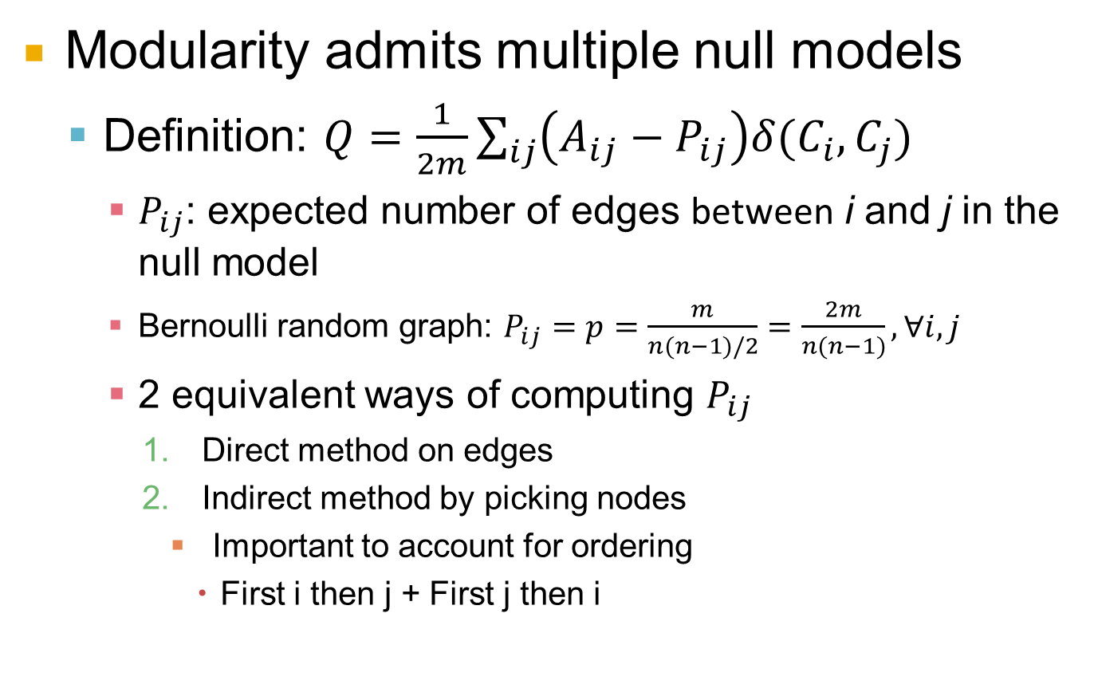
Bernoulli Null Model
Modularity admits multiple null models
  Definition: $Q=\frac{1}{2m}\sum_{ij}{\left(A_{ij}−P_{ij}\right)δ(C_{i},C_{j})}$
    $P_{ij}$: expected number of edges between i and j in the null model
    Bernoulli random graph: $P_{ij}=p=\frac{m}{n(n−1)/2}=\frac{2m}{n(n−1)}, ∀i,j$
    2 equivalent ways of computing $P_{ij}$
      Direct method on edges
      Indirect method by picking nodes
        Important to account for ordering
          First i then j + First j then i

Slide 40
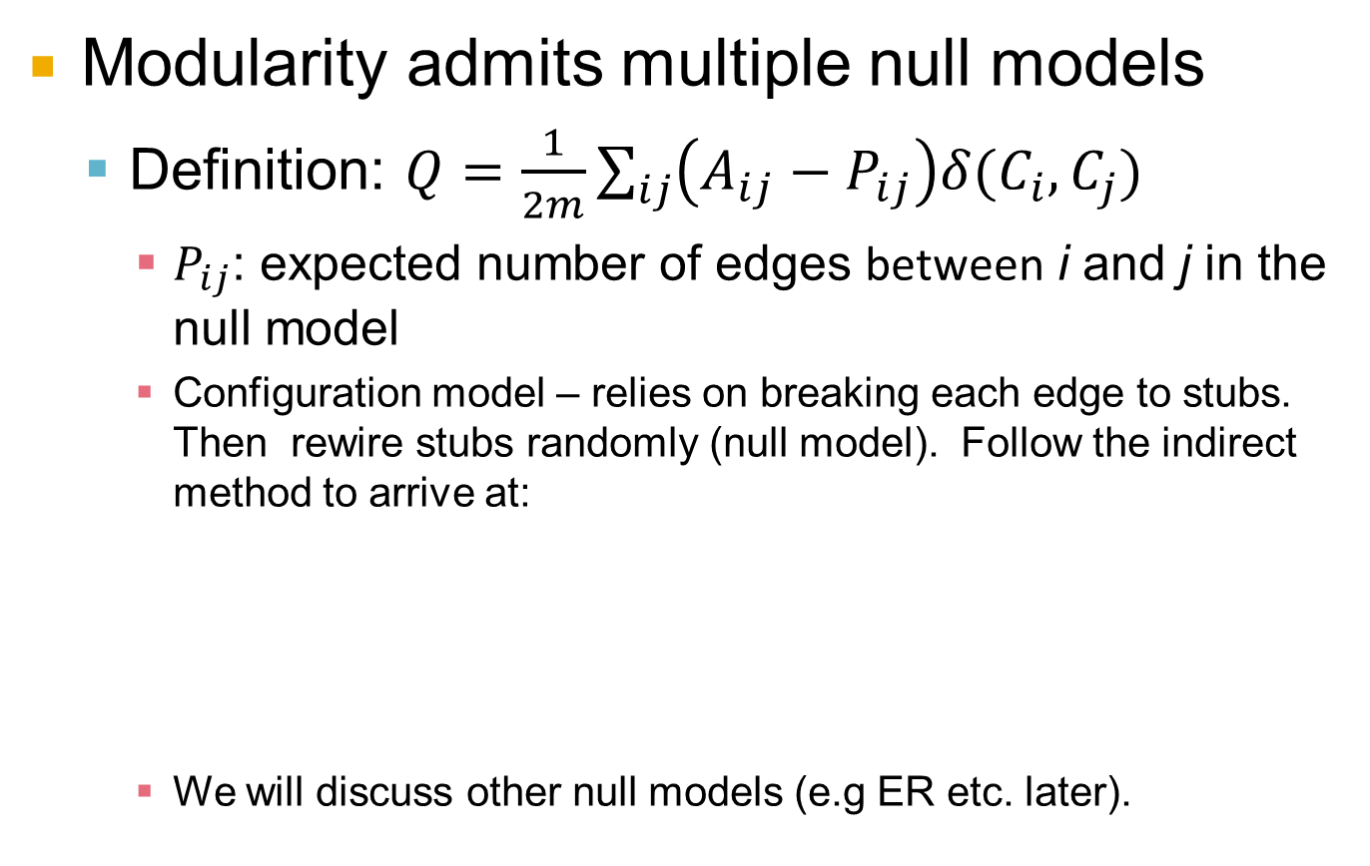
Configuration Null Model
Modularity admits multiple null models
  Definition: $Q=\frac{1}{2m}\sum_{ij}{\left(A_{ij}−P_{ij}\right)δ(C_{i},C_{j})}$
    $P_{ij}$: expected number of edges between i and j in the null model
    Configuration model – relies on breaking each edge to stubs. Then rewire stubs randomly (null model). Follow the indirect method to arrive at:
    We will discuss other null models (e.g ER etc. later).

Slide 41
Modularity: Definition
Q = (number of edges within groups) – (expected number within groups)
Then:
Modularity
  It is positive if the number of edges within groups exceeds the expected number
  0.3<Q<0.7 means significant community structure
  m … number of edges
  A_{ij} … 1 if (i,j) is edge, else 0
  k_{i} … degree of node i
  c_{i} … group id of node i
  δ(a, b) … 1 if a=b, else 0

Slide 42
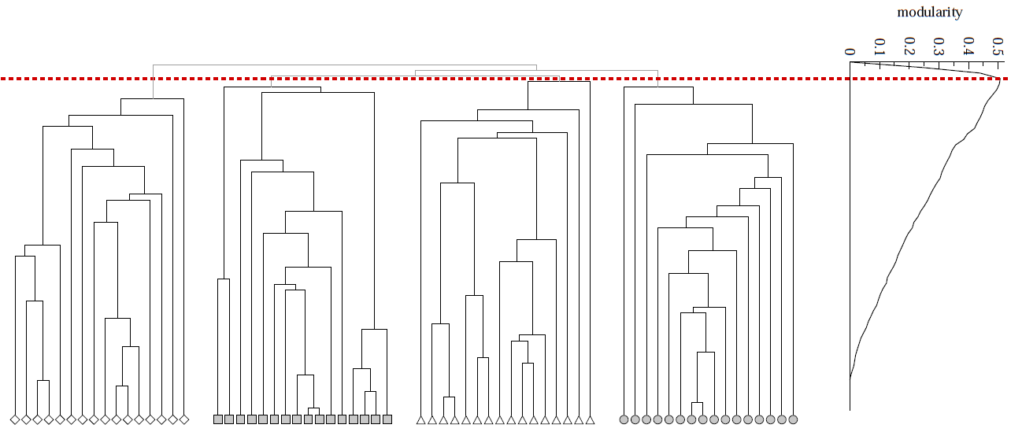
Modularity: Number of clusters
Modularity is useful for selecting the
number of clusters:
Q
Why not optimize modularity directly?
Notes:
HW: Question – come up with a graph where GIRVAN-NEWMAN MODULARITY IS NOT UNIMODAL

Slide 43
Community Discovery (more to come)
We have only covered the tip of the iceberg
We described a single algorithm
We described a single measure of cluster quality.
We will spend a lot more time on this topic later on in the course!

Slide 44
Signed Networks and Communities
-
Networks with positive and
negative relationships
Our basic unit of investigation
will be signed triangles
First we will talk about undirected
nets then directed
Plan for today:
  Model: Consider two soc. theories of signed nets
  Data: Reason about them in large online networks
  Application: Predict if A and B are linked with + or -
-
+
-
-
+

Slide 45
Signed Networks
Networks with positive and negative relationships
Consider an undirected complete graph
Label each edge as either:
  Positive: friendship, trust, positive sentiment, …
  Negative: enemy, distrust, negative sentiment, …
Examine triples of connected nodes A, B, C

Slide 46
Theory of Structural Balance
Start with the intuition [Heider ’46]:
  Friend of my friend is my friend
  Enemy of enemy is my friend
  Enemy of friend is my enemy
Look at connected triples of nodes:
+
-
-
+
+
-
-
+
+
+
-
-
Balanced
Unbalanced
Consistent with “friend of a friend” or “enemy of the enemy” intuition
Inconsistent with the “friend of a friend” or “enemy of the enemy” intuition

Slide 47
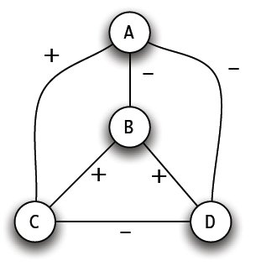
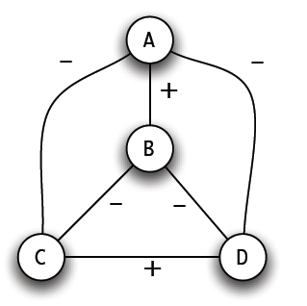
Balanced/Unbalanced Networks
Graph is balanced if every connected
triple of nodes has:
  all 3 edges labeled +, or
  exactly 1 edge labeled +
Unbalanced
Balanced

Slide 48
Local Balance  Global Factions
Balance implies global coalitions [Cartwright-Harary]
Claim: If all triangles are balanced, then either:
  The network contains only positive edges, or
  Nodes can be split into 2 sets where negative edges only point between the sets
-
+
+
+
L
R

Slide 49
Analysis of Balance
Every node in L is enemy of R
–
B
D
+
–
+
+
Any 2 nodes
in R are friends
Any 2 nodes
in L are friends
A
–
+
C
E
R
L
Friends of A
Enemies of A

Slide 50
Example: International Relations
International relations:
  Positive edge: alliance
  Negative edge: animosity
Separation of Bangladesh from Pakistan in 1971: US supports Pakistan. Why?
  USSR was enemy of China
  China was enemy of India
  India was enemy of Pakistan
  US was friendly with China
  China vetoed
  Bangladesh from U.N.
B
–
–?
–
P
+
I
–
+?
C
+
–
U
R

Slide 51
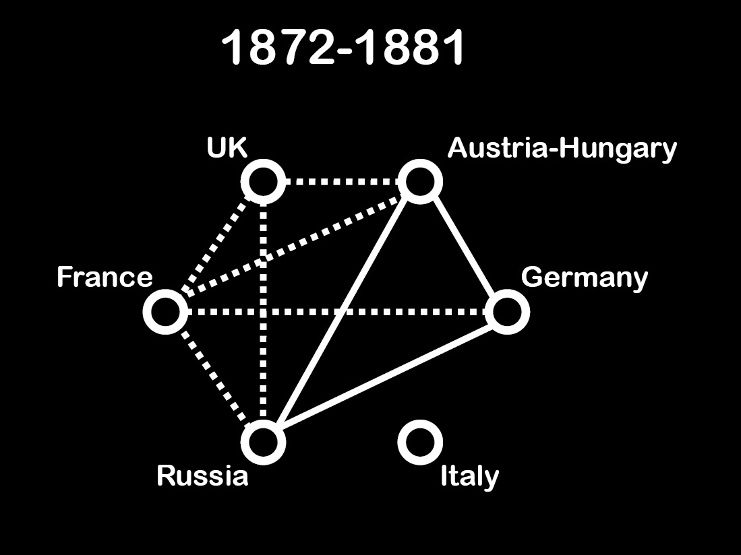

Slide 52
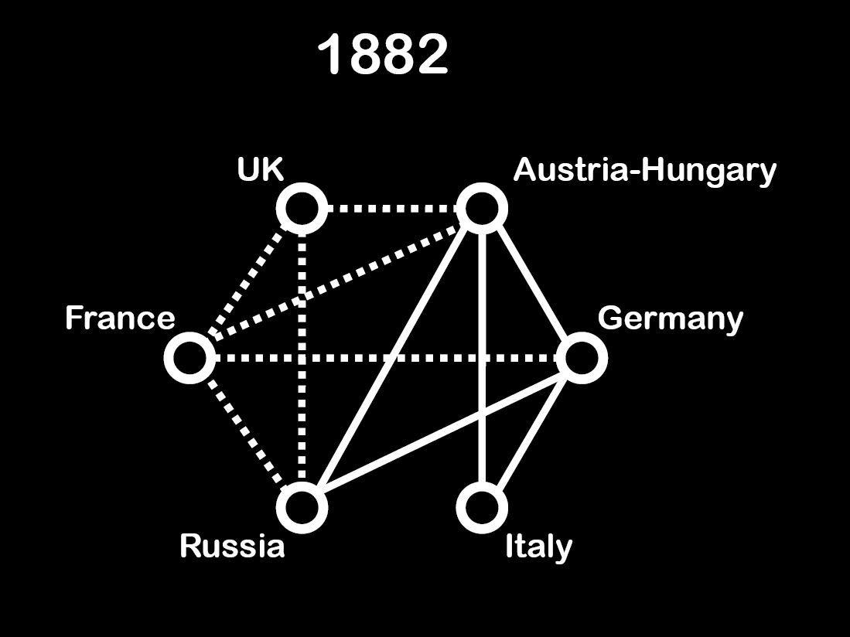

Slide 53
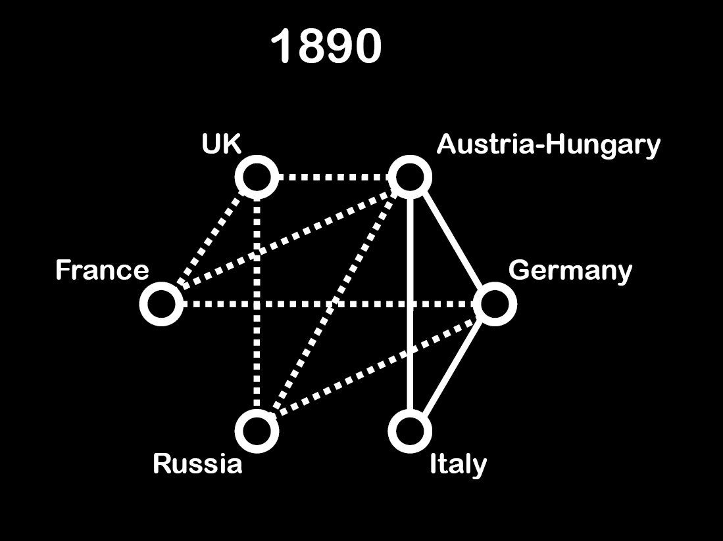

Slide 54
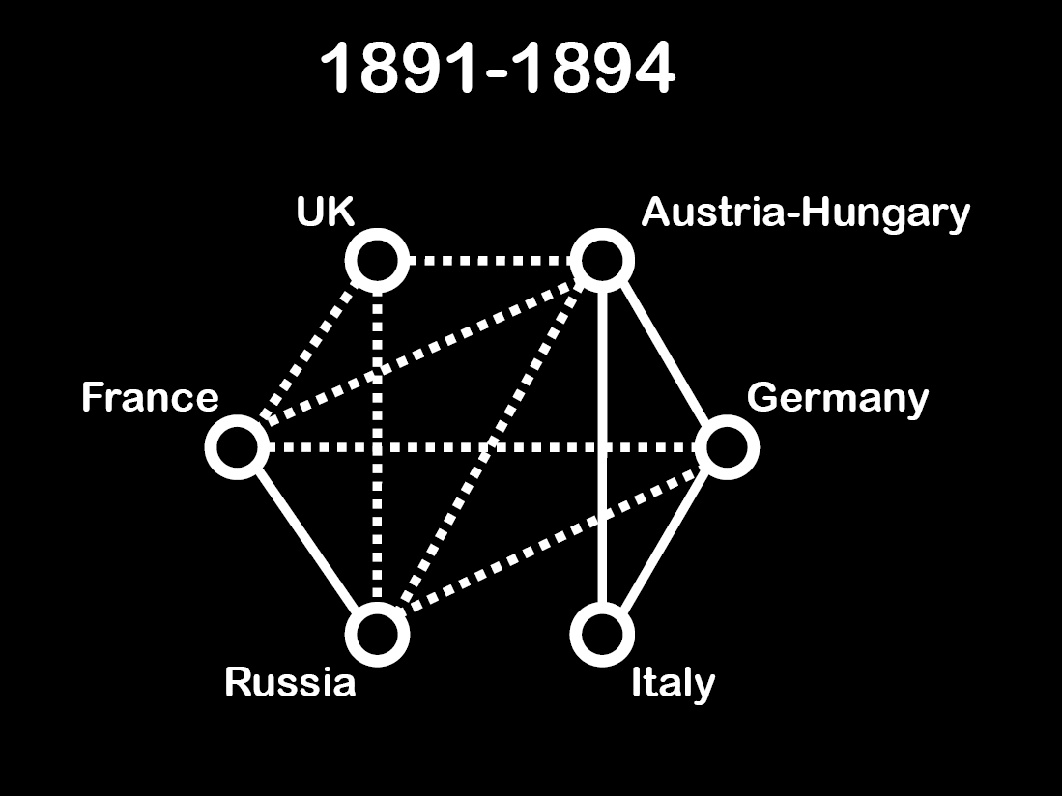

Slide 55
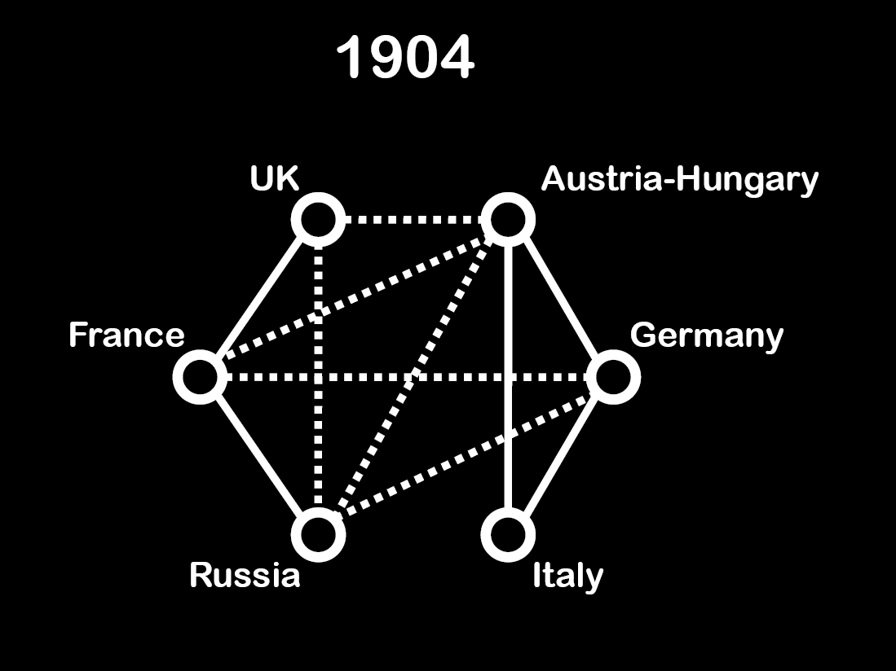

Slide 56
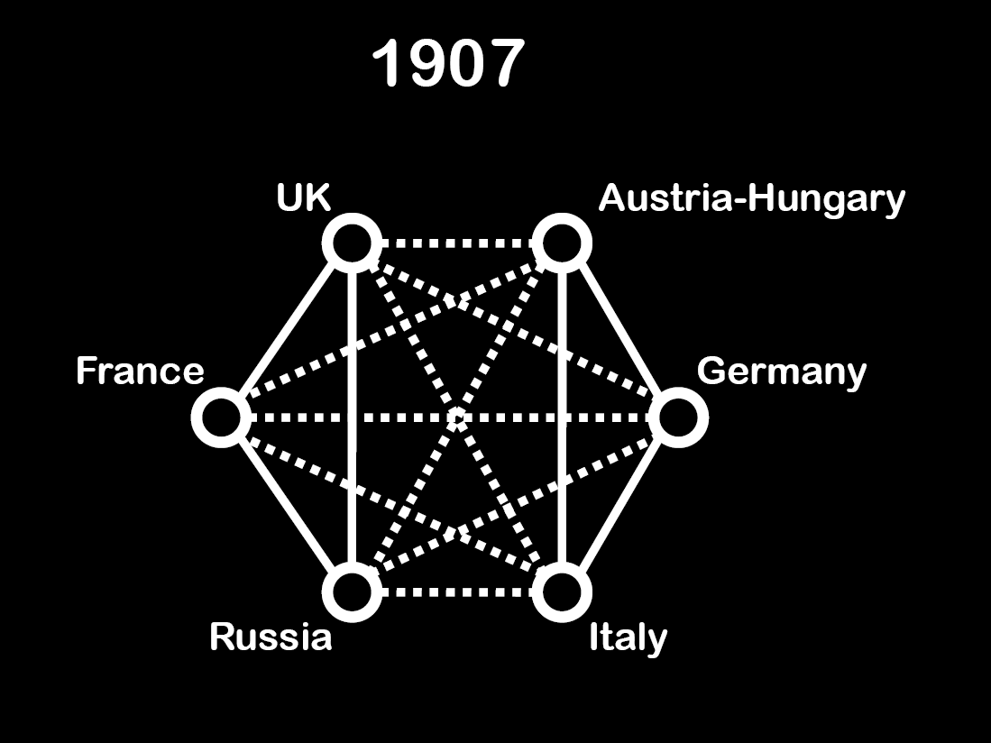

Slide 57
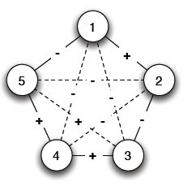
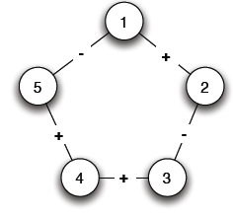
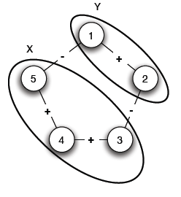
Balance in General Networks
Def 1: Local view
  Fill in the missing edges to achieve balance
Def 2: Global view
  Divide the graph into two coalitions
The 2 defs. are equivalent!
-
+
Balanced?

Slide 58
Is a Signed Network Balanced?
Graph is balanced if and only if it contains no cycle with an odd number of negative edges.
How to compute this?
  Find connected components on + edges
  For each component create a super-node
  Connect components A and B if there is a
  negative edge between the members
  Assign super-nodes to sides using BFS

Slide 59
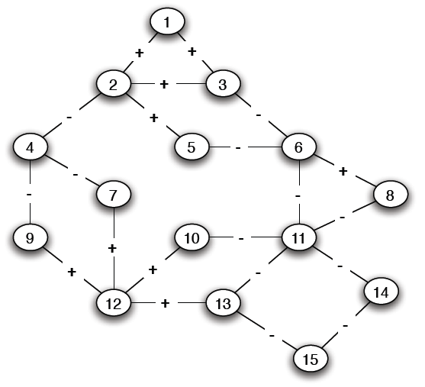
Signed Graph: Is it Balanced?

Slide 60
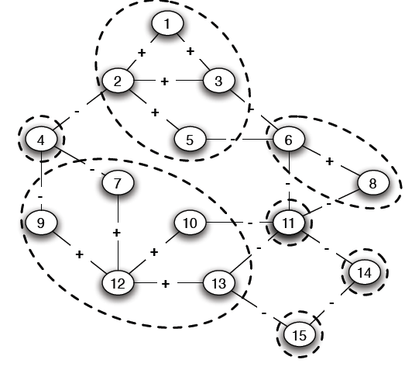
Positive Connected Components

Slide 61
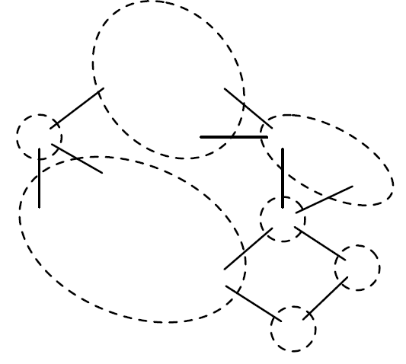
Reduced Graph on Super-Nodes

Slide 62
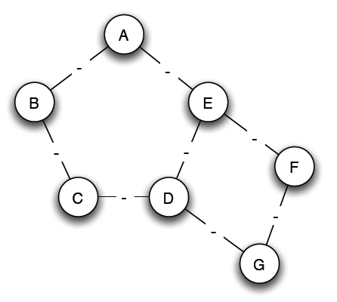
BFS on Reduced Graph
Using BFS assign each node a side
Graph is unbalanced if any two connected
super-nodes are assigned the same side
L
R
R
L
L
L
R
Unbalanced!

Slide 63
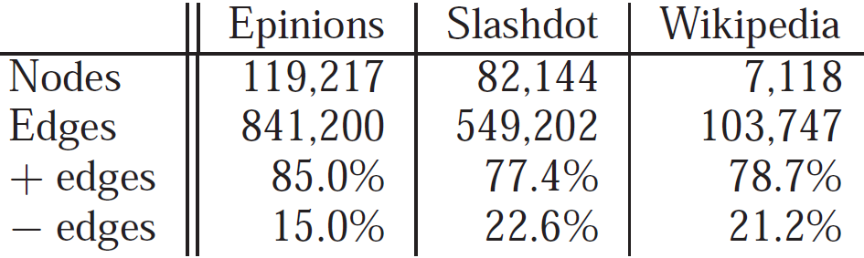
Real Large Signed Networks
[Leskovec et al. CHI ‘10]
Each link AB is explicitly tagged with a sign:
  Epinions: Trust/Distrust
    Does A trust B’s product reviews?
      (only positive links are visible)
  Wikipedia: Support/Oppose
    Does A support B to become
    Wikipedia administrator?
  Slashdot: Friend/Foe
    Does A like B’s comments?
  Other examples:
    Online multiplayer games
–
+
–
–
+
+
+
–
+
–
–
+
–
+
+
Notes:
MAKE IT DIRECTED

Slide 64
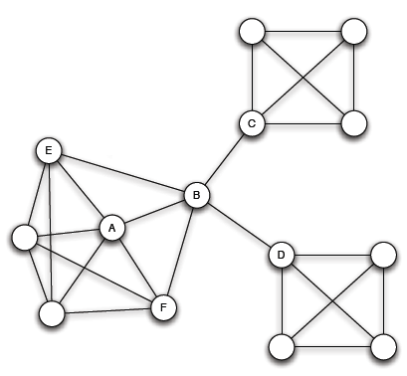
Global Structure of Signed Nets
Intuitive picture of social
network in terms of
densely linked clusters
How does structure
interact with links?
Embeddedness of
link (A,B): Number of shared neighbors
Notes:
Suggest the “coalitions” structure of networks

Slide 65
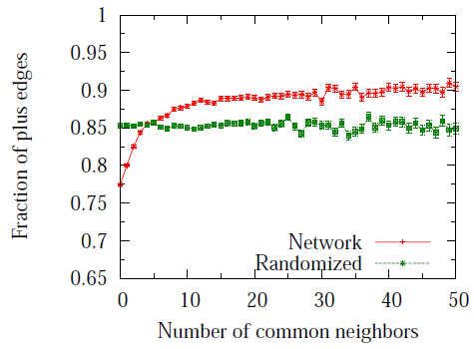
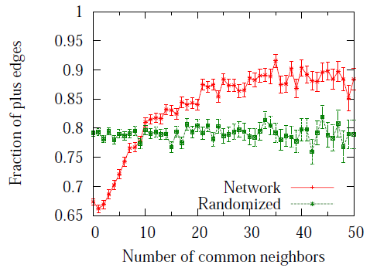
Global Factions: Embeddedness
[CHI ‘10]
Embeddedness of ties:
  Positive ties tend to be more embedded
Positive ties tend to be more clumped together
Public display of signs (votes) in Wikipedia further attenuates this
Epinions
Wikipedia

