Slide 1
CSE 5245
Lecture 1
Srinivasan Parthasarathy
Ack: Slides are adapted from Ymir Vigfusson; who in turn inherited them from various sources – as noted in individual slides. Many of the images are adapted from the textbook(s) for the course.

Slide 2
Networks & Complex Systems
We are surrounded by hopelessly complex systems:
Society is a collection of seven billion individuals
Communication systems link electronic devices
Information and knowledge is organized and linked
Thousands of genes in our cells work together in a seamless fashion
Our thoughts are hidden in the connections between billions of neurons in our brain
These systems, random looking at first, display signatures of order and self-organization

Slide 3
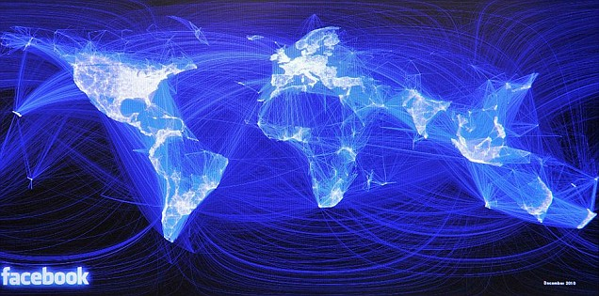
Networks
Each such system can be represented as a network, that defines the interactions between the components

Slide 4
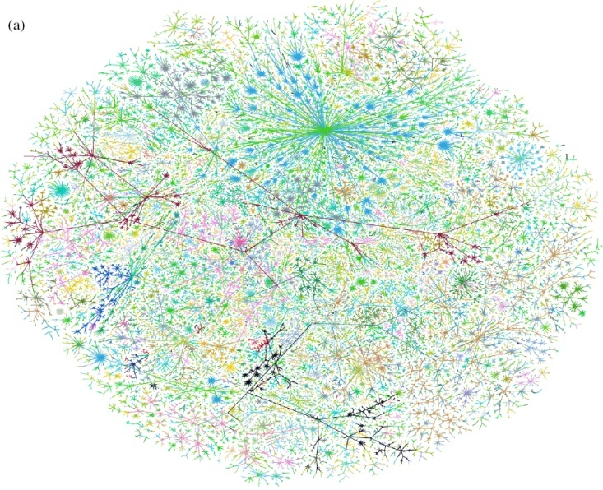
Networks: Communication
Graph of the Internet (Autonomous Systems)

Slide 5
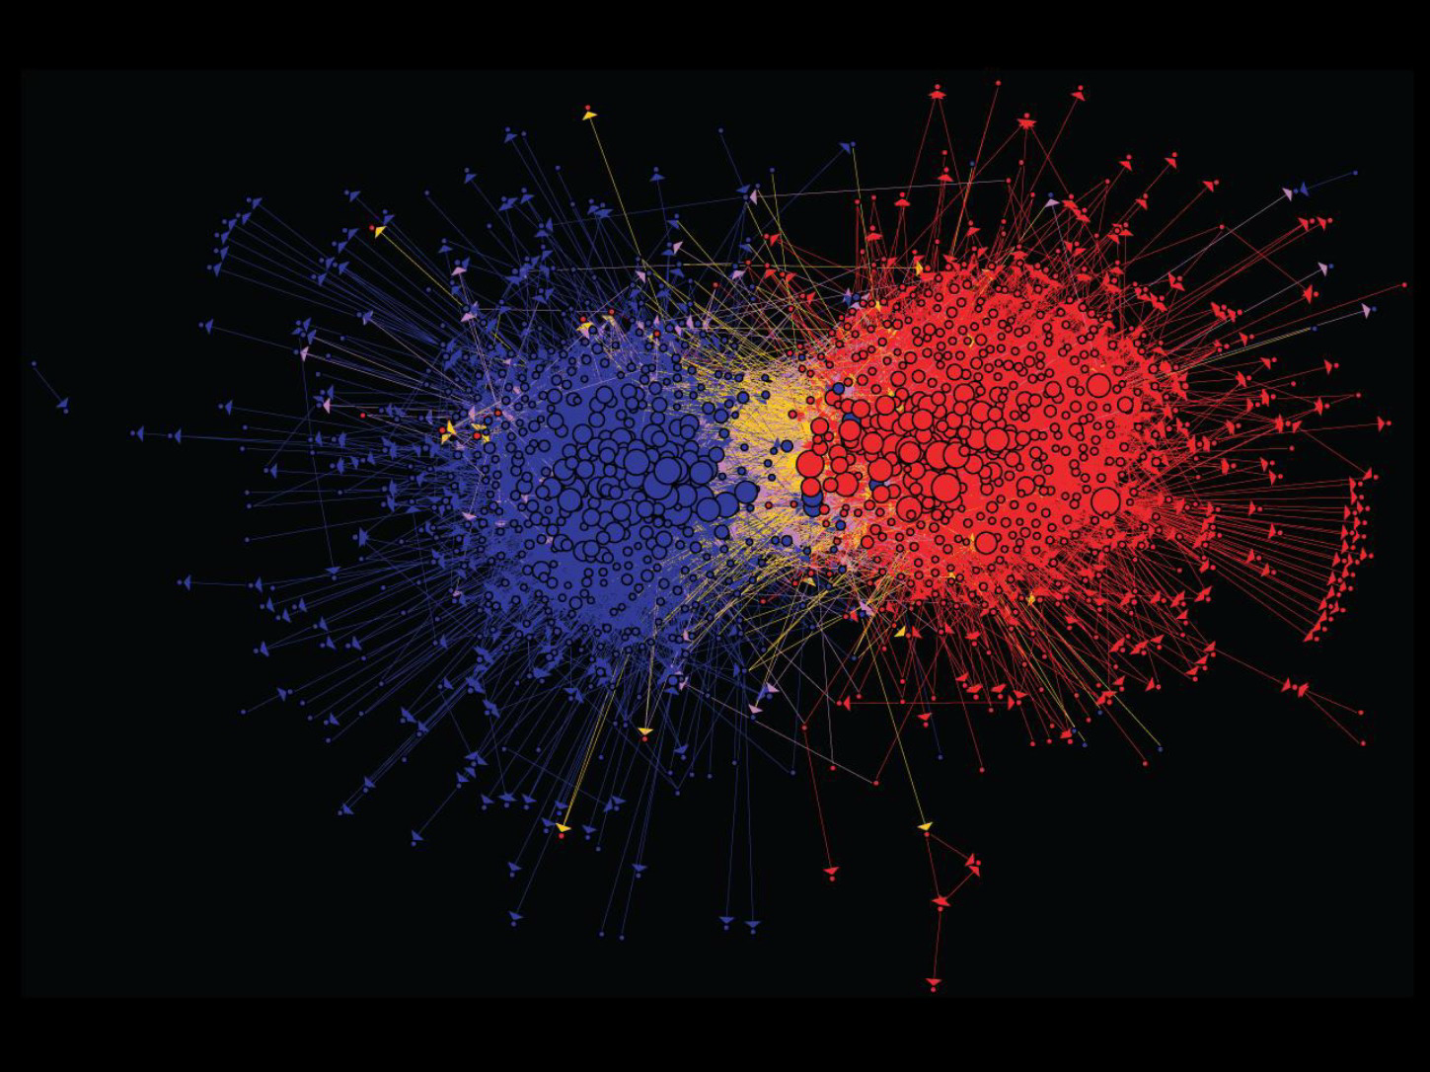
Networks: Information
Connections between political blogs

Slide 6
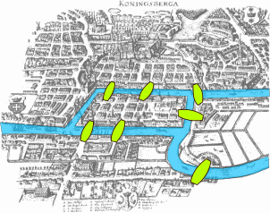
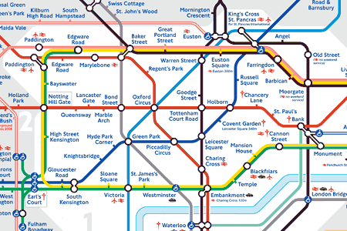
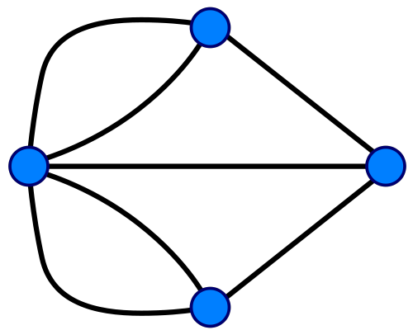
Networks: Technology
Seven Bridges of Königsberg (Euler 1735)
Return to the starting point by traveling each link of the graph once and only once.
London Underground

Slide 7
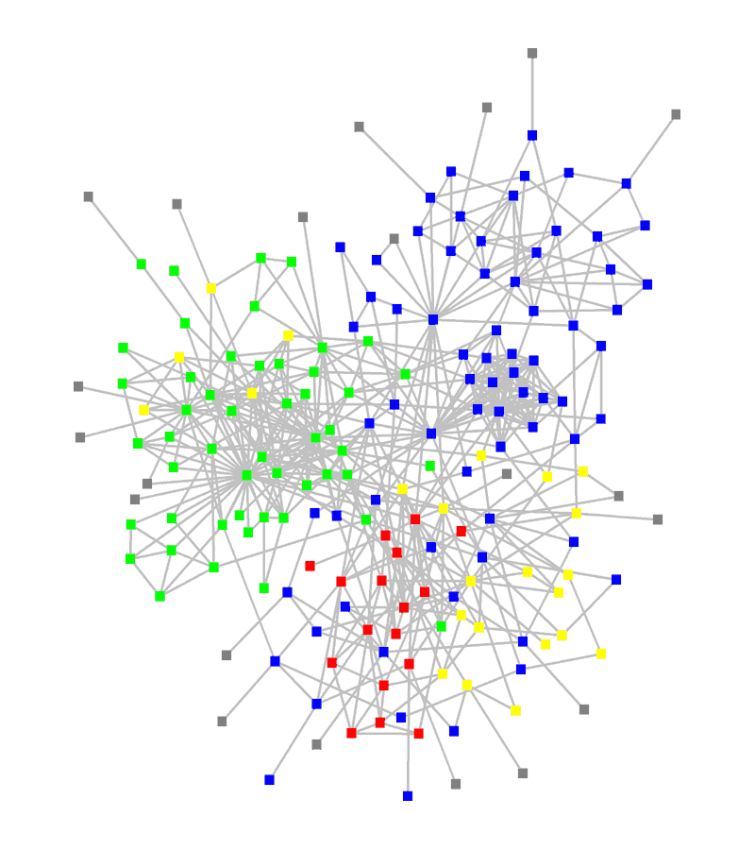
Networks: Organizations
: departments
: consultants
: external experts

Slide 8
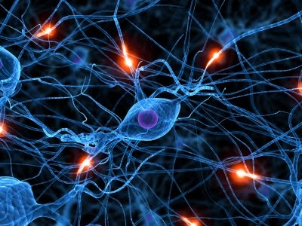
Networks: Brain
Human brain has between 10-100 billion neurons

Slide 9
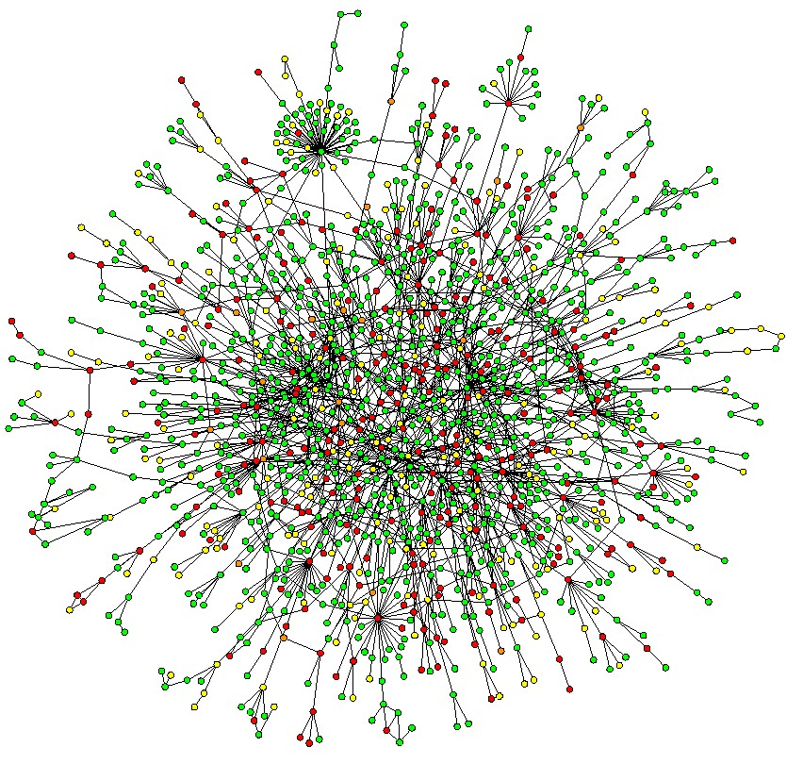
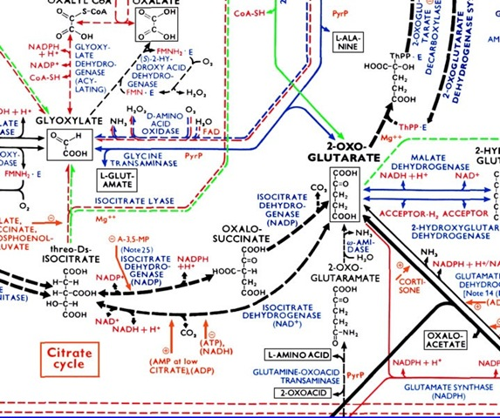
Networks: Cells
Protein-Protein Interaction Networks:
Nodes: Proteins
Edges: ‘physical’ interactions
Metabolic networks:
Nodes: Metabolites and enzymes Edges: Chemical reactions

Slide 10
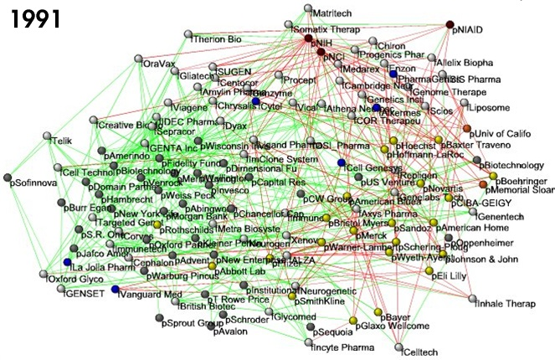
Networks: Economy
Nodes:
Companies
Investment
Pharma
Research Labs
Public
Biotechnology
Links:
Collaborations
Financial
R&D
Bio-tech companies, 1991

Slide 11
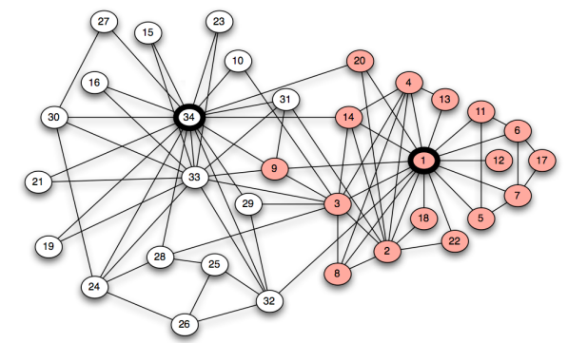
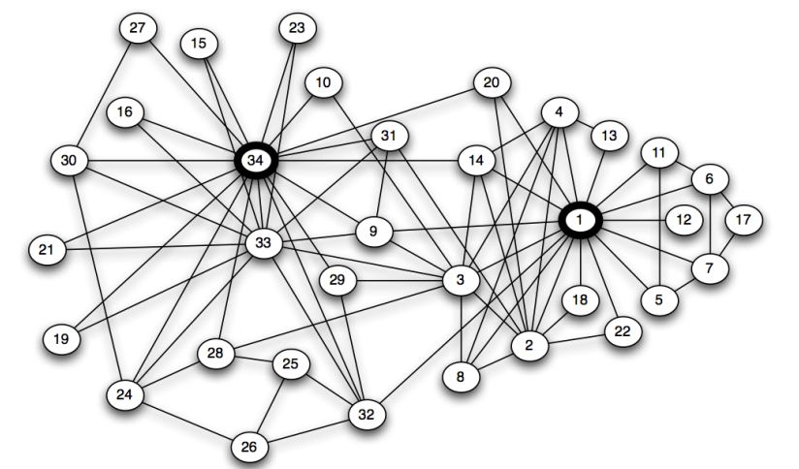
Networks: What is this?
34 person Karate club
Notes:
Wayne Zachary 1970

Slide 12
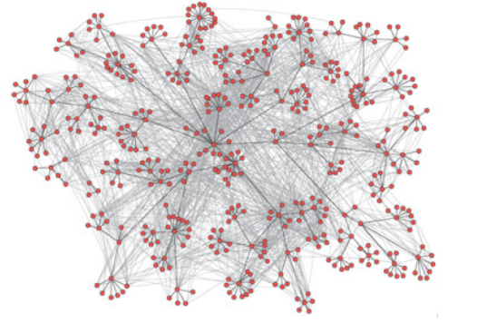
Networks: What about this?
E-mail communication patterns within HP
Superimposed on the company hierarchy
436 employees

Slide 13
Networks are everywhere
Modern society is “connected“ in different ways
Global communication
The Internet
Social networks
Financial systems
News and media
Network science
“The study of phenomena that take place within complex social, economic and technological systems.“

Slide 14
Why Networks?
Behind each such system there is an intricate wiring diagram, a network, that defines the interactions between the components
The key to understanding these complex systems unless is to understand the networks behind them

Slide 15
Reasoning about networks
What do we hope to achieve from studying networks?
Patterns and statistical properties of network data
Design principles and models
Understand why networks are organized the way they are
Predict behavior of networked systems
How do we reason about networks?
Empirical: Study network data to find organizational principles
Mathematical models: Probabilistic, graph theory
Algorithms for analyzing graphs

Slide 16
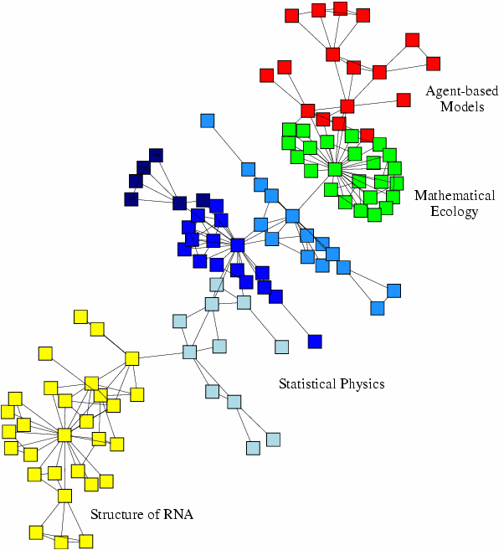
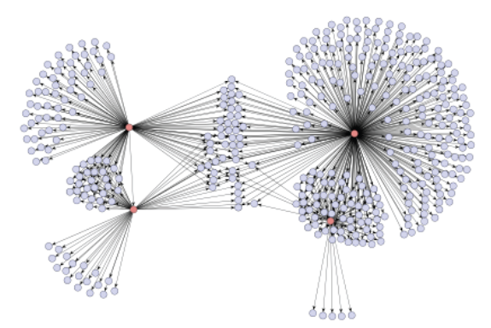
Networks: Structure & Process
What do we study in networks?
Structure and evolution
What is the structure of a network?
Why and how did it became to have such structure?
Processes and dynamics
Networks provide a “skeleton” for spreading of information, behavior, diseases
How do information and diseases spread?

Slide 17
Specific questions
What are the structural features of networks?
Hard to eyeball features of large networks
Can we reason about behavior and interaction in networks?
Strategic incentives, cause-and-effect relationships
What are the dynamics of aggregate behavior?
Why are YouTube and Facebook so popular?
How do things go viral? How do diseases spread?

Slide 18
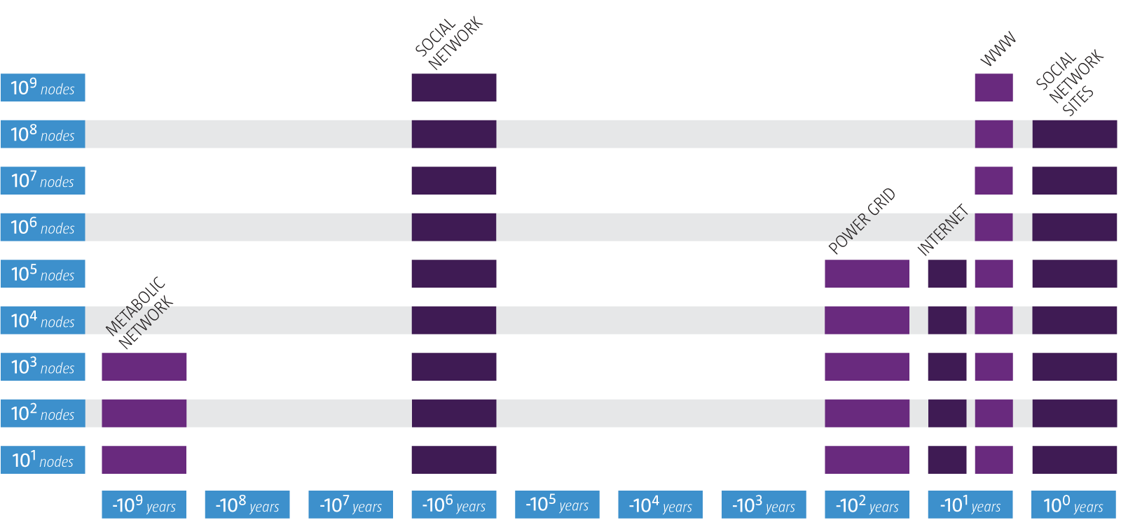
Networks: Why Now?
Age and size of networks

Slide 19
Why Networks? Why Now?
The role of networks is expanding
Data availability
Rise of the Web 2.0 and Social media
Universality
Networks from various domains of science, nature, and technology are more similar than one would expect
Shared vocabulary between fields
Computer Science, Social Sciences, Physics, Economics, Statistics, Biology, Political Science…

Slide 20
Networks: Impact

Slide 21
Networks: Impact
Intelligence and fighting (cyber) terrorism

Slide 22
Networks: Impact
Predicting epidemics
Real
Predicted

Slide 23
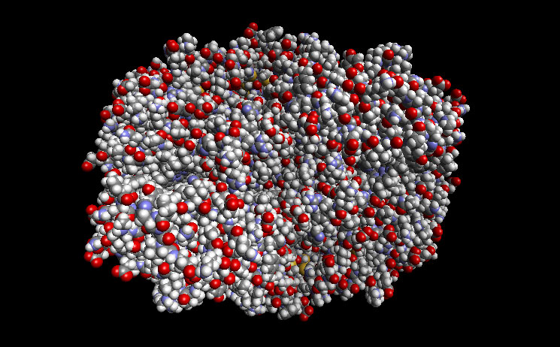
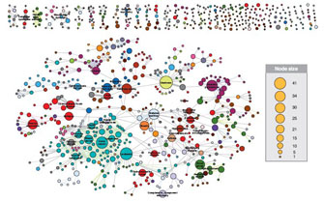
Networks: Impact
Interactions of human disease
Drug design

Slide 24
Course logistics

Slide 25
Logistics
Tu/Th 2:20-3:40PM
Office hours:
Srini: TH 1-2 PM, and by appointment on Fridays.
Yu Wang: T 1-2 PM, Wed 11-12 (noon), Mondays by apt.
Prerequisites (these would be helpful)
Linear Algebra
Probability and statistics
Graph Theory
Databases
Data Mining

Slide 26
Logistics
Reference material
Networks, Crowds and Markets (Easley, Kleinberg 2010). Book also available online!
Networks an Introduction (M. Newman). Also available online for free from an OSU IP address.
Website
http://www.cse.ohio-state.edu/~srini/5245
Collaboration advised and encouraged!
You are expected to maintain academic integrity and the OSU honor code

Slide 27
Evaluation (tentative and subject to change)
Problem Sets/Assignments (35%)
Midterm (25%)
Team Project and Presentation (40%)
Give an enthusiastic, well-prepared talk on the key ideas in chosen scientific papers on the topics of the course
Team projects (at least 3 members)
Teams must comprise of at least one grad and one undergraduate student

Slide 28
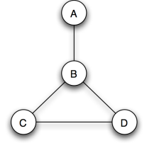
Graph theory: basics
A graph or a network is a way to specify relationships amongst a collection of items
Def: A graph consists of
Set of objects: nodes
Pairs of objects: edges
Def: Two nodes are neighbors if they are connected by an edge

Slide 29
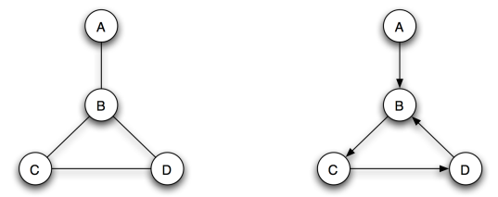
Graph orientation
Both graphs have 4 nodes (A,B,C,D) and 4 edges
The left graph is undirected
Edges have no orientation (default assumption)
The right graph is directed
Edges have an orientation, e.g. edge from B to C

Slide 30
Weighted graphs
Edges may also carry additional information
Signs (are we friends or enemies?)
Tie strength (how good are we as friends?)
Distance (how long is this road?)
Delay (how long does the transmission take?)
Def: In a weighted graph, every edge has an associated number called a weight.
Def: In a signed graph, every edge has a + or a – sign associated with it.

Slide 31
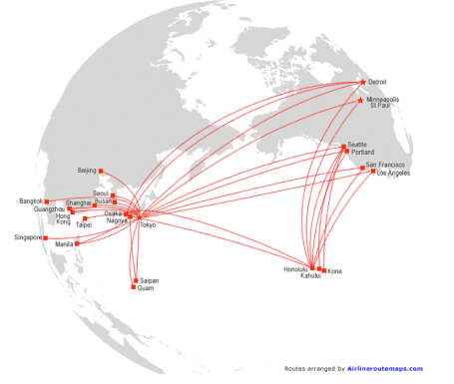
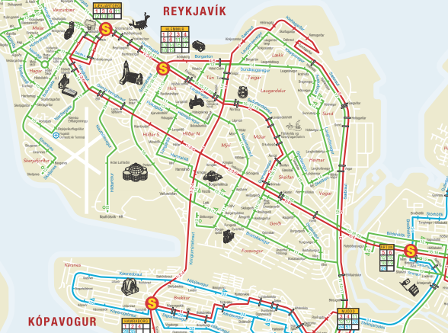
Transportation networks
Graph terminology often derived from transportation metaphors
E.g. “shortest path“, “flow“, “diameter“

Slide 32
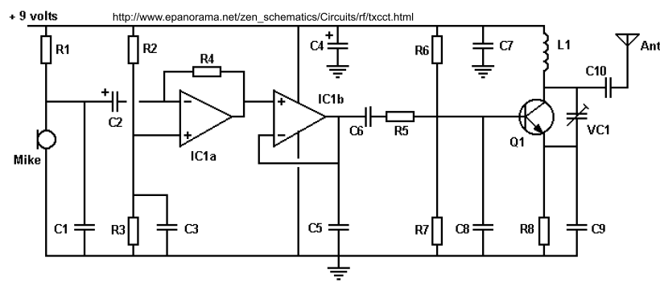
An electrical network
The physics of Kirchoff‘s laws is applied at every network node and closed paths to design circuits

Slide 33
Graph concepts
“Graph theory is a terminological jungle in which every newcomer may plant a tree“ (Social scientist John Barnes)
We will focus on the most central concepts
Paths between nodes
Cycles
Connectivity
Components (and giant component)
Distance (and search)
Measures on nodes and networks as a whole

Slide 34
Paths
Things often travel along the edges of a graph
Travel
Information
Physical quantities
Def: A path is sequence of nodes with the property that each consecutive pair in the sequence is connected by an edge
Can also be defined as a sequence of edges

Slide 35
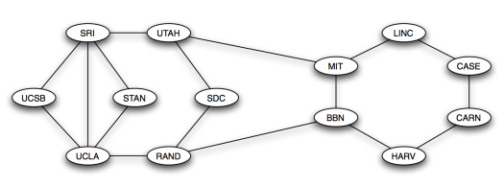
Paths
MIT – BBN – RAND – UCLA is a path

Slide 36
Paths
You could also traverse the same node multiple times
SRI – STAN – UCLA – SRI – UTAH – MIT
This is called a non-simple path
Paths in which nodes are not repeated are called simple paths

Slide 37
Cycles
These are ring structures that begin and end in the same node
LINC – CASE – CARN – HARV – BBN – MIT – LINC is a cycle
Def: A cycle is a closed path with at least three edges
In the 1970 ARPANET, every edge is on a cycle
By design. Why?

Slide 38
Connectivity
Can every node in a graph be reached from any other node through a path?
If so, the graph is connected
In many cases, graphs may be disconnected
Social networks
Collaboration networks
etc.

Slide 39
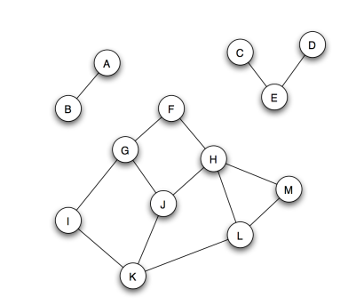
Connectivity
Is this graph connected?
What about now?
A,B not connected to other nodes
C,D,E not connected to other nodes

Slide 40
Components
If a graph is not connected, it tends to break into pieces that themselves are connected
Def: The connected components of an undirected graph are groups of nodes with the property that the groups are connected, and no two groups overlap
More precisely:
A connected component is a subset of nodes such that (1) every node has a path to every other node in the subset, and (2) the subset is not a part of a larger set with the property that every node can reach another

Slide 41
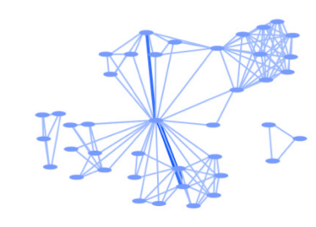
Components: Analysis
A first global way to look at graph structure
For instance, we can understand what is holding a component together
Real-world biology collaboration graph

Slide 42
Connectivity of Graphs
Connected (undirected) graph:
Any two vertices can be joined by a path.
A disconnected graph is made up by two or more connected components
B
B
Largest Component:
Giant Component
Isolated node (F)
A
A
F
C
C
D
D
F
F
F
G
G
Bridge edge: If we erase it, the graph becomes disconnected.
Articulation point: If we erase it, the graph becomes disconnected.

Slide 43
Components: Analysis
Analyzing graphs in terms of densely connected regions and the boundaries of regions
For instance, only include edges with weights above a threshold, then gradually increase the threshold
The graph will fragment into more and more components
We will later see how this becomes an important type of analysis

Slide 44
Connectivity of Directed Graphs
Strongly connected directed graph
has a path from each node to every other node and vice versa (e.g., A-B path and B-A path)
Weakly connected directed graph
is connected if we disregard the edge directions
E
B
F
A
Graph on the left is connected but not strongly connected.
D
C
G

Slide 45
Giant components
Many graphs are not connected, but may include a very large connected components
E.g. the financial graph earlier, the hyperlink graph of the web, ...
Large complex networks often contain a giant component
A component that holds a large percentage of all nodes
Rare that two or more of these will exist in a graph. Why?

Slide 46
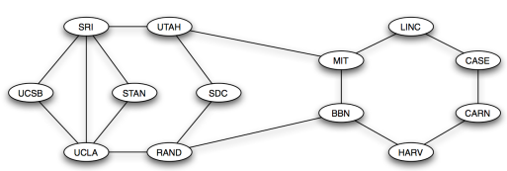
Distance
Def: The distance between a pair of nodes is the edge length of the shortest path between them
Just number of edges. Can be thought of as all edges having weight of 1
What‘s the distance between MIT and SDC?

Slide 47
Distance
Q: Given a graph, how do we find distances between a given node and all other nodes systematically?
Need to define an algorithm!
How would you approach this problem?

Slide 48
Distance: Breadth-first search (BFS)
From the given node (root)
Find all nodes that are directly connected
These are labeled as “distance 1“(1-hop, ego-net)
Find all nodes that are directly connected to nodes at distance 1
If these nodes are not at distance 1, we label them as “distance 2“ (2-hop)
...
Find all nodes that are directly connected to nodes at distance j (j-hop)
If these nodes are not already of distance at most j+1, we label them as „distance j+1“

Slide 49
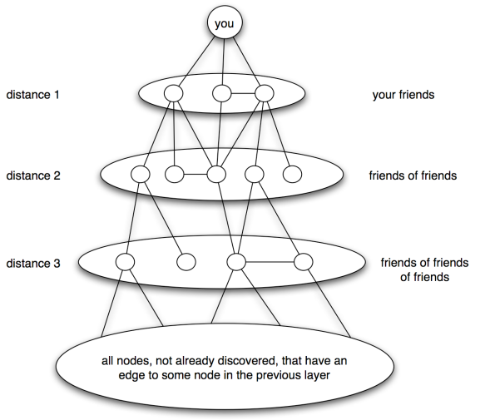
Distance: Breadth-first search (BFS)

Slide 50
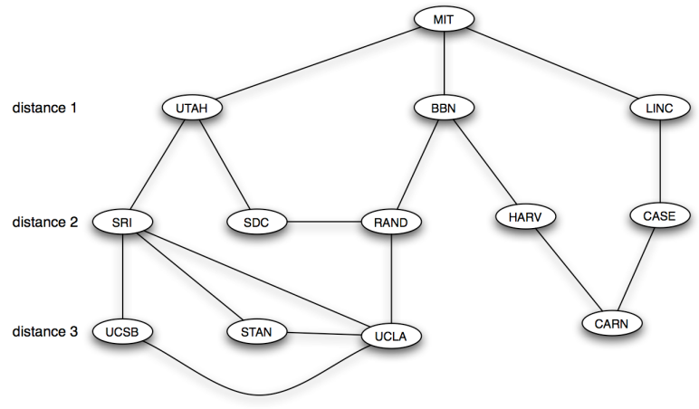
Distance: Breadth-first search (BFS)

Slide 51
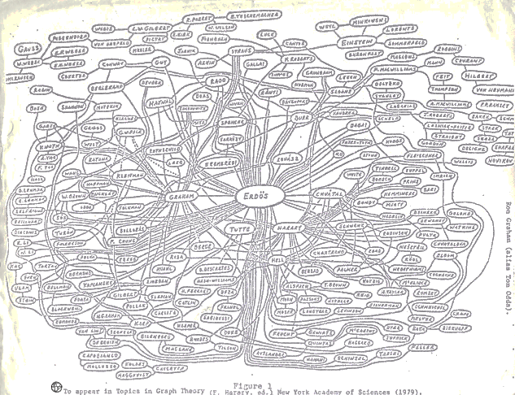
Six degrees of geekiness
Co-authorship graph centered on Paul Erdös
Notes:
Erdös published 1500 papers during his career. Some Erdös numbers:
Einstein: 2, Fermi: 3, Chomsky: 4, Crick: 5, Watson: 6

Slide 52
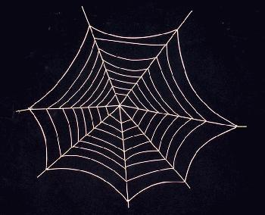
Web as a Graph
Q: What does Web “look like” at a global level?
Web as a graph:
Nodes = pages
Edges = hyperlinks
What is a node?
Problems:
Dynamic pages created on the fly
“dark matter” – inaccessible database generated pages
In early days of the Web links were navigational
Today many links are transactional
Notes:
Explain what we will do:
-- take a real system
-- represent it as a graph
-- use language of graph theory to reason about the shape of the web
-- do a computational experiment
-- learn something about the structure of the web

Slide 53
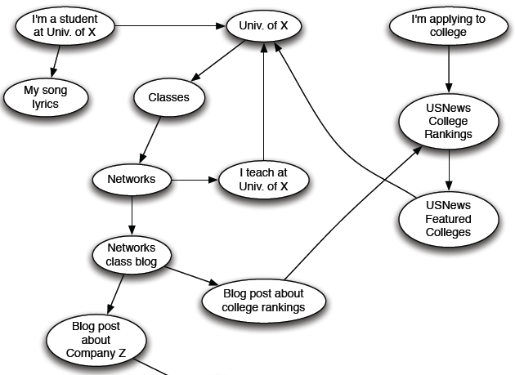
The Web as a Directed Graph

Slide 54
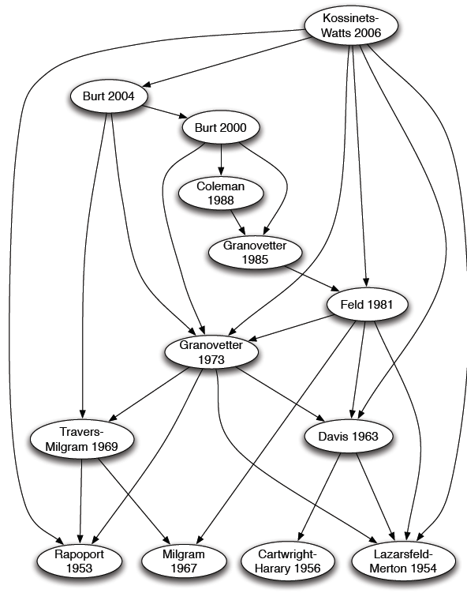
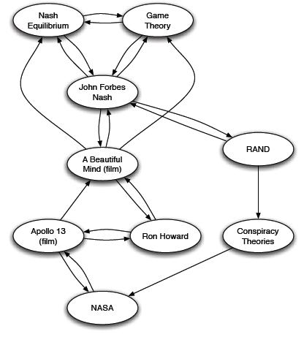
Other Information Networks
Citations
References in an Encyclopedia

Slide 55
How Does the Web Look Like?
How is the Web linked?
What is the “map” of the Web?
Web as a directed graph [Broder et al. 2000]:
Given node v, what can v reach?
What other nodes can reach v?
E
B
F
A
In(A) = {A,B,C,E,G}
Out(A)={A,B,C,D,F}
D
C
G
In(v) = {w | w can reach v} Out(v) = {w | v can reach w}

Slide 56
Directed Graphs
Two types of directed graphs:
Strongly connected
Any node can reach any node via a directed path
In(A)=Out(A)={A,B,C,D,E}
DAG – Directed Acyclic Graph:
Has no cycles: if u can reach v, then v can not reach u
Any directed graph can be expressed in terms of these two types
E
B
A
D
C
E
B
A
D
C

Slide 57
Strongly Connected Component
Strongly connected component (SCC) is a set of nodes S so that:
Every pair of nodes in S can reach each other
There is no larger set containing S with this property
E
B
F
A
Strongly connected components of the graph: {A,B,C,G}, {D}, {E}, {F}
D
C
G

Slide 58
Strongly Connected Component
Fact: Every directed graph is a DAG on its SCCs
(1) SCCs partitions the nodes of G
Each node is in exactly one SCC
(2) If we build a graph G’ whose nodes are SCCs, and with an edge between nodes of G’ if there is an edge between corresponding SCCs in G, then G’ is a DAG
Strongly connected components of graph G: {A,B,C,G}, {D}, {E}, {F}
G’ is a DAG:
E
B
F
G
A
{E}
{F}
D
C
G
{A,B,C,G}
G’
{D}

Slide 59
Proof
Why is (1) true? SCCs partitions the nodes of G.
Suppose node v is a member of 2 SCCs S and S’.
Then S∪S’ is one large SCC:
Why is (2) true? G’ (graph of SCCs) is a DAG
If G’ is not a DAG, then we have a directed cycle.
Now all nodes on the cycle are mutually reachable, and all are part of the same SCC.
S
v
S’
G’
{E}
{F}
{A,B,C,G}
{D}
Now {A,B,C,G,E,F} is a SCC

Slide 60
Graph Structure of the Web
Goal: Take a large snapshot of the Web and try to understand how it’s SCCs “fit together” as a DAG
Computational issue:
Want to find a SCC containing node v?
Observation:
Out(v) … nodes that can be reached from v
SCC containing v is: Out(v) ∩ In(v)
= Out(v,G) ∩ Out(v,G), where G is G with all edge directions flipped
v
Out(v)
Notes:
Picture, animation of the BFS
Picture why the intersection of In and Out is SCC

Slide 61
Graph Structure of the Web
There is a giant SCC
There won’t be 2 giant SCCs:
It just takes 1 page from one SCC to link to the other SCC
If the components have millions of pages the likelihood of this not happening is very small
Giant SCC1
Giant SCC2

Slide 62
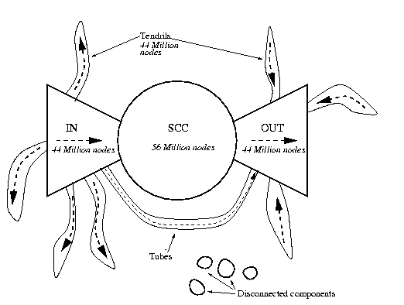
Bow-tie Structure of the Web
250 million pages, 1.5 billion links [Broder et al. 2000]

Slide 63
More on the web graph
What we mentioned:
Some conceptual organization of the Web (i.e., the bowtie)
What we haven’t learned yet:
We treats all pages as equal
Google’s homepage == my homepage
What are the most important pages?
How many pages have k in-links as a function of k?
The degree distribution: ~ 1 / k²
Link analysis ranking -- as done by search engines (PageRank)
What is the internal structure inside the giant SCC?
Clusters, implicit communities?
How far apart are nodes in the giant SCC:
Distance = # of edges in shortest path
Avg = 16 [Broder et al.]

Slide 64
Network data sets
Chapter 2 includes an overview of some massive data sets and networks
Collaboration graphs
Wikipedia, World of Warcraft, Citation graphs
Who-talks-to-whom graphs
Microsoft IM, Cell phone graphs
Information linkage
Hyperlinks
Technological networks
Power grids, communication links, Internet
Natural and biological networks
Food webs, neural interconnections, cell metabolism

Slide 65
Network data sets
Leskovec‘s SNAP at Stanford has a repository of large-scale networks
http://snap.stanford.edu/data

Slide 66
Recap
A graph consists of nodes and edges
Graphs can be directed or undirected, weighted, signed or unweighted
Paths between nodes (simple vs. non-simple)
Cycles
Connectivity
Components (and the giant component)
Distance (and BFS)
Strongly connected components, DAGs
Bow-tie structure of the web
Six degrees of separation can be checked with BFS

