Slide 1
The Importance of Communities for Learning to Influence
Eric Balkanski, et al in NIPS 2017
Presented by Mohit Jangid and Xiaohu Zhao

Slide 2
Introduction
In social networks, influence maximization has been discussed for over a decade…
First posed by Domingos and Richardson (2001)
Formulated and further developed by Kempe, Kleinberg, and Tardos (2003)
Identifying a set of influencers that can trigger a large cascade in the network.

Slide 3
Two Lines of Research
The first line studies the problem associated with learning the generative model that produces cascades from observations
The second line focuses on, assuming the generative model is known, selecting a set of influencers that has maximal influence

Slide 4
Focus of This Paper
A simple algorithm for maximizing influence from training data
leverage the strong community structure of social networks
identify a set of individuals who are influentials but whose communities have little overlap
Such an algorithm doesn’t have a bounded approximation guarantee generally.

Slide 5
Influence Process
Standard independent cascade model
A node a influences each of its neighbors b with some probability independently
Each node only has one chance to influence each of its neighbors
The number of nodes influenced after the influence process is considered as the cascade size

Slide 6
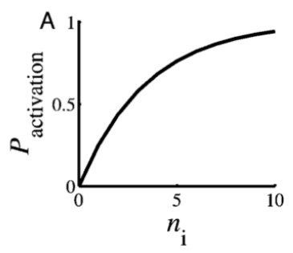
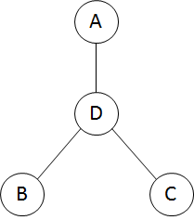
Influence Response
Independent Cascade Model
Diminishing returns
*Figure from lecture 15, Diffusion of innovation and influence maximization, http://www.leonidzhukov.net/hse/2015/networks/lectures/lecture15.pdf

Slide 7
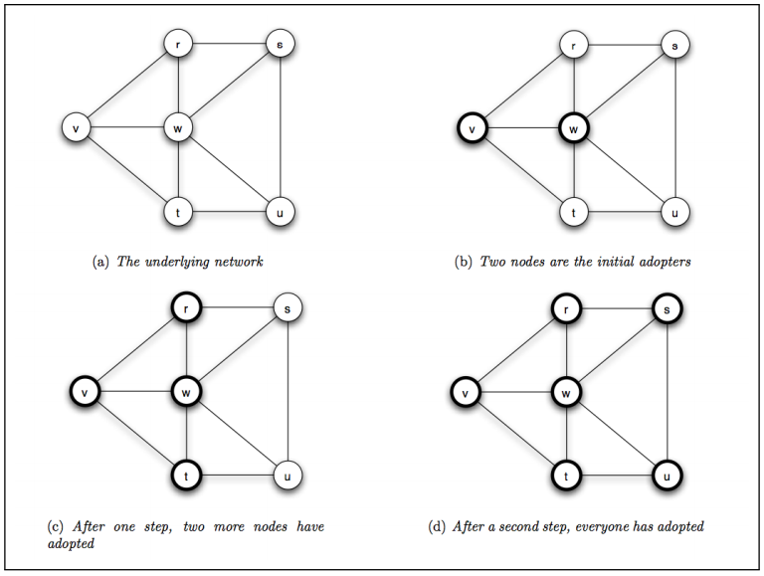
Cascade Propagation
*Figure from lecture 15, Diffusion of innovation and influence maximization, http://www.leonidzhukov.net/hse/2015/networks/lectures/lecture15.pdf

Slide 8
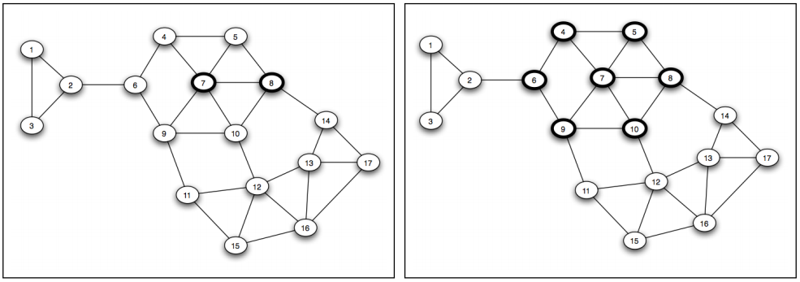
Influence Maximization Problem
Fully propagation is not guaranteed!
NP-hard
*Figure from lD. Kempe, J. Kleinberg, E. Tardos, 2003, 2005

Slide 9
The Learning to Influence Model
Given a collection of samples with seed sets of nodes and the number of nodes influenced accordingly
Each sample is generated from the influence process independently
Goal:
“Find a set S of size at most k which maximizes the expected number of nodes f(S) influenced by seed set S”

Slide 10
The Algorithm
Ordering
In decreasing order
First order marginal contribution
Pruning
Acceptable overlaps
Solution
The first k nodes after pruning

Slide 11
The Algorithm
Second order marginal contribution
Cases
Two nodes are in a community where any node influences all of community, then
Two nodes are in two communities which are not connected in the network, then

Slide 12
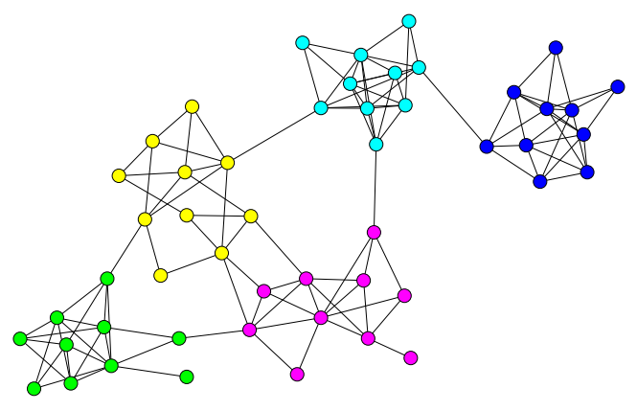
Analyzing Community Structure
The network is a random graph
The nodes are partitioned in communities
The edges are added independently
P(intra-community edge) >> P(inter-community edge)
The probability is identical in a same community
In different communities, the edge probabilities are different
*Figure from http://tuvalu.santafe.edu/~aaronc/courses/5352/fall2013/csci5352_2013_L16.pdf

Slide 13
Analyzing Community Structure
The stochastic block model (SBM) with 4 communities
Green nodes represent the optimal solution for influence maximization
Red nodes represent the k first nodes in the ordering by first order marginal contributions without pruning
“By removing the overlap, COPS obtains a diverse solution”

Slide 14
The Paper’s Claims
“The authors provided performance guarantees under two settings:
In the dense communities and small seed set setting, the approximation ratio is 1-o(1).
It is a constant in the setting with tight and loose communities and non-ubiquitous seed sets.”
The assumed graph model is Stochastic Block Model.

Slide 15
Approximation
“A NP hard approximation for a algorithms implies how closely it is possible to approximate optimal solutions to the in polynomial time.
For example, The Christofides algorithm is an algorithm for finding approximate solutions to the travelling salesman problem. It is an approximation algorithm that guarantees that its solutions will be within a factor of 3/2 of the optimal solution length.”

Slide 16
Claim 1
Piece 1: “[ER60] Assume C is a “dense" community, then the subgraph G[C] of G is connected with probability 1 − O(|C|⁻²).”
Piece 2: “First order marginal contributions corresponds to the ordering by decreasing order of community sizes that nodes belong to.”
v(a) >= (1- o(1)). |C|

Slide 17
Claim 1 cont..
Piece 3: “The algorithm does not pick two nodes in a same community.”
All pieces combined =
Theorem 6. “In the dense communities and small seed set setting, COPS with α-overlap allowed, for any constant α ∈ (0, 1) is a 1 − o(1)-approximation algorithm for learning to influence from samples from a bounded product distribution D.”

Slide 18
Giant component in Erdős–Rényi model
“Giant components are a prominent feature of the Erdős–Rényi model of random graphs.
In this model, if p < (1-c)/n for any constant c>0, then with high probability all connected components of the graph have size O(log n), and there is no giant component.”
---Loose Graph
“However, for p < (1+c)/n there is with high probability a single giant component, with all other components having size O(log n).”
--- TightGraph

Slide 19
Claim 2
Piece 1: “A tight community C contains w.h.p. (1-o(1)) a giant connected component with a constant fraction of the nodes from C.”
⇒ “Thus, a single node from a tight community influences a constant fraction of its community in expectation.”
⇒ “The ordering by first order marginal contributions thus ensures a constant factor approximation of the value from nodes in tight communities”
Piece 2: “A node from a loose community influences only at most a constant number of nodes in expectation by using Galton-Watson branching processes”

Slide 20
Caim 2 cont...
“We can now upper bound the value of the optimal solution S* . Let C1 , . . . , Ct be the t ≤ k tight communities that have at least one node in Ci that is in the optimal solution S* and that are of super-constant size, i.e., |C| = ω(1). Without loss, we order these communities in decreasing order of their size |Ci |.”
Piece 3:. “Let S* be the optimal set of nodes and C i and t be defined as above. There exists a constant c such that f(S*) ≤ summation( |Ci | + c · k ) for i=1 to t.”

Slide 21
Claim 2 cont..
Piece 3: “Since the algorithm checks for overlap using second order marginal contributions, the algorithm picks at most one node from any tight community.”
All pieces combined:
“With overlap allowed α = 1/ poly(n), COPS is a constant factor approximation algorithm for learning to influence from samples drawn from a bounded product distribution D in the setting with tight and loose communities and non-ubiquitous seed sets.”

Slide 22
Experiment
Four synthetic networks
SBM1
One community is significantly larger than the others
As number of nodes increase, the expected community size is fixed
SBM2
All communities have same expected size
As number of nodes increase, the number of communities is fixed
Erdos–Rényi (ER) random graph
Preferential attachment model (PA)
Two real networks
Facebook network
4k nodes, 88k edges
Subgraph of the DBLP co-authorship network
54k nodes, 361k edges

Slide 23
Benchmarks
The standard GREEDY algorithm
Optimal
MARGI
Picks the k nodes with highest first order marginal contribution
RANDOM
Returns a random set

Slide 24
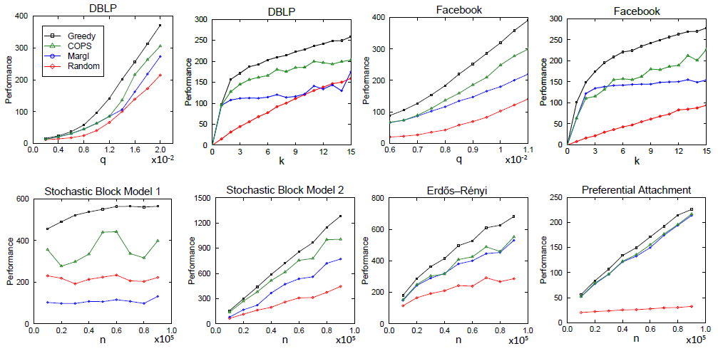
Empirical Evaluation

Slide 25
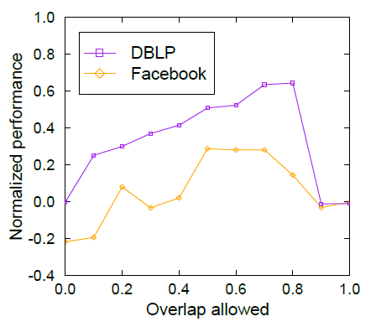
Empirical Evaluation

Slide 26
Conclusions
This paper proposed a new algorithm for Influence Maximization problem as an independent cascade propagation model in discrete-time scale.
Pros
The algorithm studies Influence Maximization problem under learned influence functions which explores the line of work practically
The algorithm is shown to perform well experimentally
Cons
The COPS algorithm should be compared with other heuristics based on community structure
It’s better to have a conclusion at the end of paper

Slide 27
Questions?

Slide 28
References
Balkanski, E., Immorlica, N., & Singer, Y. (2017). The Importance of Communities for Learning to Influence. In Advances in Neural Information Processing Systems (pp. 5864-5873).
The Importance of Communities for Learning to Influence: Reviews, “https://media.nips.cc/nipsbooks/nipspapers/paper_files/nips30/reviews/2999.html”
Giant component, “https://en.wikipedia.org/wiki/Giant_component#Giant_component_in_Erd%C5%91s%E2%80%93R%C3%A9nyi_model”
Approximation algorithm, “https://en.wikipedia.org/wiki/Approximation_algorithm”
Christofides algorithm, “https://en.wikipedia.org/wiki/Christofides_algorithm”
Lecture 15, Diffusion of innovation and influence maximization, http://www.leonidzhukov.net/hse/2015/networks/lectures/lecture15.pdf
Kempe, David, Jon Kleinberg, and Éva Tardos. "Maximizing the spread of influence through a social network." Proceedings of the ninth ACM SIGKDD international conference on Knowledge discovery and data mining. ACM, 2003.
Lecture 16, Network Analysis and Modeling, CSCI 5352 http://tuvalu.santafe.edu/~aaronc/courses/5352/fall2013/csci5352_2013_L16.pdf

