Slide 1
Cascade Principles, Bayes Rule and Wisdom of the Crowds
Lecture 6 (Largely drawn from Kleinberg book)

Slide 2
Following the crowd
We are often influenced by others
Opinions
Political positions
Fashion
Technologies to use
Why do we sometimes imitate the choices of others even if information suggests otherwise?
Why do you smoke?
Why did you vote for a particular party?
Why did you guess a particular color?

Slide 3
Following the crowd
It could be rational to do so:
You pick some restaurant A in an unfamiliar part of town
Nobody there, but many others sitting at a restaurant B
Maybe they have more information than you!
You join them regardless of your own private information
This is called herding, or an information cascade

Slide 4
Following the crowd
Milgram, Bickman, Berkowitz in1960
x number of people stare up
How many passers by will also look up?
Increasing social force for conformity?
Or expect those looking up to have more information?
Information cascades partly explain many imitations in social settings
Fashion, fads, voting for popular candidates
Self-reinforcing success of books on high-seller lists

Slide 5
Herding
There is a decision to be made
People make the decision sequentially
Each person has some private information that helps guide the decision
You can‘t directly observe the private information of others
Can make inferences about their private information

Slide 6
Rational reasons
Informational effects
Wisdom of the crowds
Direct-benefit effects
Different set of reasons for imitation
Maybe aligning yourself with others directly benefits you
Consider the first fax machine
Operating systems
Facebook
We will consider the first one today

Slide 7
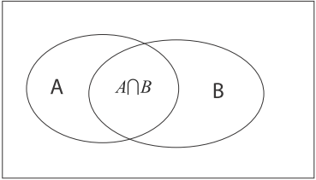
Modeling information cascades
Pr[A] where A is some event
„What is the probability this is the better restaurant?“
Pr[A | B] where A and B are events
„What is the probability this is the better restaurant, given the reviews I read?“
Probability of A given B.

Slide 8
Modeling information cascades
Def:
So:

Slide 9
Notation
P[A] = prior probability of A
P[A | B] = posterior probability of A given B
Using Bayes‘ rule
Applies when assessing the probability that a particular choice is the best one, given the event that we received certain private information
Let‘s take an example

Slide 10
Bayes‘ rule, example
Crime in a city involving a taxi
80% of taxis are black
20% of taxis are yellow
Eyewitness testimony
80% accurate
What is the probability that a taxi is yellow if the witness said it was?
„True“ = actual color of vehicle
„Report“ = color stated by witness
Want: Pr[true = Y | report = Y]

Slide 11
Bayes‘ rule, example
We can compute this:
If report is yellow, two possibilities:
Cab is truly yellow
Cab is actually black
So

Slide 12
Bayes‘ rule, example
Putting it together
Conclusion:
Even though witness said taxi was yellow, it is equally likely to be truly yellow or black!

Slide 13
Second example
Spam filtering
Suppose:
40% of your e-mail is spam
1% of spam has the phrase „check this out“
0.4% of non-spam contain the phrase
Apply Bayes‘ rule!

Slide 14
Second example
Numerator is easy
0.4 * 0.01 = 0.004
Denominator:
So

Slide 15
General cascade model
Group of people sequentially making decisions
Choice between accepting or rejecting some option
Wear a new fashion
Buy new technology
(I) State of the world
Randomly in one of two states:
The option is a good idea (G)
The option is a bad idea (B)

Slide 16
General cascade model
Everyone knows probability of the state
World is in state G with probability p
World is in state B with probability 1-p
(II) Payoffs
Reject: payoff of 0
Accept a good option: v_{g} > 0
Accept a bad option: v_{b} < 0

Slide 17
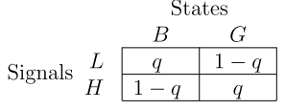
General cascade model
(III) Signals
Model the effect of private information
High signal (H):
Suggests that accepting is a good idea
Low signal (L):
Suggests that accepting is a bad idea
Make this precise:

Slide 18
General cascade model
Three main ingredients
(I) State of the world
(II) Payoffs
(III) Signals
Herding fits this framework

Slide 19
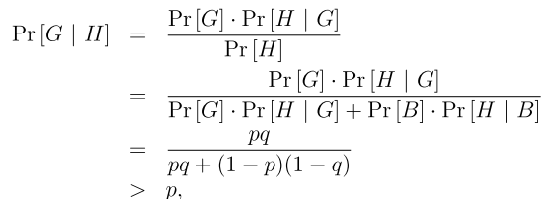
General cascade model
Consider an individual
Suppose he only uses private information
If he gets high signal:
Shifts
To:
What is this probability?

Slide 20
General cascade model
So high signal = should accept
Makes intuitive sense since option more likely to to be good than bad
Analogous for low signal (should reject)
What about multiple signals?
Information from all the other people
Can use Bayes‘ rule for this
Suppose I see a sequence S with a high signals and b low ones

Slide 21
General cascade model
So what does a person decide given a sequence S?
Want the following facts
Accept if more high signals than low ones
Let‘s derive this

Slide 22
General cascade model
How does this compare to p?

Slide 23
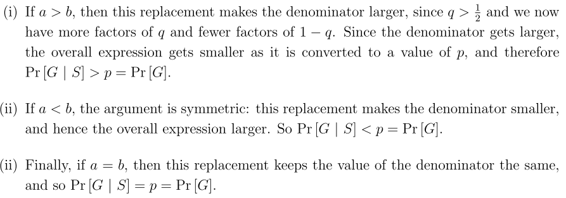
General cascade model
Suppose we changed the term
Whole expression becomes p
Does this replacement make the denominator smaller or larger?

Slide 24
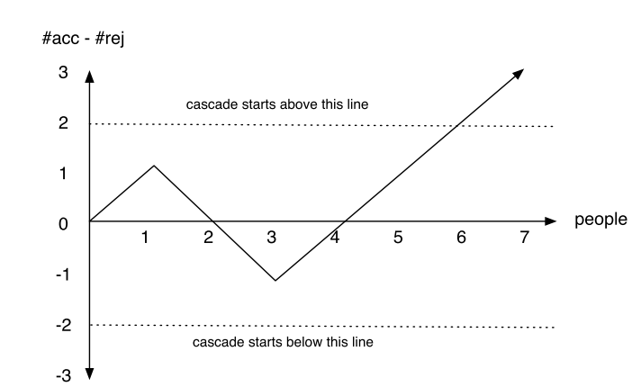
Herding experiment
Using the model we can derive:
People >3 will ignore own signal

Slide 25
Cascades - lessons
Cascades can be wrong
Accepting an option may be a bad idea
But if first two people get high signals – cascade of acceptances
Cascades can be based on very little information
People ignore private information once cascade starts
Cascades are fragile
Adding even a little bit more information can stop even a long-running cascade

