Slide 1
Learning Personalized Preference of Strong and Weak Ties for Social Recommendation
By: Ryan Liu, Justin Pinsky, Danny Radomski

Slide 2
Overview
Introduction
Motivation
Related Work
Using strong and weak ties
PTPMF (Personalized Social Tie Preference Matrix Factorization) Model
Experiments on four datasets alongside existing methods
Conclusion
Pros/Cons
Notes:
Personalized Social Tie Preference Matrix Factorization

Slide 3
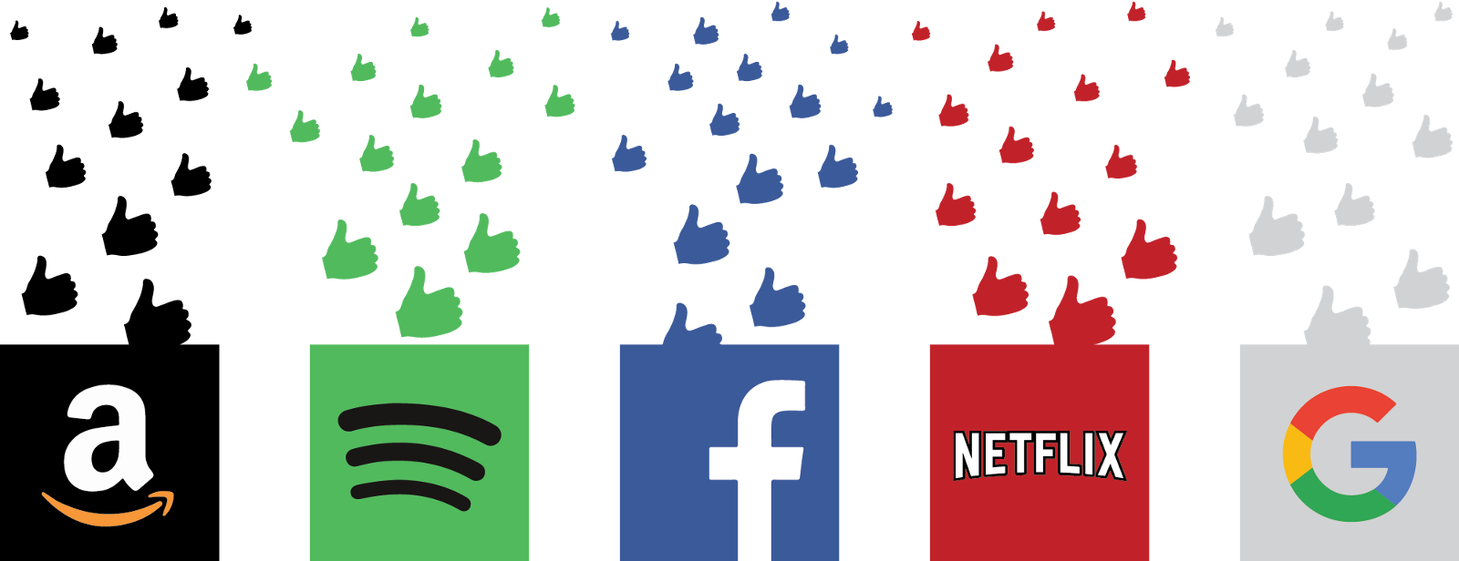
Introduction
Recommender System - an information filtering system that seeks to predict user ratings/preferences on an item.

Slide 4
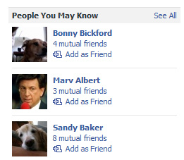
Introduction (cont.)
Examples:
Amazon
Facebook
LinkedIn

Slide 5
Motivation
No existing work for learning personalized preferences between strong and weak ties in recommender systems
Data sparsity problem
Overfitting
Cold start
Propose a social recommendation model based on a new Probabilistic Matrix Factorization model using strong and weak ties
PTPMF (Personalized Social Tie Preference Matrix Factorization)
Notes:
Most recommender systems suffer from data sparsity, where the number of items consumed by a user is often very small compared to the total number of items
this issue can affect performance of model-based collaborative filtering methods such as low-rank matrix factorization because of
overfitting: insufficient data available for training models
cold start: recommender systems fail to make recommendations for new users when no historical behavior data has been collected.

Slide 6
Related Work
Collaborative Filtering - makes recommendations based on user’s past behaviors
low rank matrix factorization
suffer from cold start and data sparsity
Social Recommendation - utilizes social information among users to improve performance of recommender systems
helps with cold start problem
Social Ties in Social Media
predicting interpersonal tie strength with social media
regression analysis to discover two different types of closeness for employees in IBM social network
different roles of tie strength
Notes:
collaborative filtering most popular (low rank matrix factorization), but suffer from cold start and data sparsity problems
gives rise to social recommendation, which utilizes social information among users to improve performances of recommender systems
Users receive personalized recommendations based on their previous engagement and usage on a platform
proposed model takes personalized tie type preference for each individual rather than global, which assumes either all individuals prefer strong ties to weak ties or vice versa
social ties in social media
closeness (personal and professional)

Slide 7
Challenges
How to effectively identify each type of social tie (strong or weak) in social network?
How to combine this method with existing social recommendation approaches to improve accuracy?
How do we learn a personalized tie type preference for strong or weak ties?
Notes:
Sociologists typically assume dyadic hypothesis: strength of tie is determined solely by interpersonal relationship between two individuals, irrespective of the rest of the network. However, this may require user activity data which is not easily accessed.
Using community detection algorithms partitions network into several subgraphs. For each edge, if u and v belong to the same subgraph, it is strong tie, otherwise weak. However, different community detection algorithms produce very different clusterings.
if bad partitioning given, hard for recommender system to recover
quality of recommendation would depend on external algo.
Jaccard’s coefficient to compute social tie strength
tie strength determined by network structure relatively local to the tie
stronger the tie b/t 2 users, the more friends overlap
ties are strong if coeff. is above some threshold (learnt from data)
exclude absent ties
Then propose PTPMF (Personalized Social Tie Preference Matrix Factorization) method, which
classifies strong/weak ties w.r.t optimal recommendation accuracy
learns a personalized preference between strong/weak tie for each user in addition to other parameters

Slide 8
Strong and Weak Ties
How to effectively identify each type of social tie (strong or weak) in social network?
strength of tie determined solely by interpersonal relationship between two individuals, irrespective of the rest of the network
use community detection algorithms to see if an edge (u, v) belong to the same subgraph after partitioning
use Jaccard’s coefficient with thresholding
Notes:
Sociologists typically assume dyadic hypothesis: strength of tie is determined solely by interpersonal relationship between two individuals, irrespective of the rest of the network. However, this may require user activity data which is not easily accessed.
Using community detection algorithms partitions network into several subgraphs. For each edge, if u and v belong to the same subgraph, it is strong tie, otherwise weak. However, different community detection algorithms produce very different clusterings.
if bad partitioning given, hard for recommender system to recover
quality of recommendation would depend on external algo.
Jaccard’s coefficient to compute social tie strength
tie strength determined by network structure relatively local to the tie
stronger the tie b/t 2 users, the more friends overlap
ties are strong if coeff. is above some threshold (learnt from data)
exclude absent ties
Then propose PTPMF (Personalized Social Tie Preference Matrix Factorization) method, which
classifies strong/weak ties w.r.t optimal recommendation accuracy
learns a personalized preference between strong/weak tie for each user in addition to other parameters

Slide 9
Accuracy & Personalized Tie Type Preference
How to combine this method with existing social recommendation approaches to improve accuracy?
How do we learn a personalized tie type preference for strong or weak ties?
PTPMF (Personalized Social Tie Preference Matrix Factorization)
classifies strong and weak ties w.r.t optimal recommendation accuracy
learns a personalized preference between strong and weak ties for each user in addition to other parameters
Notes:
Sociologists typically assume dyadic hypothesis: strength of tie is determined solely by interpersonal relationship between two individuals, irrespective of the rest of the network. However, this may require user activity data which is not easily accessed.
Using community detection algorithms partitions network into several subgraphs. For each edge, if u and v belong to the same subgraph, it is strong tie, otherwise weak. However, different community detection algorithms produce very different clusterings.
if bad partitioning given, hard for recommender system to recover
quality of recommendation would depend on external algo.
Jaccard’s coefficient to compute social tie strength
tie strength determined by network structure relatively local to the tie
stronger the tie b/t 2 users, the more friends overlap
ties are strong if coeff. is above some threshold (learnt from data)
exclude absent ties
Then propose PTPMF (Personalized Social Tie Preference Matrix Factorization) method, which
classifies strong/weak ties w.r.t optimal recommendation accuracy
learns a personalized preference between strong/weak tie for each user in addition to other parameters

Slide 10
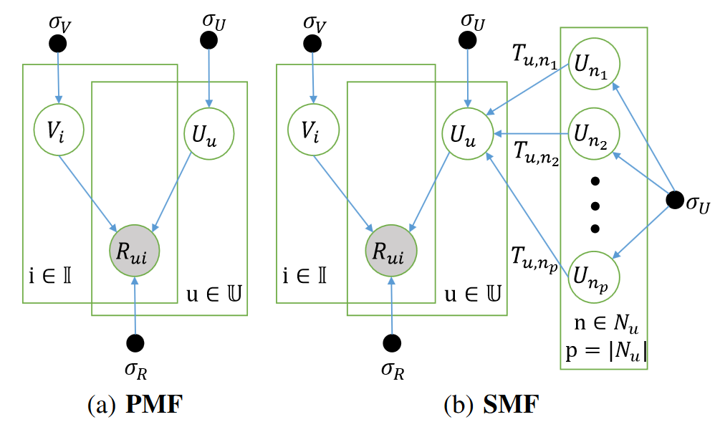
Matrix Factorization
Recommender systems
Set of Users (U), Items (I), and a Rating (R) = |U|x|I| for feedback
For social recommendations add tie matrix T = |U|x|U|
A factorization model approximates the R matrix by multiplication of d-rank factors
Where and . Usually d < |U| and |I|, thus given a user and item the Rating can be approximated by the dot product of user latent feature vector Uu and item latent feature Vi,
Where is the uth column of U and is the ith column of V

Slide 11
Probabilistic Matrix Factorization (PMF)
Based on the assumption that the rating (Rui) is normal, the conditional probability of the observed ratings is:
Where N(x|m, s^2) is normal and if user u has rated i, Iu equals 1; 0 otherwise.
g(x)is the sigmoid function, , which bounds the range of UV within [0,1].
U and V are also subject to a zero mean normal distribution, thus the conditional probabilities of user and item latent feature vectors are(I is the identity matrix):

Slide 12
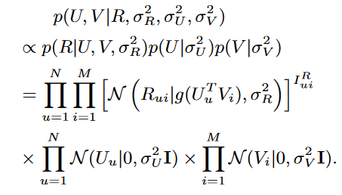
Probabilistic Matrix Factorization (PMF)
The posterior probability of U and V can be calculated through a bayesian inference,

Slide 13
Social Matrix Factorization (SMF)
Built on PMF with an assumption that the rating behavior of a user will be affected by his social ties through influence.
Where Uu is the user’s latent feature vector, Nu is the set of social ties of user u, and Tun is 1 or 0, indicates if u and n are ties or not ties. Posterior probability of vectors:
Final equation

Slide 15
The PTPMF Model
Introduces a threshold variable, Theta, to distinguish strong, Su, and weak,Wu, ties for a user u. Also Usu and Uwu as strong-tie and weak-tie latent vectors for users.
where Tuv = strength(u,v) is the tie strength between u and v. Tie strength is normalized so:
Thus the conditional probability of the latent feature vectors Uwu and Usu becomes:

Slide 16
The PTPMF Model cont.
Bu is also introduced and is the probability that u prefers weak ties to strong ties. Thus the conditional probability of the observed ratings can be expressed as:
Where g(x) is the sigmoid function and given ts and tw as the average tie strength of weak and strong ties.
We assume ThetaG and Bu follow a beta distribution. U and V follow the same normal distribution. The posterior probability of all model parameters is:

Slide 17
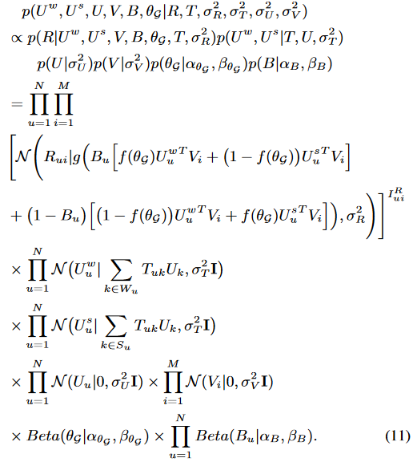
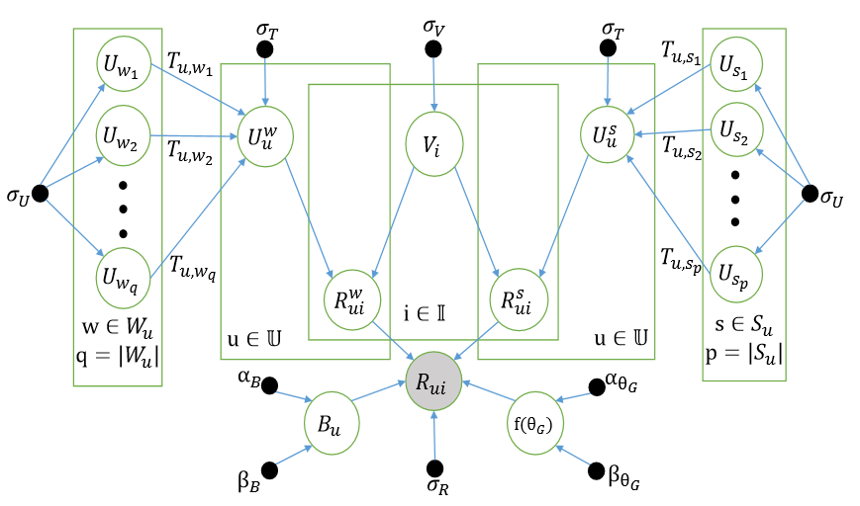
The PTPMF Model

Slide 18
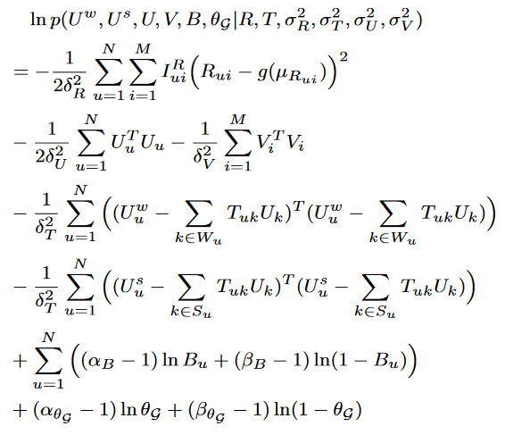
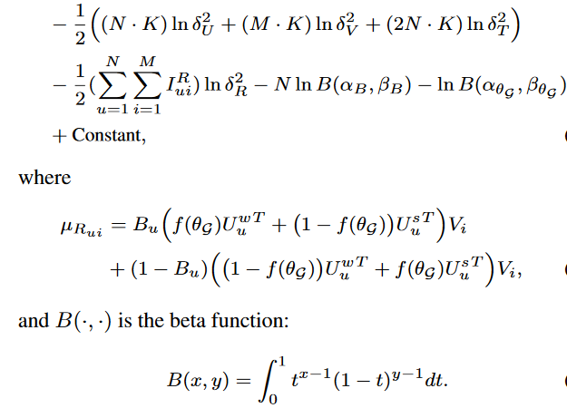
Parameter Learning
Our goal is now to learn U, Uw, Us, B, and ThetaG using maximum a posteriori (MAP) inference and taking the ln of both sides, we maximize the following objective function:

Slide 19
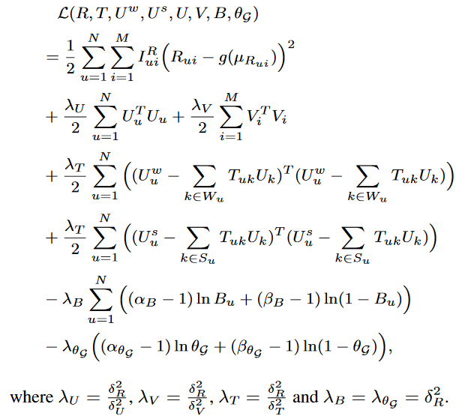
Parameter Learning
Fixing the Gaussian noise variance and beta shape parameters, maximizing the log-posterior of the previous equation is equivalent to minimizing the following objective function:

Slide 20
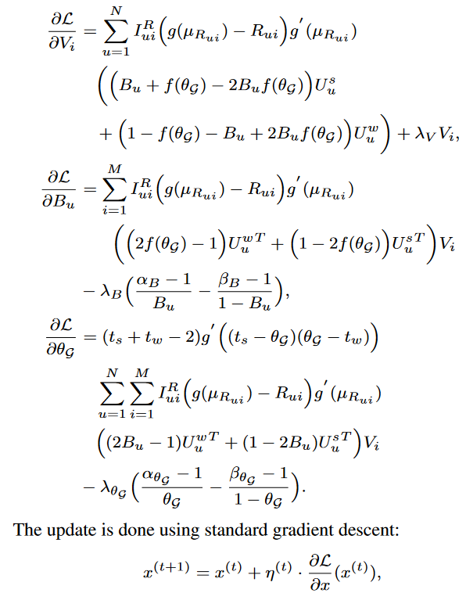
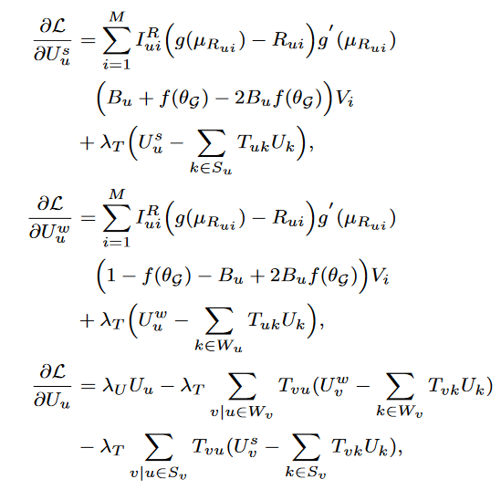
Parameter Learning
Taking the derivative and performing a gradient descent on the variables separately nets the following partial derivatives:
Notes:
N is the learning rate and the algorithm terminates when the absolute difference between losses in consecutive iterations is less than 10^-5.
All parameters are regularized to avoid overfitting.

Slide 21
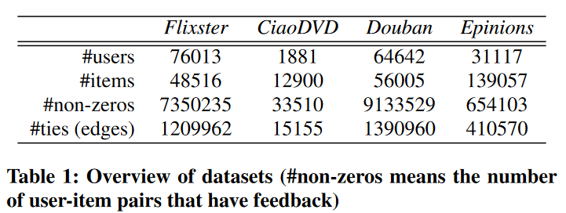
Datasets
For all datasets 80% of the data was randomly chosen for training leaving the remainder for testing. The training set was split into five equal subsets for 5-fold cross validation. One set is used for validation which is repeated 5 times.
Notes:
The parameters values that have the best average performance are chosen for testing

Slide 22
Methods Compared
PTPMF
TrustMF
SMF
SoReg
STE
SoRec
PMF
UserMean
ItemMean
Notes:
• PTPMF. Our proposed PTPMF model, which is a personalized social recommendation approach by exploiting social ties. • TrustMF. A personalized social method originally proposed by Yang et al. [42], which is capable of handling trust propagation among users. • SMF. This is a personalized social approach [15] which assumes that users’ latent feature vectors are dependent on those of their ties. • SoReg.The individual-based regularization model with Pearson Correlation Coefficient (PCC) which outperforms its other variants, as indicated in [29]. This is a personalized social method. • STE. Another personalized social method proposed by Ma et al. [26] which aggregates a user’s own rating and her friends’ ratings to predict the target user’s final rating on an item. • SoRec. The probabilistic matrix factorization model proposed by Ma et al. [28] which factorizes user-item rating matrix and user-user linkage matrix simultaneously. This is also a personalized social method. • PMF. The classic personalized non-social probabilistic matrix factorization model first introduced in [30].
• UserMean. A non-personalized non-social baseline, which makes use of the average ratings of users to predict missing values. • ItemMean. Another non-personalized non-social baseline, utilizing the average ratings of each items to make predictions.
Chosen based on personalized/social attributes

Slide 23
Evaluation Metrics
Mean Absolute Error
Root Mean Square Error
Recall
Precision
Notes:
Measure recommendation accuracy of PTPMF model
MAE
RMSE
Recall
Quantifies the fraction of consumed items that are in the top-K ranking list sorted by estimated rankings
Precision
Measures the fraction of top-K items that are indeed consumed by the user in the test set

Slide 24
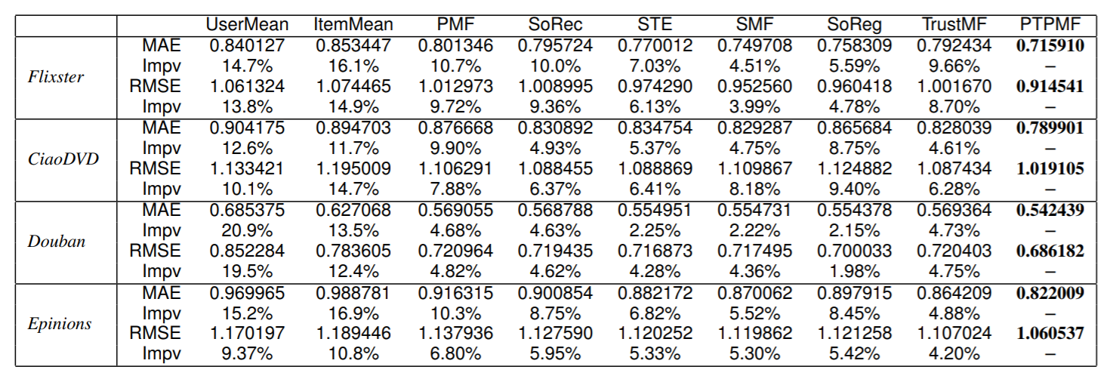
Experimental Results
Notes:
Performances of all methods on each dataset
Percentage increase of PTPMF over each baseline
Personalized non-social model (PMF) outperforms the non personalized non-socal methods (ItemMean and UserMean)
Methods taking social network info into consideration perform best (social info helps recommender systems)
PTPMF outperforms everything because of thresholding and distinction and personalized tie preference for each user

Slide 25
Recall and Precision
Notes:
UserMean and ItemMean are excluded for clarity of figures
Closer line is to top right the better the algorithm
PTPMF outperforms
Demonstrates tradeoffs b/w recall and precision (K increases = recall increases and precision decreases)

Slide 26
Comparisons on Cold Start Users
Notes:
Cold start are users who rated less than 5 items
Social recommendation methods are superior for cold-start users
In both MAE and RMSE social suff outperforms
PTPMF wins again

Slide 27
Learned Threshold vs Fixed Threshold
Notes:
Used to prove threshold learning contributes to accuracy of recommendations
Best results obtained with dynamically learned thresholds in both MAE and RMSE
The learned thresholds from the different datasets vary greatly (which supports learning)
Theta G is threshold

Slide 28
Conclusions
Recognizing the importance social relations play in social recommendation models
Use of probabilistic matrix factorization in order to link in strong and weak ties with social recommendation
PTPMF used to classify both strong and weak ties
Performed on real world datasets
PTPMF outperforms

Slide 29
Pros/Cons
Pros:
Compares against existing methods
Uses four datasets for experimentation
Describes problems with existing methods
5-fold cross validation for parameter learning
Cons:
Would have been nice to see synthetic datasets used
Datasets focused on movie reviews (¾ sets)
Some baselines aren’t the same as original work

