Slide 1
Cooking Recipe Visualizers
Chaitanya Kulkarni, Grader CSE5544

Slide 2
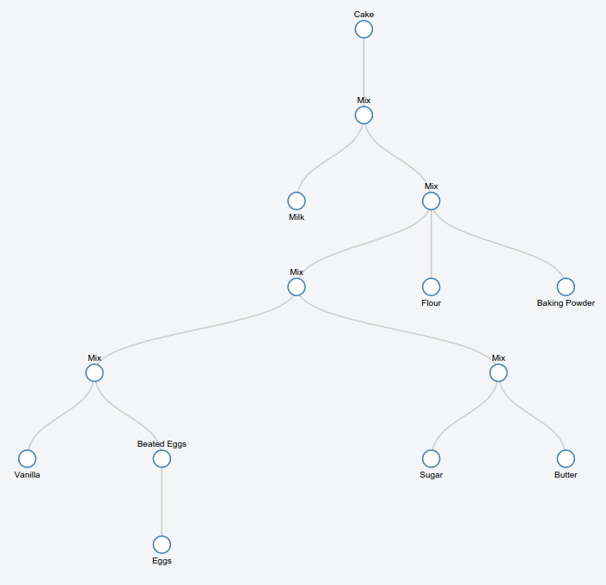
The Problem Statement
Ingredients List
1 cup white sugar
1/2 cup butter
2 eggs
2 teaspoons vanilla extract
1 1/2 cups all-purpose flour
1 3/4 teaspoons baking powder
1/2 cup milk
Recipe
Preheat oven to 350 degrees F (175 degrees C). Grease and flour a 9x9 inch pan or line a muffin pan with paper liners.
In a medium bowl, cream together the sugar and butter. Beat in the eggs, one at a time, then stir in the vanilla. Combine flour and baking powder, add to the creamed mixture and mix well. Finally stir in the milk until batter is smooth. Pour or spoon batter into the prepared pan.
Bake for 30 to 40 minutes in the preheated oven. Cake is done when it springs back to the touch.
Notes:
The main goal here is to convert recipes into process graphs.
We expect very little emphasis on the nlp aspects of this problem , and more on the visualization.

Slide 3
Related Work

Slide 4
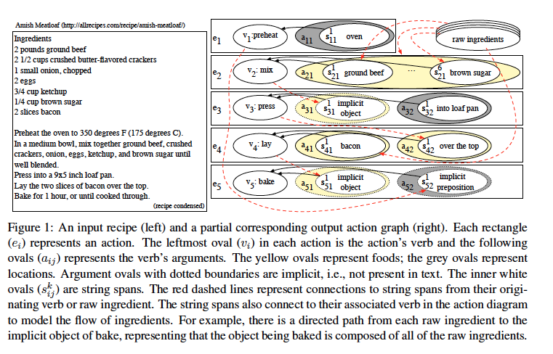

Slide 5
The Approach
- Parsing Recipe data
- Extracting data for each nodes
- Creating connections/edges
- Visualizing the graph
- Allow modifications to the graph
Notes:
The first two steps are strictly nlp related, and you can make use of out of the box methods in nlp libraries currently out there
The next 3 will be your implementations and how you want to do it.
The last 2 are about how u make use of d3 and js

Slide 6
diff (Yours vs. Zettlemoyer)

Slide 7
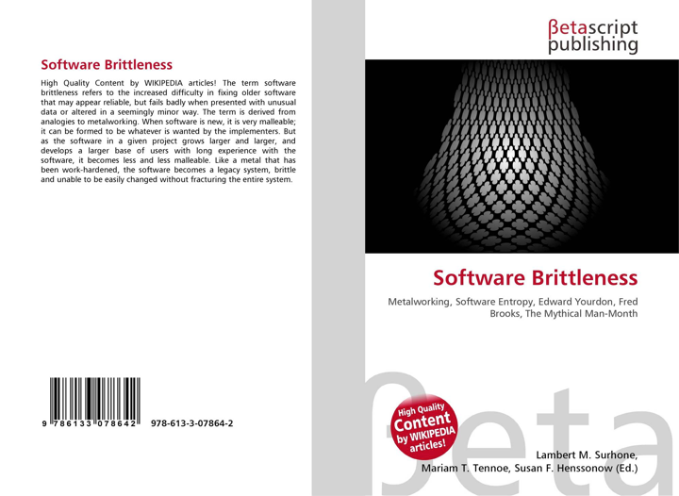
Premise

Slide 8
Need Visual Tools

Slide 9
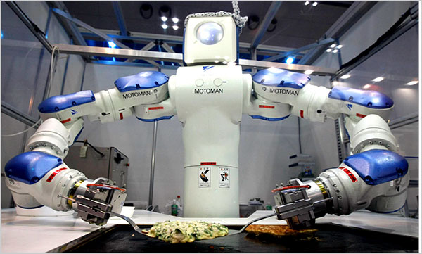
Goal - Cooking Robots
http://www.nytimes.com/2010/02/24/dining/24robots.html?pagewanted=all

Slide 10
Recommenders

Slide 11
Parsing The Data (POS tagging)
Parts of Speech Tagging
Original Text POS tagged text
In a medium bowl, mix together the sugar and butter. In|IN a|DT medium|NN bowl|NN ,|, mix|VB together|RB the|DT sugar|NN and|CC butter|NN .|.
Notes:
Pass each sentence into the out of the box pos taggers present in the nlp libraries. You will get a series of pos tags for each word.
They will not be super accurate, mostly because these pos taggers are trained on unrelated data, like wall street journals and stuff,
If you want higher accuracy you may have to train your pos model to data specific to recipe text. (all tools to do that are present in the nlp libraries).

Slide 12
Parsing The Data (POS Tagging) Contd.
Assumptions
One action verb in each sentence
Limited set of action verbs
A sentence gets converted into a subtree, if it has one actionable verb and at least one Noun object, otherwise ignore sentence.
...
Notes:
You are going to have to make simple yet strong assumptions about the data, mostly because nlp is not the main focus of this project

Slide 13
Extracting Data For Each Nodes - Chunking
Source
Notes:
Eg: Combine (flour) and (baking powder), add to the (creamed mixture) and (mix well)
You could also try Semantic Role Labeling. consists of the detection of the semantic arguments associated with the verb of a sentence and their classification into their specific roles.
Problem is that SRL dont come out of the box in any of the NLP libraries. The only way to implement them would be to go through papers, like there is this one method where you use maximum entropy model to train your roles. We wont go there because that by itself will be a project

Slide 14
Creating Connections/Edges
Again make valid assumptions
Use sequential connections - previous sentence connected to the current sentence
...
Notes:
Now before you start this step know that you have collected structured data from the previous nlp steps
Each sentence has been reduced to a bunch of tuples containing structured data like (verb, set of arguments). Feel free to fill this tuple set with any information that will be necessary for creating your graph
You are going to use this structured data to create edges.
This is where your logic comes in.

Slide 15
Visualize A Process Graph
D3
Reingold–Tilford Tree
Vertical Tree
Constraint graphs
3D
Some more examples

Slide 16
Allow modifications to the graph
After the graph is generated allow user to correct the graph
-show adding nodes
-deleting nodes
-changing nodes
Notes:
Another important step.
This will fix all your errors you accumulated in your nlp steps

Slide 17
BASIC TASKS
- Parsing Recipe data
- Extracting data for each nodes
- Creating connections/edges
- Visualizing the graph
- Allow modifications to the graph

Slide 18
END PRODUCT ?
Enter Recipe Here

Slide 19
Misc. Resources
List of ingredients
Nlp Resources
NLTK
TextBlob
spaCy
What each tag means

Slide 20
Suggested Recipe Mother Lode
http://cooking.nytimes.com/
Your mom’s recipe book if it can be digitized, and parsed
….

Slide 21
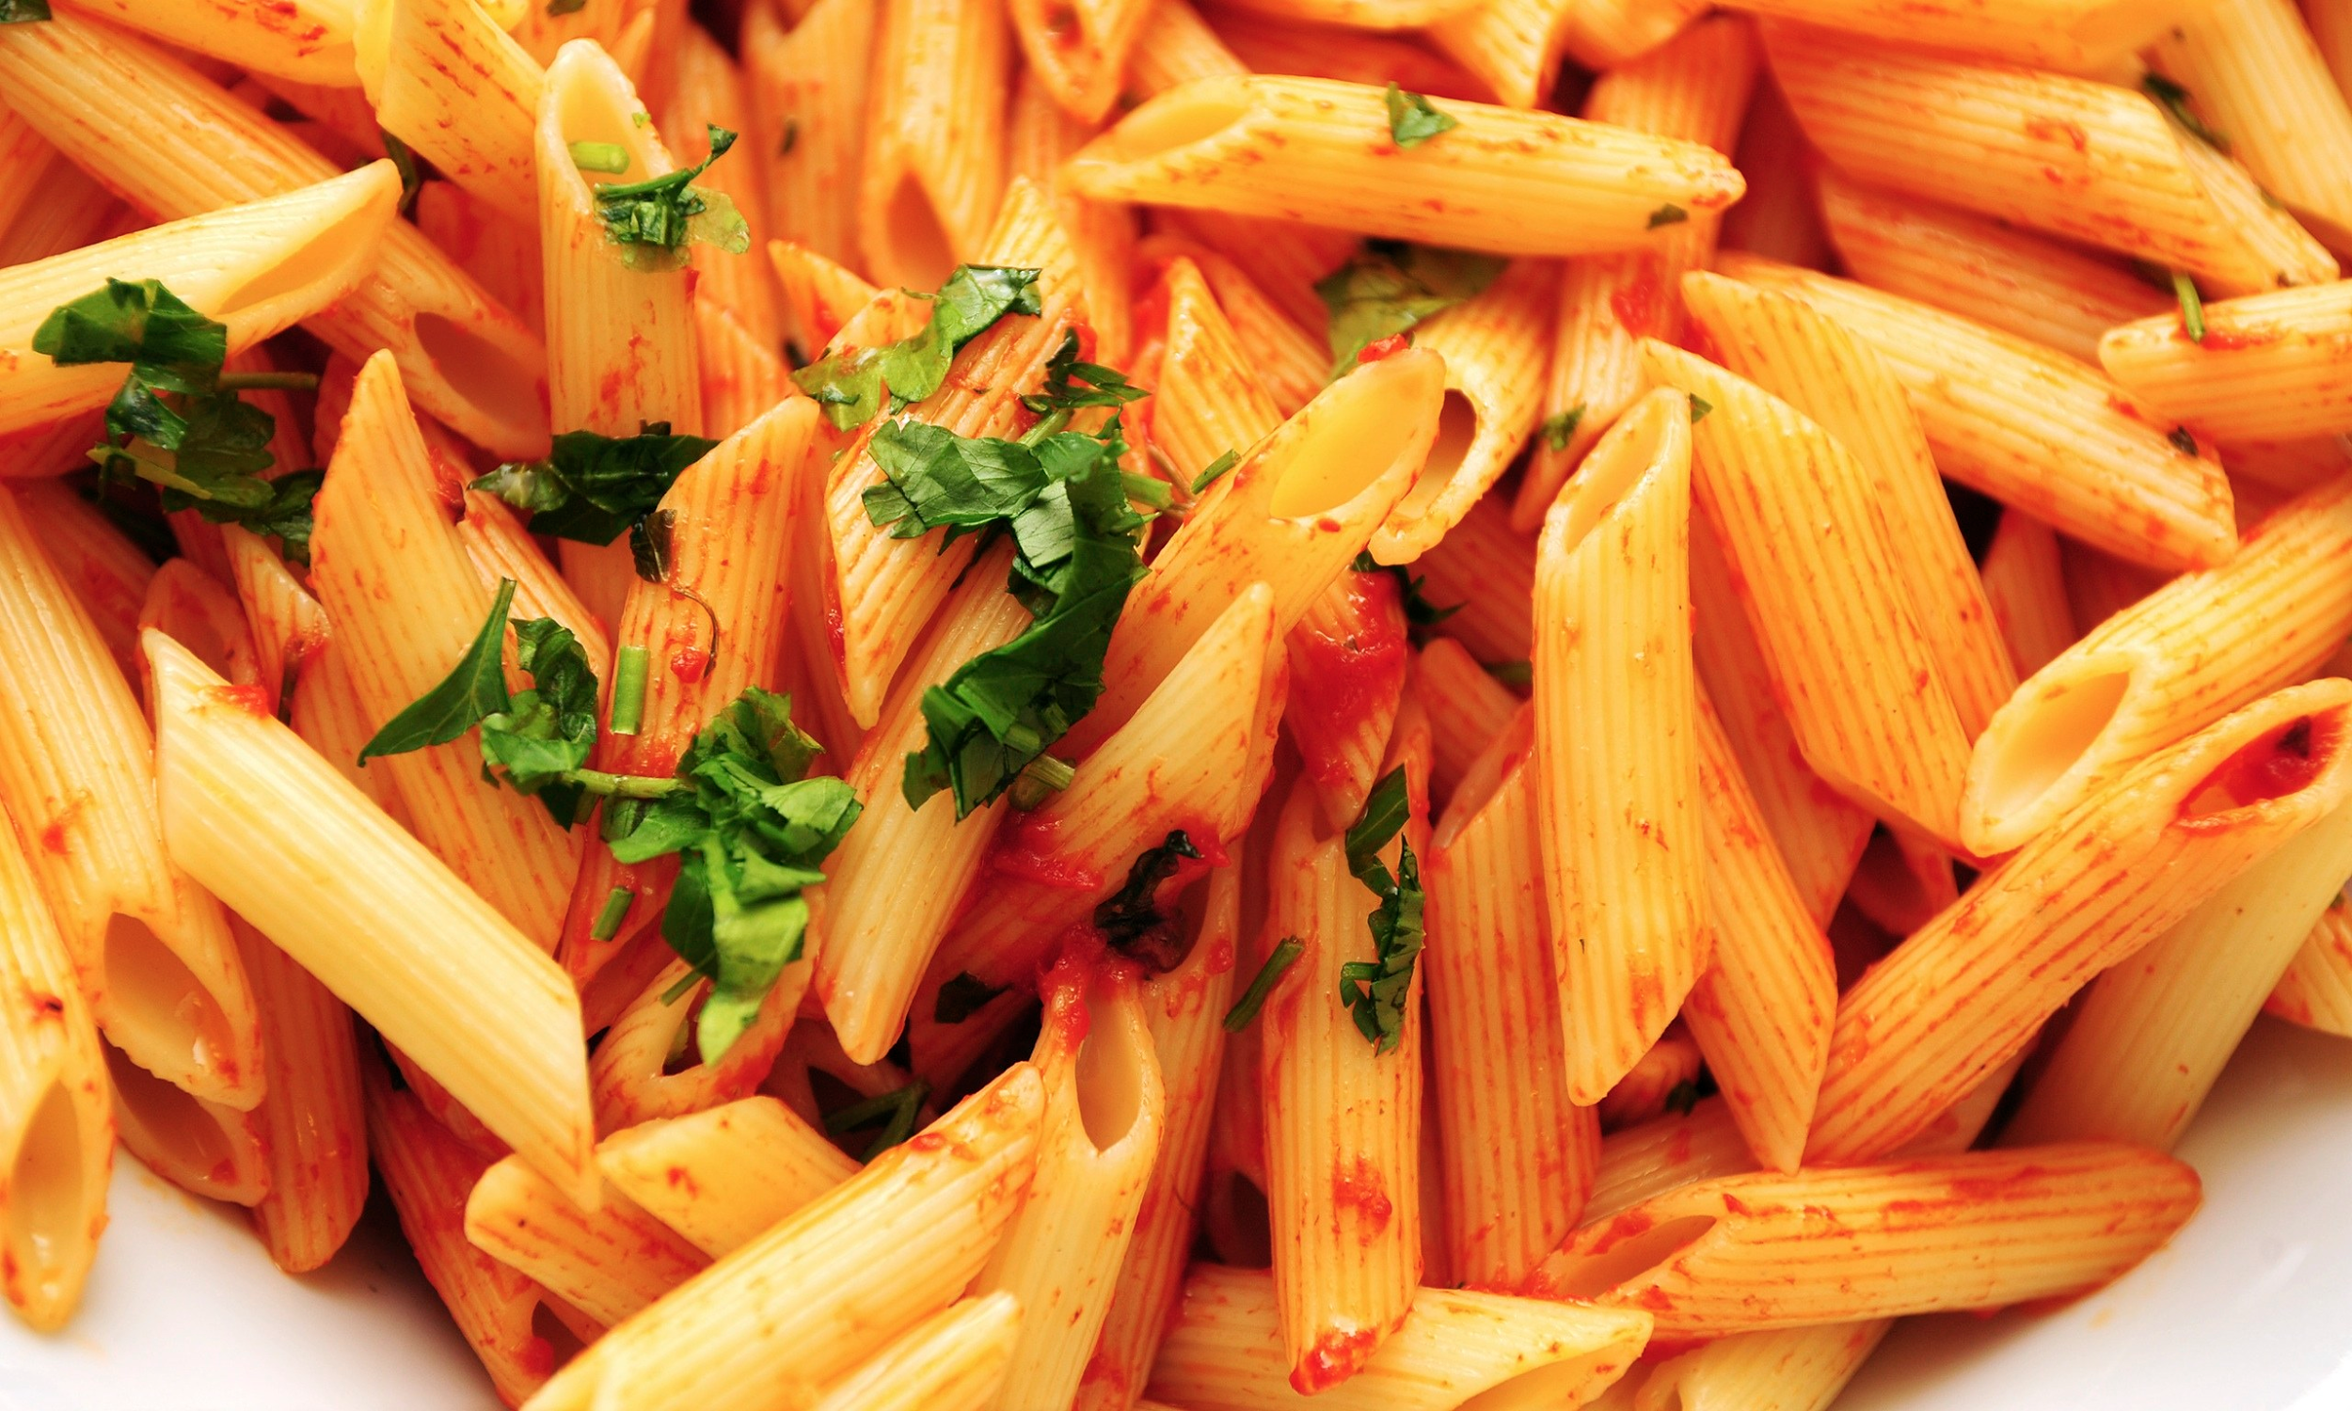
Cuisine ?

Slide 22
Also

Slide 23
The Goal

