Slide 1
GenitoUrinary Development Molecular Anatomy Project
(GUDMAP)
Kirk M. McHugh, Professor & Director
Anatomy/The Ohio State University
Nephrology & Urology Research Affinity Group/Nationwide Children’s Hospital

Slide 2
GenitoUrinary Development Molecular Anatomy Project (GUDMAP)
(GUDMAP) is a consortium of laboratories working to provide the scientific and medical community with tools to facilitate research. The key components are:
a molecular atlas of gene expression for the developing organs of the GenitoUrinary (GU) tract
a high resolution molecular anatomy that highlights development of the GU system
mouse strains to facilitate developmental and functional studies within the GU system
tutorials describing GU organogenesis
rapid access to primary data via the GUDMAP database

Slide 3
GenitoUrinary Development Molecular Anatomy Project (GUDMAP)
The goal of this project is the exploration of gene expression on development and disease.
GUDMAP allows the visualization of gene expression in specific genitourinary tract organs and tissues. This knowledge is imperative for the understanding of normal and abnormal development as well as disease development and progression.
Review existing interface and improve it. Image processing, volume rendering query analysis and processing can all play a role in the improvement of the current utility of the GUDMAP website.
http://www.gudmap.org/index.html

Slide 4
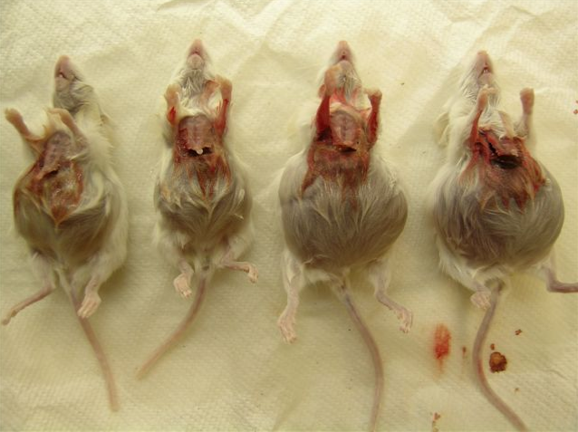
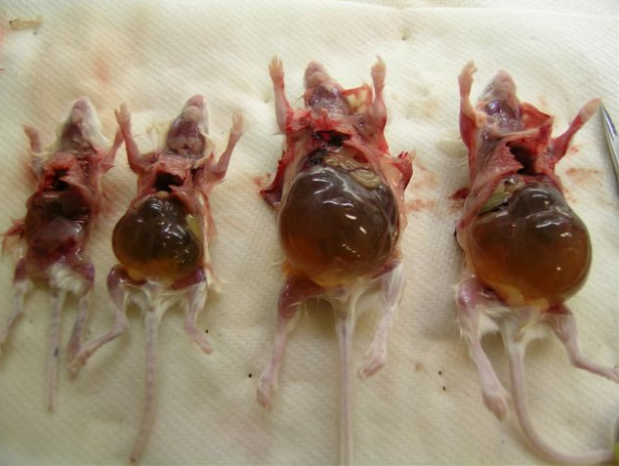
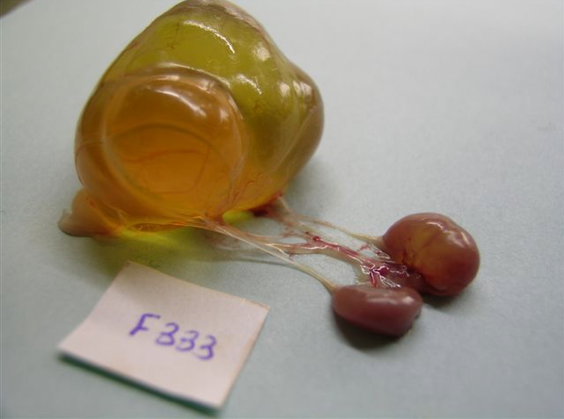
Megabladder Mouse (mgb-/-)
insertional mutation
not transgene or strain-specific
no secondary mutations
autosomal recessive
no gender bias

Slide 5
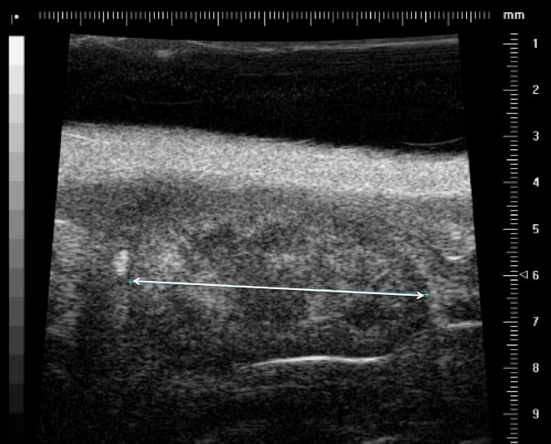
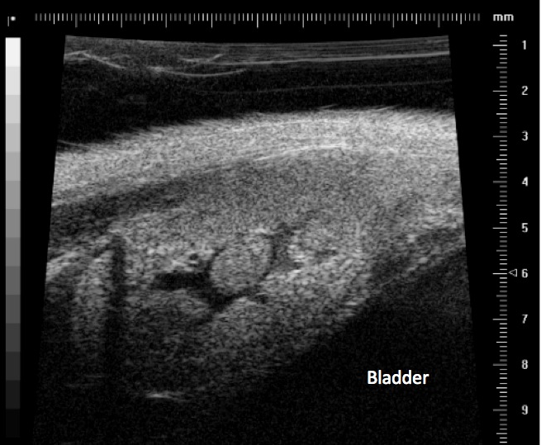
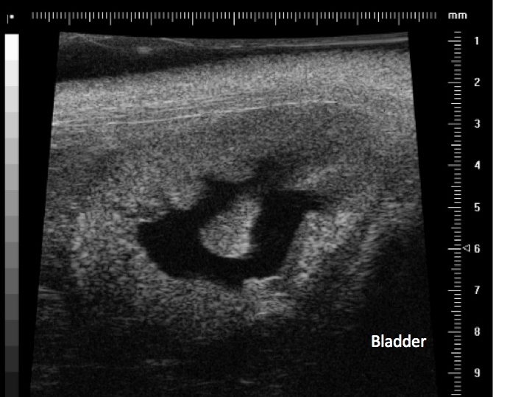
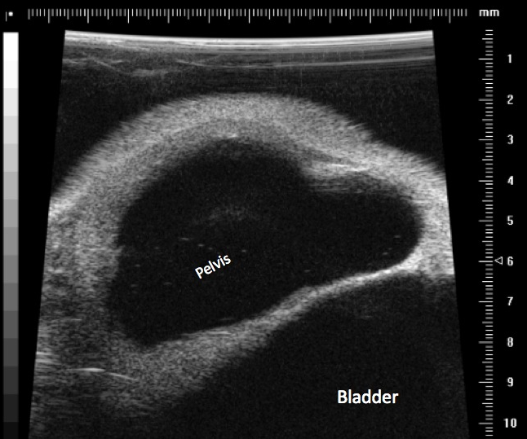
Examine Disease Progressive
mgb-/-
Control
(6)
mgb-/- mild
(7)
mgb-/- moderate
(5)
mgb-/- severe
(6)
VS
kidney mRNA extraction, Agilent cRNA microarray, analyzed using Ingenuity Pathway Analysis – iReport

Slide 6
Top Twenty Pathways Identified
A
4
-log(p-value)
3
2
1
0
RXR/LXR Activation
Acute Phase Response Signaling
Retinoate Biosynthesis
RAR Activation
NO/ROS Production in Macrophages
GADD45 Signaling
IL-17A Signaling
Serotonin Degradation
ATM Signaling
IL-12 Signaling
Androgen Biosynthesis
Sterol Biosynthesis
Glucocorticoid Receptor Signaling
Fatty Acid Degradation
P53 Signaling
Ethanol Degradation
CD27 Signaling
TSP1 Inhibition
Noradrenaline/Adrenaline Degradation
Cell Junction Signaling

Slide 7
Top Twenty Pathways Identified
All
Retinoic
Acid
Pathways
20%
Steroid
Pathways
25%
Renal Injury
Pathways
55%
Mild
Moderate
Severe
Retinoic
Acid
Pathways
20%
Steroid
Pathways
10%
Retinoic
Acid
Pathways
20%
Retinoic
Acid
Pathways
20%
Steroid
Pathways
25%
Steroid
Pathways
25%
Renal Injury
Pathways
55%
Renal Injury
Pathways
70%
Renal Injury
Pathways
55%

Slide 8
Top Activated Upstream Regulators Identified

Slide 9
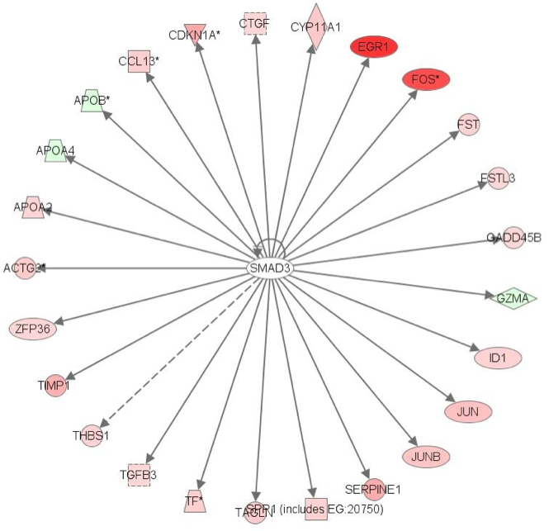
Transcription Factor Discriminates mgb-/- vs. wt Kidneys
We evaluated mgb-/- transcriptome for genes regulated by a common TF
Identified Smad3 among the most activated and its antagonist, Smad7, among the most inhibited
Confirmed increased levels of total and phosphorylated Smad3 protein as well as decreased Smad7 protein levels in whole cell extracts
Localized Smad3 to collecting ducts and showed increased levels in mgb-/- kidneys, consistent with previous localization of TGF-β to this area
Demonstrate increased levels of TGF-β1 protein and TGF-β3 mRNA and protein in mgb-/- kidneys
26 mRNAs regulated by Smad3 are differentially expressed between WT and mgb-/- kidneys, of which 22 are up-regulated

Slide 10
Top Inhibited Upstream Regulators Identified

Slide 11
How Do You Use This Data?
NIH would like to create database resource centers for investigators to use in the initial phases of their research.
GUDMAP represents one of those database sets for the genitourinary tract.
Invest monies – want high database utility.
Poorly developed websites = low utility for investigators.

Slide 12
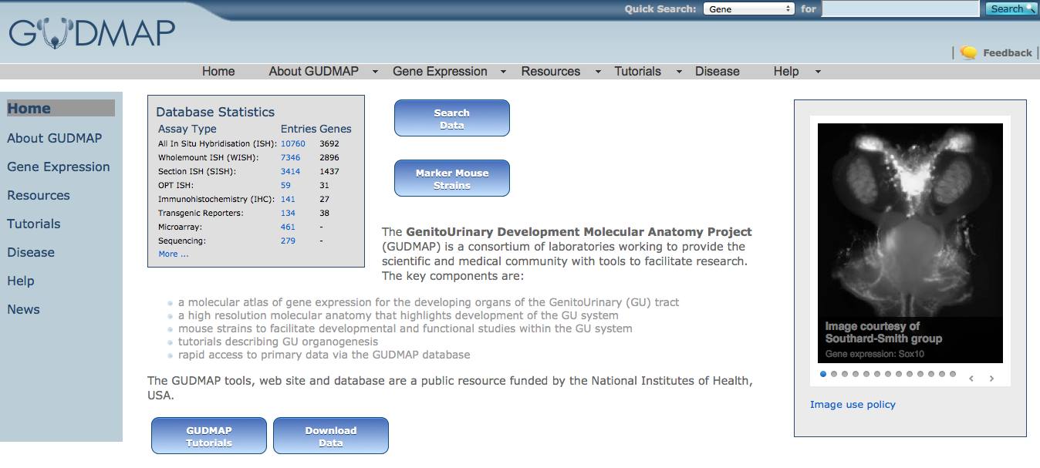
How Do You Use This Data? GUDMAP Database (http://www.gudmap.org/)

Slide 13
How Do You Use This Data? GUDMAP Database (http://www.gudmap.org/)

Slide 14
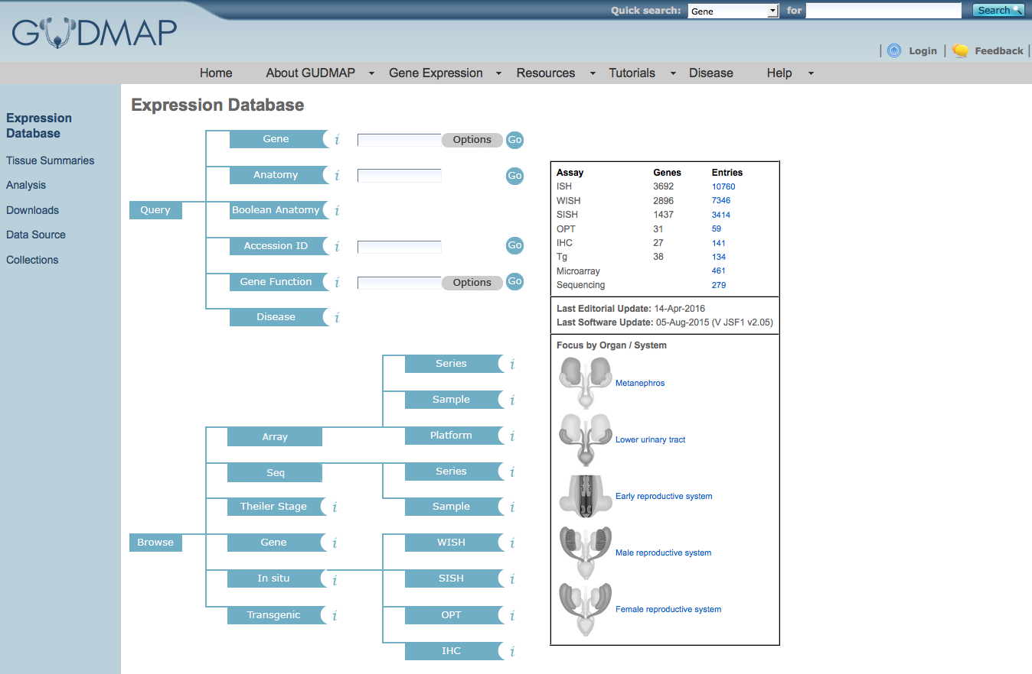
How Do You Use This Data? GUDMAP Database (http://www.gudmap.org/)

Slide 15
How Do You Use This Data? GUDMAP Database (http://www.gudmap.org/)

Slide 16
How Do You Use This Data? GUDMAP Database (http://www.gudmap.org/)

Slide 17
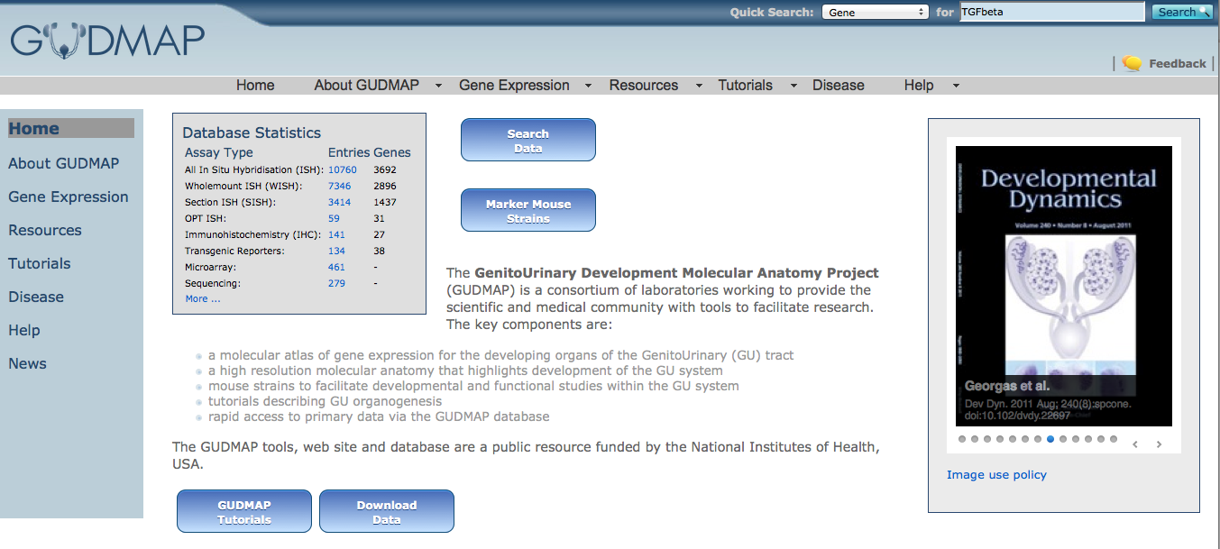
How Do You Use This Data? GUDMAP Database (http://www.gudmap.org/)

Slide 18
How Do You Use This Data? GUDMAP Database (http://www.gudmap.org/)

Slide 19
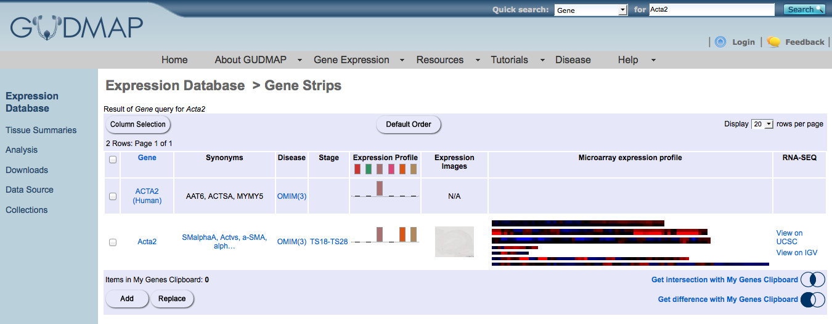
How Do You Use This Data? GUDMAP Database (http://www.gudmap.org/)
alpha smooth muscle actin – no results returned

Slide 20
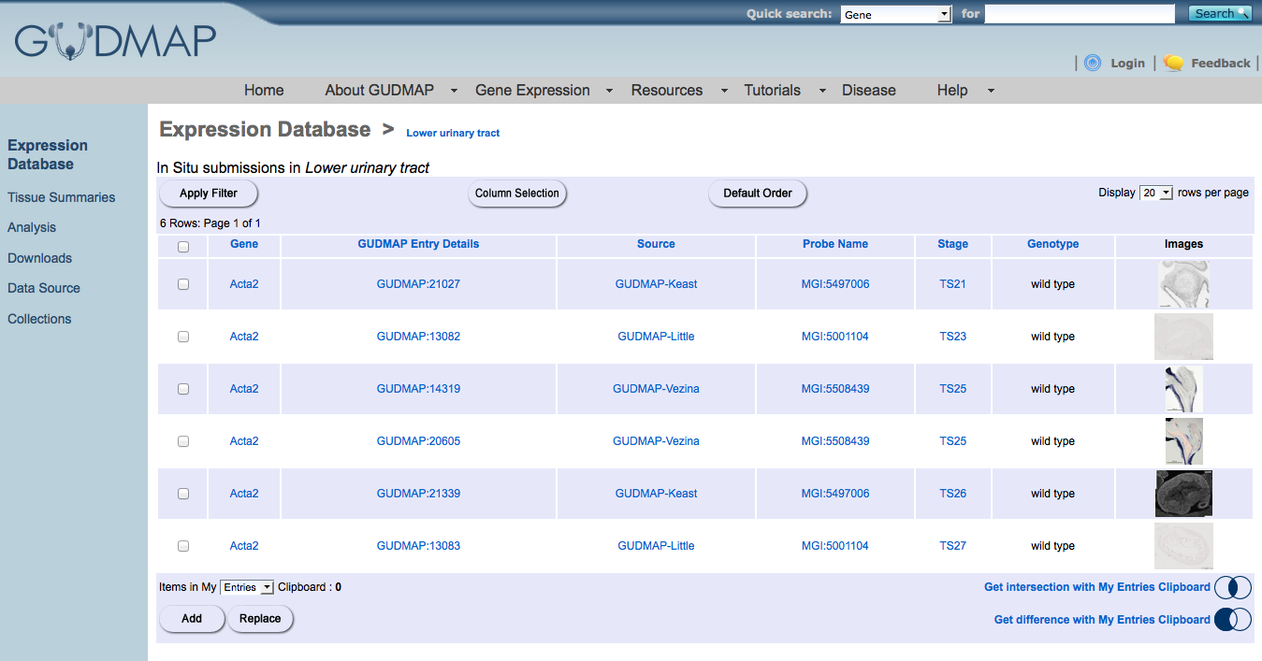
How Do You Use This Data? GUDMAP Database (http://www.gudmap.org/)
alpha smooth muscle actin – no results returned

Slide 21
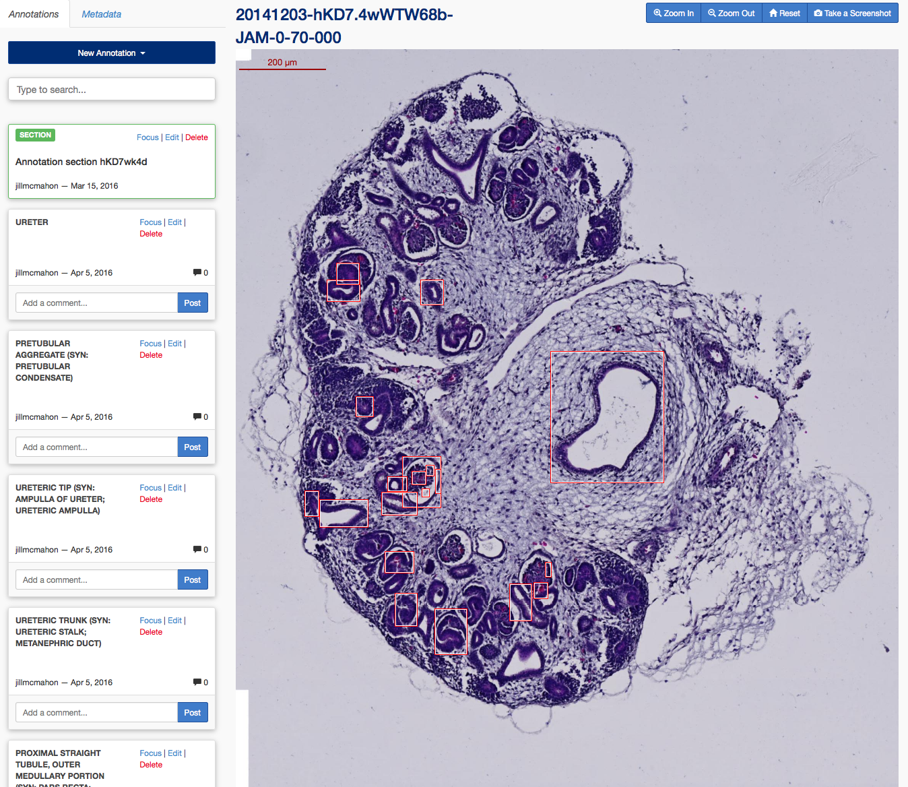
How Do You Use This Data? GUDMAP Database (http://www.gudmap.org/)

Slide 22
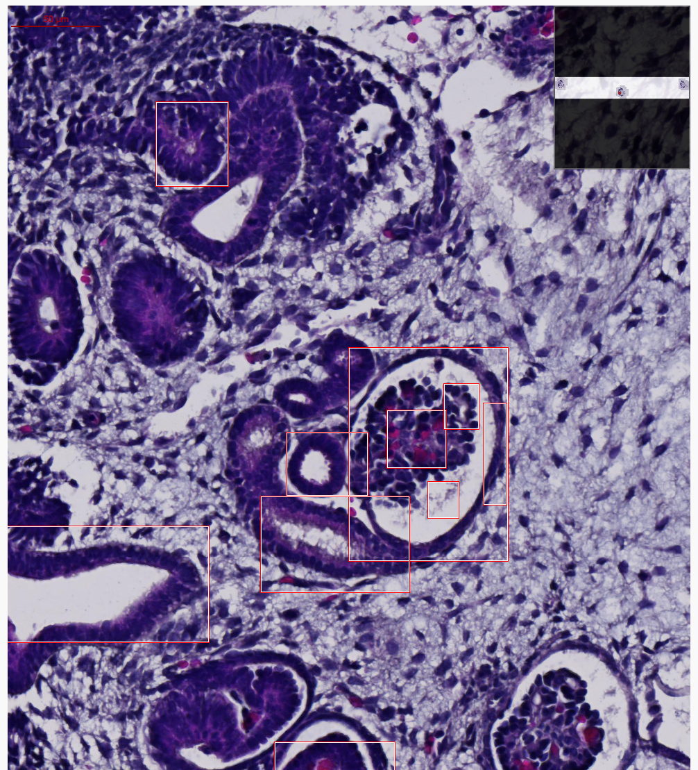
How Do You Use This Data? GUDMAP Database (http://www.gudmap.org/)
Image Annotation

Slide 23
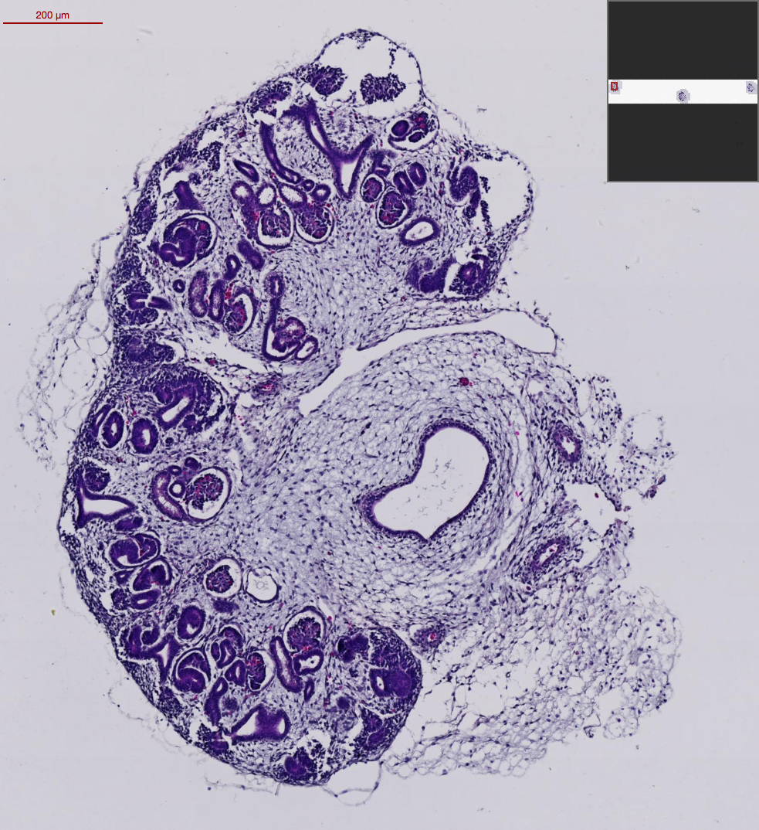
How Do You Use Data? GUDMAP Database (http://www.gudmap.org/)
Two Primary Tasks
to be Resolved
Initial Search Function
Image Annotation

