Slide 1
To Ponder
Does a problem get easier or harder to solve if I give you less information?

Slide 2
Computer Science & Engineering
An Introduction
(and some advanced concepts too!)
Prof. Paul Sivilotti
sivilotti.1@osu.edu

Slide 3

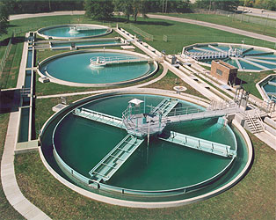





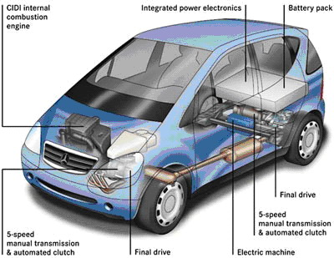
Where is Engineering?

Slide 4




















Where is Computer Science?
Notes:
CS is all these companies (that everyone recognizes as CS)

Slide 5

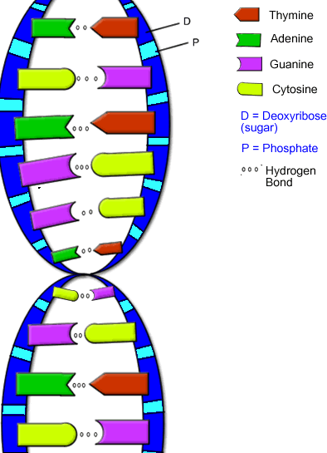

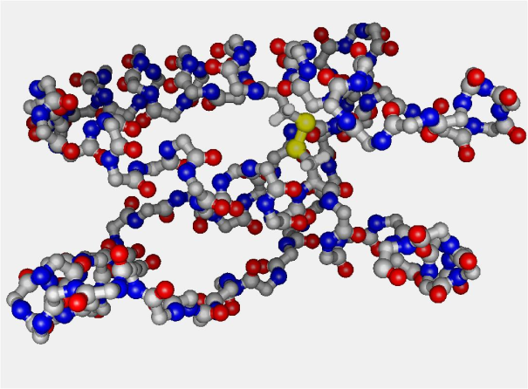


Computer Science is Also…

Slide 6
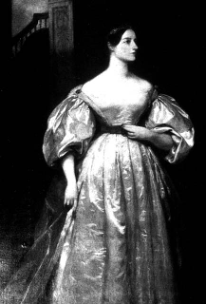
The First Computer Scientist
Ada Byron King,
Countess of Lovelace
1815-1852

Slide 7
Computers and Programs
Computer: a device that “computes”
  Takes inputs, produces output
Program: a sequence of instructions
  How to produce the output
Contrast
  Computers: smaller, faster, cheaper
  Programs: larger and more complicated!

Slide 8
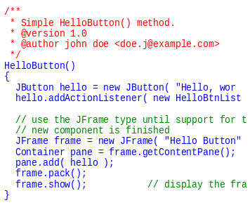
Now We’re Cooking!
Chef = computer
Recipe = program
Preheat oven to 350º
Sift together flour, cocoa, baking powder, salt
Melt 1/2c butter and 1lb chocolate
Stir 1/2c sugar into chocolate mixture
Stir in 3 large eggs
Stir in dry ingredients
Add chocolate chunks
Form into rounded balls (1T each)
Bake 10 min
What is the output?
=
=

Slide 9
Computing Choc. Chip Cookies
1 ¼ c flour
Sequence of
instructions
2 tbsp cocoa
1 tsp baking pwdr
¾ tsp salt
36 chocolate
chip cookies
½ c butter
1 lb chocolate
½ c sugar
3 eggs

Slide 10
Requirements in Engineering
Engineering is about problem solving
  Given a set of requirements
  Design a good solution
If a design does not meet requirements
  Not useful (in this case)
  Wrong, broken, dangerous…
Many designs do meet requirements
  Which to choose? A “good” one, of course!
  Optimization

Slide 11





Requirements: Example
Span at least 9000’
Support 6 lanes of traffic, 40 million car crossings per year
Height at least 220’
Withstand winds up to 50mph
✗
✗
✗
✓
✓

Slide 12

Requirements: Example #2
Span at least 33’
Support 2 lanes of pedestrian traffic
Clearance at least 50’
Prevent prisoners from escaping during crossing

Slide 13
Back to Software Engineering
A software engineer builds programs
  Instructions for how to turn inputs into outputs
  Recipe engineering!
A program must meet certain requirements…
  How are requirements given for a program?
  How are requirements given for a recipe?
  (For software, “requirements” are usually called “specifications”)

Slide 14
Specifying Choc. Chip Cookies
1 ¼ c flour
Sequence of
instructions
2 tbsp cocoa
1 tsp baking pwdr
¾ tsp salt
36 chocolate
chip cookies
½ c butter
1 lb chocolate
½ c sugar
3 eggs

Slide 15
Requirements in Software
A software engineer builds programs
  Instructions for how to turn inputs into outputs
  Recipe engineering!
Programs must meet specifications
  What transformation to do (not how to do it)
  input: ingredients
  output: final dish
For the same requirements, many solutions
  Good recipes are efficient
  Good recipes are fast
  Good recipes are easy to understand
  Good recipes are easy to change

Slide 16
Your Turn
Lab 1
  You are given several specifications
  Write programs that meet these specifications
The best dishes are made from scratch…

Slide 17
Lab 1: Debrief
Put the problems in increasing order of difficulty:
  Fixed Start / Reach the Ocean
  Random-Facing Start / Reach the Ocean
  Fixed-Start / Reach the Ship
  All-Random Start / Reach the Ocean
Why is C harder than A?

Slide 18
Description of Outputs
reach the ship
Harder
Less Information
Easier
reach the ocean

Slide 19
Description of Outputs
36 chocolate
chip cookies
Harder
36 cookies
some cookies
something sweet
Less Information
Easier
something edible

Slide 20
Description of Inputs
Less Information
some fat
½ c fat
½ c butter
½ c butter
(unsalted)
Harder
Easier

Slide 21
Description of Inputs
Less Information
all random
random facing
fixed
Harder
Easier

Slide 22
Comparing Specifications
Harder
Information
reach
the ship
C
Information
reach
the ocean
D
B
A
Easier
all random
random facing
fixed
Harder
Easier

Slide 23
Lab 1 Take-Home Messages
A specification that says less about outputs is easier to implement
  But may be less useful (might not produce an appealing final dish)
A specification that says less about inputs is harder to implement
  But may be more useful (more general since it can be applied in more situations)

Slide 24
Lab 2: Composition
Big programs are always built out of lots of smaller ones
Output from one program can be used as input to another
Example
  recipe for chocolate chip cookies
  recipe for chocolate genoise cake
  recipe for frosting

Slide 25
Building a Big Recipe
recipe 1
1 ¼ c flour
2 tbsp cocoa
1 tsp baking pwdr
¾ tsp salt
choc chip
cookies
½ c butter
1 lb chocolate
½ c sugar
3 eggs
recipe 4
recipe 2
1 ¼ c flour
2 tbsp cocoa
?
1 tsp baking pwdr
genoise
cake
¾ tsp salt
½ c butter
1 lb chocolate
½ c sugar
3 eggs
recipe 3
1 ¼ c flour
2 tbsp cocoa
1 tsp baking pwdr
¾ tsp salt
icing
½ c butter
1 lb chocolate
½ c sugar
3 eggs

Slide 26
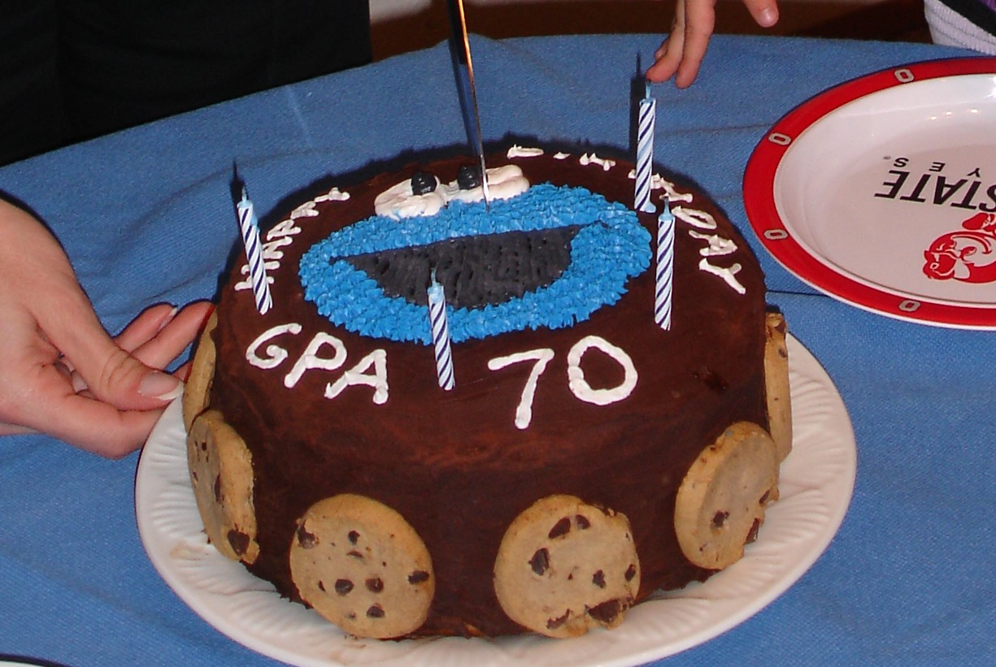

Slide 27
Take-Home Messages
Computer program: a sequence of instructions
  A recipe for a chef
Specifications: what to do (not how)
  Given in terms of inputs and outputs
  Less information about outputs, easier to implement
  Less information about inputs, harder to implement
Software engineering: how to design programs
  Recipe design: correct, easy to understand and modify
  Usually work in teams: communication & coordination
Composition: big programs from smaller ones
  Output of one program can be input to another

Slide 28
Computer Science & Engineering
An Introduction
(and some advanced concepts too!)
Prof. Paul Sivilotti
sivilotti.1@osu.edu

