Slide 1
Presentation to CSE Advisory Board
Neelam Soundarajan
April 25, 2014

Slide 2
Responsibilities
As associate chair:
Decide on course offerings
Assign faculty to teach individual sections
As chair of Undergrad Studies Comm:
Keep track of the state of the programs, identify problems and possible solutions
Identify possible changes in the programs
Coordinate assessment activities

Slide 3
Enrollments and Graduates (BS-CSE & BS-CIS)
Year | New Majors | Graduates
2001-’02 | 220 | 185
2002-’03 | 163 | 196
2003-’04 | 170 | 180
2004-’05 | 167 | 143
2005-’06 | 143 | 129
2006-’07 | 170 | 142
2007-’08 | 179 | 119
2008-’09 | 208 | 140
2009-’10 | 230 | 127
2010-’11 | 241 | 174
2011-’12 | 283 | 209
2012-’13 | 245 | 220
2013-'14 | 373 | 214

Slide 4
Enrollments and Graduates (BS-CSE & BS-CIS)

Slide 5
Enrollment Trends (CS Majors -- National)

Slide 6
Plans
Starting Su 2014, GPA requirement will go to 3.0
Starting Su 2015, GPA requirement will go to 3.2 (this still needs college approval)
But ... impact of new Data Analytics program?
Impact of continuing high demand for CS ...

Slide 7
Who Teaches Our Courses?

Slide 8
Who Teaches Our Courses? (contd)

Slide 9
Who Teaches Our Courses? (contd)

Slide 10
Report on Undergrad Programs
Students generally satisfied with our programs
Especially satisfied with our capstone design courses and other project-oriented courses
Couple of new courses: Data mining, Mobile app dev.
Considering some tweaks to the programs

Slide 11
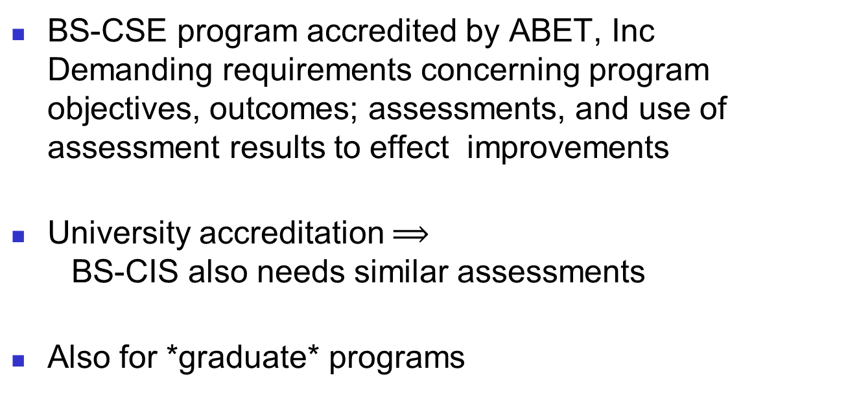
Assessment of Undergrad Programs
BS-CSE program accredited by ABET, Inc Demanding requirements concerning program objectives, outcomes; assessments, and use of assessment results to effect improvements
University accreditation $⟹$ BS-CIS also needs similar assessments
Also for *graduate* programs

Slide 12
BS-CSE program objectives:
Graduates of the program will be employed in the computing profession, and will be engaged in learning, understanding, and applying new ideas and technologies as the field evolves.
Graduates with an interest in, and aptitude for, advanced studies in computing will have completed, or be actively pursuing, graduate studies in computing.
Graduates will be informed and involved members of their communities, and responsible engineering and computing professionals.

Slide 13
BS-CSE Outcomes Assessment
Exit survey
Exit test (POCAT):
Multiple-choice test on required and some elective courses (Length: 20-30 minutes)
Students take the test in their last semester (typically on a weekday evening; pizza and pop provided)
Anonymous (results posted by student code; only the individual student knows his/her code)
Has been very effective
Proposal: Relate student performance to specific instructors

Slide 14
Plans/proposals/...
Proposal: Move POCAT on-line and use info about which courses a student completed to ask questions only about those courses
Proposal: Relate student performance in POCAT to specific instructors
Detailed information at: http://www.cse.ohio-state.edu/ugrad/BSCSE_Continuous_Improvement/
Comments? Questions? (e-mail: soundarajan.1@osu.edu

