Slide 1
Symmetric-Key Encryption
CSE 5351: Introduction to Cryptography
Reading assignment:
Chapter 3
Read sections 3.1-3.2 first (skipping 3.2.2)

Slide 14
Pseudorandom Generators and Stream Ciphers
Encryption schemes using pseudorandom generators
K&L: Section 3.3

Slide 16
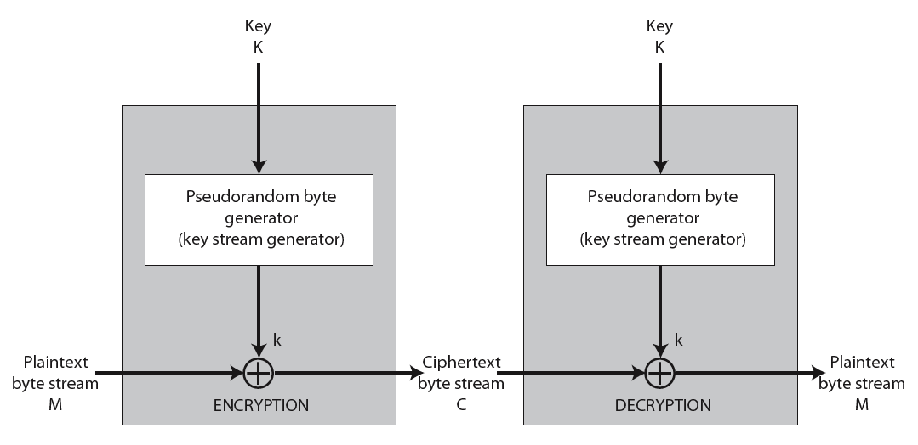

Slide 39
Security of RC4
RC4 is not a truly pseudorandom generator.
The key stream generated by RC4 is biased.
The second byte is biased toward zero with high probability.
The first few bytes are strongly non-random and leak information about the input key.
Defense: discard the initial n bytes of the keystream.
Called “RC4-drop[n-bytes]”.
Recommended values for n = 256, 768, or 3072 bytes.
Efforts are under way (e.g. the eSTREAM project) to develop more secure stream ciphers.

Slide 40
The Use of RC4 in WEP
WEP is an RC4-based protocol for encrypting data transmitted over an IEEE 802.11 wireless LAN.
WEP requires each packet to be encrypted with a separate RC4 key.
The RC4 key for each packet is a concatenation of a 40-bit or 104-bit long-term key and a random 24-bit R.
RC4 key: Long-term key (40 or 104 bits) R (24)
l
802.11
Frame:
l
Header R Message CRC
encrypted

Slide 41
WEP is not secure
Mainly because of its way of constructing the key
Can be cracked in a minute
http://eprint.iacr.org/2007/120.pdf

Slide 42
Stronger Security Notions
K&L: Section 3.4

Slide 53
Constructing CPA-Secure Encryption Schemes
K&L: Section 3.5

Slide 54
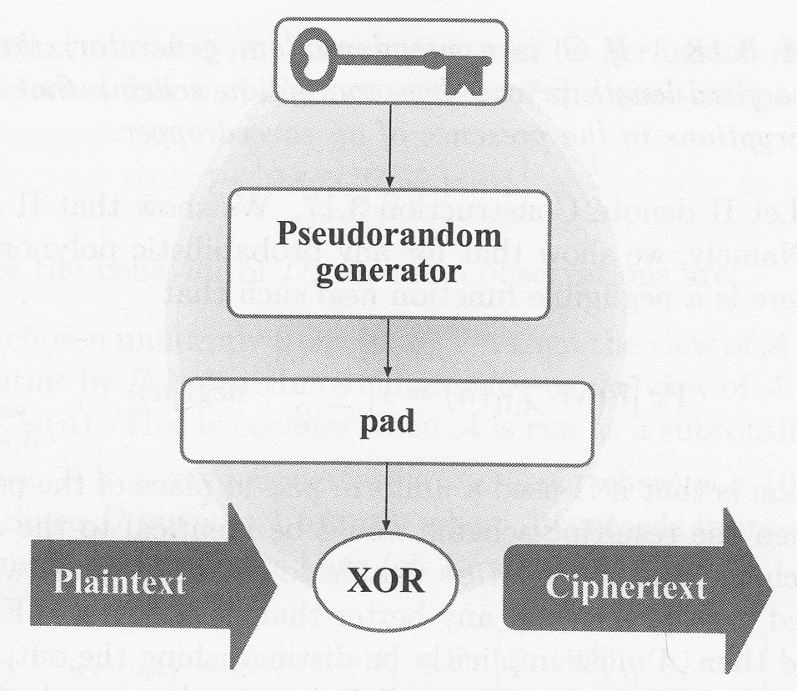
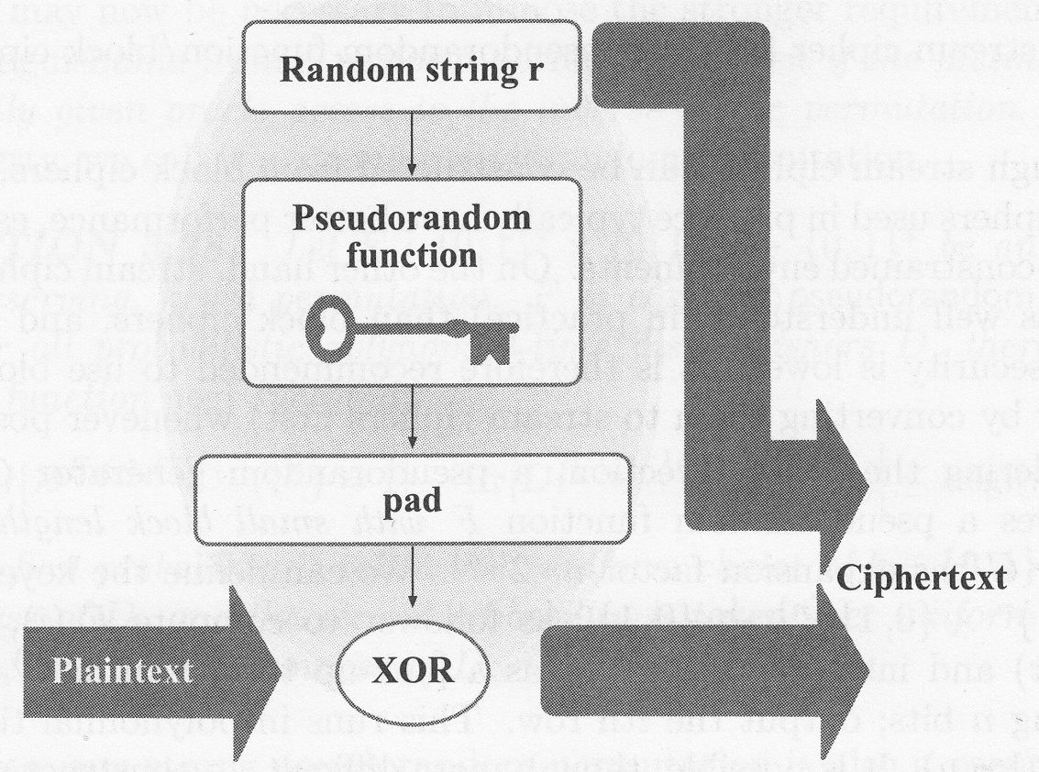
Pseudorandom
generator
secret
one-time pad

Slide 71
Modes of Operations
K&L: Section 3.6.2

Slide 75
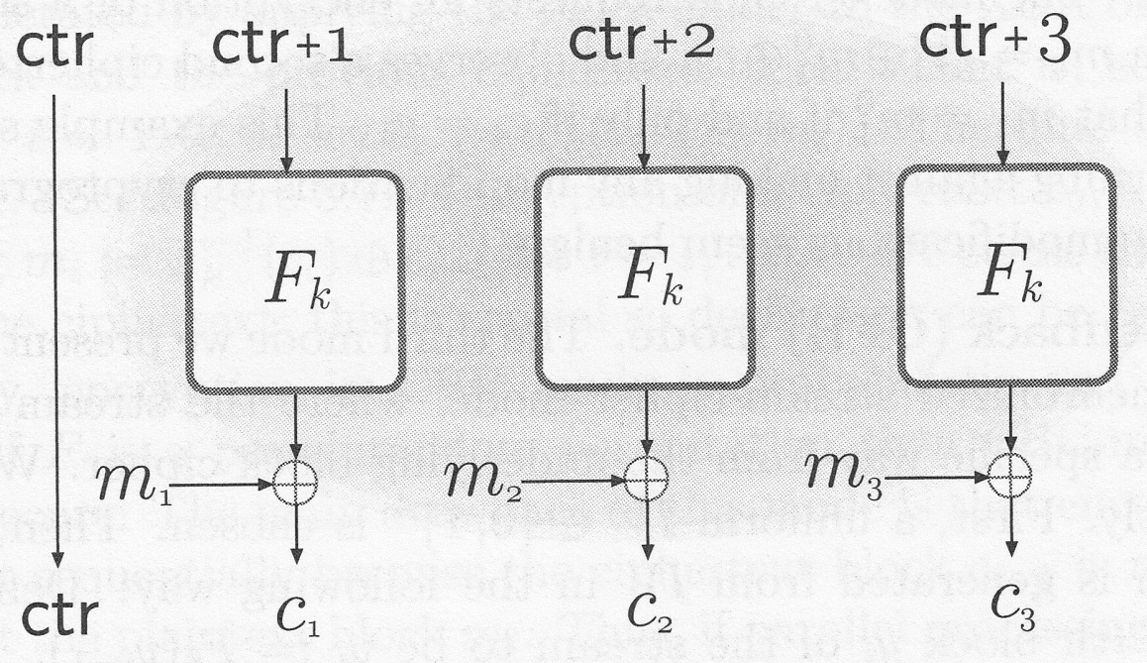
Counter Mode (CTR)

Slide 77
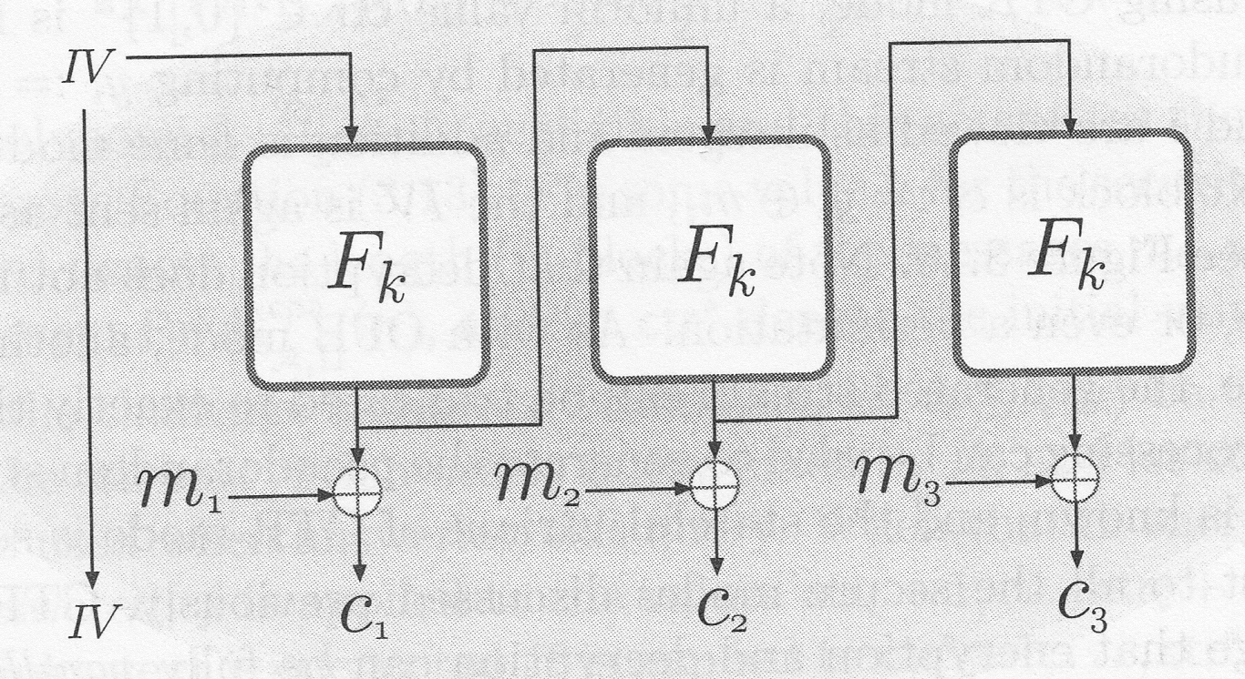
Output feedback

Slide 79
How is Cipher Feedback (CFB) different from OFB?

Slide 81
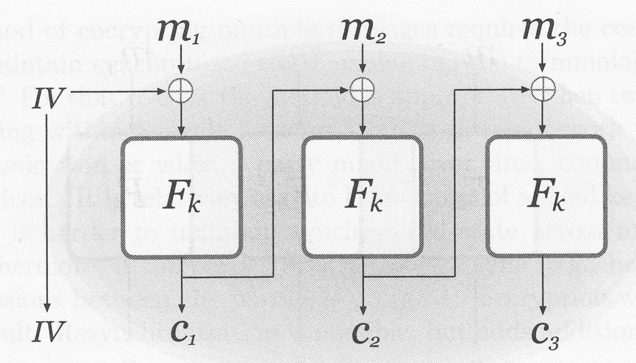
Cipher block chaining (CBC)

Slide 82
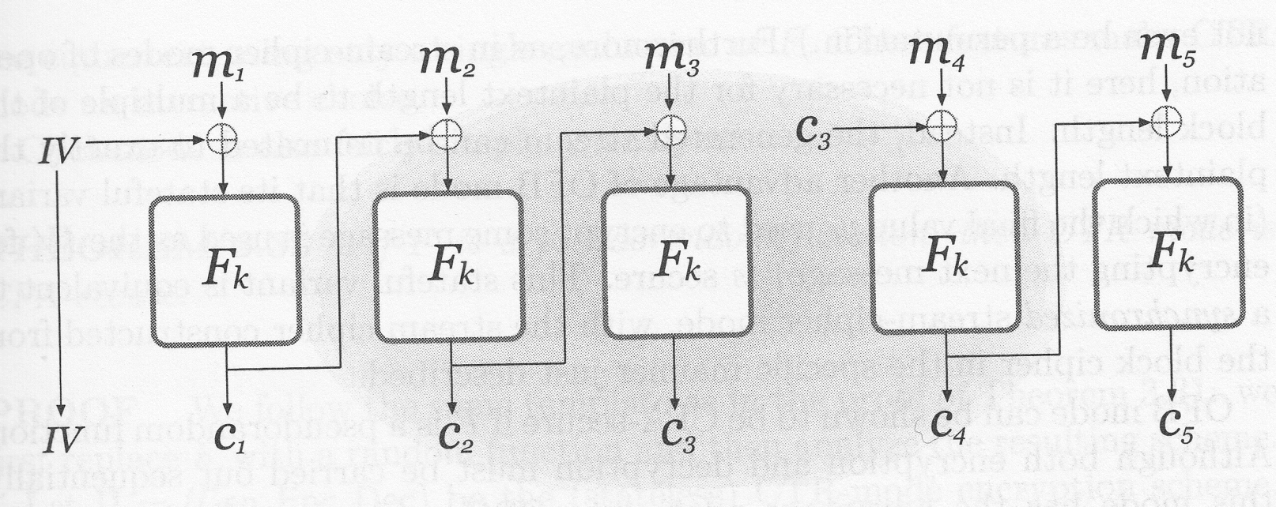
Chained CBC
CBC
IV’

Slide 83
Chained CBC

Slide 87
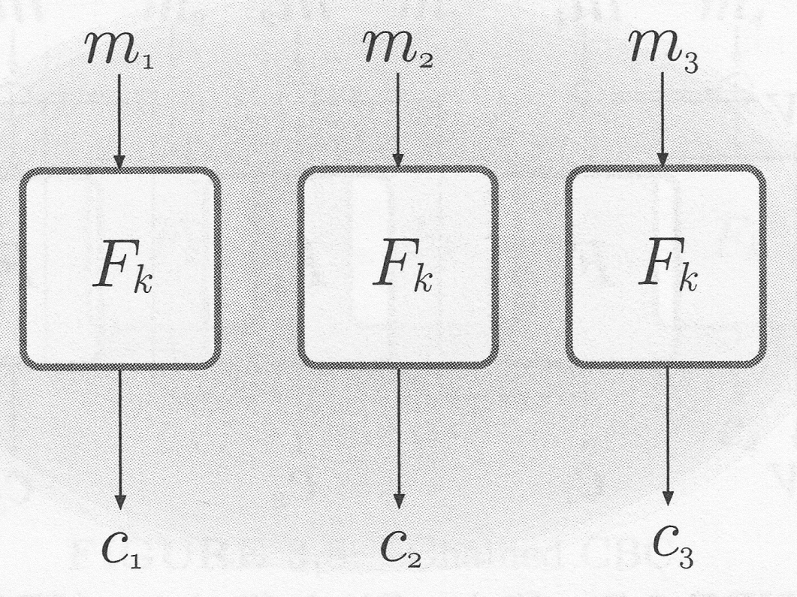
Electronic Code Book (ECB)

Slide 89
Chosen-Ciphertext Attacks
K&L Section 3.7

Slide 95
Padding-Oracle Attack: a concrete example of (partial) chosen-ciphertext attacks
K&L Section 3.7.2

Slide 99
Cipher block chaining (CBC)

