Slide 1
Procedural Content Lab2
CSE 788
Prof. Roger Crawfis

Slide 2
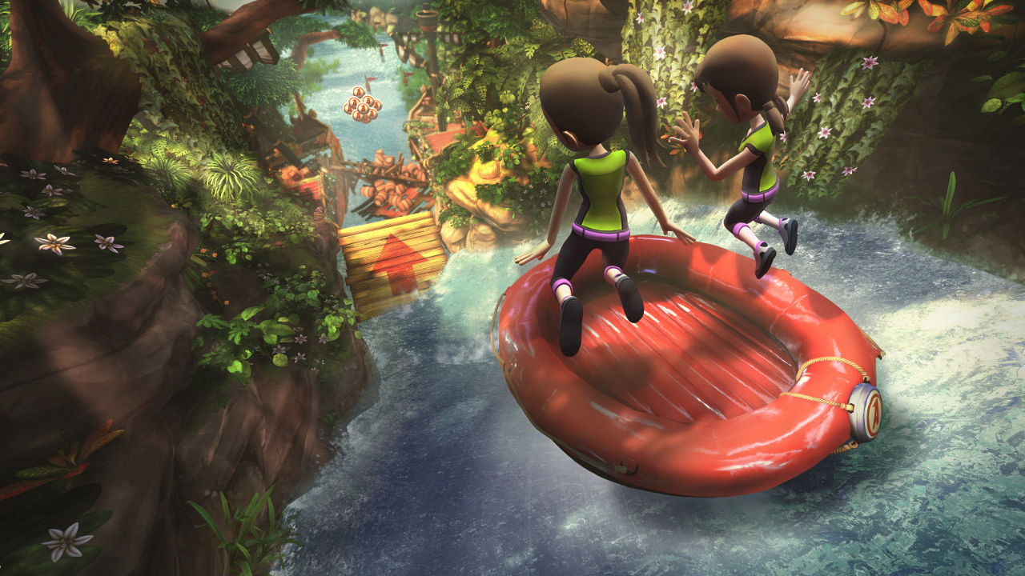
River fly (or raft) through

Slide 3
Specifications
Can either be 3D or a top-down scroller
Procedural elements to add:
High-frequency features to your terrain
Water for your river
Rocks (or rock sprites) for the river bed and along the canyon walls
Camera controls to move left / right and jump.
Obstacles in the river (fallen trees, etc.)

Slide 4
Extra Credit
Sky dome or sky box
Water splashes
Lighting (shadows?) on the terrain.
A small movie if easily doable.

Slide 5
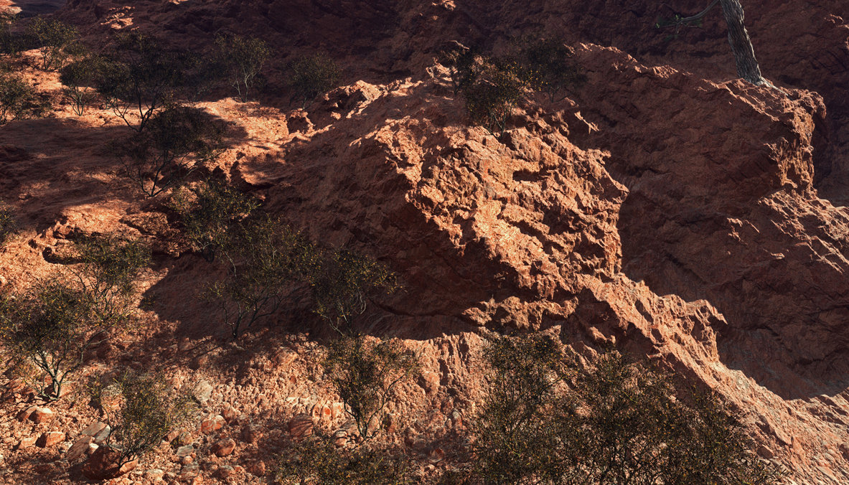
Displacement textures, rocks and bushes.
by Tangled Universe on deviantart.com

Slide 6
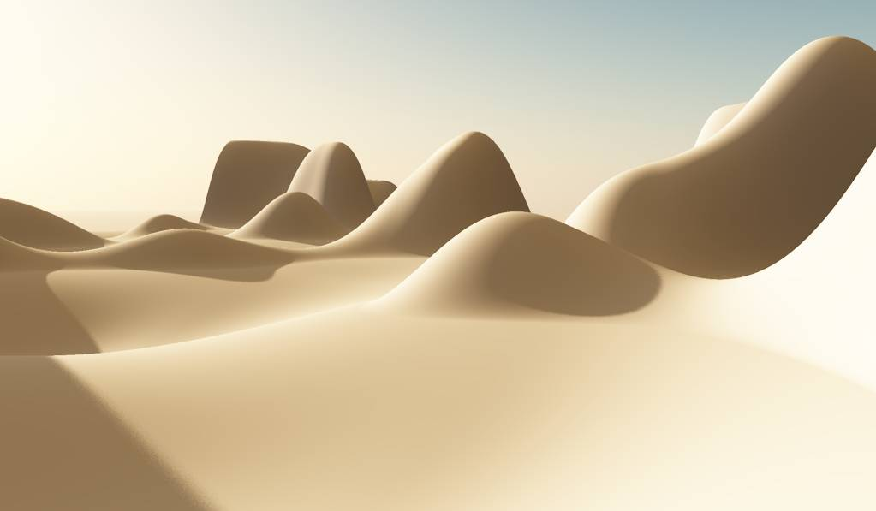

Slide 7
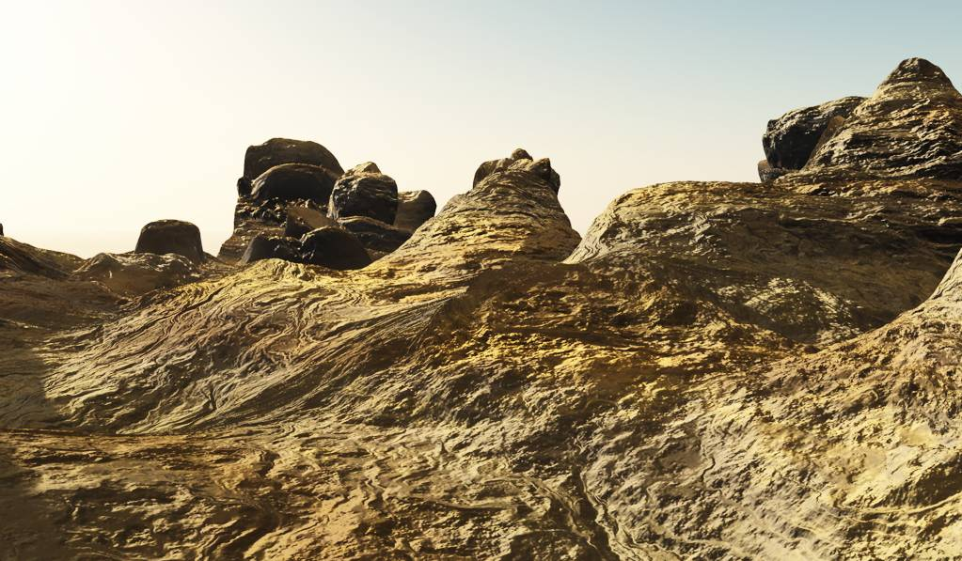

Slide 8
What to turn in
Source code.
Description on how you generated your scene, etc.
3-4 Powerpoint slides that visual guide the class through your creation.

