Slide 1
The Artificial Life of Plants
Przemyslaw Prusinkiewicz, Mark Hammel,
Radom´ır Mˇech
Department of Computer Science
University of Calgary
Calgary, Alberta, Canada T2N 1N4
e-mail: pwpjhammeljmech@cpsc.ucalgary.ca
Jim Hanan
CSIRO - Cooperative Research Centre
for Tropical Pest Management
Brisbane, Australia
e-mail: jim@ctpm.uq.oz.au
From Artificial life for graphics, animation, and virtual reality,
volume 7 of SIGGRAPH ’95 Course Notes, pages 1-1–1-38. ACM
Press, 1995.

Slide 2
L-systems
Aristid Lindenmayer, 1968
Formalism to simulate development of multi-cellular organisms
Has been extensively used to simulate development of plants
Data base amplification
Generate complex structures from small data sets
Emergence
a process in which a collection of interacting units acquires qualitatively new properties that cannot be reduced to a simple superposition of individual contributions
Module
any discrete constructional unit that is repeated as the plant develops
an apex, a flower, or a branch

Slide 3
Example (from wiki)
variables : X F (draw forward)
constants : + − (turn right/left) angle : 25°
start : X
rules :
X → F-[[X]+X]+F[+FX]-X
F → FF

Slide 4
Plant development as rewriting
Development at modular level is captured by parallel rewriting system
Parent -> child
Modules belong to alphabet of module types
Rewriting rules are called productions

Slide 5
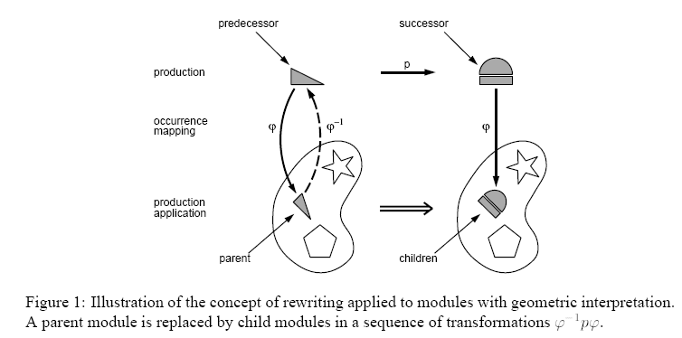
Rewriting

Slide 6
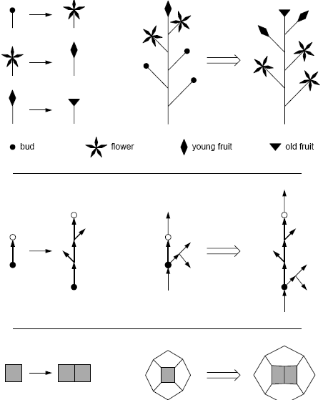
Example

Slide 7
Productions
May be applied sequentially
Or parallel
Rewrite modules simultaneously at each derivation step
Parallel is more appropriate for biological development, as such development takes place simultaneously in each part of an organism
Start with an axiom
Derivation steps form a developmental sequence

Slide 8
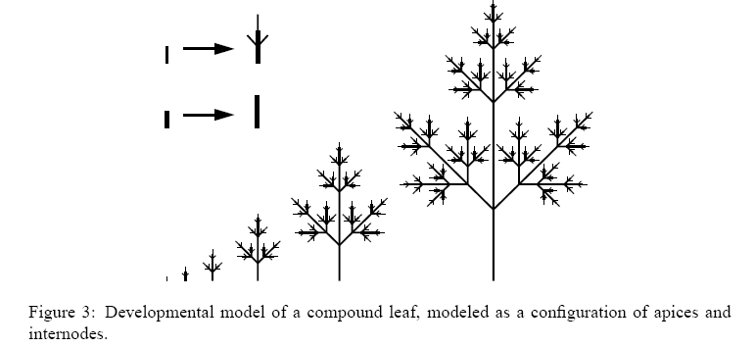
Example

Slide 9
Koch Construction
Koch construction
Initiator
Generator
Oriented broken line of N equal sides of length r
Replace each straight line with a copy of a generator

Slide 10
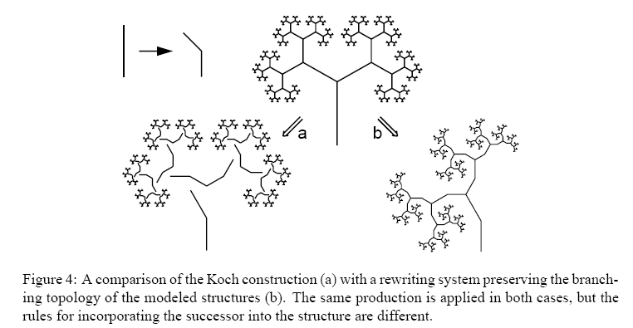
Example

Slide 11
Parametric L-Systems
Extend L-system by assigning numerical attributes
A(t):t > 5 -> B(t + 1)CD(t^0.5, t – 2)
Called deterministic iff for each module A, production set includes exactly one production

Slide 12
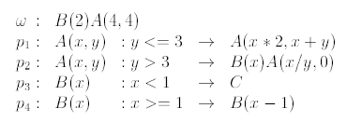
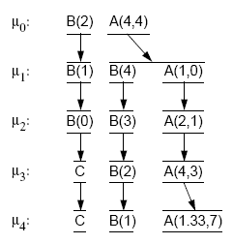
Parametric L-Systems
Example

Slide 13
Stochastic L-systems
If x <= 3, p1 = 2 / (2 + 3), p2 = 3 / (2 + 3)

Slide 14
Parametric L-Systems
0L-system
Context free
1L-system
Context on one side (left or right context)
2L-system
Both left and right context

Slide 15
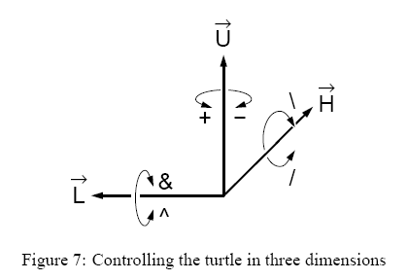
Turtle interpretation of L-Systems
Move a cursor over plane or in 3D
Specify its movements by commands

Slide 16
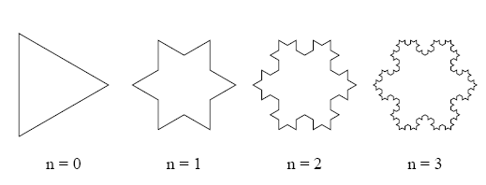
Examples

Slide 17
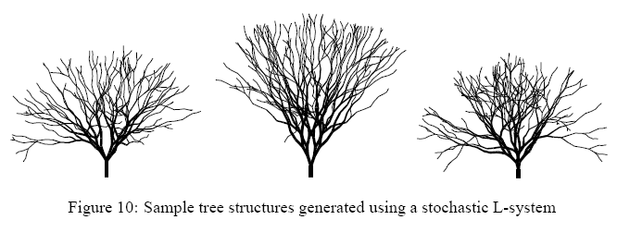
Examples
P1 describes creating of two new branches
P2 describes creating of a branch and a bud

Slide 18
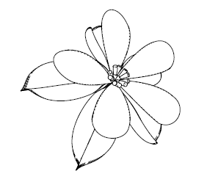
Examples

