Slide 1
Real-Time Rendering
Shadow Volumes
CSE 781
Prof. Roger Crawfis

Slide 2
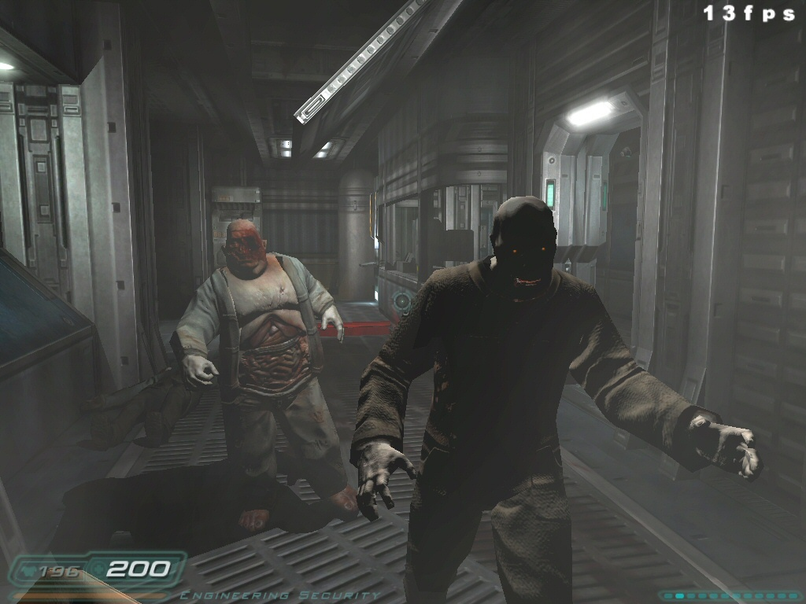
Real-Time Shadows Require:
Dynamic lights
Dynamic occluders
Dynamic receivers
Zombies optional

Slide 3
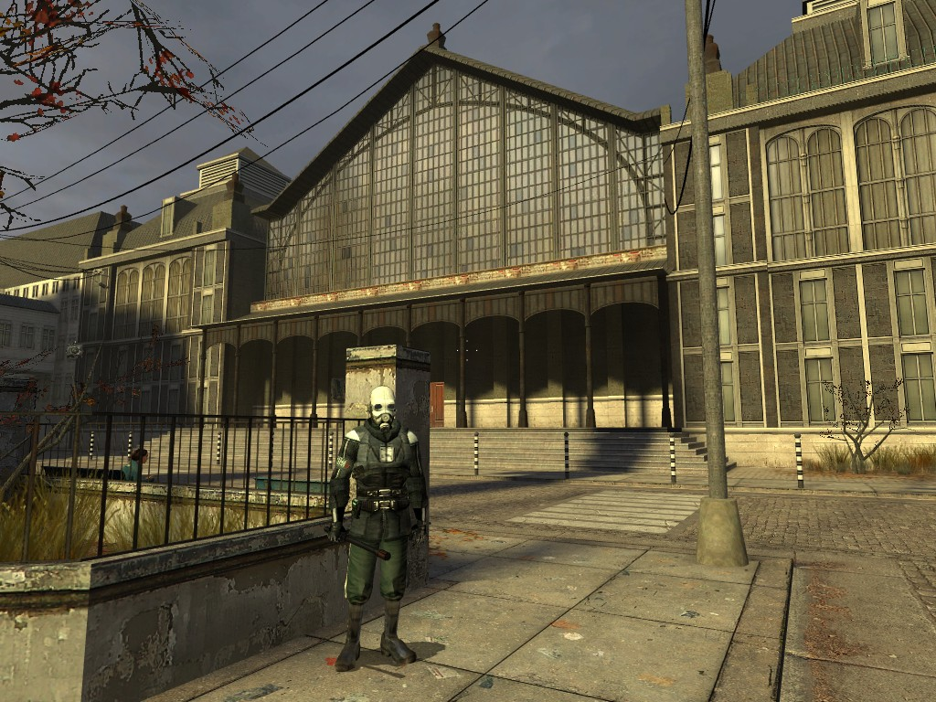
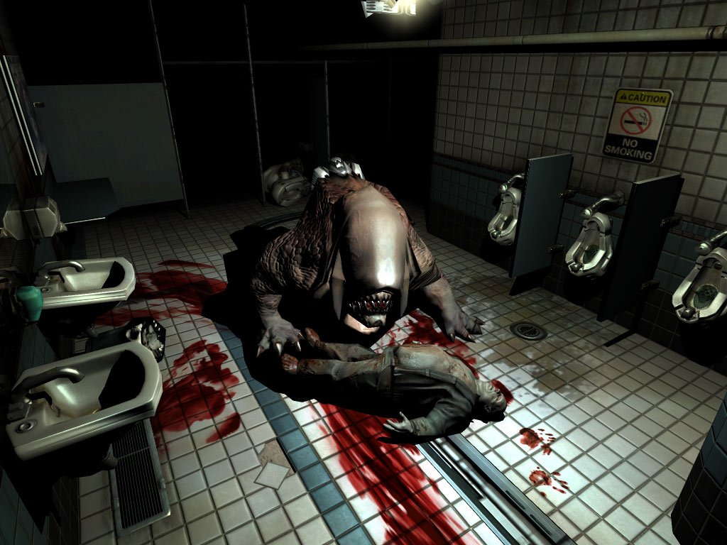
We Have Two Options
Half-Life 2
DOOM 3
Shadow Maps
  Image-based
Shadow Volumes
  Geometry-based

Slide 4
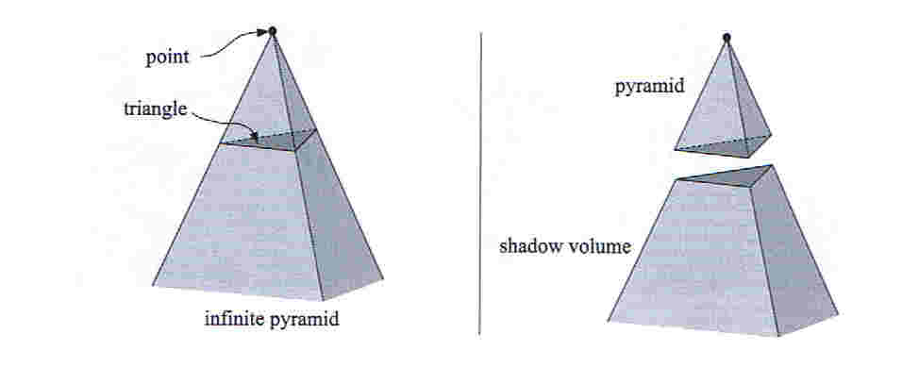
What is shadow volume?
A volume of space formed by an occluder
Bounded by the edges of the occluder
Any object inside the shadow volume is in shadow
light source

Slide 5
Definitions (2D slice)
Surface outside
shadow volume
(illuminated)
Shadowing
occluder
Light
source
Shadow
volume
(infinite extent)
Eye position
(shadows are independent of the eye position)
Partially shadowed receiver
Surface inside
shadow volume
(shadowed)

Slide 6
Shadow Volumes
Nice theory, but how do we use it?
Key concerns:
  How do I determine whether a point (fragment) is in shadow?
  How do we create the shadow volumes?
  How do we get it real-time?

Slide 7
Point in Polygon Test
A point p lies in polygon P if a ray (any ray) from p intersects the boundary of P an odd number of times.
Ignoring end
cases.
o
p
Ray from p

Slide 8
Shadow Volume Example
Assume the eye and light are at infinity and are not in the shadow volume.
Ray hits 2 shadow volume polygons, hence the ray intersection with the triangle is not in shadow.

Slide 9
Shadow Volume Example
Ray hits 1 shadow volume polygon

Slide 10
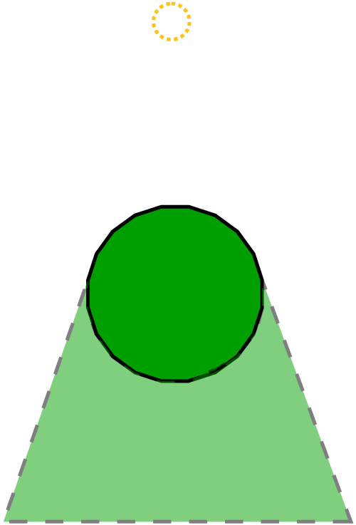
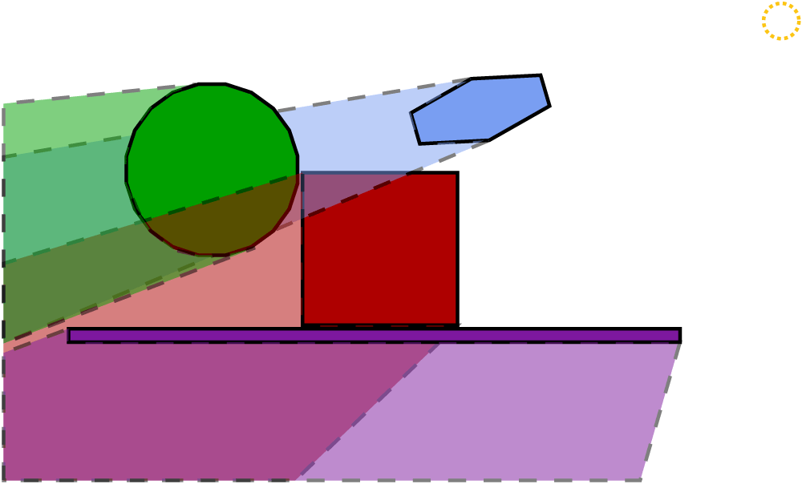
Shadow Volumes
Per-object, construct shadow volume from light
Multiple shadow volumes may interact
Does the odd / even rule still hold?

Slide 11
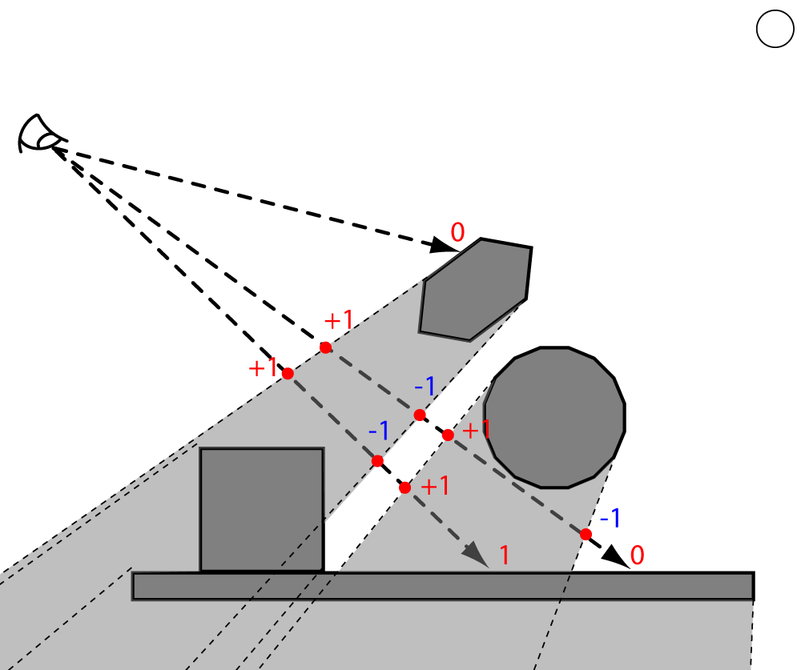
Shadow Intersection Count
Create a signed count of ray crossings
  Non-zero: shadowed
  Zero: lit
Add one when
entering a shadow
volume.
Subtract one on exit.
Frank Crow
(Siggraph ’78)

Slide 12
Shadow Intersection Count
Light
source
Shadowing object
zero
+1
zero
+2
In shadow
+2
Eye
position
+1
+3

Slide 13
Creating a Shadow Volume
For each edge in each occluder polygon
  Create a quad with the edge points and two points at infinity along the rays from the light through the edge point.
Repeat for all
lights.
light source
quadrilateral

Slide 14
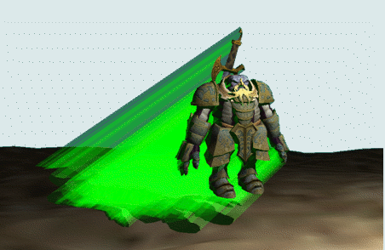
Creating a Shadow Volume
If we draw all of these extra quads.

Slide 15
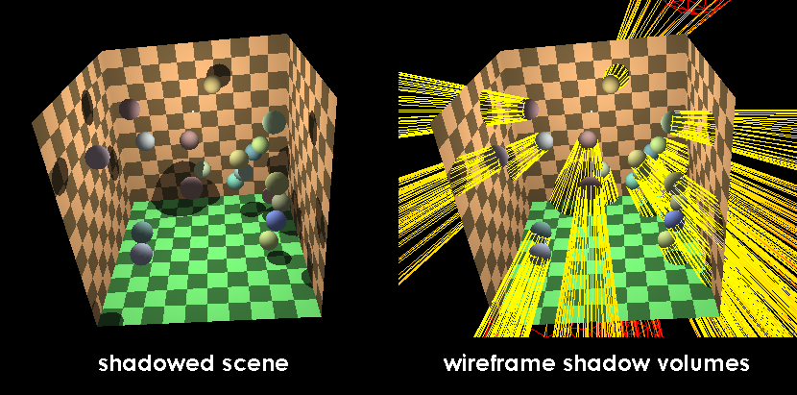
Creating a Shadow Volume
http://upload.wikimedia.org/wikipedia/commons/a/af/Shadow_volume_illustration.png

Slide 16
Shadow Intersection Count
Key idea: Draw the shadow volume polygons to the stencil buffer.
  Draw all front facing shadow volume polygons and increment the stencil buffer.
  Draw all back facing shadow volume polygons and decrement the stencil buffer.
  Draw all scene polygons without lighting to set the depth buffer.

Slide 17
Stencil Buffer
Same resolution as color and depth buffers
Usually (and at least) 8-bits, but can vary
Used to hold values related to elements being written into frame buffer
Control whether a fragment is discarded or not
  Stencil function (Stencil test) - used to decide whether to discard a fragment
  Stencil operation – decide how the stencil buffer is updated as the result of the test

Slide 18
Stencil Buffer
glutInitDisplayMode(GLUT_STENCIL);
glEnable(GL_STENCIL_TEST);
glClearStencil(0);
glClear(GL_STENCIL_BUFFER_BIT);

Slide 19
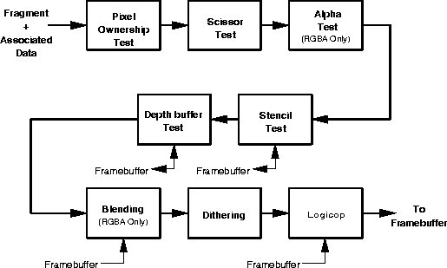
Stencil Testing
Recall OpenGL’s fragment operations

Slide 20
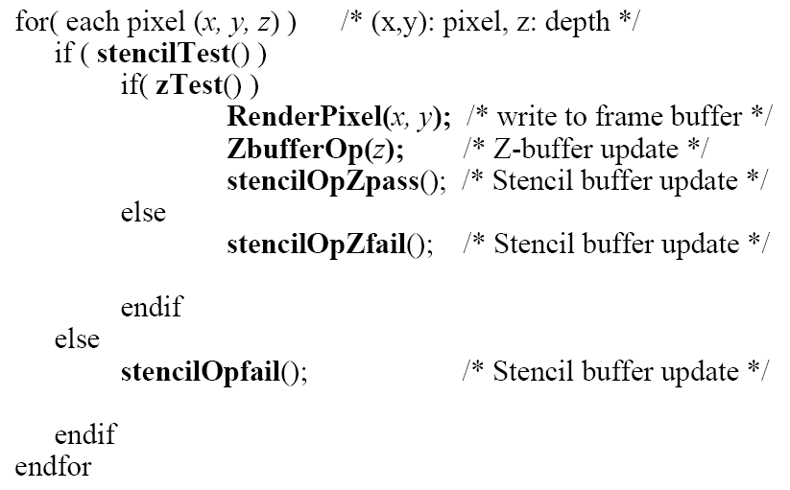
Stencil & Z Buffer

Slide 21
Stencil Testing
void glStencilFunc( GLenum func, GLint ref, GLuint mask );
  sets the function and reference value for stencil testing.
  func: test function, see next page.
  ref: reference value
  mask:A mask that is ANDed with both the reference value and the stored stencil value when the test is done.

Slide 22
Stencil Testing
param Meaning
GL_NEVER Always fails.
GL_LESS Passes if ( ref & mask) < ( stencil & mask).
GL_LEQUAL Passes if ( ref & mask) ≤ ( stencil & mask).
GL_GEQUAL Passes if ( ref & mask) ≥ ( stencil & mask).
GL_NOTEQUAL Passes if ( ref & mask) ( stencil & mask).
GL_ALWAYS Always passes.

Slide 23
Modify The Stencil Buffer
void glStencilOp( GLenum fail, GLenum zfail, GLenum zpass );
  sets the stencil test actions.
  fail: The action to take when the stencil test fails
  zfail: Stencil action when the stencil test passes, but the depth test fails.
  zpass: both the stencil test and the depth test pass

Slide 24
Modify The Stencil Buffer
param Meaning
GL_KEEP keep the current value
GL_ZERO set the value in stencil buffer to zero
GL_REPLACE set the value in stencil buffer to ref in glStencilFunc()
GL_INCR increase the current value in stencil buffer
GL_DECR decrease the current value in stencil buffer
GL_INVERT bitwise inverse the current value in stencil buffer

Slide 25
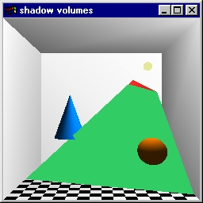
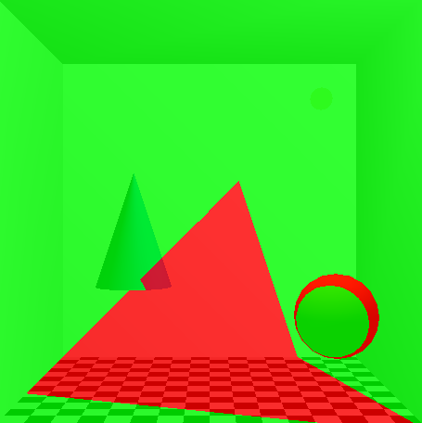
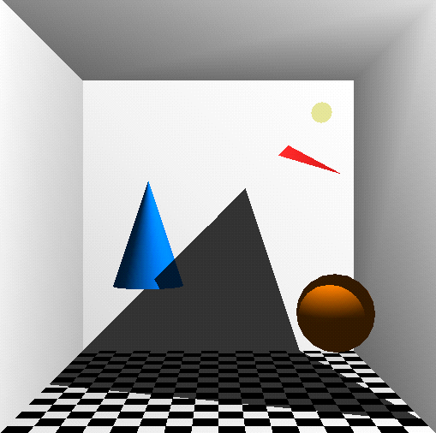
Stencil-based Shadow Volumes
Drawing the quads
Stencil buffer contents
Shadowed scene
red = stencil value of 1
green = stencil value of 0
GLUT shadowvol example credit: Tom McReynolds

Slide 26
Stencil-based Shadow Volumes
1. Render all the objects using only ambient lighting. Make sure depth buffer is written.
2. Starting with a light source, extrude all the occluders with respect to the light source.
4. Clear the stencil buffer, and then render the shadow volumes using the depth-pass technique (next slide). The depth-pass technique will set a value 1 in the stencil buffer position for every fragment that is inside the shadow volume.
5. Using the updated stencil buffer, render all objects using diffuse and specular lighting for this light for all fragments that correspond to zero stencil values.
6. Accumulate the colors from step 5.
7. Repeat step 2 to 6 for all the lights in the scene.

Slide 27
Stencil-based Shadow Volumes
Depth-pass (or zPass) technique:
  Render front face of shadow volume. If depth test passes, increment stencil value, else do nothing. Disable draw to color and depth buffers.
  Render back face of shadow volume. If depth test passes, decrement stencil value, else do nothing. Disable draw to color and depth buffers.
The depth pass technique works for multiple intersecting shadow volumes.

Slide 28
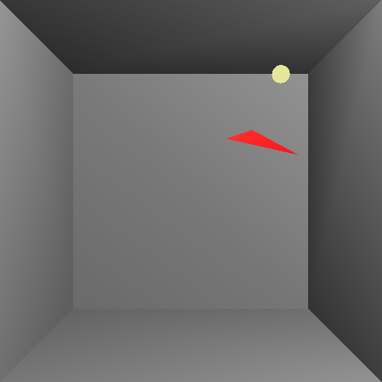
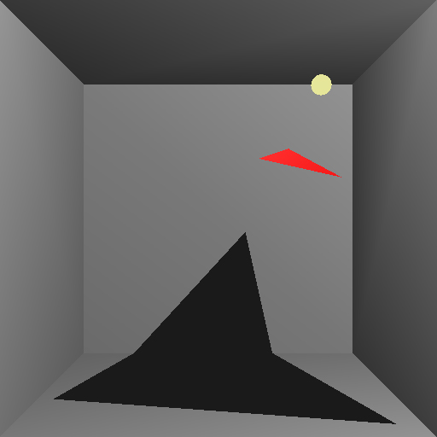
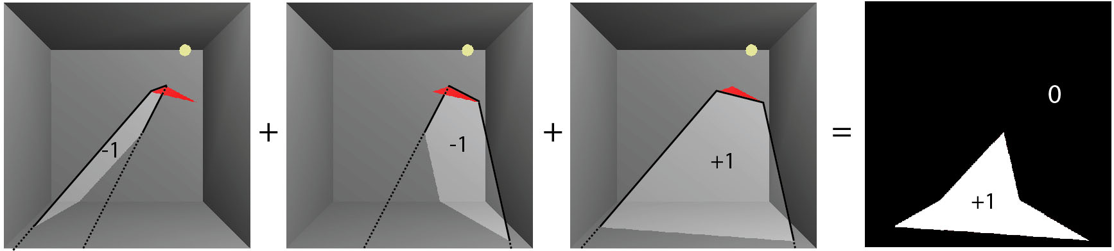
Z-pass by example
What we have...
What we wnat...

Slide 29
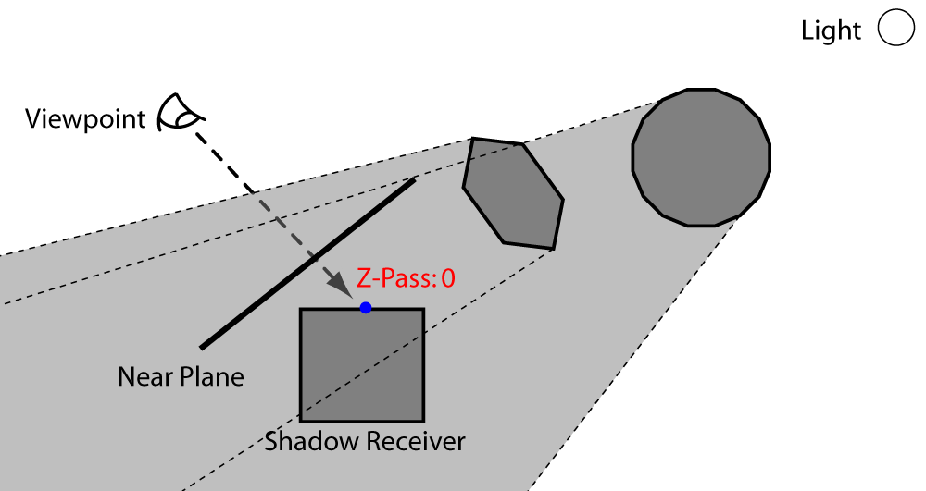
Z-Pass Problems
Geometry containing vital information was clipped by the near plane

Slide 30
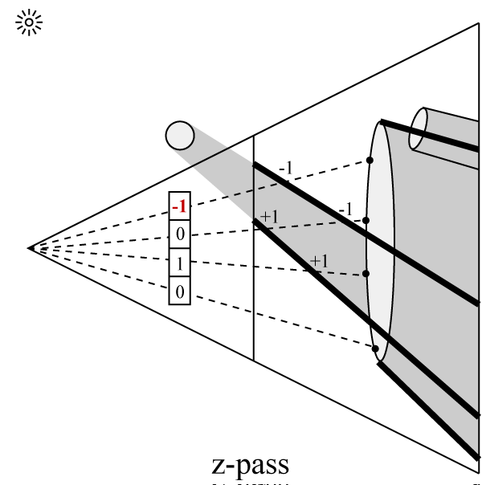
Z-Pass Problems

Slide 31
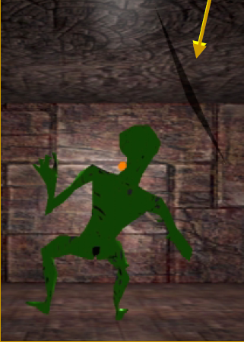
Z-Pass Problems
Previous work tries to cap the near plane
Compute cap on CPU somehow
  Can cause cracks in shadow due to numerical issues
From http://developer.nvidia.com/object/cedec_stencil.html

Slide 32
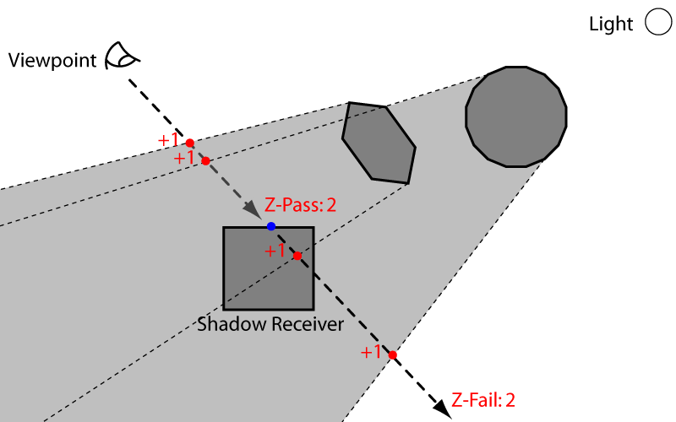
Z-Fail Shadow Volumes
Reversing depth test gives equivalent result in the stencil
  Shadow volume fragments that fail the depth test influence the stencil
Near plane will never clip relevant geometry since geometry behind the viewer could never fail the depth test

Slide 33
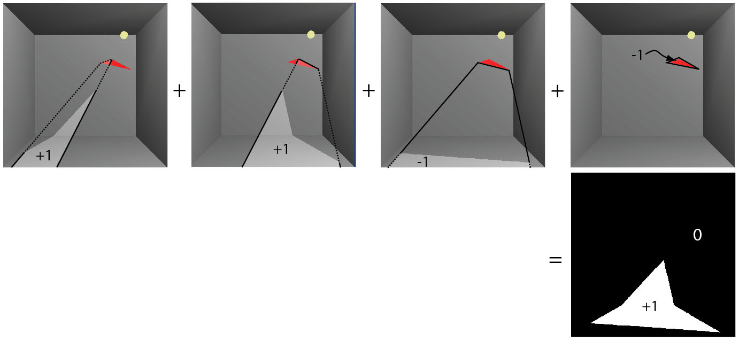
Z-fail by example

Slide 34
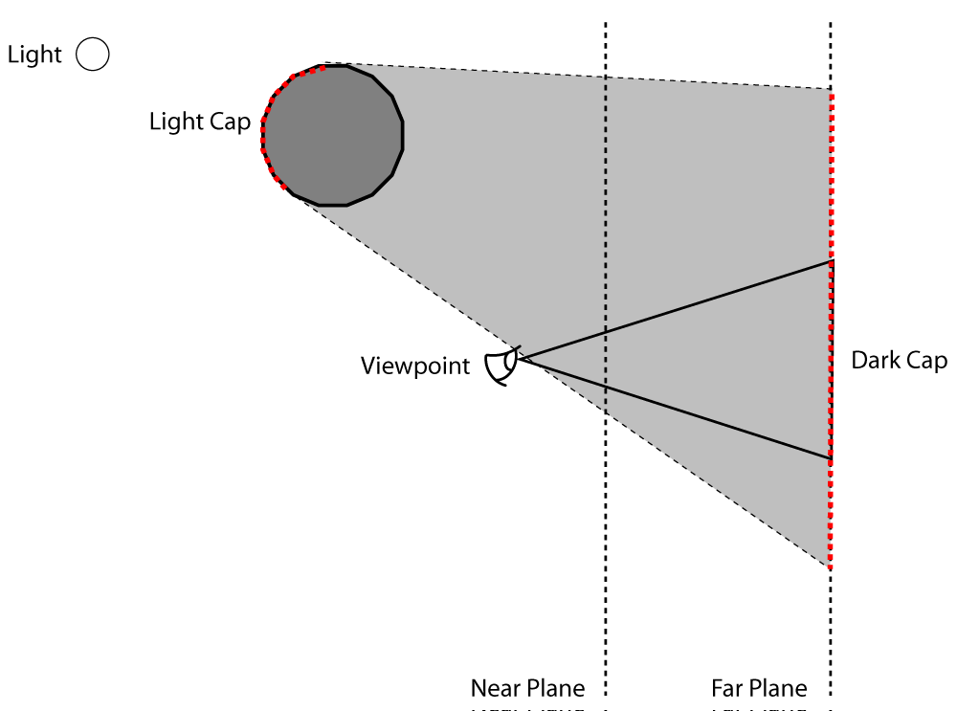
Z-Fail Caps
Far plane can still clip sides
Still need caps
Fortunately, Z-Fail caps are
robust and easy

Slide 35
Shadow Volume Efficiency
Create a shadow volume from the silhouette of an object instead of each polygon.
Required a CPU-based computation before geometry shaders.
Again, you can cheat with shadows and have the shadow volume geometry be a simplified proxy occluder.
Need to recompute silhouettes for dynamic scenes.

Slide 36
Merging shadow volumes
Edge shared by two occluders creates both a front- and a back-facing quad.
This interior edge makes
two quads, which cancel out
Instead, use only potential silhouette edges as seen from the light:

Slide 37
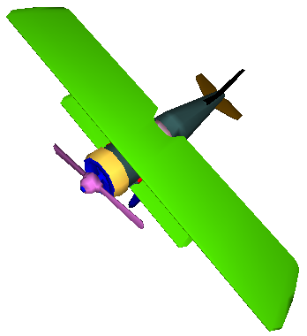
Shadow Volume Efficiency
Object (as seen from light)
Silhouette
(used to create shadow volume)

Slide 38
Shadow Volume Advantages
Omni-directional approach
  Not just spotlight frustums as with shadow maps
Automatic self-shadowing
  Everything can shadow everything, including self
  Without shadow acne artifacts as with shadow maps
Window-space shadow determination
  Shadows accurate to a pixel (Object method)
Required stencil buffer broadly supported

Slide 39
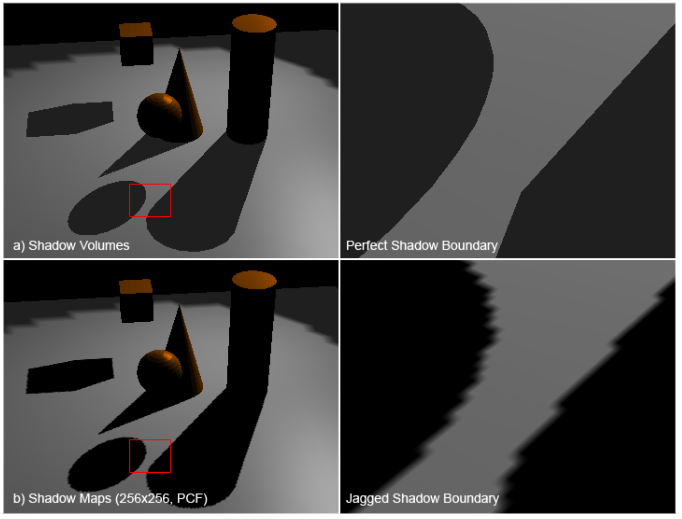
Shadow Maps vs. Shadow Volumes
Sindholt, Joen. “A comparison of shadow algorithms” Examination thesis for MSE, TU Denmark. May 2005

Slide 40
Shadow Volume Disadvantages
Ideal light sources only
  Limited to local point and directional lights
  No area light sources for soft shadows
Requires polygonal models with connectivity
  Models must be closed (2-manifold)
  Models must be free of non-planar polygons
Silhouette computations are required
  Can burden CPU
  Particularly for dynamic scenes
Inherently multi-pass algorithm
Consumes lots of GPU fill rate

Slide 41
zFail versus zPass Summary
When stencil increment/decrements occur
  Zpass: on depth test pass
  Zfail: on depth test fail
Increment on
  Zpass: front faces
  Zfail: back faces
Decrement on
  Zpass: front faces
  Zfail: back faces
Which clip plane creates a problem
  Zpass: near clip plane
  Zfail: far clip plane

Slide 42
Wrapped Stencil Counts
Traditionally, stencil counts could not go negative, so we had to:
  First, render increment pass
  Second, render decrement pass
Wrapped Stencil operations
  Decrement on 0 yields 255.
  Increment on 255 yields 0.
  New Glenum’s GL_INCR_WRAP and GL_DECR_WRAP

Slide 43
Two-sided Stencil Testing
Implementation wise, we would set the cull-face states and render the shadow volume geometry twice:
  Rasterizing front-facing geometry
  Rasterizing back-facing geometry
  Order dependent on zPass or zFail.
Would be great if we could do this in one pass, incrementing if the geometry faces one direction and decrementing otherwise.
  Two sets of stencil state: front- and back-facing
  Rasterizes just as many fragments, but more efficient for CPU & GPU
  See glStencilFuncSeparate.

Slide 44
Two-sided Stencil Testing
glStencilOpSeparate(GLenum face, GLenum sfail,
GLenum dpfail, GLenum dppass)
Specifies what action to take as a result of stencil test and depth test: GL_KEEP, GL_ZERO, GL_INCR_WRAP, GL_DECR_WRAP, etc.
  sfail - fails stencil test
  dpfail - passes stencil test, fails depth test
  dppass- passes both stencil and depth test

