Slide 1
Real-Time Rendering
Intro to Shadows
CSE 5542
Prof. Roger Crawfis

Slide 2
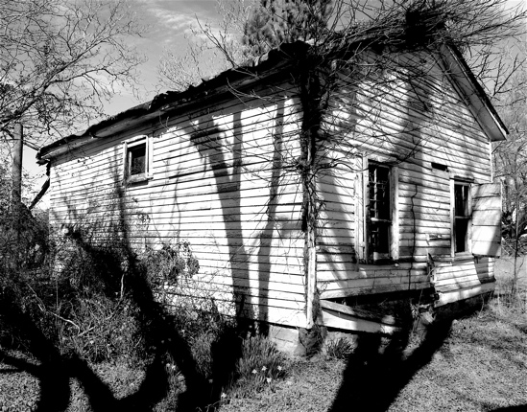
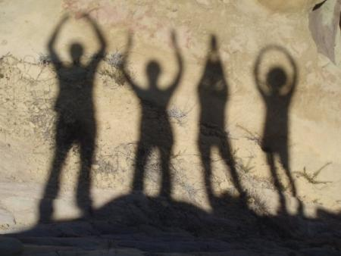
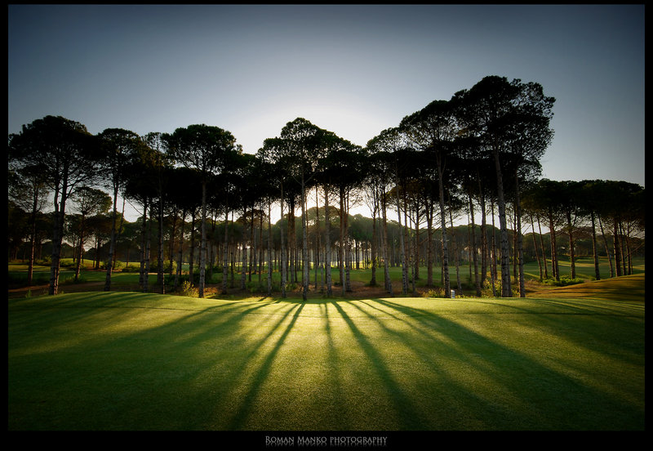
Shadows can be Wonderful!

Slide 3
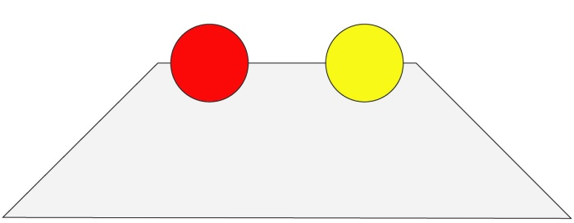
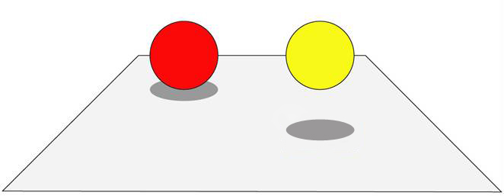
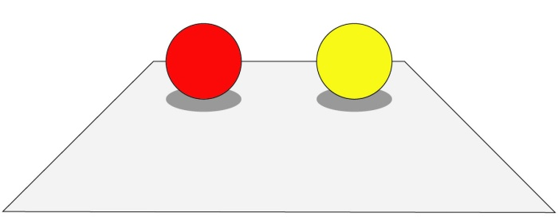
Importance of Shadows
Trapezoid?

Slide 4
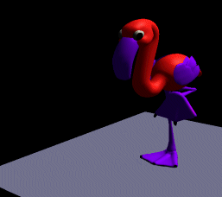
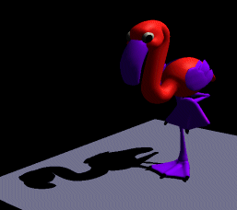
Importance of Shadows
Cue to object-object relationship.
Provides additional depth cue.

Slide 5
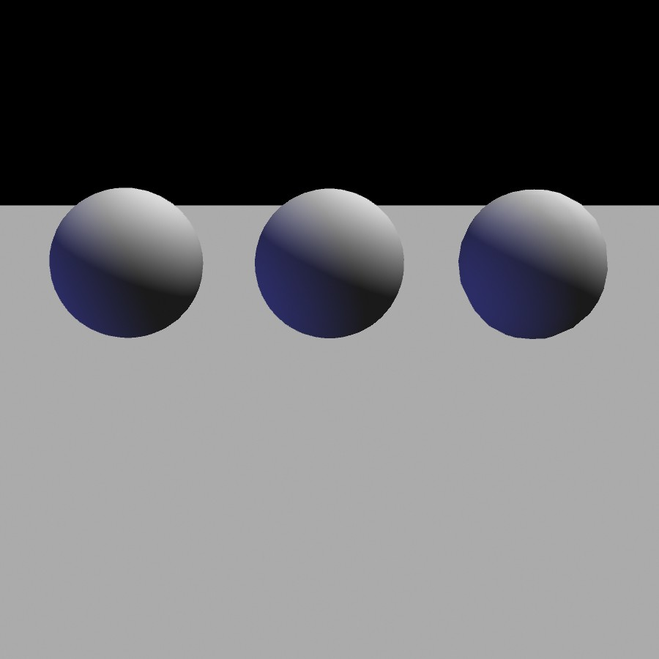
Importance of Shadows
Notes:
5

Slide 6
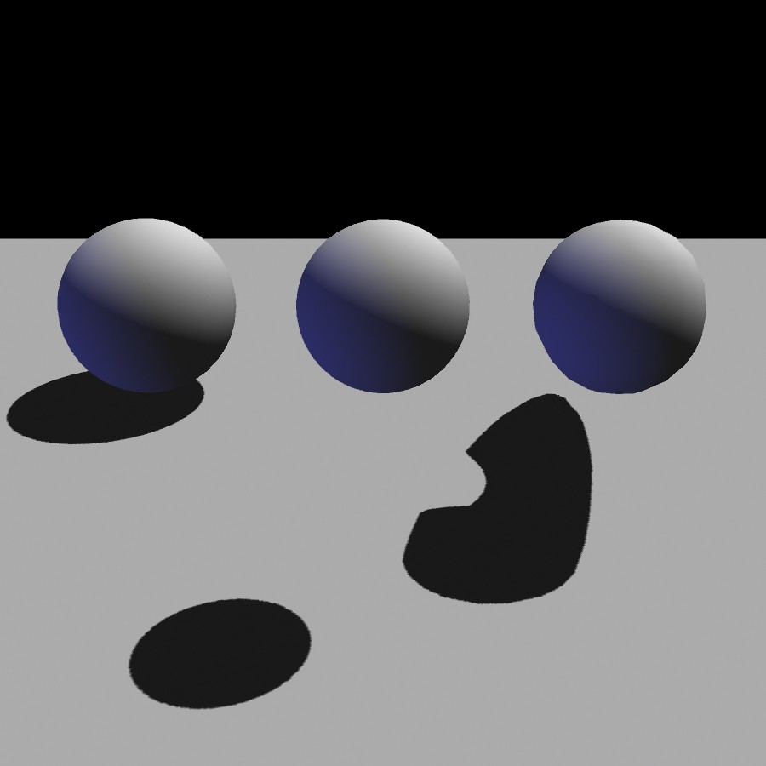
Importance of Shadows
Notes:
6

Slide 7
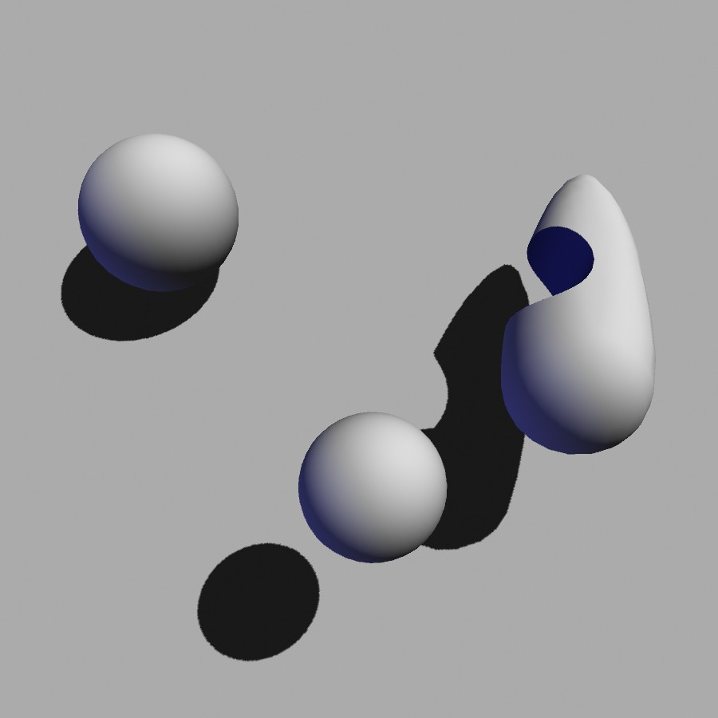
Importance of Shadows
Notes:
7

Slide 8
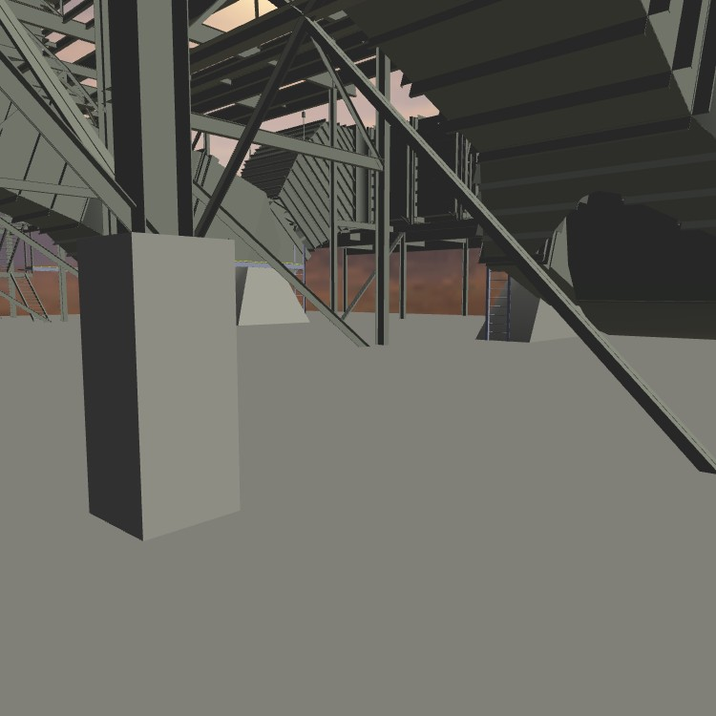
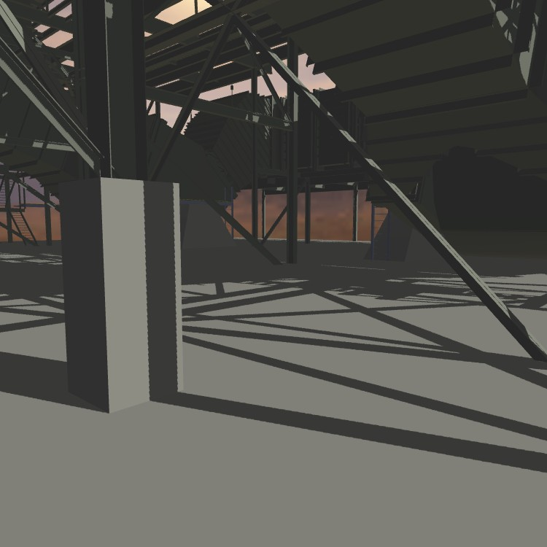
Importance of Shadows
Without shadows
With shadows
Notes:
8

Slide 9
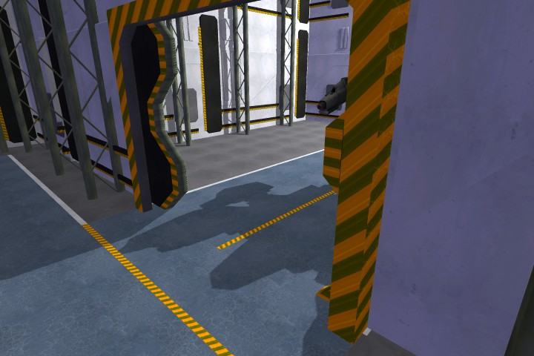
Importance of Shadows
Notes:
9

Slide 10
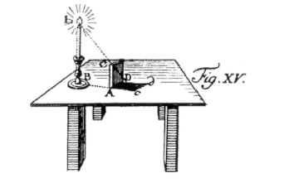
Definition
Shadow: Darkness caused when part or all of the illumination from a light source is blocked by an occluder.
light
occluder
shadow
Notes:
10

Slide 11
Terminology
(area) light source
occluder
penumbra
umbra
receiver
shadow
umbra – fully shadowed region
penumbra – partially shadowed region

Slide 12
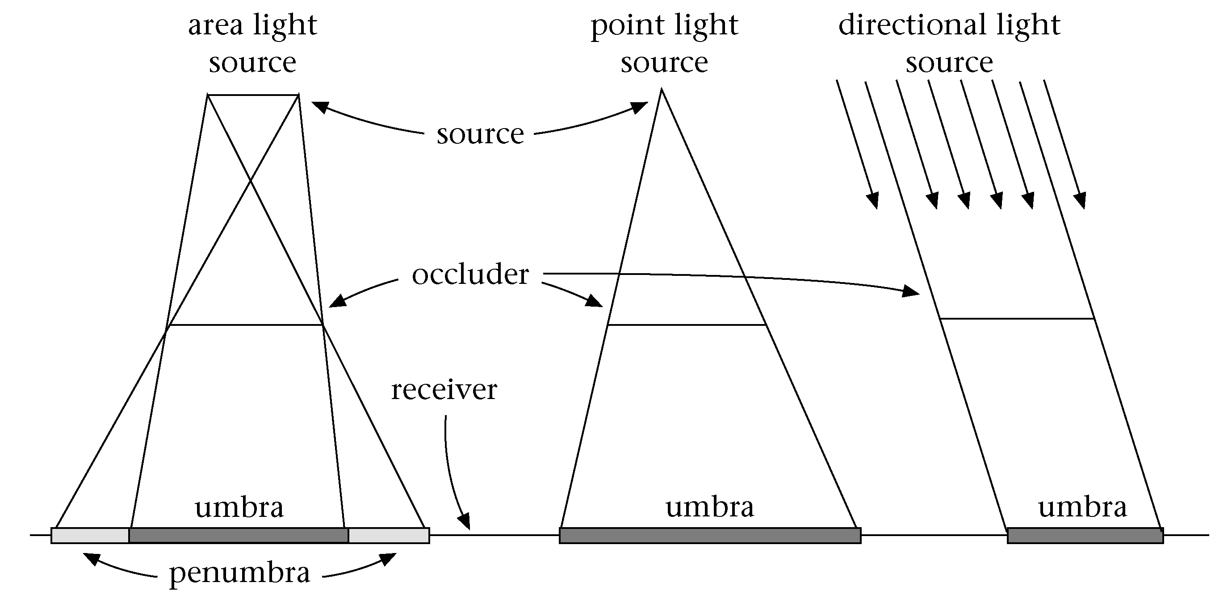
Terminology

Slide 13
Definition: Shadow Volume
Volume formed by extruding the occluder from the light source.
Open and infinite
Space inside the volume is in shadow.
Space outside the volume is not.

Slide 14
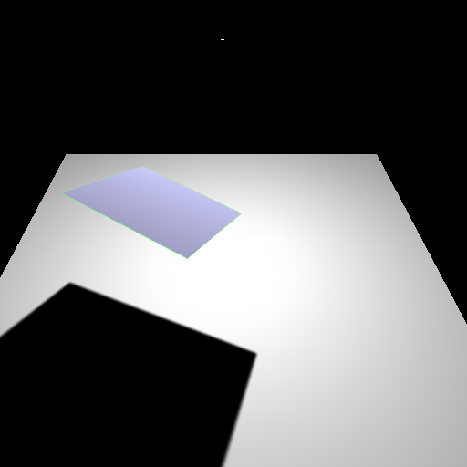
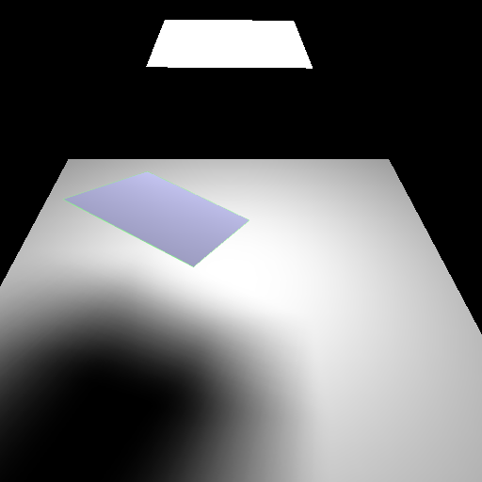
Hard and soft shadows
point
light
extended
light
penumbra
umbra
umbra
Hard shadow
Soft shadow
Notes:
14

Slide 15
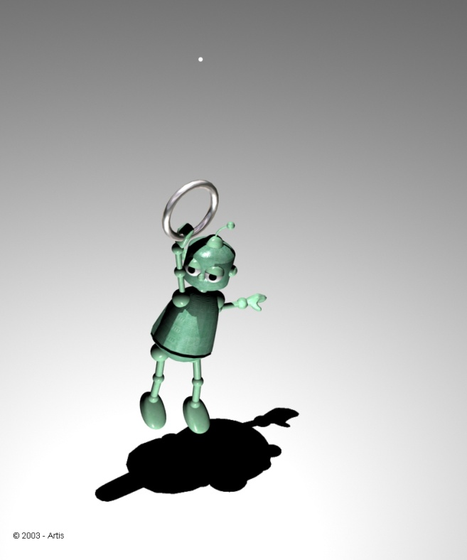
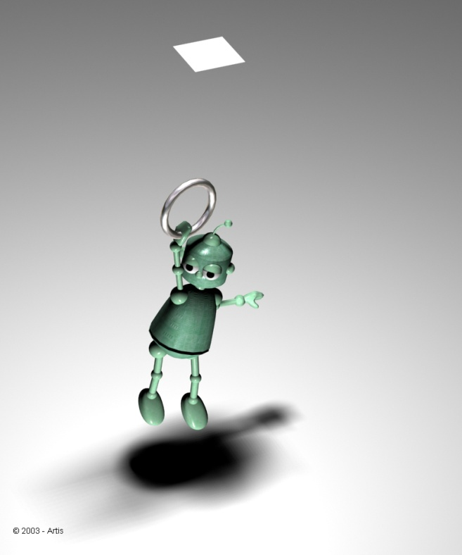
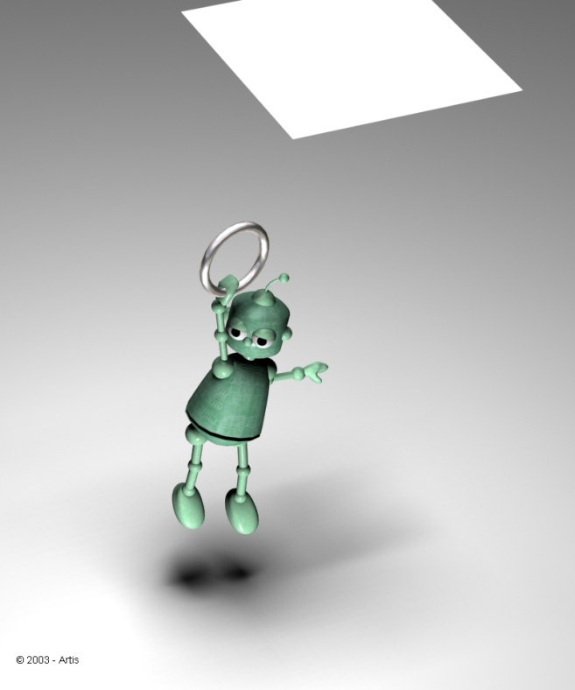
Soft Shadows
Shadow is a function of the area of the light source and the distance.

Slide 16
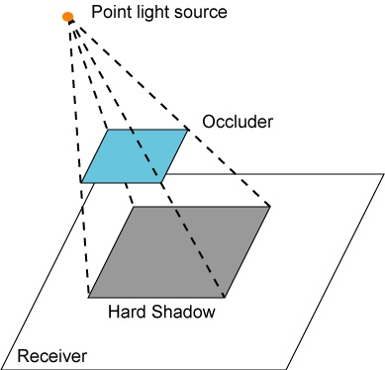

Hard shadow creation
For every pixel, light source is either visible or occluded

Slide 17
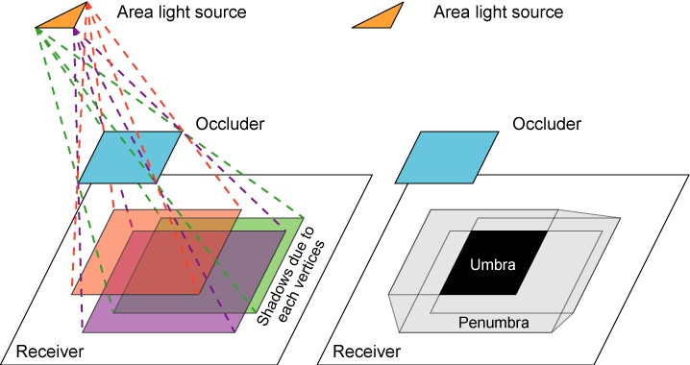
Soft shadow creation

Slide 18
Issues Affecting Shadows
Scene Complexity
  Number of light sources
  Types of light sources
  Number of occluders
  Number of receivers
  Position, size and strength of lights
Static vs. dynamic
  Occluders, Receivers, Lights, Light properties (on/off, intensity, …)
Self-shadowing
Opaque vs. transparent objects
Precision or realism of shadows

Slide 19
Current Shadow Methods
There exist a very large number of methods
We are interested in methods suitable for interactive walkthroughs, speed is crucial
We will classify them on complexity:
no shadows
Sharp shadows
Soft shadows
Special effects

Slide 20
Sharp Shadows
Point or directional light sources
Fake
Hardware Assisted
Pre-computed
Ray tracing
Fast but often
inadequate
Billboard
Projected object
Use of specialized
hardware to generate
shadows
• Shadow texture
• Shadow volumes
Shadows are
pre-computed
and stored for
repeated use
• Detail polygons
Rather slow
for large scenes

Slide 21
Soft Shadows
Area light sources
Hardware Assisted
Pre-computed
Radiosity
Ray-based
Mainly treat the
light source as a
collection of points
• Accumulation
buffer
• Shadow volumes
• Shadow textures
Mainly analytical
computation on
the geometry of
the source
• Light maps
• Discontinuity
Meshing
This is also
pre-computed
• Hemi-cube
• Ray casting
• Distributed
ray tracing
• Cone Tracing

Slide 22
Approaches
Ad-hoc / Custom
  Artist directed shadows
  Very simple and constrained conditions.
Analytical
  Find all boundaries within the umbra / penumbra. Precise.
Sampling
  Probabilistic sampling of whether a particular fragment is within the umbra / penumbra. With enough samples can be made precise.

Slide 23
Shadows and Illumination
Given a point is in shadow, how do we change the illumination?
Light Source
Viewer
Occluder
Point is in shadow
Point is lit

Slide 24
Shadows and Illumination
Illumination model with included visibility term:
Visibility term determines if a light can “see” the point
If point is in shadow, only ambient term applies
For all lights
Visibility Term: 0 or 1 for point/directional lights

Slide 25
Shadows and OpenGL
In OpenGL we send the geometry for a model through the pipeline.
The Visibility function, V, is not a constant in our illumination model.
  Per vertex information?
  Per fragment using a texture map?
  Some per-pixel masking function?
Recall that we need a V for each light.

Slide 26
Shadows and Illumination
Note, we can re-write our illumination equation:
Negative light.
c_{i}

Slide 27
Masking in OpenGL
OpenGL provides several ways of masking pixels
  Stencil buffer with stencil test
  Alpha test with fragment’s alpha values
  Blending with fragment’s and framebuffer’s alpha values.
  Texture sampling and shaders.

Slide 28
Negative Light
Algorithm (single light)
  Render receivers with full illumination
  For each occluder
    Project occluder from the light to the receivers
    Darken (set to black or ambient) the illumination.

Slide 29
Negative Light
With multiple light sources this technique does not work. If the algorithm simply sets the pixels to black (or ambient), then it will erases the contributions from all light sources.

Slide 30
Positive Light
Algorithm
  Render scene with ambient illumination only
  For each light source
    Render scene with illumination from this light only
    Scale illumination by shadow mask
    Add contribution to frame buffer

Slide 31
Real-Time Rendering
Ad-hoc Shadows
CSE 5542
Prof. Roger Crawfis

Slide 32
Ad-Hoc and Custom Shadows
Fake proxy geometry.
Projection of model to a plane.
Projection of a texture to a plane.

Slide 33
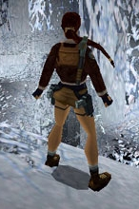
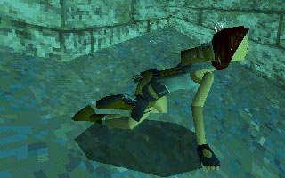
Fake Proxy Shadow
Shadows are simple hand-drawn polygons or textures.
Images from TombRaider. ©Eidos Interactive.

Slide 34
Fake Proxy Shadow
Neither static lighting or dynamic lighting – it is faked.
Do not care whether it is a static or dynamic occluder.
Typically a single object (occluder) to a single, and simple, object (receiver).
Hard and soft (fake) shadows are easily supported.
For certain cases works great!

Slide 35
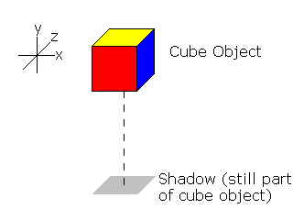
Fake Proxy Shadow
Approximation of shadow position and shape based on object’s typical use.
Typically assumes overhead lighting.
Typically assumes a single flat ground plane as a receiver.
E.g., draw the bottom of the bounding box.

Slide 36
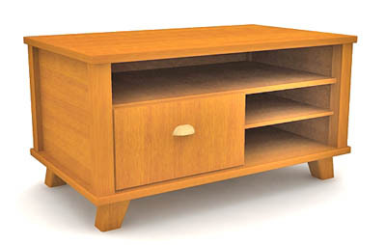
Fake Proxy Shadow
Consider this model
of a desk with a fake
shadow using an
ellipse:
Know where the shadow is going to be.
Will change some depending on the light placement in the room, but good enough!
The ellipse is part of the model.

Slide 37
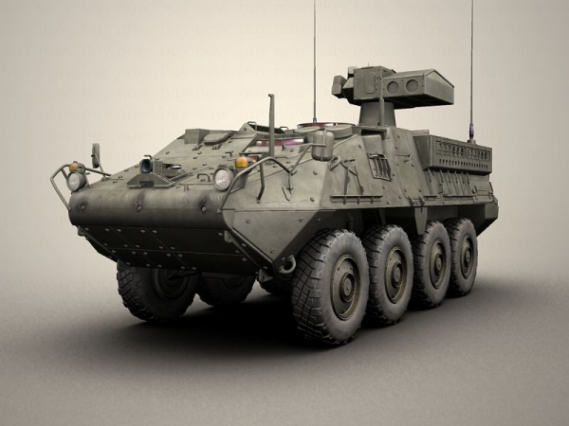
Fake Proxy Shadow

Slide 38
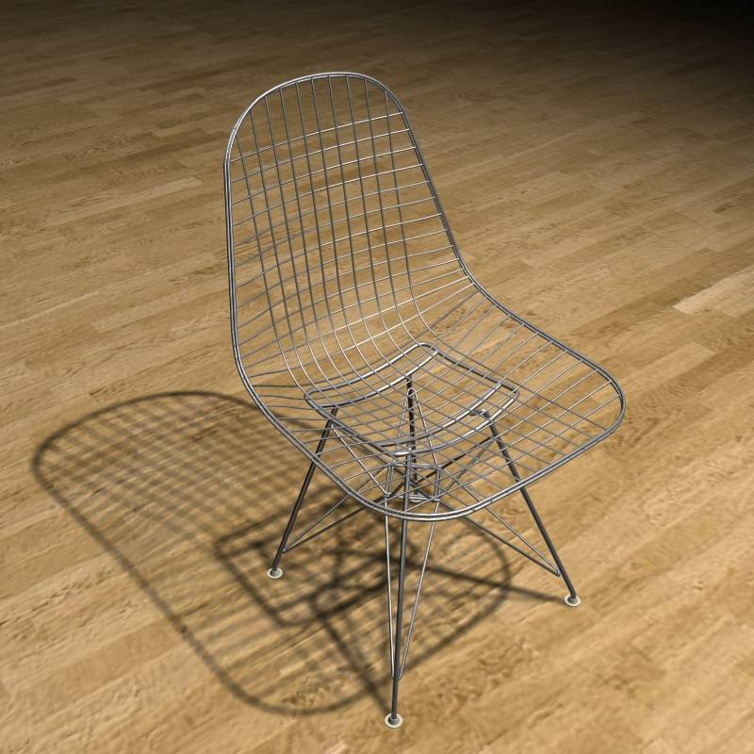
Fake Proxy Shadow
Quite complex model.
Know it will sit on a flat floor.
Will fail if we place another object behind or underneath it.

Slide 39
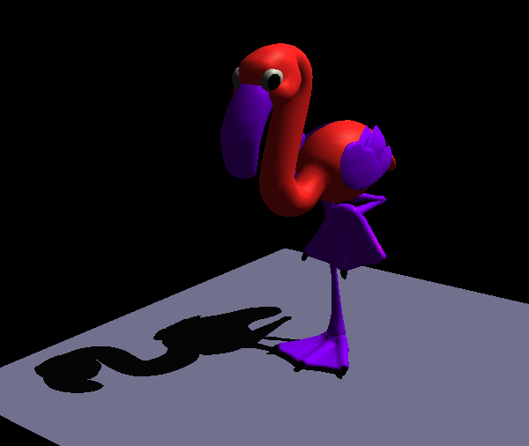
Projected Occluder
Shadows for large planar receivers
  Ground plane
  Walls
Use mathematics to flatten (splat) the object to the plane.

Slide 40
Projected Occluder
Works for:
  Static or dynamic occluders.
  Only planar receivers.
    A wall and a floor can be shadowed separately.
  Static or dynamic light sources.
  Mainly hard shadows.
  Usually a single light source.

Slide 41
Projected Occluder
Projection of a vertex, v, to a plane with normal, n, and coefficient d.
Could be done in shader, but also leads to a 4x4 matrix.

Slide 42
Projected Occluder
Example: xz plane at y=0
l=(l_{x},l_{y},l_{z})
y
v
p
y=0

Slide 43
Projected Occluder
Transformation as a 4 by 4 matrix

Slide 44
Projected Occluder
Basic algorithm
  Render scene (full lighting)
  For each receiver plane
    Compute projection matrix M
    Multiply with actual transformation (modelview)
      Note, even though this is a projection.
      Need to flatten it in world space.
    Render selected (occluder) geometry
      Darken/Black

Slide 45
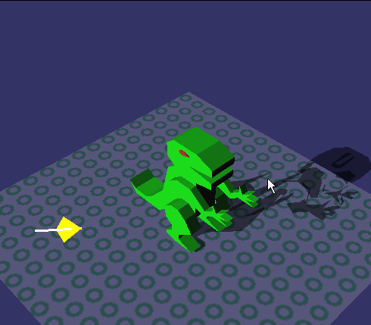
Projected Occluder Problems
Z-Fighting
  Use bias when rendering shadow polygons
  Use stencil buffer (no depth test)
Z fighting

Slide 46
Projected Occluder Problems
Bounded receiver polygon
  Use stencil buffer (restrict drawing to receiver area)
extends off ground region

Slide 47
Projected Occluder Problems
Shadow polygon overlap
  Use stencil count (only the first pixel gets through)
double blending

Slide 48
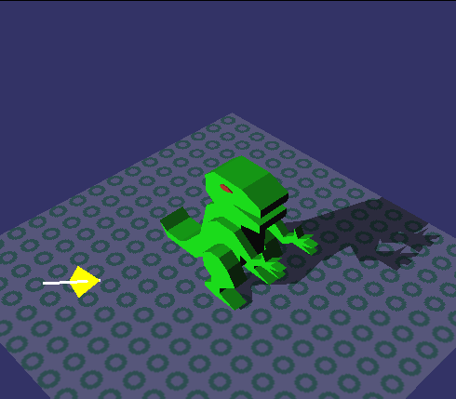
Projected Occluder - Fixed

Slide 49
Projected Occluder Algorithm
Stencil buffer algorithm (1bit stencil)
  Render scene without receiver polygon
  Clear stencil buffer
  Render receiver plane
    Set the stencil buffer for all visible pixels
  Render occluder polygons
    No depth testing
    Check if stencil buffer is set
    Use the stencil operation ‘clear’
    Blend in the polygons (darken)

Slide 50
Projected Occluder Problems
Wrong Shadows & Anti-Shadows
  Objects behind light source
  Objects behind receiver
light
light
receiver
receiver
occluder behind receiver
occluder behind light

Slide 51
Projected Occluder
Summary
  Only practical for very few, large receivers
  Easy to implement
  Use stencil buffer (z fighting, overlap, receiver)
  Requires occluder geometry to be redrawn for each light source.
    Can use a simplified model (proxy occluder geometry).

Slide 52
Projected Shadow Texture
Sky layers
Cast shadows

Slide 53
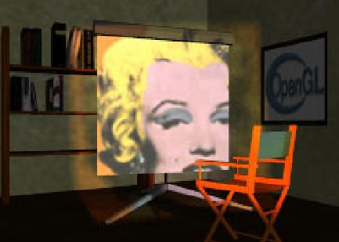
Projective Textures
Textures can be projected like a slide projector.
Before we talk about this projective textures let’s look at texture interpolation.
Source: Wolfgang Heidrich [99]

Slide 54
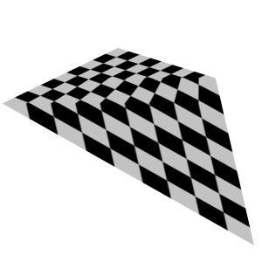
Perspective-Correct Texturing
While we think of 2D texture mapping using only the (s, t) coordinates, doing this will lead to errors.
The texture will swim.
A fix for this is needed
for regular 2D texture
mapping.

Slide 55
Perspective-Correct Texturing
Interpolation in screen space is not the same as interpolation in 3-space
  Problem is perspective
  Need to interpolate in the plane of the triangle.
Interpolation in screen space
Interpolation in plane

Slide 56
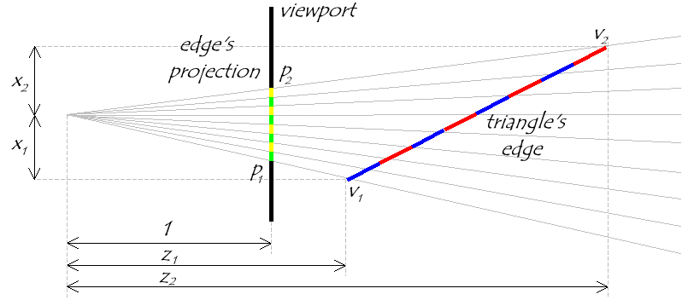
Visualizing the Problem
Notice that uniform steps on the image plane do
not correspond to uniform steps along the edge.

Slide 57
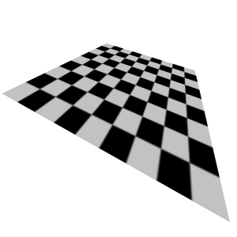
Perspective-Correct Texturing
2D perspective-correct texture mapping
  (s, t) should be interpolated linearly in eye-space.
  Compute per-vertex s/w, t/w, and 1/w
  Linearly interpolate these three
  parameters over the polygon.
  Per-fragment compute:
    s’ = (s/w) / (1/w)
    t’ = (t/w) / (1/w)
  There is an OpenGL hint to indicate perspective texture interpolation.
    This is on by default with modern hardware.

Slide 58
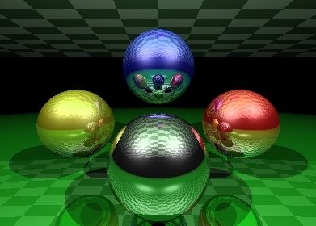

Projective Textures
Similar to projecting objects to the screen.
Now project the scene to the light source.
Use this projection from the receivers as their texture coordinates (a texture parameterization).
Receiver geometry
image plane
camera
Slide projector

Slide 59
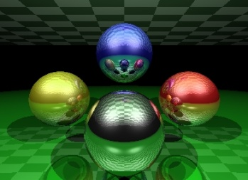
Projective Textures
Texture Coordinates – Project the objects to the “image plane” of the projector and use the projector’s NDC to calculate the texture coordinates
objects
objects
Texture
Projection
projector
projector

Slide 60
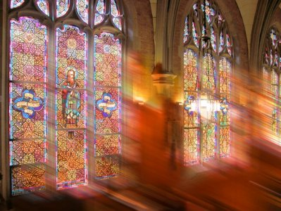
Projective Textures
The receiver’s need to know about the projected texture, the light does not automatically apply to objects and is not an OpenGL state.
OpenGL allows 4D
texture coordinates,
which can handle
the projection.

Slide 61
Projective Texturing
Tricking hardware into doing projective textures
  By interpolating q/w (perspective correction), hardware computes per-fragment
    (s/w) / (q/w) = s/q
    (t/w) / (q/w) = t/q
  Net result: Projective texturing
    OpenGL (glTexGen) or a vertex shader, specifies the texture parameterization. Typically want this in world space, but like headlights can be done in eye space.

Slide 62

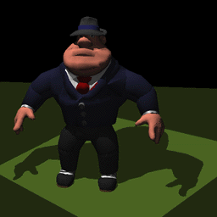
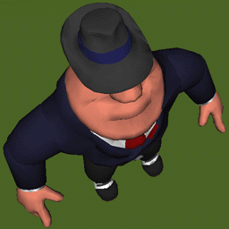
Projective Texture Shadows
Light’s point-of-view
Shadow projective texture (modulation image or light-map)
Eye’s point-of-view, projective texture applied to ground-plane

Slide 63
Projective Texture Shadows
Two-pass approach
For each light source:
  Create a light camera that encloses shadowed area (bounding box of the occluder).
  Render shadow casting objects into light’s view.
    Use a simple shader (set fragment color to black).
  Create projective texture from light’s view
Render Scene using the projective textures.
  Render fully-lit shadow receiving objects.
    Modulate light contribution with the projective-texture for that light.
  Render fully-lit shadow casting objects

Slide 64
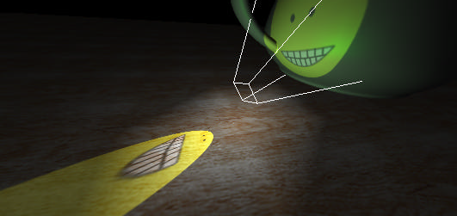
Projected Texture Problems
Similar problems to the projected occluders:
  Receiver is behind the projector.
  Occluder is behind receiver.
Projected Texture Mapping, Cass Everitt, nVidia

Slide 65
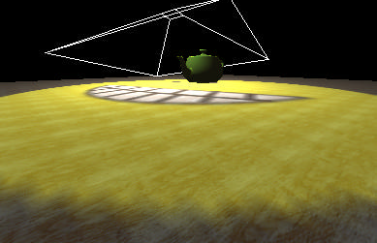
Projected Texture Problems
Precision issues:
  Occluder very close to light (wide frustum).
  Projector frustum faces the viewing frustum (sampling rate needed varies greatly).
Projected Texture Mapping, Cass Everitt, nVidia

Slide 66

Projective Texture Shadows
Texture can easily be projected onto multiple receivers.
Receivers do not need to be planar.
Static scenes only or you need to regenerate textures.
  A sky layer can however
  move its shadow image
  with the clouds.
No self shadowing.
No area light sources (you can blur the texture though for a fake effect).

Slide 67
Ad-Hoc Shadow Summary
A common theme of these methods is that the occluders and/or receivers were predetermined.
For Fake shadows, the occluder was part of the model. Any receiver rendered before it would be darkened.
For the projection-based techniques, either the occluder had a priori knowledge of the receiver (projected occluders) or the receiver had a priori knowledge of the occluder(s) (projected shadow textures).
The occluder must also be different than the receiver (no self-shadowing).

