Slide 1
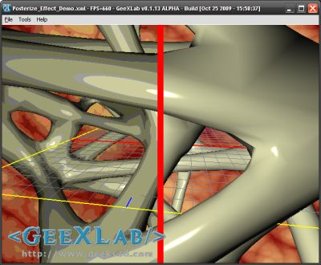
Simple post-process shaders
Vertex Shader
in vec2 inTexCoords;
in vec2 inPosition;
out vec2 texCoords;
void main(void)
{
gl_Position = vec4(inPosition.x, inPosition.y, 0.5, 1);
texCoords = inTexCoords;
}
Fragment Shader
uniform sampler2D imageTex;
uniform float gamma = 0.6;
uniform float N = 8;
in vec2 texCoords;
void main()
{
vec3 c = texture(imageTex, texCoords.xy).rgb;
c = pow(c, vec3(gamma, gamma, gamma));
c = c * N;
c = floor(c);
c = c / N;
c = pow(c, vec3(1.0/gamma));
gl_FragColor = vec4(c, 1.0);
}

Slide 2
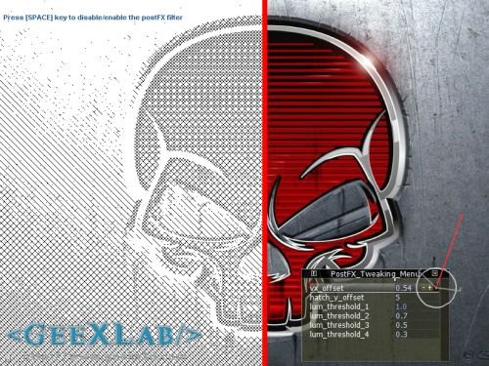
Different Fragment Shader
uniform sampler2D sceneTex; // 0
uniform float vx_offset = 0.54;
uniform float hatch_y_offset; // 5.0
uniform float lum_threshold_1; // 1.0
uniform float lum_threshold_2; // 0.7
uniform float lum_threshold_3; // 0.5
uniform float lum_threshold_4; // 0.3
void main()
{
vec2 uv = gl_TexCoord[0].xy;
vec3 tc = vec3(1.0, 0.0, 0.0);
if (uv.x < (vx_offset-0.005))
{
float lum = length(texture2D(sceneTex, uv).rgb);
tc = vec3(1.0, 1.0, 1.0);
if (lum < lum_threshold_1)
{
if (mod(gl_FragCoord.x + gl_FragCoord.y, 10.0) == 0.0)
tc = vec3(0.0, 0.0, 0.0);
}
if (lum < lum_threshold_2)
{
if (mod(gl_FragCoord.x - gl_FragCoord.y, 10.0) == 0.0)
tc = vec3(0.0, 0.0, 0.0);
}
if (lum < lum_threshold_3)
{
if (mod(gl_FragCoord.x + gl_FragCoord.y - hatch_y_offset, 10.0) == 0.0)
tc = vec3(0.0, 0.0, 0.0);
}
if (lum < lum_threshold_4)
{
if (mod(gl_FragCoord.x - gl_FragCoord.y - hatch_y_offset, 10.0) == 0.0)
tc = vec3(0.0, 0.0, 0.0);
}
}
else if (uv.x>=(vx_offset+0.005))
{
tc = texture2D(sceneTex, uv).rgb;
}
gl_FragColor = vec4(tc, 1.0);
}
http://www.geeks3d.com/20110219/shader-library-crosshatching-glsl-filter/

