Slide 1
Real-time Rendering Overview
CSE 5542
Prof. Roger Crawfis
The Ohio State University

Slide 2
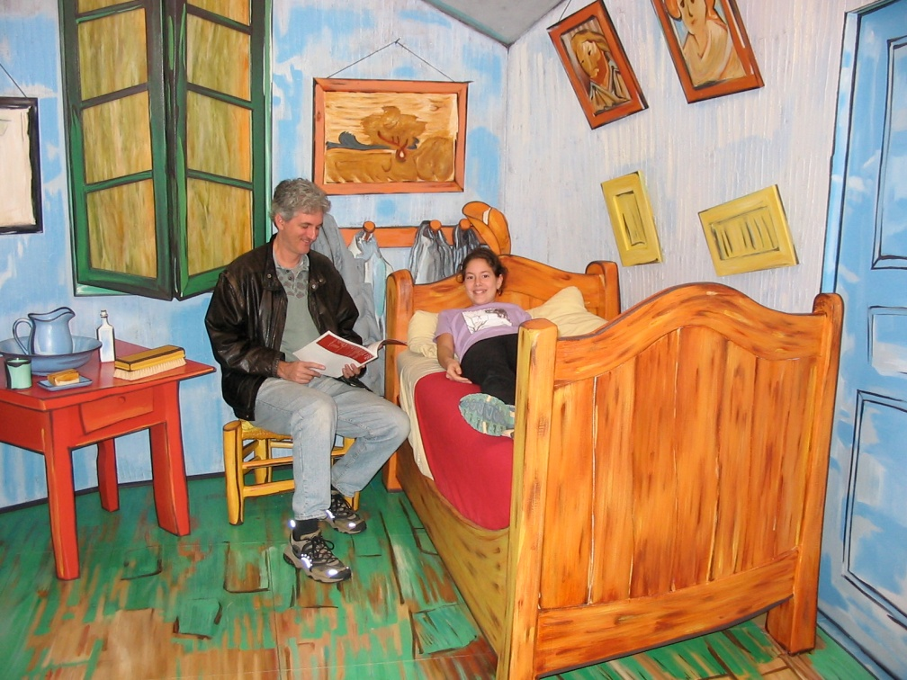
What is Computer Graphics?
Computer-generated images or sequences of images (i.e., animations, movies)
The scientific study of techniques and methods for generating such images
Not simply trying for photorealism!
Painterly effects
Caricatures
Not CG. But real 3D!!!
sculptures by J Seward Johnson, Jr.
Based on van Gogh’s The Bedroom
http://www.phy.duke.edu/~socolar/family/corcoran.html
http://www.corcoran.org/exhibitions/travel_results.asp?Exhib_ID=63

Slide 3
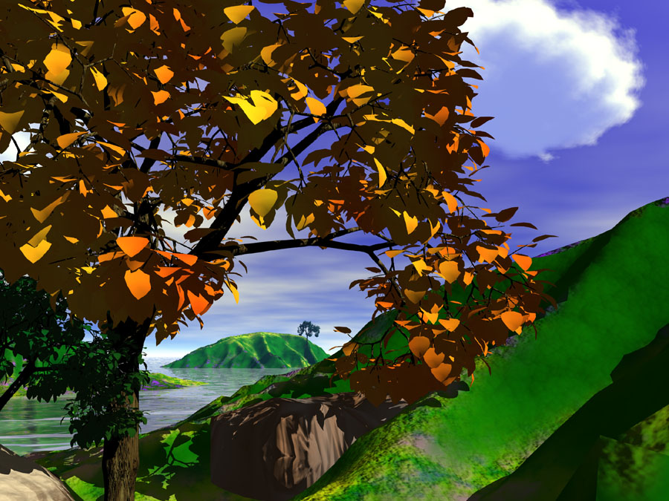
Some 3-D Computer Graphics Applications
Manufacturing design (CAD)
Movies, TV, commercials
Animations
Special effects mixed with live footage
Visual arts
Video games
Scientific visualization
Simulation of natural phenomena
Car navigation console
Roger Crawfis, Ohio State Univ.

Slide 4
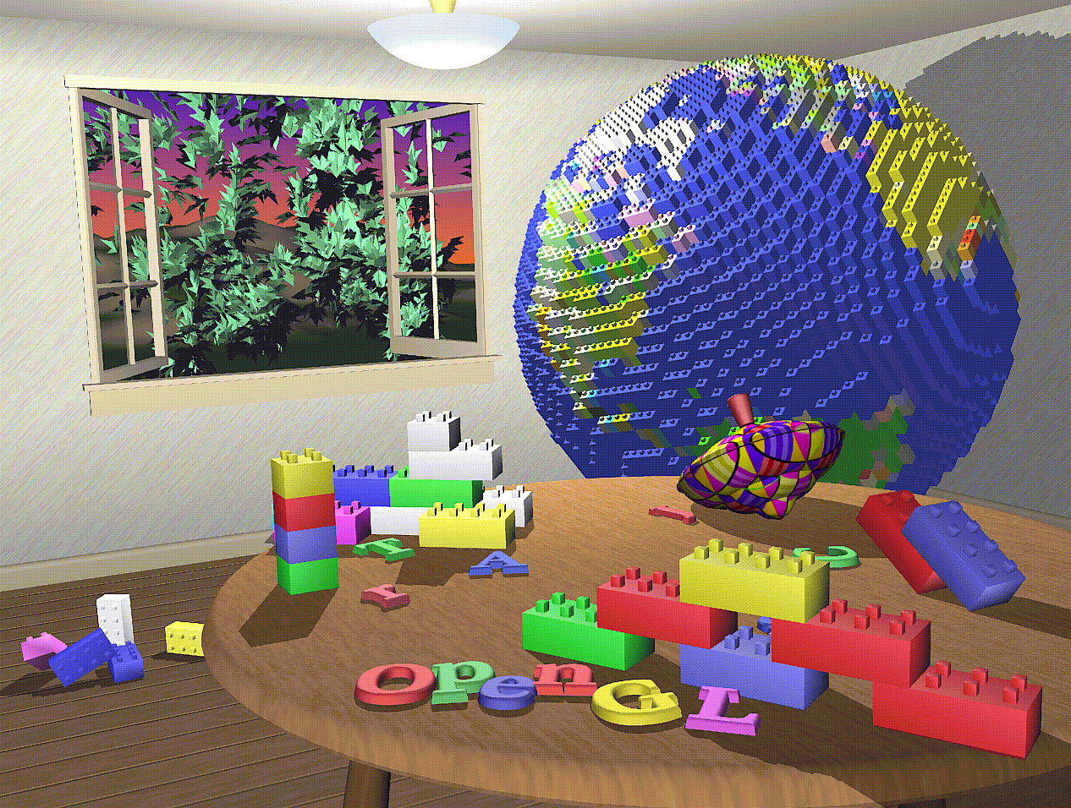
Outline of Computer Graphics
Geometry
Rasterization
Shading
Hidden surface elimination
Texture mapping
Modeling
Animation
Ray tracing
Global illumination
from M. Woo et al., 1997

Slide 5
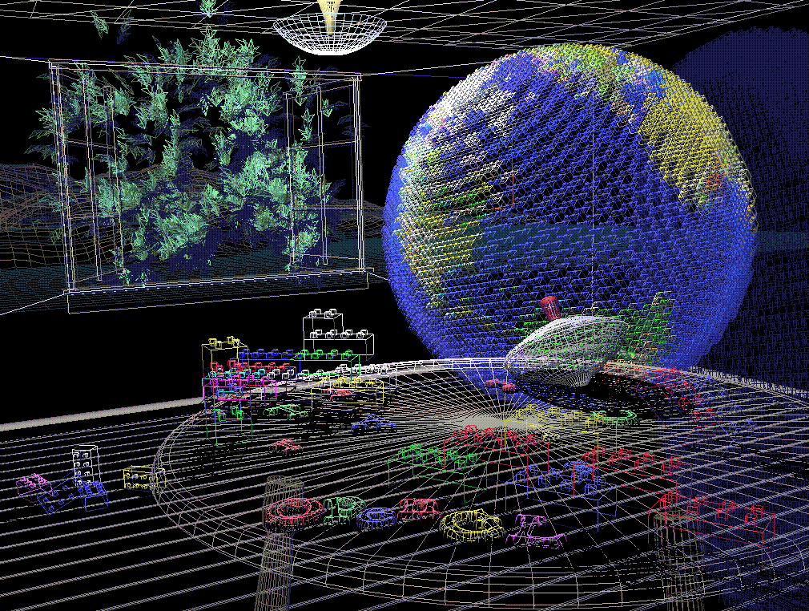
Outline of course
Geometry
Rasterization
Shading
Hidden surface elimination
Texture mapping
Modeling
Animation
Ray tracing
Global illumination
How to specify the 3-D positions of the camera and the scene objects and their various parts, how to project these to 2-D image locations, and how to represent trans-formations of these positions

Slide 6
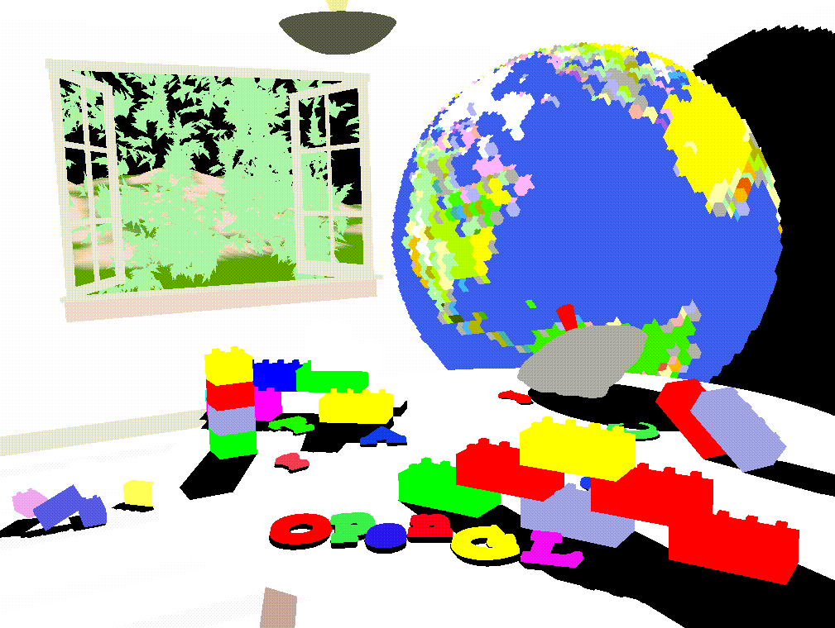
Outline of course
How to set individual image pixels corresponding to projected geometric objects such as points, lines, polygons, and more complicated shapes. Anti-aliasing reduces artifacts (“jaggies”) caused by finite image resolution
Geometry
Rasterization
Shading
Hidden surface elimination
Texture mapping
Modeling
Animation
Ray tracing
Global illumination

Slide 7
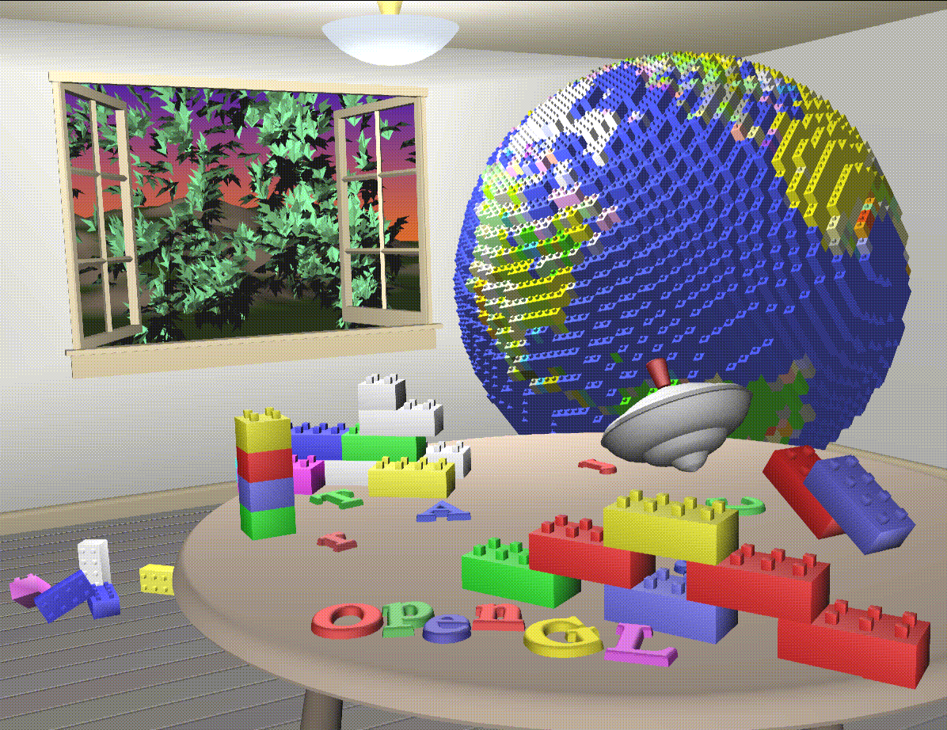
Outline of course
Geometry
Rasterization
Shading
Hidden surface elimination
Texture mapping
Modeling
Animation
Ray tracing
Global illumination
How to model light interaction with 3-D surfaces with varying material properties in order to calculate the proper colors perceived by the eye at different image locations

Slide 8
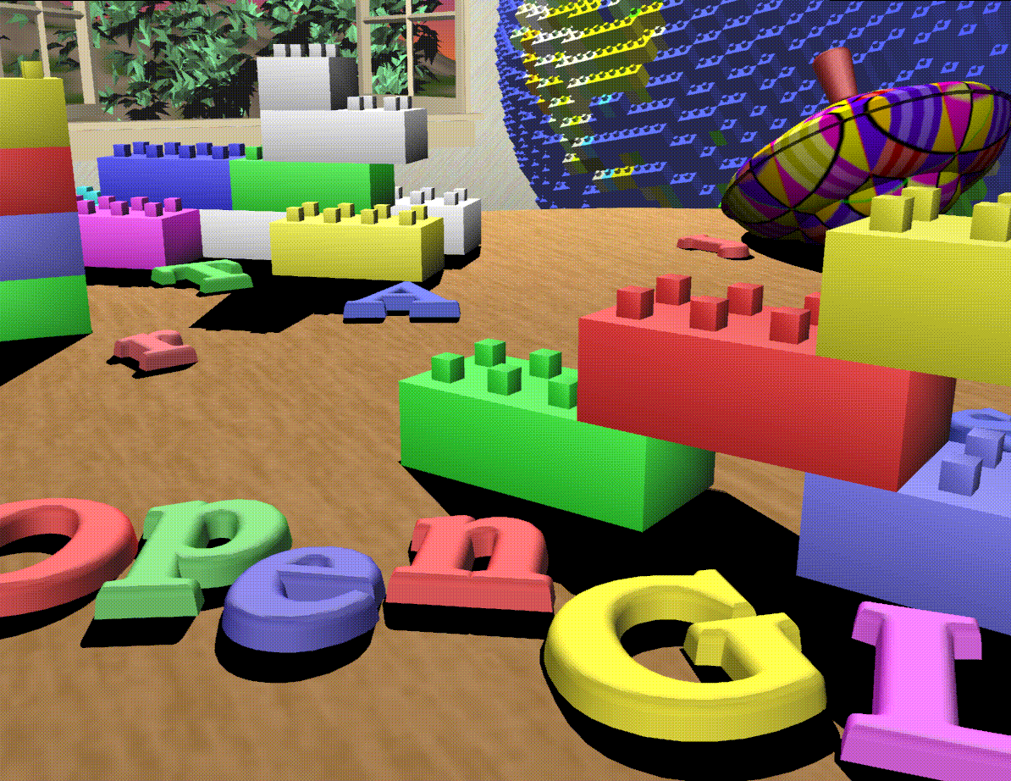
Outline of course
Geometry
Rasterization
Shading
Hidden surface elimination
Texture mapping
Modeling
Animation
Ray tracing
Global illumination
How to determine only the visible parts of scene objects

Slide 9
Outline of course
Geometry
Rasterization
Shading
Hidden surface elimination
Texture mapping
Modeling
Animation
Ray tracing
Global illumination
How to apply “layers” of detail to scene objects to show features, simulate bumps and reflections, or other precomputed shading effects.

Slide 10
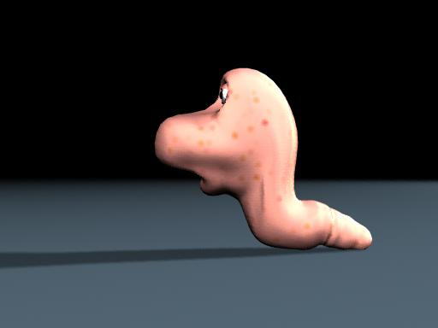
Outline of course
Geometry
Rasterization
Shading
Hidden surface elimination
Texture mapping
Modeling
Animation
Ray tracing
Global illumination
Brown et al, OSU
How to efficiently represent the geometry of scene objects, which may be complex, curved, etc. (CSE 5543)

Slide 11
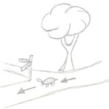
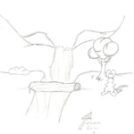
Outline of course
Geometry
Rasterization
Shading
Hidden surface elimination
Texture mapping
Modeling
Animation
Ray tracing
Global illumination
Chen et al, OSU
How to render dynamic scenes, as well as how to simulate dynamic phenomena (CSE 3541, 5913)

Slide 12
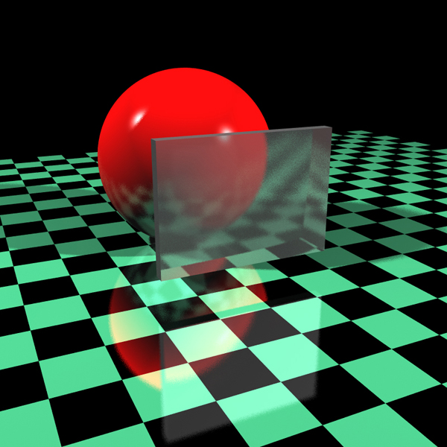
Outline of course
Geometry
Rasterization
Shading
Hidden surface elimination
Texture mapping
Modeling
Animation
Ray tracing
Global illumination
Handler, OSU
How to realistically simulate the movement of rays from light sources through multiple object reflections and refractions on the way to the eye (CSE 5545)

Slide 13
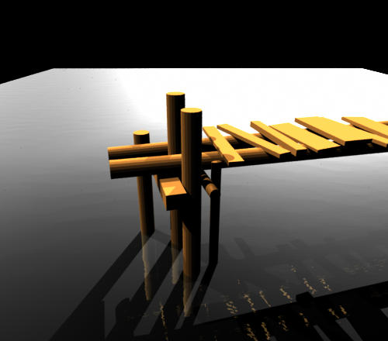
Outline of course
Geometry
Rasterization
Shading
Hidden surface elimination
Texture mapping
Modeling
Animation
Ray tracing
Global illumination
Gao et al, OSU
How to realistically simulate inter-reflections of light between multiple sources and object surfaces (CSE 5545)

Slide 14
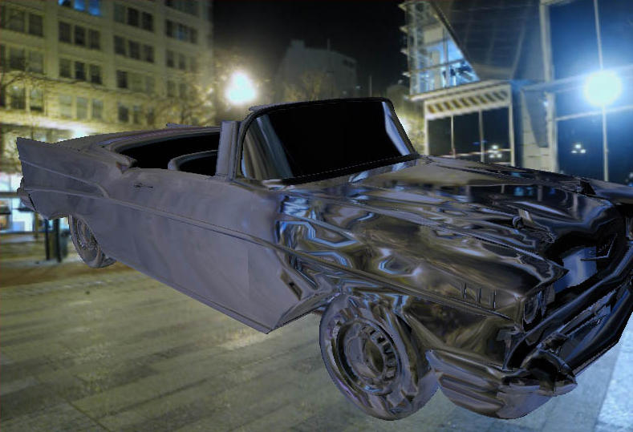
Outline of course
Geometry
Rasterization
Shading
Hidden surface elimination
Texture mapping
Modeling
Animation
Ray tracing
Global illumination
Primary focus of this class, but …
Parmelee and Ruston, OSU

Slide 15
Graphics Algorithms
Most importantly are the many algorithms that allow us to simulate the complex physics, cheat, and provide other visual special effects.

Slide 16
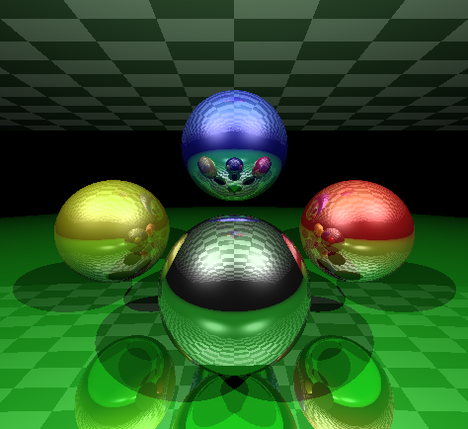
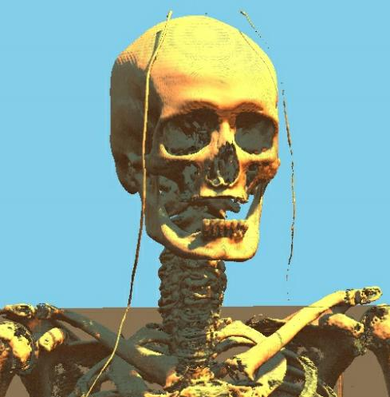
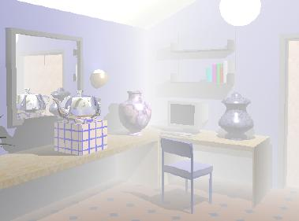
What will I learn from this course?
A good understanding of graphics hardware/software technology – algorithms and jargons
Learn how to use OpenGL to write 2D/3D drawing programs
Expertise in writing complex shaders for computer graphics.

Slide 17
Course Overview
Prerequisites
CSE 3541/5541 or knowledge of basic computer graphics (linear algebra, coordinate systems, light models).
Good programming skills (C/C++/C#/Java)
Desired
Interested in Computer Graphics:
Love graphics and want to learn more
Be willing to learn things by yourself and try out cool stuff

Slide 18
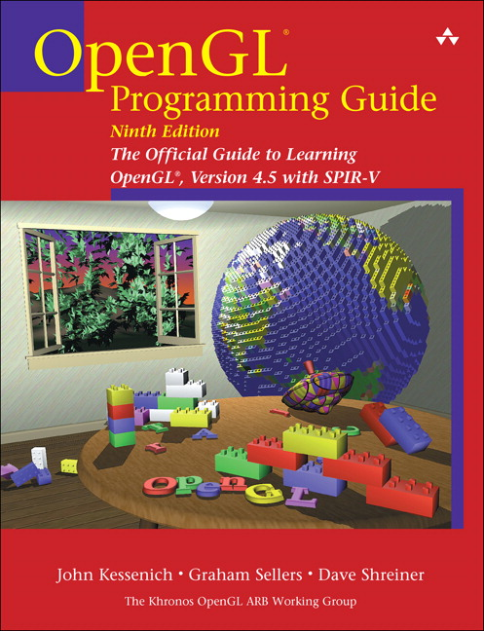
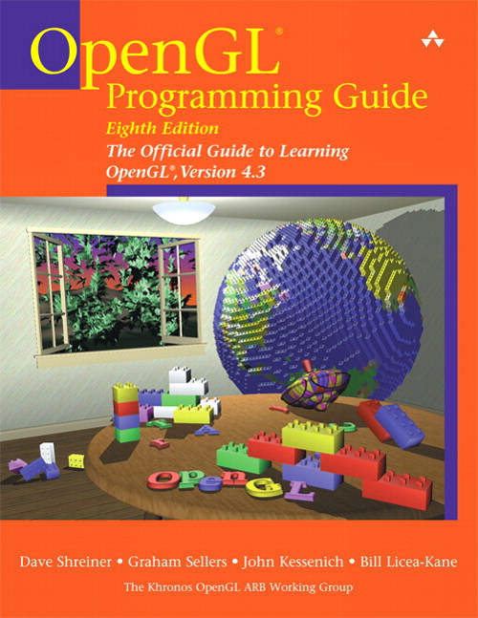
Reference Books
The red book The yellow book
OpenGL programmer’s OpenGL Shading Language

Slide 19
Grading
5 programming assignments worth 55% of course grade.
About 2 weeks each
Electronic submission through the CSE submit
Up to three days late, but 10% penalty for each day
No credit after three days, so finish early.
Exams
Quizes: 10%
Exam: 20%
Homework
Will probably have about 5 home-works, four for grade and one for extra credit – 5% apiece.

Slide 20
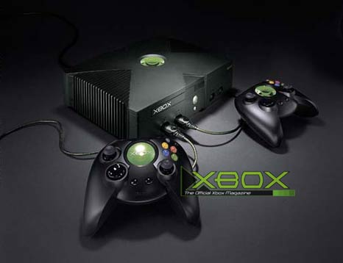
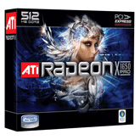
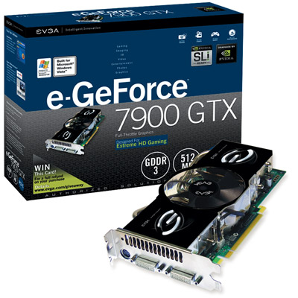
Some Jargon
Graphics Processor or Graphics Processing Unit (GPU)
What about it?
nVIDIA/ATI Graphics Chips
32-bit colors, Z/stencil buffer
Advanced Per-pixel lighting
Millions of triangles per second
…

Slide 21
OpenGL programming
An industry standard API
This is NOT just a API course
You are expected to learn the graphics
processing and the theory behind it.
You don’t need to implement the low-level rasterization algorithms. Instead, we will use OpenGL.

Slide 22
Homeworks
These will be a combination of small programming assignments and questions.
C++
WebGL / Javascript

Slide 23
Lab Environment
Desired Programming environment
C++
OpenGL graphics library
Windows Visual Studio .Net
Windows PC with dedicated 3D graphics GPU.
Apple is probably fine these days
X-Windows / Linux probably not.
Class discussion.

Slide 24
Staying Informed
Ask fellow students about anything missed in the previous lectures.
Check the course web site frequently.

Slide 25
Take home message
What makes most realistic-looking images/animations look so good is a lot of expensive software, artistic and detailed modeling, and a lot of computing power and time
For LOTR “Return of the King”, a “renderwall” of ~3,200 CPUs ran 24/7, with an average render time of hours per frame
The underlying computer graphics principles are what this course will focus on.

Slide 26
Real-time
Was does real-time mean?
1/20 -> 1/120 second (8 ms).
Goal is to cheat or reduce the fidelity as little as possible to achieve real-time. CSE 5545 may take hours per frame.
And use the hardware efficiently
Possible cheats?
1000’s of light sources versus a light map.

Slide 27
Agenda
Course Overview
The OpenGL pipeline software architecture.
The OpenGL Shading Language – GLSL
Simple GLSL shader examples
Homework #1

Slide 28
Agenda
History of OpenGL
Understanding the backward capabilities and some of the ugliness in the current specification.
History of Shading Languages
History of Graphics Hardware
Understand where we came from and why some of the literature / web sources may no longer be valid.
Appreciate modern Stream-based Architectures.
Review of Computer Graphics

Slide 29
Agenda
Implementing a Trackball interface
Frame Buffer Objects
Multi-texturing and a 3D Paint application
Environment Mapping
Normal and Displacement Mapping

Slide 30
Agenda
The GPU vs. the CPU
Performance trends
Specific Hardware Implementations

Slide 31
Agenda
Hierarchical z-buffer and z-culling
Shadow algorithms
Planar shadows
Ambient occlusion
Shadow volumes
Shadow maps
Aliasing and precision issues

Slide 32
Agenda
Aliasing and Fourier Theory
Full-screen anti-aliasing
Texture filtering and sampling
Shadow map filtering

Slide 33
Agenda
Special topics (TBD)
Animation and Skinning
OpenGL in a multi-threading context
High-performance rendering
Frustum culling
Clip-mapping
Non-photorealistic rendering
Volume rendering

Slide 34
Rendering
Graphics rendering pipeline
Geometry processing
Rasterization
Raster ops
Application
Geometry
Rasterizer
Image

Slide 35
Quick Overview of OpenGL
Well, pretty low-level. Vulkan is even lower.
OpenGL is:
A low-level API
OS independent
Window system independent
Consortium controlled standard
Includes a spec for a shading lang., GLSL.
Geometry in OpenGL consists of points, lines, triangles, quadrilaterals and a general polygon.
OpenGL allows for different appearances through changes in state settings
Current program
Current normal or data
Polygon mode
Goal today is to bootstrap you into OpenGL.

Slide 36
The (Traditional) OpenGL 3+ Pipeline
Application
Vertex Shader
transformed vertices and data
Geometry Shader
Note: All of the shaders have access to (pseudo) constants (more on this later).
Rasterizer
texture
Fragments with interpolated data
Fragment Shader
pixel color, depth, stencil (or just data)
Compositor
Display

Slide 37
The Stream Model
The pipeline diagram does not do the process justice.
Think of an OpenGL machine as a simplified assembly line.
To produce widget A:
Stop assembly line
Load parts into feed bins
Set operations and state for the A’s process assembly
Restart the assembly line
Streams parts for A through the line
To produce widget B:
Stop assembly line
Load parts into feed bins
Set operations and state for the B’s process assembly
Restart the assembly line
Streams parts for B through the line

Slide 38
The Stream Model
In reality, there are three simultaneous sets of assembly lines running at the same time. Similar to plant A produces pistons, Plant B produces engines and Plant C produces cars.
Yes, I am being abstract.
Previous programming to the pipeline required you to map data to specific concrete objects, so it actually helps to think of the OpenGL pipeline abstractly first.

Slide 39
The Stream Model
The Vertex Shader
Takes in a single vertex and associated data (called attributes – normal, color, texture coordinates, etc.).
Outputs a single vertex (3D point) and associated data (not necessarily the same data from above).
Vertex Shader
transformed vertices and data

Slide 40
The Stream Model
The Geometry Shader
Takes as input a primitive (e.g. a triangle) defined as a collection of vertices, and data associated at each vertex.
May also have access to adjacent primitives and their vertices and data.
Outputs either:
Nothing - kills the primitive
A similar primitive or set of primitives with associated data.
A completely different primitive (e.g. a line strip) or set of primitives and associated data.
Primitive and data
Geometry Shader
Primitive(s) and data

Slide 41
The Stream Model
The Fragment Shader (Pixel Shader in DirectX)
Takes as input a fragment (pixel location), the depth associated with the fragment and other data.
Outputs either:
Nothing – kills the fragment
A single RGBA color and a depth value
A collection of RGBA color values and a single depth value
A collection of data and a single depth value
May also include a single optional stencil value
Depth with interpolated data
Fragment Shader
Color(s), depth, stencil (or just data)

Slide 42
The Stream Model
Some key points to consider / remember:
If the wrong parts are feed into the system then the results are meaningless or the assembly line crashes.
For example, if ¾” hex nut bolts are needed and ½” phillips screws are feed into the system the manifolds may fall off.
What other resources does the system have access to?
Something like grease may be considered an infinite resource at one or more stations.
The specific locations of welding sites and bolt placement.
How do we prevent one Plant from either swamping another plant with parts or preventing it from running due to low inventory?

Slide 43
The Stream Model
So, to make a functional OpenGL Shader Program, we need to connect the three independent shaders together.
But, they do not connect!!!
Vertex Shader
transformed vertices and data
Geometry Shader
Rasterizer
texture
Fragments with interpolated data
Fragment Shader
pixel color, depth, stencil (or just data)
Compositor
Display

Slide 44
The Real Pipeline
Top Secret
Top Secret
List<T> vertexStream
List<V’> fragmentStream
Initial Vertex data format
Transformed Vertex data format
List<Triangle<U’>> triangleStream
Re-Processed Vertex data format
Vertex Shader
Process Data
Process Data
Geometry Shader
Fragment Shader
Process Data
List<U> vertexStream
Transformed Vertex data format
List<List<D>> fragmentStream
Re-Processed Vertex data format
List<Primitive<V>> triangleStream
Final fragment format
Top Secret
Raster Ops
Top Secret

Slide 45
The Real Pipeline
Top Secret is not the proper term there, but rather “Beyond Your (Current) Control”. I could have put Primitive Assembly and Rasterization, but there are a few more things going on. We will look at more details of this when go even deeper into the pipeline.
I also used Triangle in List<Triangle<U>> to make it clear that the primitive types do not need to match (this is C#/.NET syntax btw).
List == Array
For now, realize that the data types need to match and other than that, the shaders are independent.

Slide 46
The Real Pipeline
To make things a little more clearer, lets look at a specific instance of the types. This is similar to basic fixed functionality for a lit-material. Note, the structs are for illustration only.
T - Initial Vertex Data
struct VertexNormal {
Point vertex;
Vector normal;
}
U - Transformed Vertex Data
struct VertexColor {
Point vertex;
Color color;
}
V – Re-Processed Vertex Data
struct VertexColor {
Point vertex;
Color color;
}
D – Final Fragment Data
struct VertexColor {
float depth;
Color color;
}

Slide 47
The Real Pipeline
Top Secret
Top Secret
List<T> vertexStream
List<V’> fragmentStream
Initial Vertex data format
Transformed Vertex data format
List<Triangle<U’>> triangleStream
Re-Processed Vertex data format
Can this be a no-op?
Can this be a no-op?
Can this be a no-op?
Process Data
Vertex Shader
Process Data
Process Data
Fragment Shader
Geometry Shader
List<U> vertexStream
Transformed Vertex data format
List<List<D>> fragmentStream
Re-Processed Vertex data format
List<Primitive<V>> triangleStream
Final fragment format
Top Secret
Raster Ops
Top Secret

Slide 48
Clarifications
What does a no-op Geometry shader mean / imply?
What is special about the Vertex or Fragment shaders?
Type U is constrained?
Not clear.
Types V and D?
Are the List (or array) sizes the same?

Slide 49
GLSL – The OpenGL Shading Language
C++/C-like
Basic data types:
void – use for method return signatures
bool – The keywords true and false exist (not an int)
int – 32-bit. Constants with base-10, base-8 or base-16.
float – IEEE 32-bit (as of 1.30).
uint (1.30) – 32-bit.
Variables can be initialized when declared.
int i, j = 45;
float pi = 3.1415;
float log2 = 1.1415f;
bool normalize = false;
uint mask = 0xff00ff00

Slide 50
GLSL Data Types
First class 2D-4D vector support:
Float-based: vec2, vec3, vec4
Int-based: ivec2, ivec3, ivec4
Bool-based: bvec2, bvec3, bvec4
Unsigned Int-based (1.30): uvec2, uvec3, uvec4
Initialized with a constructor
Overloaded operator support;
vec3 eye = vec3(0.0,0.0,1.0);
vec3 point = vec3(eye);
Component-wise multiplication
vec3 sum = eye + point;
vec3 product = eye * point;
float delta = 0.2f;
sum = sum + delta;

Slide 51
GLSL Vectors
Component access:
A single component of a vector can be accessed using the dot “.” operator (e.g., eye.x is the first component of the vec3).
Since vectors are used for positions, colors and texture coordinates, several sequences are defined:
x, y, z, w
r, g, b, a
s, t, p, q
Masking
Can use the accessors to mask components:
vec2 p = eye.xy;
Swizzling
Can also change order: eye.yx

Slide 52
GLSL Data Types
First class matrix support
Square float-based: mat2, mat3, mat4, mat2x2, mat3x3, mat4x4
Non-square float-based: mat2x3, mat2x4, mat3x2, mat3x4, mat4x2, mat4x3
Usually, multiplication is component-wise (it is not a dot product with vectors). Matrices are the exception. These follow the normal mathematical rules of vector-matrix and matrix-matrix multiplication.

Slide 53
Vertex Shader Example
Here are a couple of the most minimal vertex shaders.
Specifying a position.
The data for gl_Position must be set.
What does this do?
void main()
{
gl_Position = (0,1,0,1);
}

Slide 54
Vertex Shader Example
Copying over the incoming position.
What does this accomplish?
When might it be useful?
What happens with the modelview and projection matrices?
What type is gl_Position and gl_Vertex?
When is it called?
void main()
{
gl_Position = gl_Vertex;
}
in vec3 ndcPosition;
void main()
{
gl_Position = vec4(ndcPosition,1.0f);
}

Slide 55
Fragment Shader Example
Setting the color
What is the value of the green and alpha components?
Do we care about the alpha component?
What does this shader do? When?
void main()
{
gl_FragColor.r = 0.8f;
gl_FragColor.b = 0.8f;
}
out vec4 background;
void main()
{
background = vec4(0.8f,0.0f,0.8f,1.0f);
}

Slide 56
Memory Access in Shaders
If all we have is the stream, then we need a new shader for each little tweak.
Shader’s can be parameterized before they are “turned on” (the assembly line is restarted).
ProcessStream will use the values of BrickColor and MortarColor.
We need a mechanism to copy data values from CPU memory (main memory) to GPU memory. We do not want to access main memory for every element in a stream.
class MyShader{
public Color BrickColor { get; set; }
public Color MortarColor { get; set; }
public IEnumerable<VertexColor> ProcessStream(IEnumerable<VertexNormal> vertexStream);
}

Slide 57
Memory Access in Shaders
In OpenGL these parameterized values are called uniform variables.
These uniform variables/constants can be used within a shader on the GPU.
Setting them is done on the CPU using the set of glUniform API methods (more later).
The number and size of these constants is implementation dependent.
They are read only (aka constants) within the shader.

Slide 58
Memory Access in Shaders
Texture Memory is handled specially:
It is already a GPU resource, so it makes no sense to copy it over.
Additional processing of the data is usually wanted to provide wrapping and to avoid aliasing artifacts that are prevalent with texture mapping. This latter issue is known as texture filtering.
As we will see, textures can also be written into on the GPU. Read-only memory semantics allow better optimizations than read/write memory accesses in a parallel processing scenario. As such, textures are read-only when used in a shader.
All three shaders can access texture maps.

Slide 59
GLSL Data Types
Samplers
Samplers are equivalent to Texture Units (glActiveTexture).
You indicate what type of texture you expect in this slot with the sampler type (23 texture types!):
SAMPLER 1D, SAMPLER 2D, SAMPLER 3D, SAMPLER CUBE, SAMPLER 1D SHADOW, SAMPLER 2D SHADOW, SAMPLER 1D ARRAY, SAMPLER 2D ARRAY, SAMPLER 1D ARRAY SHADOW, SAMPLER 2D ARRAY SHADOW, SAMPLER CUBE SHADOW, INT SAMPLER 1D, INT SAMPLER 2D, INT SAMPLER 3D, INT SAMPLER CUBE, INT SAMPLER 1D ARRAY, INT SAMPLER 2D ARRAY, UNSIGNED INT SAMPLER 1D, UNSIGNED INT SAMPLER 2D, UNSIGNED INT SAMPLER 3D, UNSIGNED INT SAMPLER CUBE,UNSIGNED INT SAMPLER 1D ARRAY, or UNSIGNED INT SAMPLER 2D ARRAY
A run-time (non-fatal) error will occur if the texture type and indicated sampler type are not the same.
DirectX 10 is separating the concerns of a sampler from that of a texture. Currently each texture needs its own sampler.
Used with built-in texturing functions (more later)
Declared as uniform variables or function parameters (read-only).

Slide 60
GLSL Data Types
GLSL allows for arrays and structs
Arrays must be a constantly declared size.
The types within a struct must be declared.

Slide 61
GLSL Variable Qualifiers
Const
Used to define constants
Used to indicate a function does not change the parameter
Uniform
Pseudo-constants set with glUniformXX calls.
Global in scope (any method can access them).
Read only.
Set before the current stream (before glBegin/glEnd).
Attribute
Deprecated – Use in in the future
The initial per vertex data
Varying
Deprecated – Use out in the future
Indicates an output from the vertex shader to the fragment shader

Slide 62
GLSL Variable Qualifiers
OpenGL 3.0
Varying and Attribute is being deprecated in favor of in, out, centroid in and centroid out.
Function parameters can also use an inout attribute.
Centroid qualifier is used with multi-sampling and ensures the sample lies within the primitive.
Out variables from vertex shaders and in variables from fragment shaders can also specify one of the following:
Flat – no interpolation
Smooth – perspective correct interpolation
Noperspective – linear interpolation in screen space

Slide 63
GLSL Functions
You can define and call functions in GLSL.
No recursion
Regular scoping rules
Note: Uniform variables can be specified at the function level. They are still accessible to all routines. If specified in two different compile units, they are merged. Different types for the same uniform name will result in a link error.

Slide 64
GLSL Built-in Functions
GLSL defines many built-in functions, from simple interpolation (mix, step) to trigonometric functions, to graphics specific functions (refract, reflect).
Almost all of these take either a scalar (float, int) or a vector.
A full complement of matrix and vector functions.
Some of the simpler functions may be mapped directly to hardware (inversesqrt, mix).
See the specification or the OpenGL Shading Language Quick Reference Guide for more details.

Slide 65
Texture Look-up Functions
Texture accesses return a 4-component vector, even if the texture is only one channel. The exception is Shadow samplers return a float
Prior to Shading Language 1.3, these were all float, so it returned a vec4. Now it can be ivec4 and uvec4 as well.
The texture function takes a sampler as its first input, and a texture coordinate as its second input.
Optional bias, offset or LOD is possible in several of the variants.
See the spec for more details.
OpenGL 3.0 added the ability to inquire the texture size in texels, access a specific texel and specify the gradient to use for filtering.

Slide 66
GLSL Built-in Functions
Other functions:
The fragment shader can take the derivative of any value being interpolated across the triangle using the dfdx and dfdy functions.
There is a built-in noise function for Perlin-like noise.

Slide 67
GLSL Built-in Variables
Most of the state variables are being deprecated in OpenGL 3.0
These variables allow a shader to communicate with the old fixed functionality pipeline.
Many of the following slides are old and invalid, but you may see code like this in old shaders, so.
Look at the quick reference and spec for the current stuff.

Slide 68
GLSL Built-in Variables
Special Vertex Built-in variables
in int gl_VertexID; // may not be define in all cases
in int gl_InstanceID;
in int gl_BaseInstance
in int gl_BaseVertex
in int gl_DrawID
out vec4 gl_Position; // must be written to
out float gl_PointSize; // may be written to
out float gl_ClipDistance[]; // may be written to
out float gl_CullDistance[]; // may be written to
This is the important one!

Slide 69
GLSL Built-in Variables
Special Fragment Built-in variables
Special Notes:
If gl_FragColor is written to, you can not write to gl_FragData and vice versa.
If gl_FragDepth is assigned inside a conditional block, it needs to be assigned for all execution paths.
If a user-define out variable is assigned to, then you can not use gl_FragColor or gl_FragData
User defined outputs are mapped using glBindFragDataLocation (more later)
in vec4 gl_FragCoord;
in bool gl_FrontFacing;
in float gl_ClipDistance[];
Many more added since 3.2, see spec.
out vec4 gl_FragColor; // deprecated
out vec4 gl_FragData[gl_MaxDrawBuffers]; // deprecated
out float gl_FragDepth;

Slide 70
GLSL Built-in Attributes
Vertex Shader Built-in Attributes (Inputs)
These have all been deprecated to streamline the system.
in vec4 gl_Color; // deprecated
in vec4 gl_SecondaryColor; // deprecated
in vec3 gl_Normal; // deprecated
in vec4 gl_Vertex; // deprecated
in vec4 gl_MultiTexCoord0; // deprecated
in vec4 gl_MultiTexCoord1; // deprecated
in vec4 gl_MultiTexCoord2; // deprecated
in vec4 gl_MultiTexCoord3; // deprecated
in vec4 gl_MultiTexCoord4; // deprecated
in vec4 gl_MultiTexCoord5; // deprecated
in vec4 gl_MultiTexCoord6; // deprecated
in vec4 gl_MultiTexCoord7; // deprecated
in float gl_FogCoord; // deprecated
Notes on texture mapping:
Will use the current texture coordinate.
You do not need to specify any texture coordinates
For multiple textures you do not need to specify the same number of texture coordinates
In other words, texture coordinates and texture units are completely decoupled.

Slide 71
GLSL Built-in State
All of the State (except the near and far plane) have been deprecated.
These were a nice convenience, but…
uniform mat4 gl_ModelViewMatrix;
uniform mat4 gl_ProjectionMatrix;
uniform mat4 gl_ModelViewProjectionMatrix;
uniform mat4 gl_TextureMatrix[gl_MaxTextureCoords];
// Derived state
uniform mat3 gl_NormalMatrix; // transpose of the inverse of the
// upper leftmost 3x3 of gl_ModelViewMatrix
uniform mat4 gl_ModelViewMatrixInverse;
uniform mat4 gl_ProjectionMatrixInverse;
uniform mat4 gl_ModelViewProjectionMatrixInverse;
uniform mat4 gl_TextureMatrixInverse[gl_MaxTextureCoords];
uniform mat4 gl_ModelViewMatrixTranspose;
uniform mat4 gl_ProjectionMatrixTranspose;
uniform mat4 gl_ModelViewProjectionMatrixTranspose;
…

Slide 72
GLSL Vertex to Fragment Vars
OK, I must admit, that the spec has these in a different section from the specials. Not clear why these are different than gl_ClipDistance for instance, except that those values would be used by the fixed-function clipping.
Vertex varying variables
Fragment varying variables
out vec4 gl_FrontColor;
out vec4 gl_BackColor;
out vec4 gl_FrontSecondaryColor;
out vec4 gl_BackSecondaryColor;
out vec4 gl_TexCoord[]; // Deprecated
out float gl_FogFragCoord; // Deprecated
in vec4 gl_Color;
in vec4 gl_SecondaryColor;
in vec2 gl_PointCoord;
in float gl_FogFragCoord; // Deprecated
in vec4 gl_TexCoord[]; // Deprecated

Slide 73
Example (old 3.0)
Vertex Shader
Compute projected position
Compute vertex color
Compute vertex texture coordinates
What are the types?
What does “*” mean or do?
void main()
{
// transform vertex to clip space coordinates
gl_Position = gl_ModelViewProjectionMatrix * gl_Vertex;
// Copy over the vertex color.
gl_FrontColor = gl_Color;
// transform texture coordinates
gl_TexCoord[0] = gl_TextureMatrix[0] * gl_MultiTexCoord0;
}

Slide 74
Example
Fragment Shader
Look-up (sample) the texture color
Multiply it with the base color and set the final fragment color.
Note: The depth is not changed
gl_FragDepth = gl_FragCoord.z
uniform sampler2D texture;
void main()
{
vec4 color = texture2D( texture, gl_TexCoord[0].st );
gl_FragColor = gl_Color * color;
}

Slide 75
Example
Some things to note:
There is a main() for both the vertex and the fragment shader
There is no concept of the stream
Data can not be shared between instances
There is little to no difference between the built-in state and user defined uniform variables.
These are really kernels. They are applied to the stream (similar to the Select clause in LINQ or SQL).
class MyShader{
public Color BrickColor { get; set; }
public Color MortarColor { get; set; }
public IEnumerable<VertexColor> ProcessStream(IEnumerable<VertexNormal> vertexStream,
Func<VertexNormal,VertexColor> kernel);
}

Slide 76
OpenGL and GLSL
OK, we can define these kernels, but how do we tell the system (CPU / OpenGL / GPU) to use them?
Two new objects in OpenGL
Shader Routine – a compilation unit
Shader Program – a linked unit
Setting up your shader program then takes a few steps:
Create object handlers for each routine.
Load the source into each routine.
Compile each routine.
Create object handler for the shader program
Attach each routine to the program
Link the program
Use the program

Slide 77
OpenGL and GLSL
Let’s look at some of my C# code for doing this. Below are some of the pertinent snippets.
namespace OhioState.Graphics
{
/// <summary>
/// This interface represents a shader routine;
/// </summary>
public interface IShaderRoutine
{
/// <summary>
/// Get or set shader content.
/// </summary>
string ShaderContent { get; set; }
/// <summary>
/// Compile the shader.
/// </summary>
/// <param name="resourceManager">Resource manager.</param>
/// <returns>Whether or not compilation succeeded.</returns>
bool Compile(IRenderPanel panel);
}
}

Slide 78
Key Interfaces
1 namespace OhioState.Graphics
2 {
3 /// <summary>
4 /// Represents a shader program used for rendering.
5 /// </summary>
6 public interface IShaderProgram
7 {
8 /// <summary>
9 /// Make the shader active.
10 /// </summary>
11 /// <param name="panel">The <typeparamref name="IRenderPanel"/>
12 /// for the current context.</param>
13 void MakeActive(IRenderPanel panel);
14 /// <summary>
15 /// Deactivate the shader.
16 /// </summary>
17 void Deactivate();
14 /// <summary>
15 /// Attach any shaders.
16 /// </summary>
17 void AttachShader(IShaderRoutine shader);
18 }
19 }

Slide 79
Key Interfaces
namespace OhioState.Graphics
{
public interface IHardwareResource<T>
{
T GUID { get; }
}
public interface IOpenGLResource : IHardwareResource<uint>
{
}
}

Slide 80
Shader Routines
protected ShaderRoutineGL()
{
// The constructor should not make any OpenGL calls
}
public bool Compile(IRenderPanel panel) {
if (!created) {
Create();
}
if (needsCompiled) {
LoadSource();
// Create the Handle (GUID) for the shader
Gl.glCompileShader(guid);
int compileStatus;
Gl.glGetShaderiv(guid, Gl.GL_COMPILE_STATUS,
out compileStatus);
isCompiled = (compileStatus == Gl.GL_TRUE);
SetCompilerLog();
needsCompiled = false;
}
return isCompiled;
}

Slide 81
Shader Routines
private void Create()
{
// Since OpenGL wants to return an unsigned int and unsigned int's
// are not CLR compliant, we need to cast this. ATI was giving me
// some signed numbers, so we need to prevent a conversion here.
unchecked
{
// Create the Handle (GUID) for the shader
guid = (uint)Gl.glCreateShader(shaderType);
}
created = true;
}
private void LoadSource()
{
int length = currentContent[0].Length;
string[] content = new string[1];
int[] lengthArray = { length };
// load the source code into the shader object
Gl.glShaderSource(guid, 1, currentContent, lengthArray);
}

Slide 82
Shader Programs
namespace OhioState.Graphics.OpenGL {
public class ShaderProgramGL : IShaderProgram,
IOpenGLResource, IDisposable
{
public ShaderProgramGL()
{
// Do not make OpenGL calls here
}
public void MakeActive(IRenderPanel panel)
{
if (!created)
{
Create();
}
if (needsLinked)
{
if (!Link())
return;
needsLinked = false;
}
Gl.glUseProgram(guid);
}
public void Deactivate()
{
//disable the program object
Gl.glUseProgram(0);
}

Slide 83
Shader Programs
private void Create()
{
unchecked
{
guid = (uint)Gl.glCreateProgram();
}
created = true;
}

Slide 84
Shader Programs
public void AttachShader(IShaderRoutine shader)
{
if (!created)
{
Create();
}
if (!shaderList.Contains(shader))
{
shaderList.Add(shader);
Gl.glAttachShader(guid, (shader as IOpenGLResource).GUID);
needsLinked = true;
}
}

Slide 85
Shader Programs
public bool Link()
{
int linkInfo;
int maxLength;
Gl.glLinkProgram(guid);
//
// The status of the link operation will be stored as part of the program object's state.
// This value will be set to GL_TRUE if the program object was linked without errors and
// is ready for use, and GL_FALSE otherwise. It can be queried by calling glGetProgramiv
// with arguments program and GL_LINK_STATUS.
//
Gl.glGetProgramiv(guid, Gl.GL_LINK_STATUS, out linkInfo);
linkStatus = (linkInfo == Gl.GL_TRUE);
Gl.glGetProgramiv(guid, Gl.GL_INFO_LOG_LENGTH, out maxLength);
linkLog.EnsureCapacity(maxLength);
Gl.glGetProgramInfoLog(guid, maxLength, out maxLength, linkLog);
return linkStatus;
}

Slide 86
Shader Programs
public void Dispose()
{
Dispose(true);
}
private void Dispose(bool disposing)
{
if (disposing)
{
this.RemoveAllRoutines();
}
if (created)
{
Gl.glDeleteProgram(guid);
}
GC.SuppressFinalize(this);
}

Slide 87
Materials
To use these, I wrap them in a Composite interface called IMaterial.
IMaterial contains an IShaderProgram, settings for the Raster Operations, other OpenGL state (material colors, etc.) and a set of UniformVariable name/value mappings. More than you need now.
The uniform variables can either be part of a material or part of a shader program. Different trade-offs. With materials, we can re-use the shaders, but are required to re-set the uniform vars each frame.
When the material is made active, it simply calls the IShaderProgram’s MakeActive() method.

Slide 88
Some Demos

Slide 89
History of OpenGL
Pre-1992
2D Graphics – GTK
3D – IRIS GL, ANSI/ISO PHIGS, PEX
1992 – OpenGL 1.0
PHIGS killer
Controlled by the ARB (Architecture Review Board)
1995 – OpenGL 1.1
Texture Objects
Vertex Arrays
1998 – OpenGL 1.2
3D Textures
Imaging Subset
1998 – OpenGL 1.2.1
ARB extension mechanism
Multi-texturing ARB extension
3D Graphics start to flourish on the PC at about this time

Slide 90
History of OpenGL
2000 – OpenGL 1.3
Multi-texturing
Texture Combiners (Yuck!)
Multi-sampling
Compressed textures and cube-map textures
2001 – OpenGL 1.4
Depth Textures
Point Parameters
Various additional states
2003 – OpenGL 1.5
Occlusion Queries
Texture comparison modes for shadows
Vertex Buffers
Programmable Shaders introduced as an ARB extension.

Slide 91
History of OpenGL
2004 – OpenGL 2.0
Programmable Shaders
Multiple Render Targets
Point Sprites
Non-Power of Two Textures
2006 – OpenGL 2.1
Shader Language 1.2
sRGB Textures

Slide 92
History of OpenGL
2008 – OpenGL 3.0
Deprecation model!
Frame Buffer Objects
Shader Language 1.3
Texture Arrays
Khronos Group controlled
2009 – OpenGL 3.2
Geometry Shaders
2010 – OpenGL 3.3, 4.0 and 4.1
Tesselation
OpenCL support / inter-op
OpenGL ES 2.0 compatibility

Slide 93
The OpenGL 1.0 Pipeline
Texture
Map
Combine vertices into triangle, Convert to fragments, Interpolate
Light
Transform
Project
Depth-test
Alpha-test
Blending
Texture map, Final color
Vertex
Shader
Triangle
Setup
Fragment
Shader
Raster
Operations
Frame-
buffer

Slide 94
History of Shading Languages
RenderMan
Cg
HLSL
GLSL 1.0
GLSL 1.2
Automatic integer to float conversion
Initializers on uniform variables
Centroid interpolation
GLSL 1.3
Integer support
Texel access (avoid sampler)
Texture arrays

Slide 95
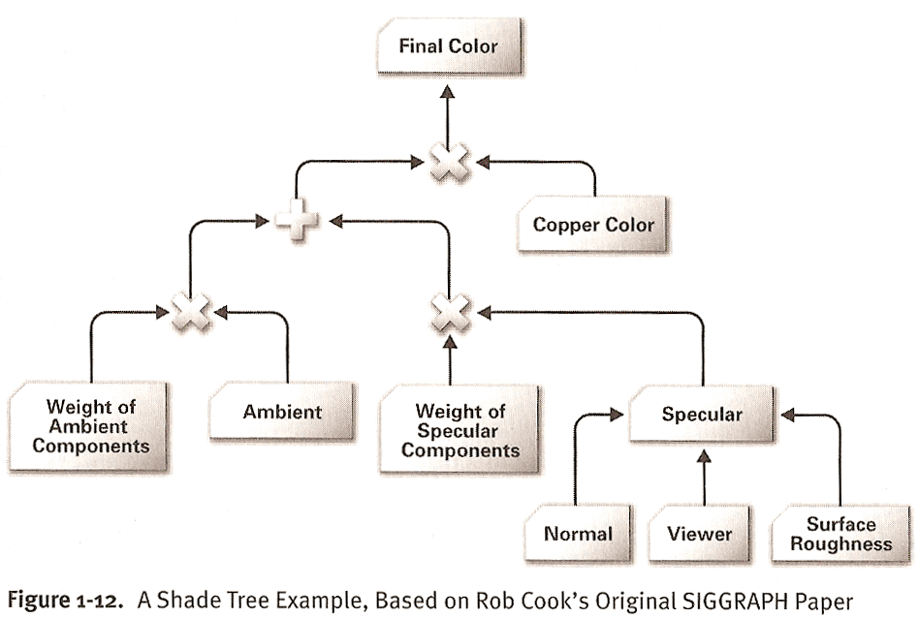
Renderman
Shade Trees by Robert Cook (SIGGRAPH 1984)
Uses a tree structure to determine what operations to perform.
Really took off with Perlin’s and Peachey’s Noise functions and shading results at SIGGRAPH 1985.

Slide 96
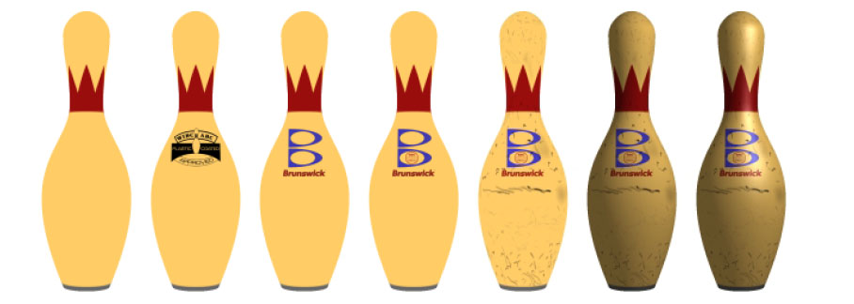
Renderman
Still heavily used in feature film productions.
Entire careers focused around shader development.
[Proudfoot 2001]

Slide 97
Cg and HLSL
Cg was developed by nVidia
HLSL was developed by Microsoft
They worked very closely together. As such there is little difference between the two languages.
Difference is in the run-time.
struct VERT_OUTPUT {
float4 position: POSITION;
float4 color : COLOR;
};
VERT_OUTPUT green(float2 position : POSITION)
{
VERT_OUTPUT OUT;
OUT.position = float4(position, 0, 1);
OUT.color = float4(0, 1, 0, 1);
return OUT;
}
Semantics

Slide 98
GLSL
OpenGL’s belated entry.

Slide 99
Other Shading Languages
There have been many other shading languages, targeting different capabilities.
Sh
Brooks
CUDA
OpenCL
Ashli

Slide 100
History of Graphics Hardware
Early History
Flight-Simulators – Evans and Sutherland
CAD – Workstations – SGI, DEC, HP, Apollo
Visualization
Stellar (1989?)
Ardent
SGI
Entertainment (Hollywood)
Cray
Custom Hardware – Pixar Image Computer
It is important to note, that this early excitement in 3D graphics in the late 1980’s and early 1990’s set the stage for the PC boom.

Slide 101
History of PC Graphics Hardware
Generation I: 3dfx Voodoo (1996)
One of the first true 3D game cards
Add-on for a standard 2D video card.
Vertex transformations on the CPU
Texture mapping and z-buffering.
PCI bus becomes the bottleneck
http://accelenation.com/?ac.id.123.2
Vertex
Transforms
Primitive
Assembly
Rasterization
and
Interpolation
Frame
Buffer
Fragment
Operations
CPU
PCI
GPU

Slide 102
History of PC Graphics Hardware
Generation II: GeForce/Radeon 7500 (1998)
Hardware-based transformation and lighting (TnL) calculations.
Multi-texturing support.
AGP bus
nVidia coins the term GPU, ATI counters with the term VPU (Visual Processing Unit).
Device driver becomes a bottleneck
http://accelenation.com/?ac.id.123.5
Vertex
Transforms
Primitive
Assembly
Rasterization
and
Interpolation
Frame
Buffer
Fragment
Operations
AGP
GPU

Slide 103
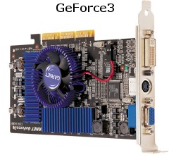
History of PC Graphics Hardware
Generation III: GeForce3/Radeon 8500(2001)
For the first time, allowed limited amount of programmability in the vertex pipeline
Also allowed volume texturing and multi-sampling (for anti-aliasing)
http://accelenation.com/?ac.id.123.7
AGP
Vertex
Transforms
Primitive
Assembly
Rasterization
and
Interpolation
Frame
Buffer
Fragment
Operations
Small vertex
shaders
GPU

Slide 104
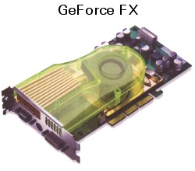
History of PC Graphics Hardware
Generation IV: Radeon 9700/GeForce FX (2002)
Fully-programmable graphics cards
Different resource limits on fragment and vertex programs
http://accelenation.com/?ac.id.123.8
Vertex
Transforms
Programmable
Vertex shader
Rasterization
and
Interpolation
Programmable
Fragment
Processor
Frame
Buffer
AGP
GPU
Texture Memory

Slide 105
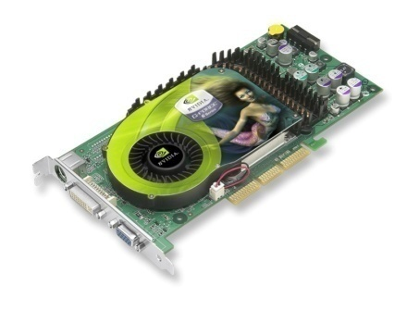
History of PC Graphics Hardware
Generation V: GeForce6/X800 (2004)
Simultaneous rendering to multiple buffers
True conditionals and loops
Texture access by vertex shader
PCI-e bus
More memory/program length/texture accesses
GPU is idle, move towards smarter fragments, rather than more and more geometry.
Vertex
Transforms
Programmable
Vertex shader
Rasterization
and
Interpolation
Programmable
Fragment
Processor
Frame
Buffer
PCI-Express
GPU
Texture Memory
Texture Memory

Slide 106
PC Graphics Hardware
 | GeForce 7800 GTX | GeForce 7900 GTX | ATI Radeon X1800 | ATI Radeon X1900
Transistor Count | 302 million | 278 million | 321 million | 384 million
Die Area | 333 mm² | 196 mm² | 288 mm² | 352 mm²
Core Clock Speed | 430 MHz | 650 MHz | 625 MHz | 650 MHz
# Pixel Shaders | 24 | 24 | 16 | 48
# Pixel Pipes | 24 | 24 | 16 | 16
# Texturing Units | 24 | 24 | 16 | 16
# Vertex Pipes | 8 | 8 | 8 | 9
Memory Interface | 256 bit | 256 bit | 256 bit ext (512 int) | 256 bit ext (512 int)
Mem Clock Speed | 1.2 GHz GDDR3 | 1.6 GHz GDDR3 | 1.5 GHz GDDR3 | 1.55 GHz GDDR3
Peak Mem Bwdth | 38.4 GB/sec | 51.2 GB/sec | 48.0 GB/sec | 49.6 GB/sec

Slide 107
History of PC Graphics Hardware
Generation V: GeForce8800/HD2900 (2006)
Redesign of the GPU (more later)
Support for DirectX 10 (more later)
Geometry Shader
Madness continues– and you get to be part of it!
Input
Assembler
Programmable
Vertex shader
Programmable
Geometry
Shader
Raster
Operations
Programmable
Pixel
Shader
PCI-Express
Output
Merger

Slide 108
GPU’s, APU’s, SoC
While Intel has the largest percentage of GPU’s for desktop computers (about 50%). These are typically integrated GPU’s
nVidia and AMD have most of the dedicated GPU market.
There are far more phones, tablets and vehicles which have GPU’s in their SoC (System on a Chip): Qualcom, Imagination, ARM.

Slide 109
Generation VI
OpenGL 4.0 adds three new stages between the vertex shader and the geometry shader.
Hull Shader – takes in the control points for a patch and tells the tessellator how much to generate (OnTessellating?).
Tessellator – Fixed function unit that take
Domain Shader – Post tessellator shader (OnTessellated?). Move the new points to where you want them.

Slide 110
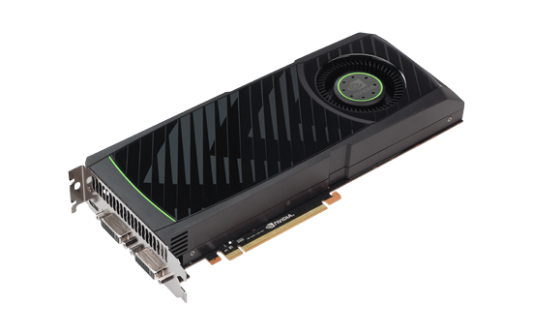
History of PC Graphics Hardware
Input
Assembler
Programmable
Vertex shader
PCI-Express
Programmable
Hull Shader
Tesselator
Programmable
Domain
Shader
Programmable
Geometry
Shader
Raster
Operations
Programmable
Pixel
Shader
Generation VI: DirectX 11 and OpenGL 4.0
Hull Shader
Domain Shader
Output
Merger

Slide 111
State of the Art – 2017
Where are we now in this rapid era of mind-blowing performance with unleashed creativity?
nVidia Volta:
21 Billion transistors
5,120 cores
Do we need it? Target is data centers.
OpenGL 4.6

Slide 112
OpenGL 4.6 Pipeline
Buffers
Fixed function
Programmable
Texture binding
Buffer binding
T B

Slide 113
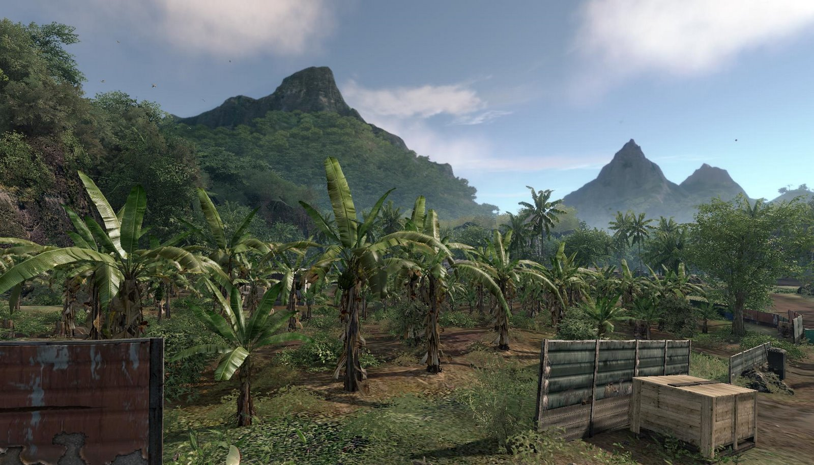
Crysis
The next few images are actually a little old, but show off the DirectX 10 class hardware.

Slide 114
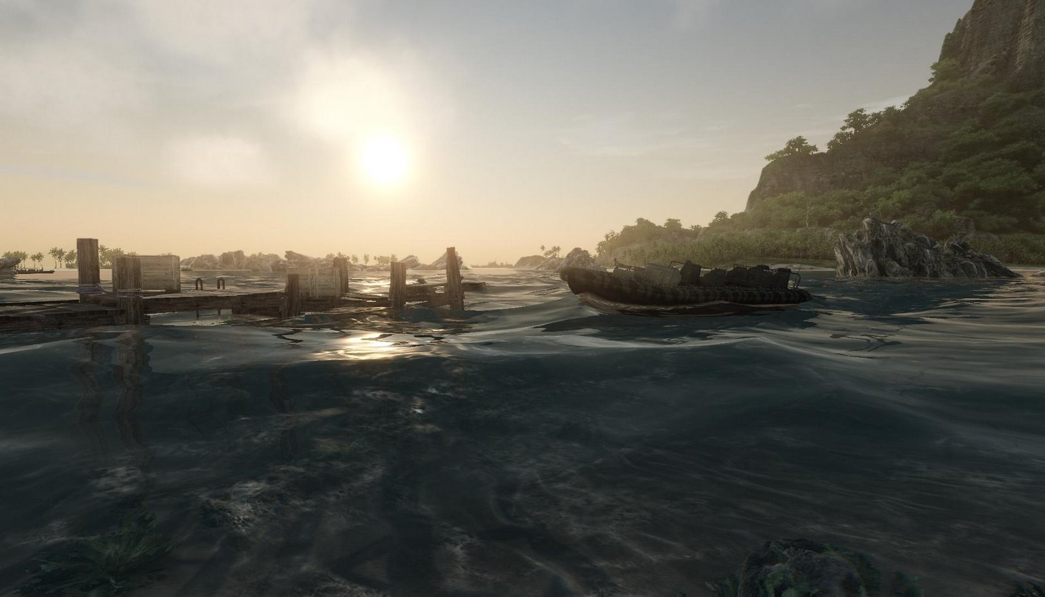

Slide 115
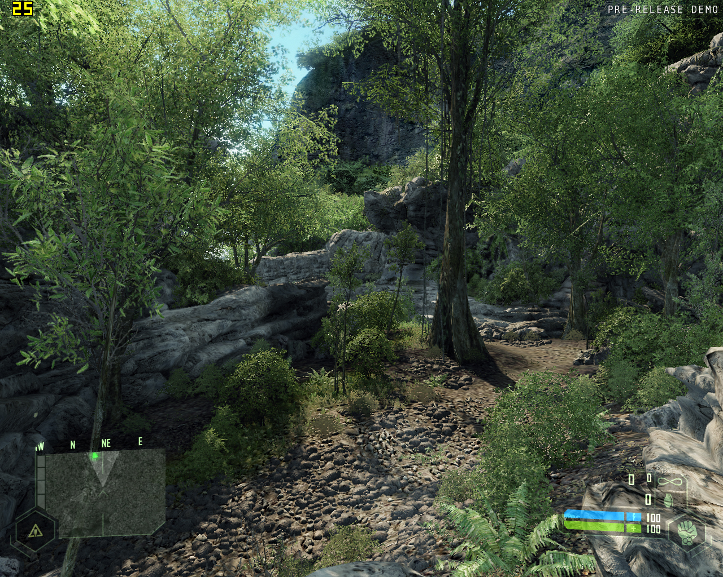

Slide 116
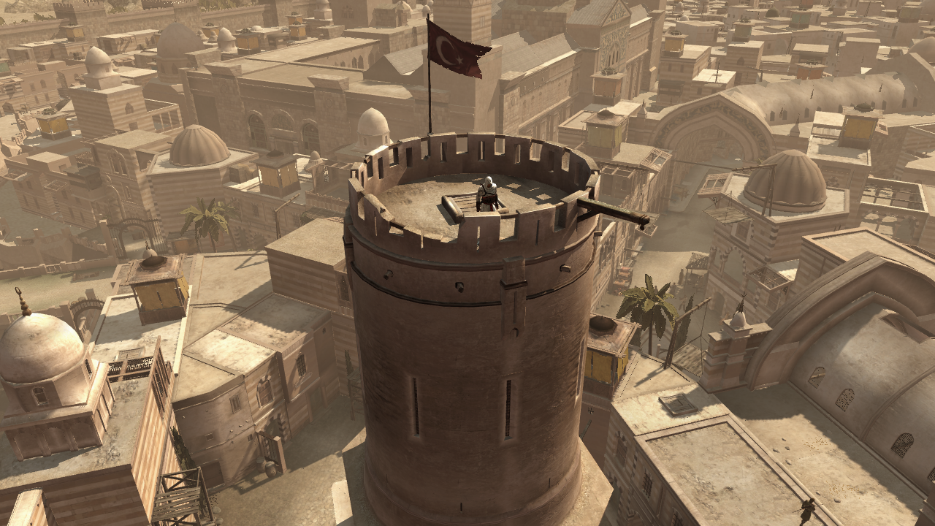
Thief

Slide 117
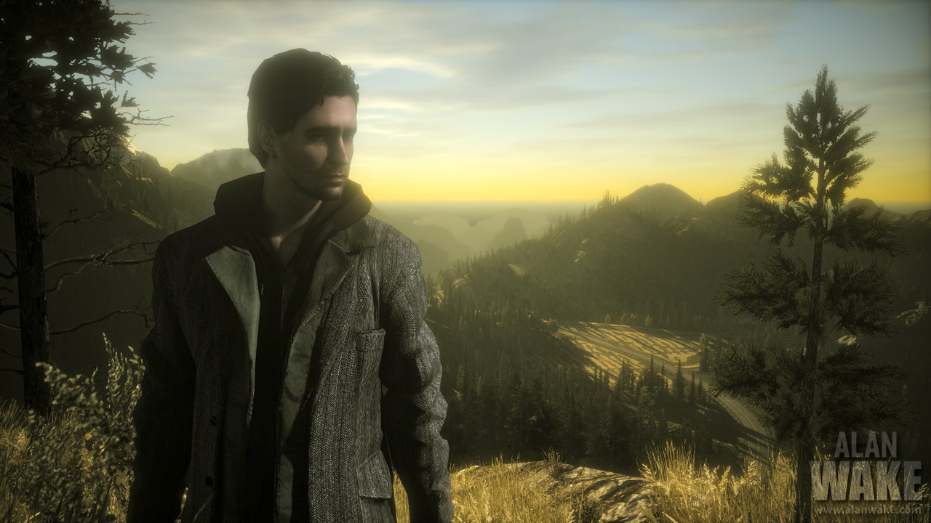

Slide 118
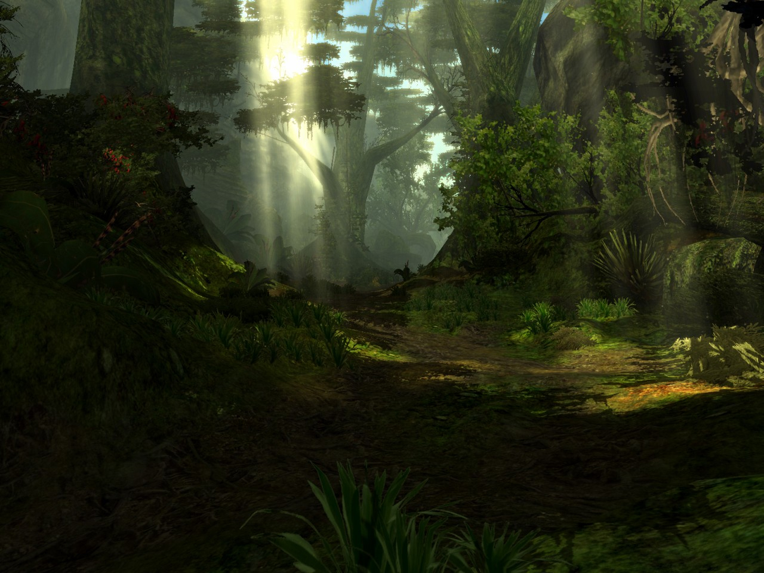
Age of Conan

Slide 119
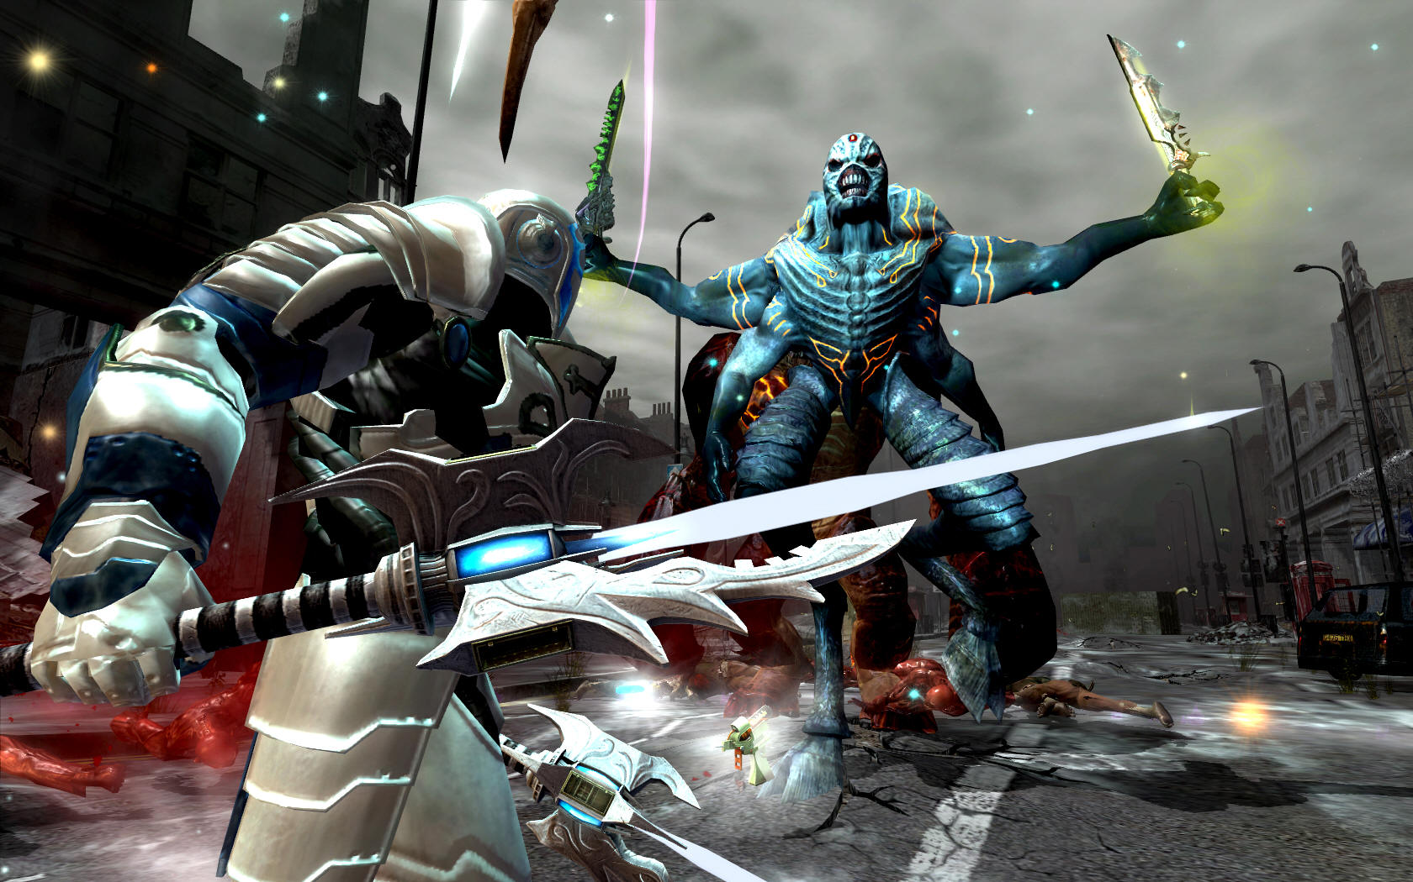

Slide 120
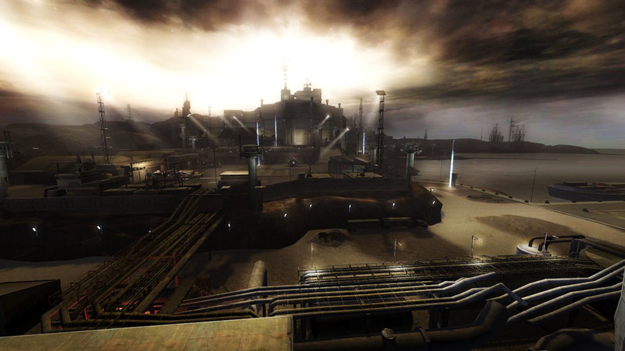
Stormrise

Slide 121
Cool Stuff
By the end of this course you will have the knowledge and skills to accomplish all of this!

Slide 122
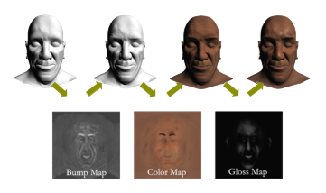
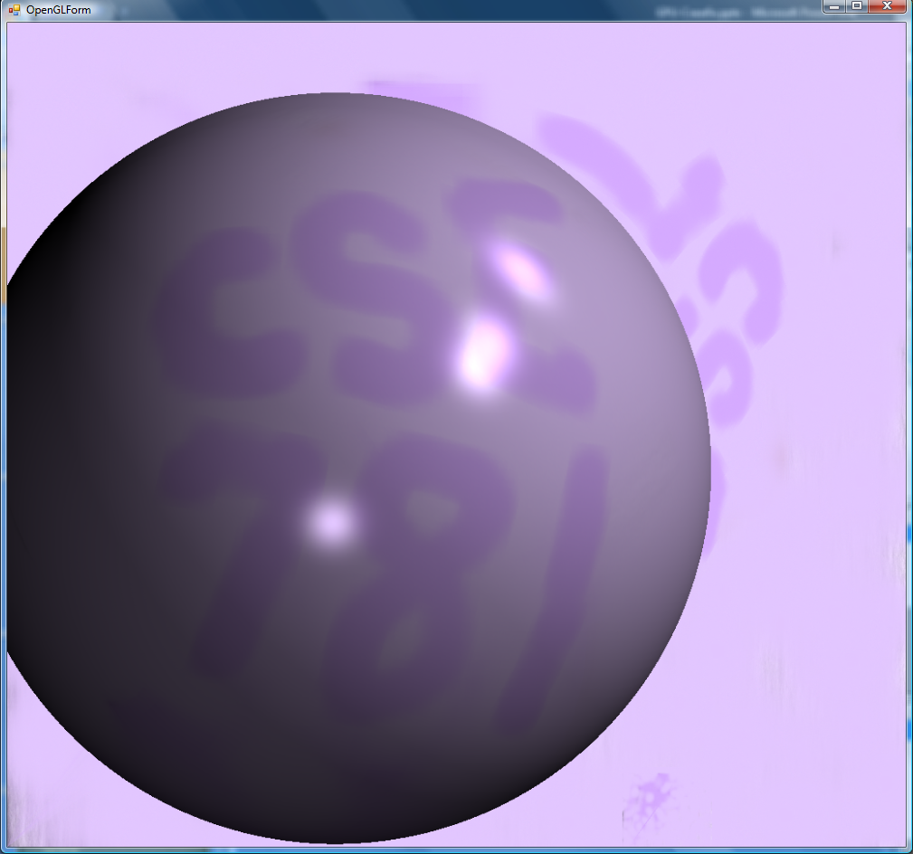
3D Paint

