Slide 1
Design Patterns in FPS Levels
Kenneth Hullett, Jim Whitehead

Slide 2
Introduction
FPS games can be divided into levels.
Level designer's responsibility:
Place game objects
Create maps
Control NPC's behavior
Consider challenge, pacing and navigation etc.
Goal: create a good gameplay.

Slide 3
What is a good gameplay?
Sensation - visual, special effect
Fantasy - writing, style of graphics
Narrative - sense of drama, plot or storyline
Challenge - difficulty level
Fellowship - companionship
Discovery - navigation
Expression - player to player interaction
Masochism - subjection to structure of the game.

Slide 4
Level design
Pacing
overall flow of movement impetus, threat, tension and tempo
Tension
sense of struggle and survive
Challenge
clear goal with uncertain attainment
Segmentation
temporal, spatial and challenge
Spatial Configuration
Navigation

Slide 5
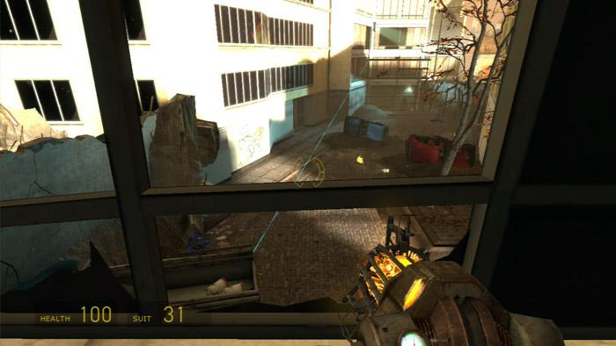
Pattern Collection
Sniper Location
Height of location
Available space for sniper
Amount of cover and coverable area
Accessible of location

Slide 6
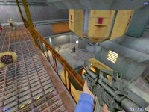
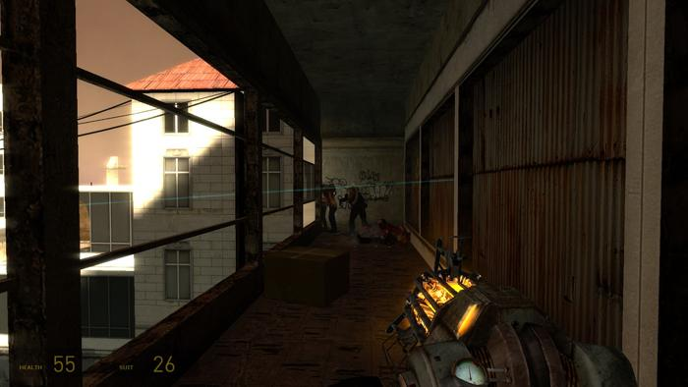
Gallery
The size of the passageway
Height if elevated area above passageway
The amount of cover

Slide 7
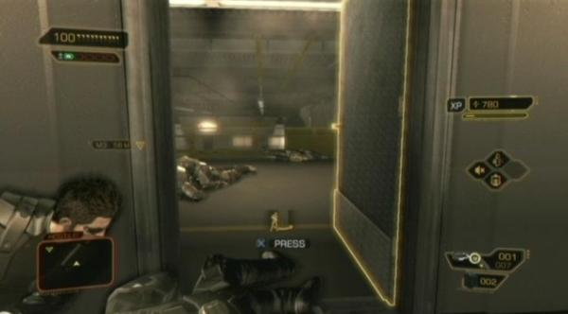
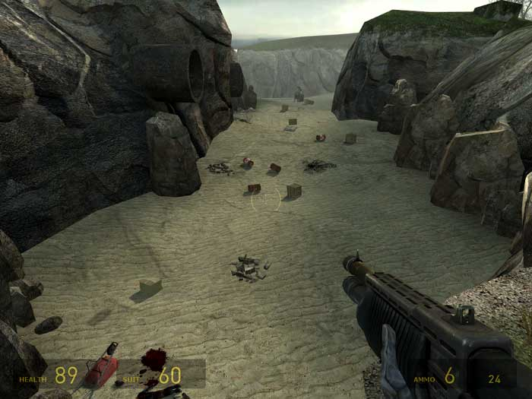
Choke Point
The width of the choke point opening
The length of the choke point

Slide 8
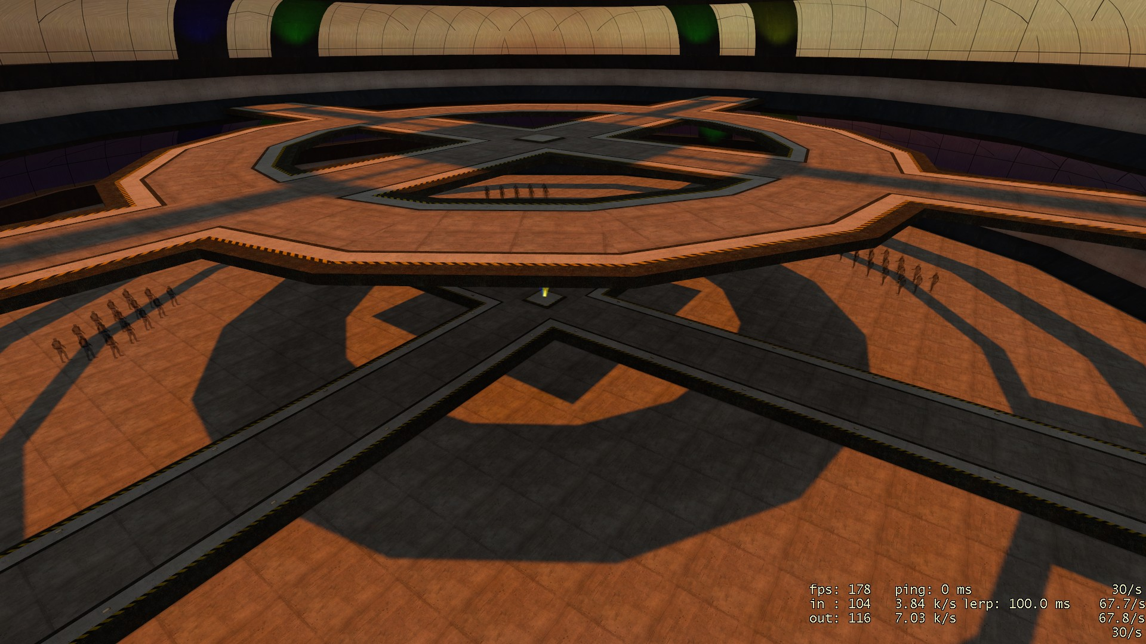
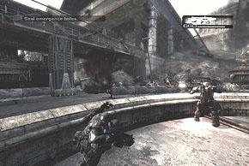
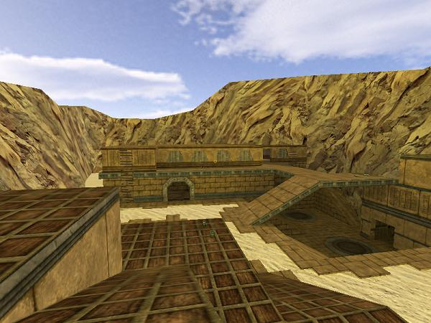
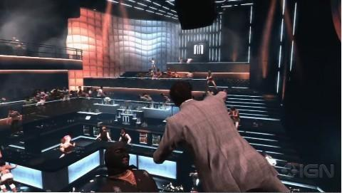
Patterns for Large-scale Combat
Arena
The size of the arena
The amount of cover

Slide 9
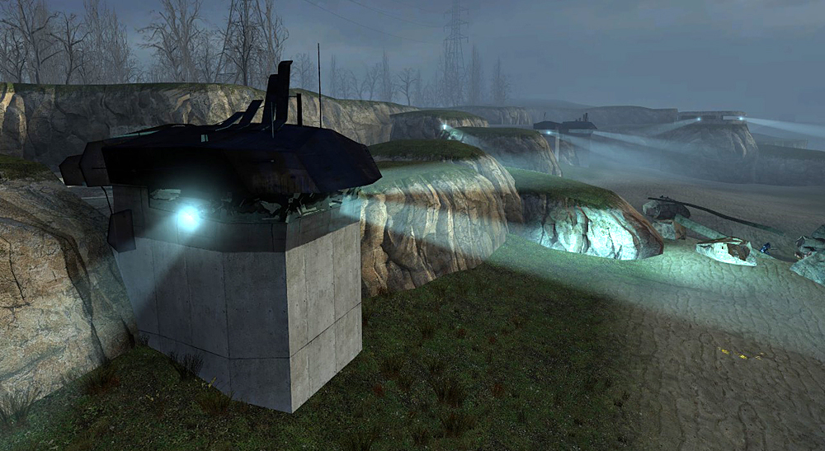
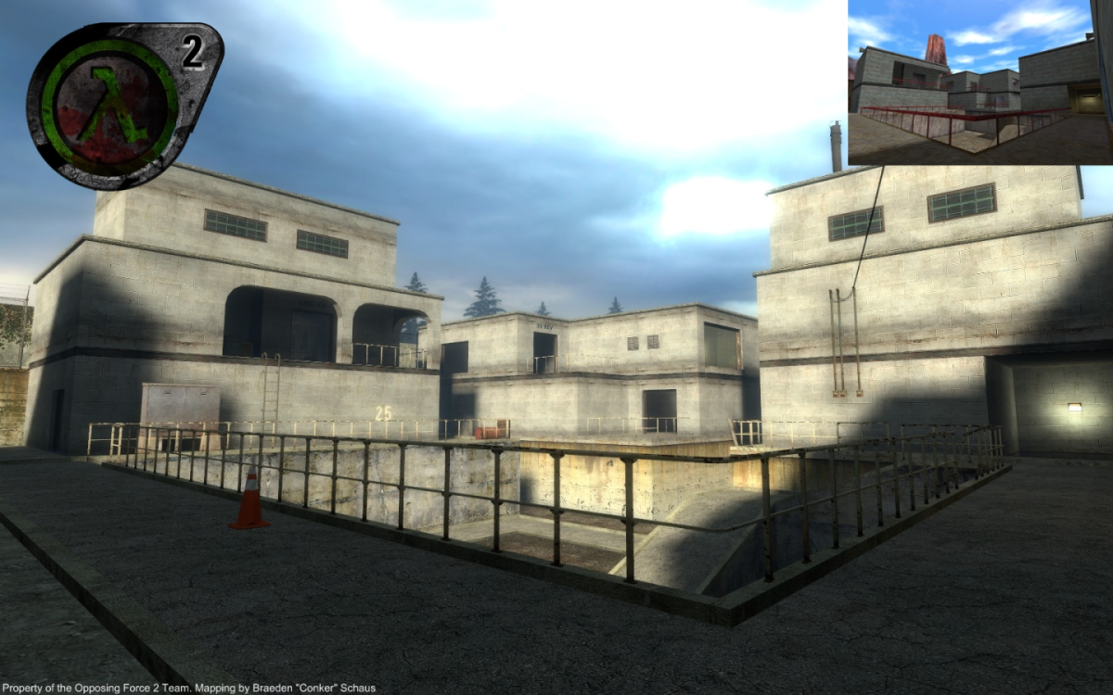
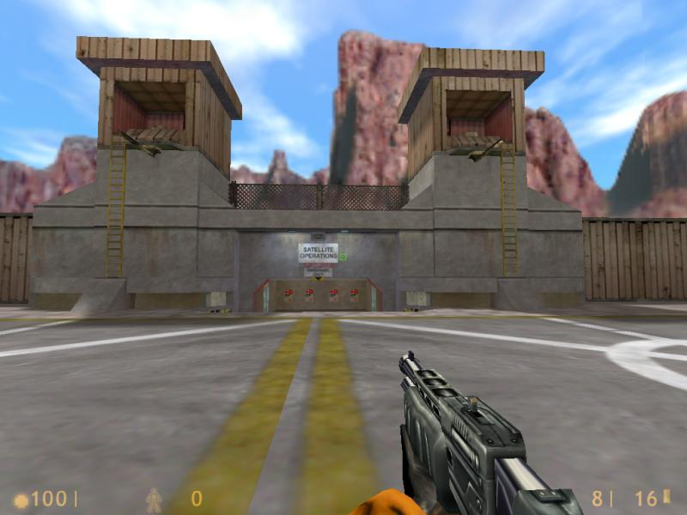
Stronghold
Size, amount of cover
Access point of stronghold
Level objective

Slide 10
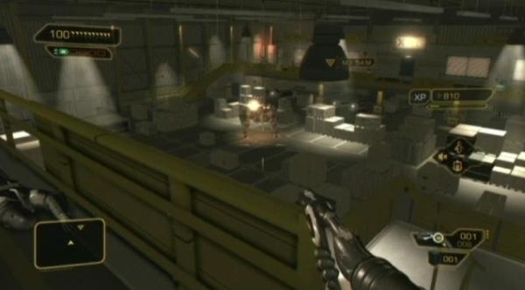
Patterns for alternative routes
Split Level
Difference in height between the levels
Openness between levels

Slide 11
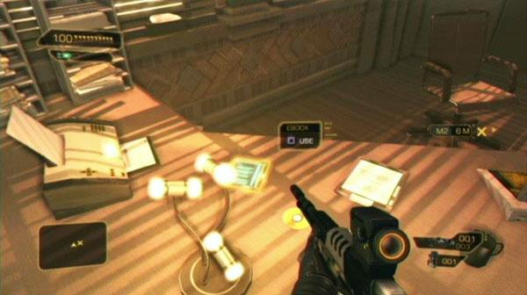
Hidden Area
Difficulty of finding
Rewards
Enemy NPC

Slide 12
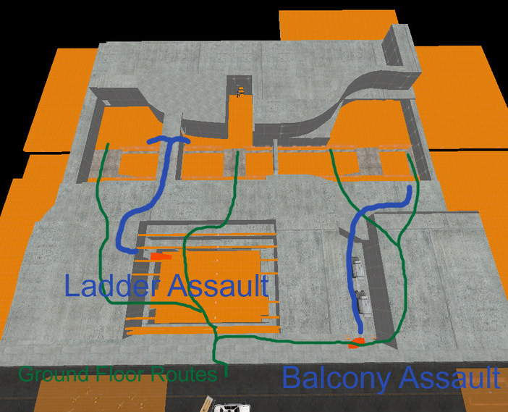
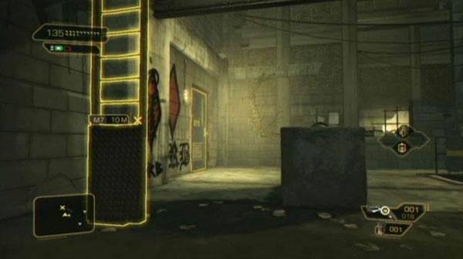
Flanking Route
The position that can be reached by flanking
amount of cover

Slide 13
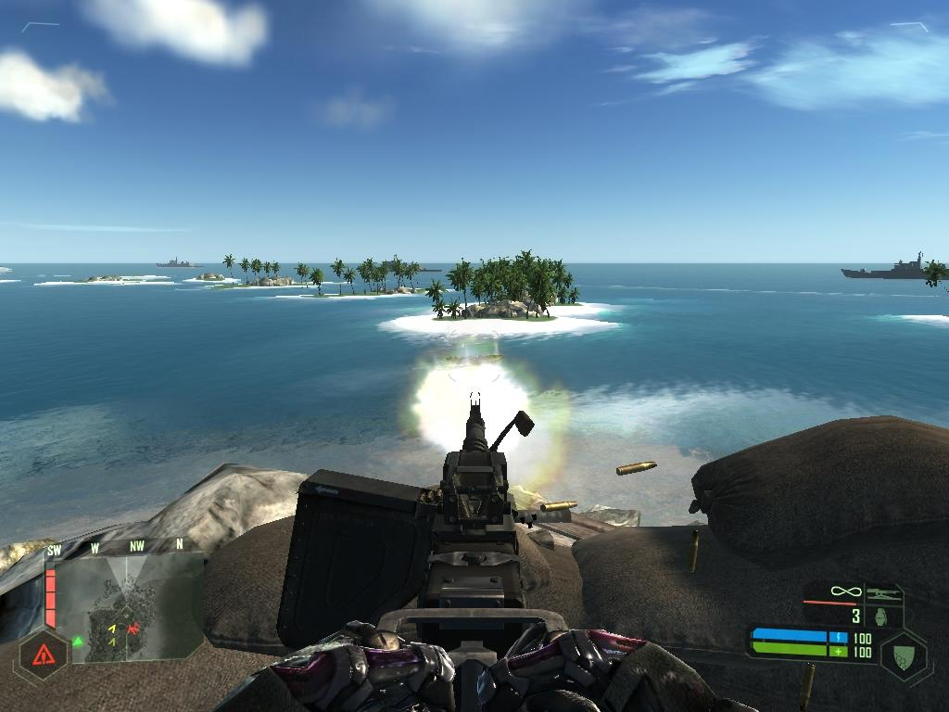
Patterns for alternate gameplay
Turret
Coverable area
Type of weapon
Amount of ammunition
Fixed/ flexible

Slide 14
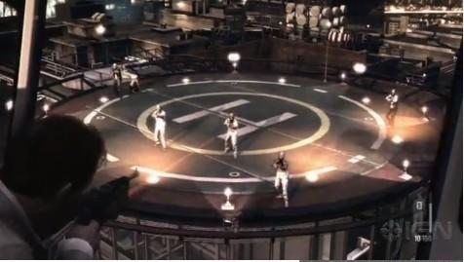
Vehicle Section
Driver/passenger
Type of vehicle
Vehicle section
Terrain type

