Slide 1
Procedural Content for Games Lab1 Results
CSE 788
Prof. Roger Crawfis

Slide 2
Lab1 Results
Many varied techniques

Slide 3
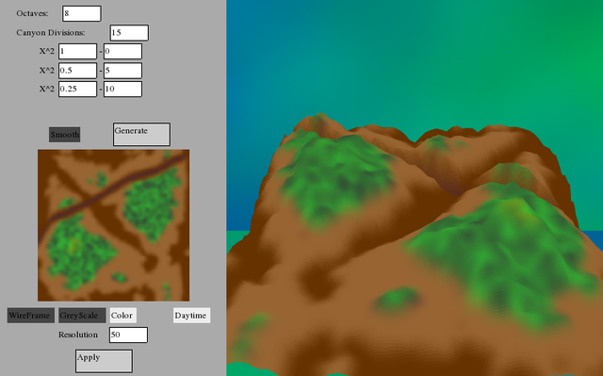

Slide 4
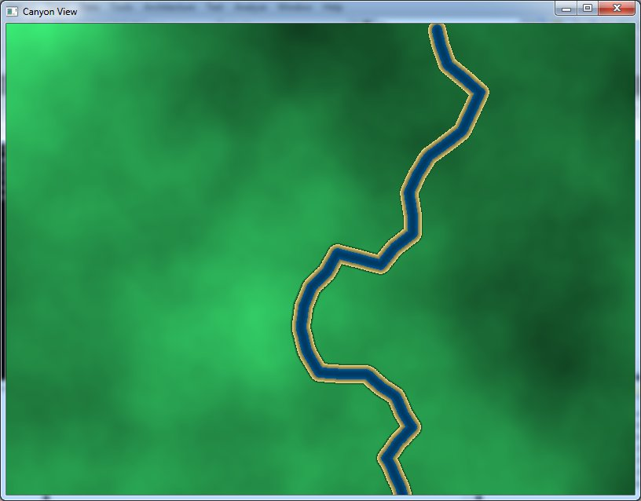

Slide 5
