Slide 1
Real-time Rendering Texture Mapping I
CSE 781
Prof. Roger Crawfis

Slide 2
What is an image?
How would I rotate an image 45 degrees?
How would I translate it 0.5 pixel?

Slide 3
What is a Texture?
Given the (u,v), want:
F(u,v) ==> a continuous reconstruction
= { R(u,v), G(u,v), B(u,v) }
= { I(u,v) }
= { index(u,v) }
= { alpha(u,v) }
= { normals(u,v) }
= { surface_height(u,v) }
= ...

Slide 4
What is the source of a texture?
Procedural Image
RGB Image
Intensity image
Opacity table

Slide 5
Procedural Texture
Periodic and everything else
Checkerboard
Scale: s= 10
if ((u * s) % 2 + (v * s)%2) <> 1
texture(u,v) = 0; // black
else
texture(u,v) = 1; // white

Slide 6
RGB Textures
Places an image on the object
Camuto 1998

Slide 7
Intensity Modulation Textures
Multiply the objects color by that of the texture.

Slide 8
Opacity Textures
A binary mask, really redefines the geometry.

Slide 9
Bump Mapping
This modifies the surface normals.
More on this later.
Lao 1998

Slide 10
Displacement Mapping
Modifies the surface position in the direction of the surface normal.
Lao 1998

Slide 11
Reflection Properties
Kd, Ks
BDRF’s (Bi-Directional Reflectance Function)
Brushed Aluminum
Tweed
Non-isotropic or anisotropic surface micro facets.

Slide 12
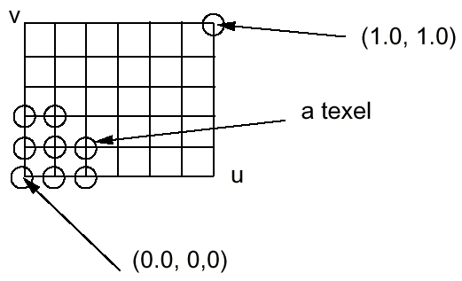
Texture and Texel
Each pixel in a texture map is called a Texel
Each Texel is associated with a 2D, (u,v), texture coordinate
The range of u, v is [0.0,1.0]

Slide 13
(u,v) tuple
For any (u,v) in the range of (0-1, 0-1), we can find the corresponding value in the texture using some reconstruction and re-sampling (i.e., interpolation).

Slide 14
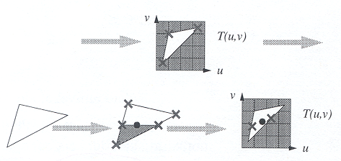
Two-Stage Mapping
Model the mapping: (x,y,z) -> (u,v)
Do the mapping

Slide 15
Image space scan
For each scanline, y
For each pixel, x
compute u(x,y) and v(x,y)
copy texture(u,v) to image(x,y)
Samples the warped texture at the appropriate image pixels.
inverse mapping

Slide 16
Image space scan
Problems:
Finding the inverse mapping
Use one of the analytical mappings that are invertable.
Bi-linear or triangle inverse mapping
May miss parts of the texture map
Texture
Image

Slide 17
Texture space scan
For each v
For each u
compute x(u,v) and y(u,v)
copy texture(u,v) to image(x,y)
Places each texture sample to the mapped image pixel.
forward mapping

Slide 18
Texture space scan
Problems:
May not fill image
Forward mapping needed
Image
Texture

Slide 19
Continuous functions F(u,v)
We are given a discrete set of values:
F[i,j] for i=0,…,N, j=0,…,M
Nearest neighbor:
F(u,v) = F[ round(N*u), round(M*v) ]
Linear Interpolation:
i = floor(N*u), j = floor(M*v)
interpolate from F[i,j], F[i+1,j], F[i,j+1], F[i+1,j+1]

Slide 20
How do we get F(u,v)?
Higher-order interpolation
F(u,v) = ∑ _{i}∑_{j} F[i,j] h(u,v)
h(u,v) is called the reconstruction kernel
Guassian
Sinc function
splines
Like linear interpolation, need to find neighbors.
Usually four to sixteen

Slide 21
Texture Parameterization
Definition:
The process of assigning texture coordinates or a texture mapping to an object.
The mapping can be applied:
Per-pixel
Per-vertex

Slide 22
Texture Parameterization
Mapping to a 3D Plane
Simple Affine transformation
rotate
scale
translate
y
z
x
v
u

Slide 23
Texture Parameterization
Mapping to a Cylinder
Rotate, translate and scale in the uv-plane
u -> theta
v -> z
x = r cos(theta), y = r sin(theta)
v
u

Slide 24
Texture Parameterization
Mapping to Sphere
Severe distortion at the poles
Non-invertible
u -> theta
v -> phi
x = r sin(theta) cos(phi)
y = r sin(theta) sin(phi)
z = r cos(theta)

Slide 25
Texture Parameterization
Mapping to a Cube
v
common
seam
u

Slide 26
Two-pass Mappings
Map texture to:
Plane
Cylinder
Sphere
Box
Map object to same.
v
u
u-axis

Slide 27
S and O Mapping
Pre-distort the texture by mapping it onto a simple surface like a plane, cylinder, sphere, or box
Map the result of that onto the surface
Texture → Intermediate is S mapping
Intermediate → Object is O mapping
S
T
(u,v)
(x_{i},y_{i})
(x_{o},y_{o},z_{o})
Texture space
Intermediate space
Object space

Slide 28
S Mapping Example
Cylindrical Mapping

Slide 29
O Mapping
A method to relate the surface to the cylinder
or
or

Slide 30
O Mappings Cont’d
Bier and Sloan defined 4 main ways
Reflected ray
Object normal
Object centroid
Intermediate surface
normal
Notes:
Should be single valued, invertable, and continuous mapping
Used in painting packages alot

Slide 31
Texture Parameterization
Plane/ISN (projector)
Works well for planar objects
Cylinder/ISN (shrink-wrap)
Works well for solids of revolution
Box/ISN
Sphere/Centroid
Box/Centroid
Works well for roughly
spherical shapes

Slide 32
Texture Parameterization
Plane/ISN

Slide 33
Texture Parameterization
Plane/ISN
Resembles a slide projector
Distortions on surfaces perpendicular to the plane.
Watt

Slide 34
Texture Parameterization
Cylinder/ISN
Distortions on horizontal planes
Draw vector from point to cylinder
Vector connects point to cylinder axis
Watt

Slide 35
Texture Parameterization
Sphere/ISN
Small distortion everywhere.
Draw vector from sphere center through point on the surface and intersect it with the sphere.
Watt

Slide 36
Texture Parameterization
What is this ISN?
Intermediate surface normal.
Needed to handle concave objects properly.
Sudden flip in texture coordinates when the object crosses the axis.

Slide 37
Texture Parameterization
Flip direction of vector such that it points in the same half-space as the outward surface normal.

Slide 38
3D Paint Systems
Determine a texture parameterization to a blank image.
Usually not continuous
Form a texture map atlas
Mouse on the 3D model and paint the texture image.
Lab2 demo

Slide 39
Texture Atlas
Find patches on the 3D model
Place these (map them) on the texture map image.
Space them apart to avoid neighboring influences.

Slide 40
Texture Atlas
Add the color image (or bump, …) to the texture map.
Each polygon, thus has two sets of coordinates:
x,y,z world
u,v texture

Slide 41
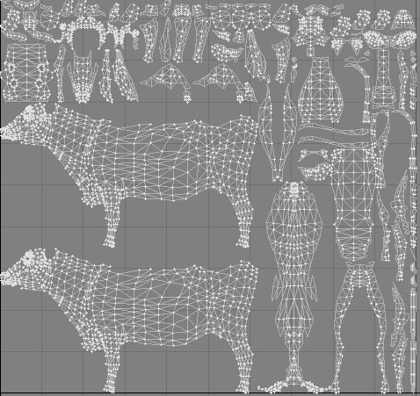
Example 2

Slide 42
3D Paint
To interactively paint on a model, we need several things:
Real-time rendering.
Translation from the mouse pixel location to the texture location.
Paint brush style depositing on the texture map.

Slide 43
3D Paint
Problems:
Mip-mapping leads to overlapped regions.
Large spaces in the texture atlas to avoid overlap really wastes texture space.
The texture arrays mitigate this.
A common vertex may need to be repeated with different texture coordinates.
The brush may need to be split into different parts according to the texture atlas.
The quality of the texture atlas is important

