Slide 1
Real-time Rendering
Advanced Shadow Maps
CSE 781
Prof. Roger Crawfis

Slide 2
Shadow Map Enhancements
Two main research thrusts.
  Shadow Map Filtering
    Variance Shadow Maps
    Convolution Shadow Maps
    Exponential Shadow Maps
    Layered Variance Shadow Maps
    …
  Shadow Map Projections
    Perspective Shadow Maps
    Trapezoidal Shadow Maps
    Cascade Shadow Maps
    Parallel-Split Shadow Maps
    …
I will cover Variance Shadow Map Filtering and briefly give the key concept behind several others. Most of these are very recent 2006-present, so the impact of the research is yet unknown.

Slide 3
Shadow Map Filtering
The major problem here is how to take N depth samples and store them or an approximation of their distribution.
We do not care about their locations, only that 20% are closer.
From statistics, we want a Probability Distribution Function (PDF).
See nVidia Slides.

Slide 4
Variance Shadow Maps
Andrew Lauritzen, RapidMind

Slide 5
Overview of Shadow Mapping
Introduced by Williams in 1978
Advantages compared to shadow volumes:
  Cost less sensitive to geometric complexity
  Can be queried at arbitrary locations
  Often easier to implement
Disadvantages:
  Aliasing
Notes:
Don’t need to worry as much about special cases, capping geometry, etc.

Slide 6
Shadow Mapping Algorithm
Render scene from light’s point of view
  Store depth of each pixel
When shading a surface:
  Transform surface point into light coordinates
  Compare current surface depth to stored depth
  If depth > stored depth, the pixel is in shadow; otherwise the pixel is lit

Slide 7
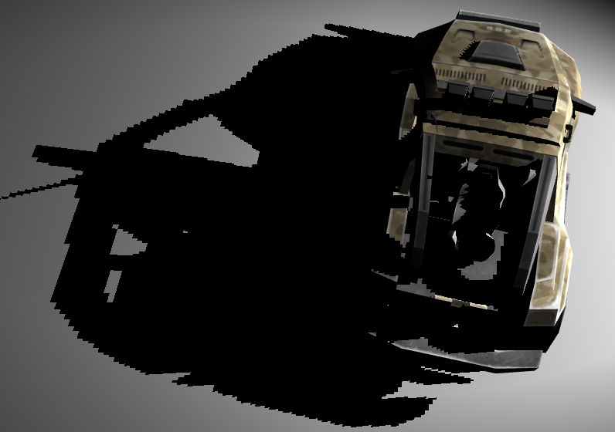

Aliasing Artifacts
Magnification artifacts
Notes:
Can be addressed to some extent by increasing shadow map resolution. However maximum texture size limits are reached quickly, and are still inadequate (and needlessly expensive) for a large scene.
This is a 512x512 shadow map.

Slide 8
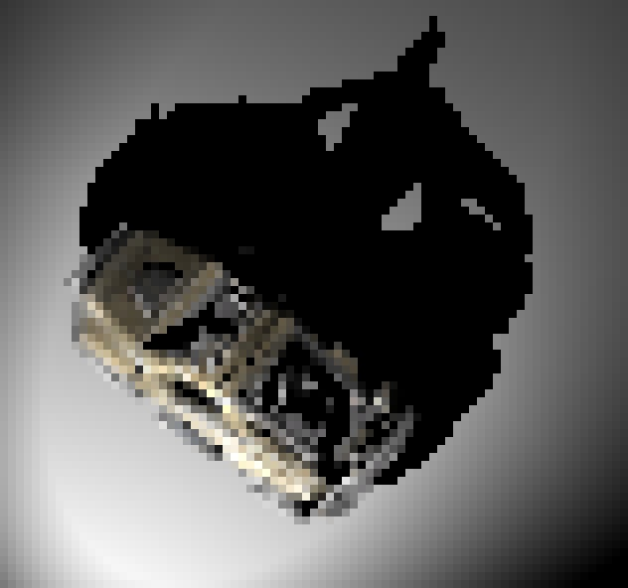

Aliasing Artifacts
Minification artifacts
  Typically encountered when viewed from a distance
  Produces ugly and distracting “swimming” effect along shadow edges

Slide 9
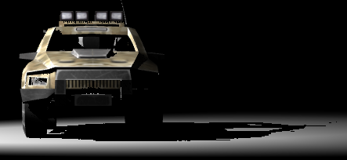
Aliasing Artifacts
Anisotropic artifacts
  A mix of minification and magnification
  Encountered at shallow angles

Slide 10
Solutions?
Also encountered with colour textures
Reduce aliasing by hardware filtering
  Magnification artifacts => linear interpolation
  Minification artifacts => trilinear, mipmapping
  Anisotropic artifacts => anisotropic filtering

Slide 11
Solutions?
Can we apply these to shadow maps?
  Not at the moment
Interpolating depths is incorrect
  Gives depth < average(occluder_depth)
  Want average(depth < occluder_depth)
Notes:
Occluder depth is stored in the shadow map.

Slide 12
Percentage Closer Filtering
Proposed by Reeves et al. in 1987
Filter result of the depth comparison
  Sample surrounding shadow map pixels
  Do a depth comparison for each pixel
  Percentage lit is the percentage of pixels that pass the depth comparison (i.e. are “closer” than the nearest occluder)
NVIDIA hardware support for bilinear PCF
Good results, but can be expensive!
Notes:
For example, combining PCF with mipmapping would require a comparison with *every* pixel in the shadow map in the worst case.

Slide 13
Occluder Distribution
Really want a cumulative distribution function (CDF) of a set of depths
  F(t) = P(x≤t)
  F(t) is the probability that a fragment at distance “t” from the light is in shadow
1
f(t)
F(t)
0
t
t
Notes:
Cumulative distribution function allows us to compute the probability that a fragment is in shadow directly.
Example probability density function and associated cumulative distribution function is shown. For shadows, the example could be something like participating media with higher particle density in the interior of the “cloud”.

Slide 14
Deep Shadow Maps
Lokovic and Veach, in 2000
Per-pixel piecewise linear function
No hardware filtering
Complex reconstruction
Notes:
Deep shadow maps can handle complex high-frequency geometry and volumetric effects, but require variable storage per-pixel, making the reconstruction and evaluation expensive.
Don’t utilize the filtering and antialiasing hardware that we have available on GPUs.

Slide 15
Occluder Distribution
A representation that filters linearly?
  Allows us to utilize hardware filtering
Idea: Moments of distribution function!
  E(x) is the mean, E(x²), E(x³), etc.
  Linear in distribution

Slide 16
Variance Shadow Maps
Store depth squared as well as depth
  Gives E(x) and E(x²) where x is the depth of the nearest occluder
  Use the moments to approximate the fraction of the distribution that is more distant than the surface point being shaded
Notes:
When linearly filtered, we get the average of whatever components we store.

Slide 17
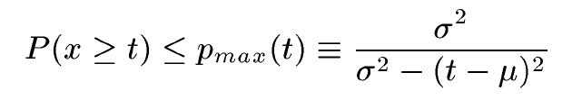
Variance Shadow Maps
We want to find P(x≥t)
We have the mean, and can find variance:
  μ = E(x)
  σ² = E(x²) – E(x)²
Cannot compute CDF exactly
Chebyshev’s Inequality states:
Notes:
Recall x is a random variable representing the occluder depth distribution function, and t is the current fragment depth. Thus P(x>=t) is precisely the percentage of fragments over the filter region that are more distant than the current fragment, i.e. the percentage of fragments that are lit.
Note: this version of Chebyshev’s inequality is valid when t > mu.

Slide 18
Variance Shadow Maps
Inequality only gives an upper bound
  Becomes equality in the case of single planar occluder and receiver
  In a small neighbourhood, an occluder and receiver will have constant depth and thus p_{max} will provide a close approximation to p
So just use p_{max} for rendering

Slide 19
Implementation
// Call the parent light shader
light_contrib & dir_to_light & dist_to_light & n_dot_l =
spot_light_shader(surf_position, surf_normal);
// Transform the surface position into light space and project
ShAttrib4f surf_light = light_view_projection | surface_position;
ShTexCoord2f tex_coord = 0.5 * surf_light(0,1)/surf_light(3) + 0.5;
// Query the shadow map
ShAttrib2f moments = shadow_map(tex_coord);
// Standard shadow map comparison
ShAttrib1f lit_factor = (dist_to_light <= moments(0));
// Variance shadow mapping
ShAttrib1f E_x2 = moments(1);
ShAttrib1f Ex_2 = moments(0) * moments(0);
ShAttrib1f variance = E_x2 - Ex_2;
ShAttrib1f m_d = moments(0) - dist_to_light;
ShAttrib1f p_max = variance / (variance + m_d * m_d);
// Attenuate the light contribution as necessary
light_contrib *= max(lit_factor, p_max);
Notes:
Uses Sh. See http://www.rapidmind.net and http://libsh.org.
So when t <= mu, contrib is always 1 (i.e. full light contribution). When t > mu, contrib = p_{max}.

Slide 20
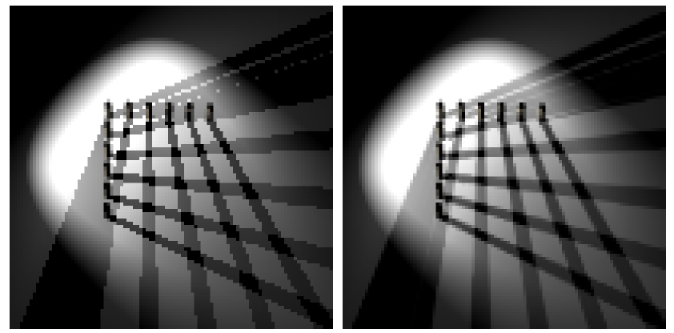
Mipmapping Results
Shadow Map
Variance Shadow Map

Slide 21
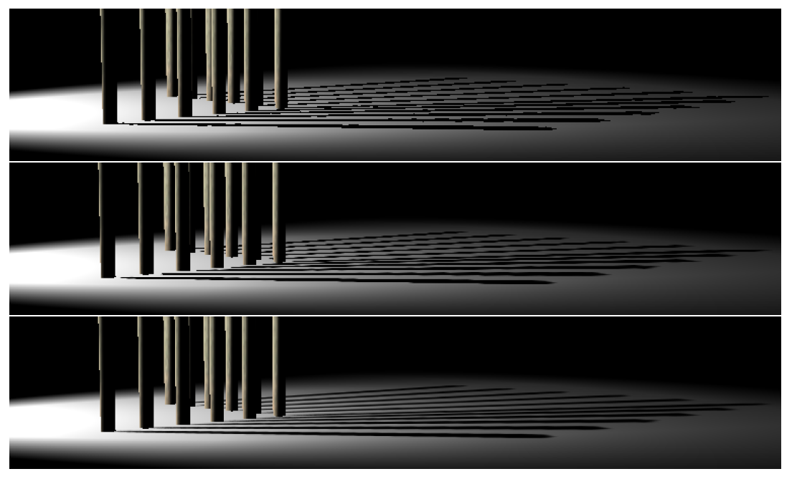
Anisotropic Filtering Results
Shadow Map
Bilinear PCF
Variance Shadow Map
Notes:
Top is standard shadow mapping.
Middle is bilinear percentage closer filtering.
Bottom is variance shadow maps with hardware anisotropic filtering.

Slide 22
Variance Shadow Maps
Can we do more?
  Our shadow maps can be arbitrarily filtered now
Pre-filter shadow map using a Gaussian blur
  Equivalent to percentage closer filtering
  Separable convolution => O(n) on kernel size
  Much faster than PCF complexity of O(n²)

Slide 23
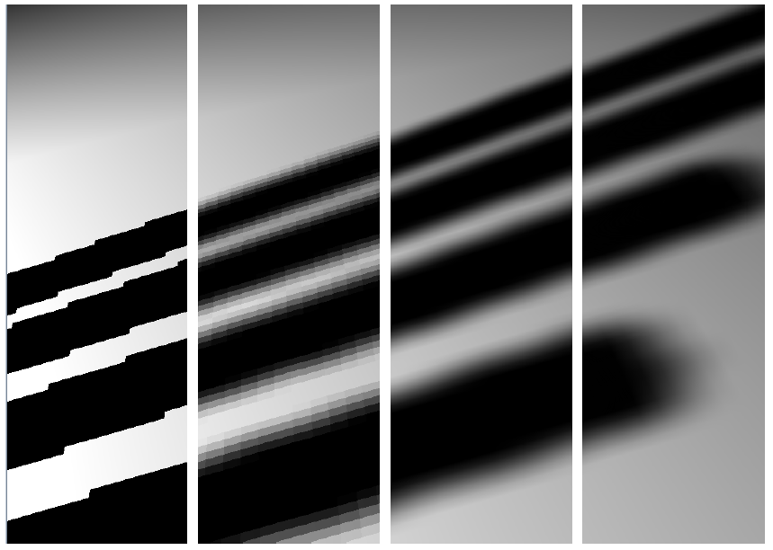
Gaussian Blur Results
SM
PCF 5x5
Bil.PCF 5x5
VSM
Notes:
Left to right:
Standard shadow mapping.
5x5 percentage closer filtering.
5x5 bilinear percentage closer filtering.
Variance shadow mapping with 5x5 gaussian blur.

Slide 24
Super-sampling
Generate more samples and filter
  Render large shadow map and down-sample
  Or simply use texture LOD bias
Tiled rendering of a huge shadow map
  Render 4 tiles at 4096x4096 each
  Down-sample to a single texture
  Gives an anti-aliased 4096x4096 shadow map

Slide 25
Multi-sampling
Simply enable multi-sampling while rendering the shadow map
Support is dependent on chosen texture format
  More of this later…
Notes on gamma correction
  Hardware might “gamma correct” the samples
  This is incorrect for non-colour data!
  Ideally we want to turn this “feature” off…
Notes:
Some hardware doesn’t enable gamma correction for floating point render targets. This works well for us here.

Slide 26
Other Fun Stuff
Orthogonal to projection-warping techniques
  Perspective shadow maps (PSM)
  Trapezoidal shadow maps (TSM)
Notes:
2-component 16-bit fixed point formats that can be filtered available.
Can be combined trivially with trapezoidal or perspective shadow maps.

Slide 27
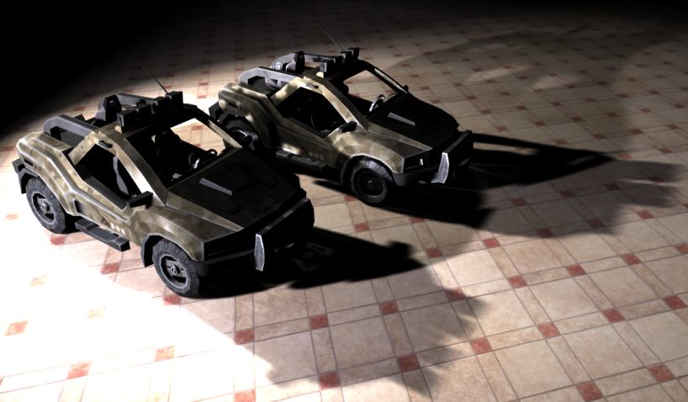
Demo

Slide 28
Texture Formats
Ideal texture format:
  Renderable
  Two components
  High precision
  Supports filtering (anisotropic, mipmapping)
  Supports multisampling

Slide 29
Depth and Shadow Formats
+/- Indirectly renderable
- Single-component
- Often highly non-uniform precision
- Do not support arbitrary linear filtering
  Mipmapping, trilinear, anisotropic, etc.
- Do not support multisampling
Not the way to go…
Notes:
Really want to just output some value and save it. We need more than a simple depth buffer here.

Slide 30
Floating-point Formats
No renderable two-component formats!
4x fp16
  + NVIDIA GeForce 6/7 supports filtering!
  +/- Average precision
  +/- Some hardware supports multisampling
4x fp32
  + Great precision
  - No filtering on current hardware
  - No multisampling on current hardware
Probably the best current options

Slide 31
Fixed-point Formats
8-bit formats?
  - Poor precision makes these unusable
2x 16-bit (i.e. G16R16)
  + Two component
  + Often supports filtering
  +/- Renderable on some hardware
  +/- Acceptable precision (at least as good as fp16)
  +/- Some hardware supports multisampling
Dreaming:
  2x 32-bit filterable fixed point format?

Slide 32
Texture Format Summary
Floating-point formats probably the best
  Ideally we want filterable fp32
16-bit fixed-point formats could work too
  Dependent on what hardware supports

Slide 33
Numerical Stability
Recall the computation of variance:
  σ² = E(x²) – E(x)²
Highly numerically unstable!
Recall Chebyshev’s Inequality:
Can be a problem when fragment is near occluder
Need a high-precision texture format

Slide 34
Ways to Improve Stability
Can use any distance metric that we want
  Post-projection “depth” (z) is a bad choice
  Use a linear metric, ex. distance to camera
When using floating-point formats
  Rescale the numeric range to fall in [-1, 1]
  Gets an extra bit of precision from the sign
Notes:
Since our model is probabilistic, all we need is a strictly ordered depth metric.
Standard depth buffer value is fine for comparison, but bad for math. As soon as we get even a small ways from the near clip plane, precision drops off drastically.

Slide 35
Ways to Improve Stability
Four-component floating-point formats
  Store extra precision in extra components
  Must still filter linearly!!!
Example encoding:
Example decoding:
ShAttrib2f moments = (...);
ShOutputAttrib4f output;
const float factor = 64.0f; // Try to gain 6 more bits
output(0,1) = frac(moments * factor) / factor;
output(2,3) = moments - output(0,1);
ShAttrib4f input = shadow_map(tex_coord);
ShAttrib2f moments = input(0,1) + input(2,3);
Notes:
Recall that we can’t render to two-component floating point formats, so let’s put those other two components to *some* use!
Even with this trick, still don’t get nearly as much precision as fp32.

Slide 36
Ways to Improve Stability
Use a 32-bit per component floating-point texture!
We’ve had no precision problems with fp32

Slide 37
Notes on Shadow Bias
Biasing depth comparison usually required
  Proportional to slope of polygon (glPolygonOffset)
  Scene dependent and error-prone
Not required for variance shadow maps!
  If (t – μ) ~ 0 then p_{max} ~ 1
May want to bias variance very slightly
  For numeric stability reasons
  This is neither slope nor scene dependent!
Notes:
P_{max} becomes sigma^2 / sigma^2 (i.e. variance over variance) ~ 1.

Slide 38
How Fast?
GeForce 6800GT @ 1024x768
Notes:
Note that these techniques are not all comparable in quality.
Vanilla variance shadow maps are slightly slower than shadow mapping, and about the same speed as bilinear PCF.
For larger PCF/blur kernels, variance shadow maps will ultimately win due to their separable convolution filter and single texture read per framebuffer fragment.

Slide 39
How Fast?
Fix shadow map at 512x512
Notes:
Percentage closer filtering is done per lit fragment, and so it scales with framebuffer resolution.
Pre-filtering variance shadow maps is done once before rendering, and so scales only with shadow map size.

Slide 40
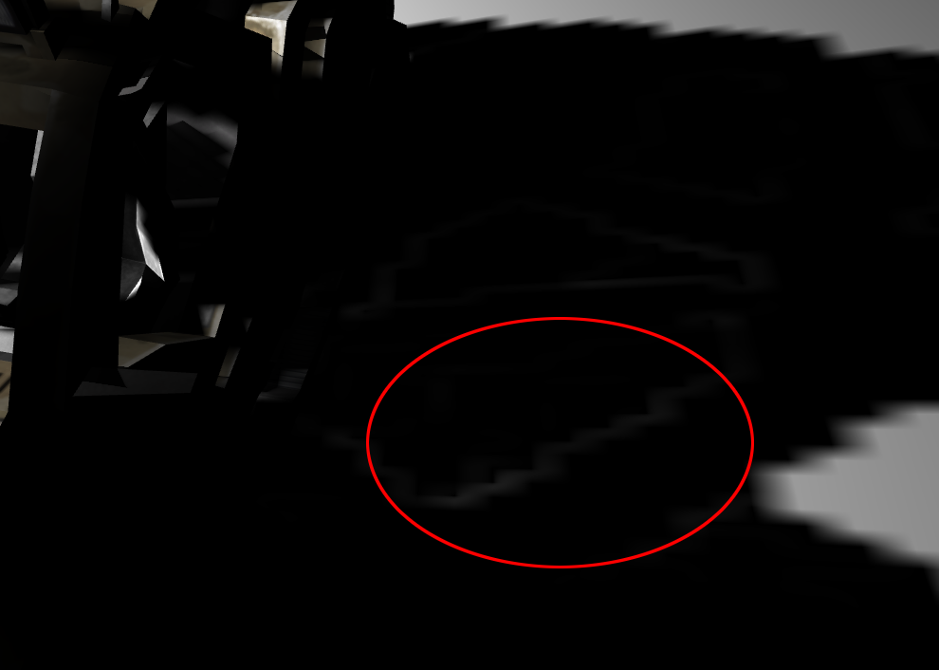
Light Bleeding
p_{max} works in many situations, but not all
When σ² is large, can get “light bleeding” :
Notes:
I’ve adjusted the contrast in the image to make the error more visible.

Slide 41
Ways to Reduce Light Bleeding
Lower depth complexity in light space
  Ex. Use variance shadow maps for the sun, not headlights
  Construct scenes with this artifact in mind
  Control attenuation ranges carefully
Use ambient or multiple lights
  Contrast will be lessened
Use static lights
  Moving lights makes the projection obvious
Use smaller filter regions
  Artifact is only as large as the filter region
Notes:
Light bleeding is potentially worse with large filter kernels.

Slide 42
Ultimate Solutions
Find a higher-order inequality?
Fast, programmable hardware filtering?
Combine with percentage closer soft shadows
  Randima Fernando (NVIDIA), 2005
  Cheap, perceptually-correct soft shadows?
Lots of potentially fruitful hybrid techniques!
Notes:
Light bleeding is potentially worse with large filter kernels.

Slide 43
Conclusion
Introduced a simple solution to many forms of shadow map aliasing
Implemented easily on modern hardware
Compares favourably in both performance and quality to existing techniques

Slide 44
For More Information…
Donnelly and Lauritzen, Variance Shadow Maps, ACM Symposium on Interactive 3D Graphics and Games 2006
http://www.punkuser.net/vsm/
Questions?

Slide 45

The Source for GPU Programming

Slide 46
Real-time Rendering
Variance Shadow Maps
CSE 781
Prof. Roger Crawfis
http://http.developer.nvidia.com/GPUGems3/gpugems3_ch08.html

Slide 47
Magnification Artifacts
Notes:
Can be addressed to some extent by increasing the shadow map resolution, but this doesn’t scale.

Slide 48
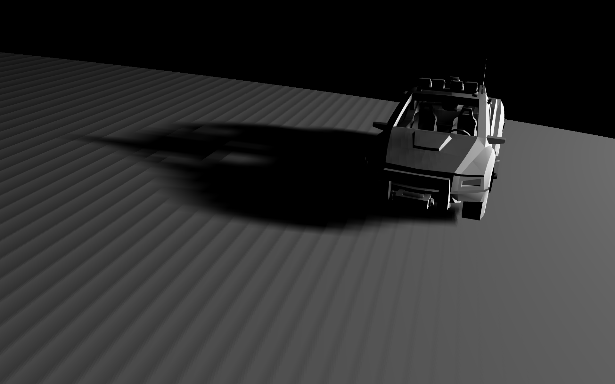
Biasing Artifacts
Notes:
Both types of biasing artifacts (improper self-shadowing and shadow “pull-away”) are visible in this one picture, which means biasing the depth cannot solve both of these problems.

Slide 49
Solutions
Magnification artifacts:
  Improve the projection (warping, etc.)
  Parallel-split/cascaded shadow maps
Minification artifacts:
  Percentage closer filtering
  Trilinear filtering with variance shadow maps
Biasing
  Using back faces/midpoints
  Biasing the depth
  Variance shadow maps
Notes:
Projection warping/splitting totally compatible with VSM.
PCF is slow (O(n^2)) and makes biasing worse. It gets particularly expensive when filtering is used to soften shadow edges.
Rendering back faces can help, but it messes up contact points (shadows tend to pull away). Midpoints works better but is more expensive to render and has the same biasing problems for thin objects.
Biasing depth works “okay”, but it cannot be made perfect and gets unworkable as filter widths increase.

Slide 50
Variance Shadow Maps (VSM)
Store depth squared as well as depth
Do any linear filtering
  Multi-sampling and blurring
  Tri-linear and anisotropic filtering
Single lookup into shadow map
  Yields E(x) and E(x²) where x is the depth of the nearest occluder
Use Chebyshev’s Inequality to compute the shadow attenuation

Slide 51
Problems Solved by VSMs
Efficient filtering!
  Hardware filtering
  Separable O(n) pre-filtering (blur)
Biasing
  Large filter regions are automatically handled properly
  Can account for the extents of a single shadow map texel using the second moment

Slide 52
Mipmapping Results

Slide 53
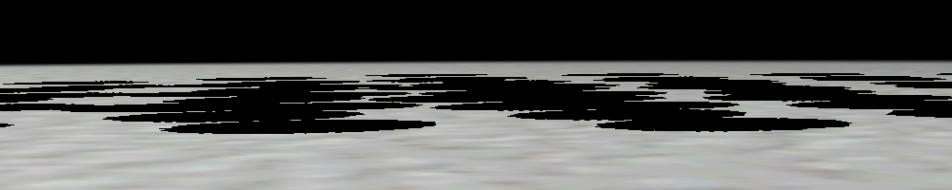
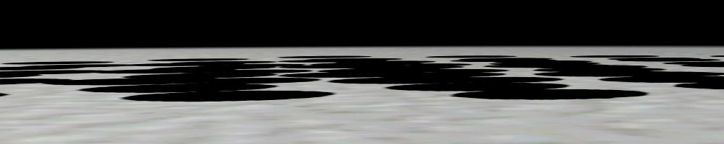
Anisotropic Filtering Results

Slide 54
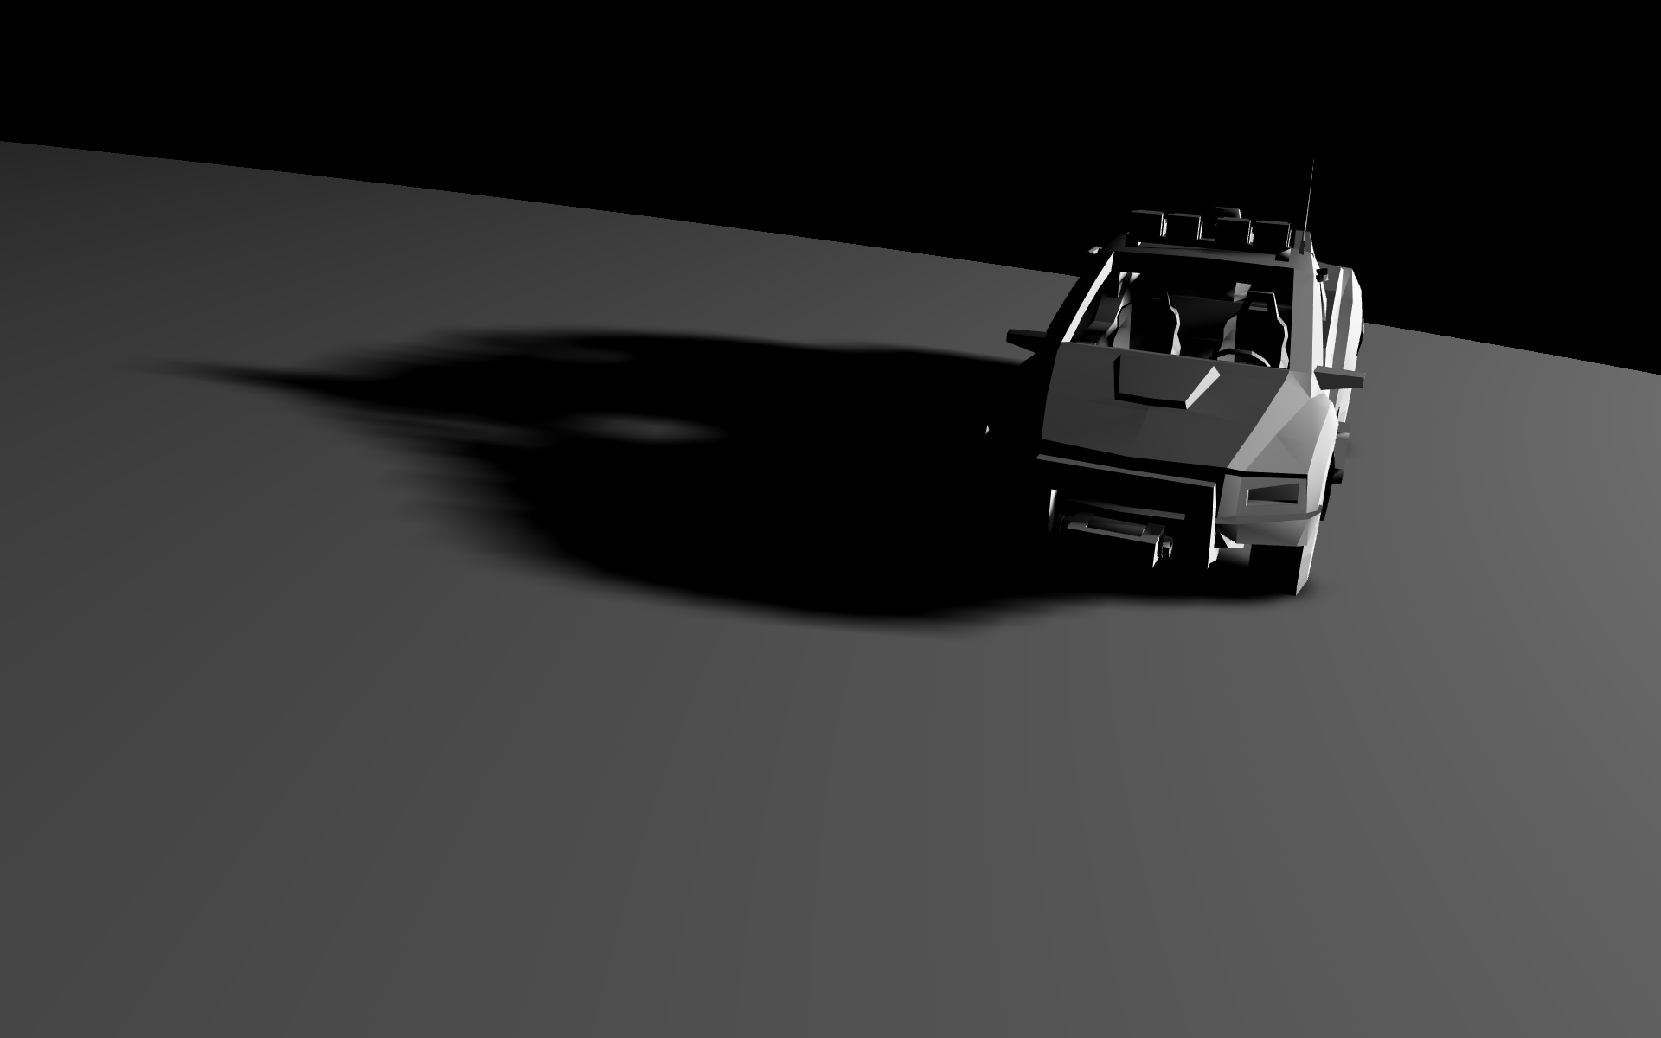
Biasing Artifacts Resolved

Slide 55
Problems with VSMs
Light bleeding
Want arbitrary per-pixel filter regions for plausible soft shadows
  Not possible with pre-filtering

Slide 56
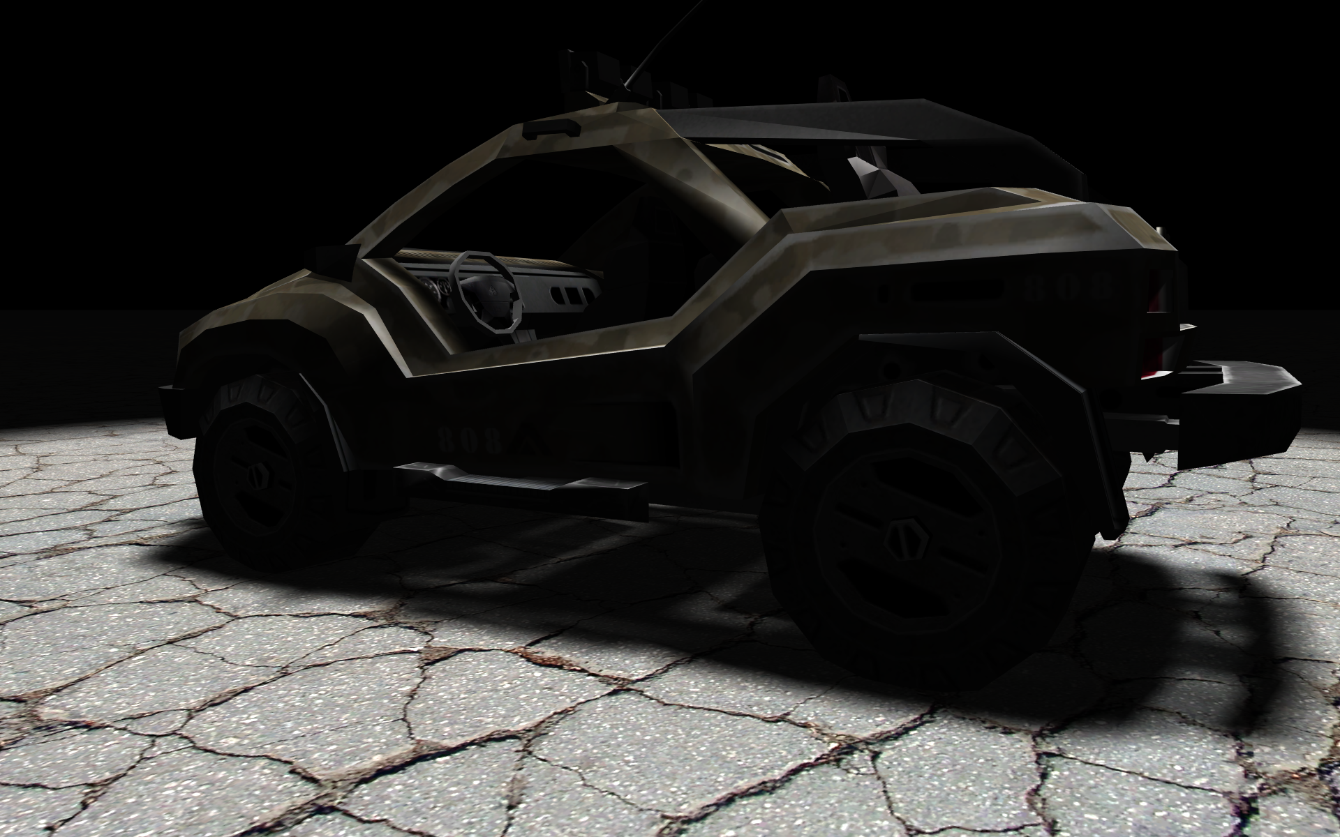
Light Bleeding

Slide 57
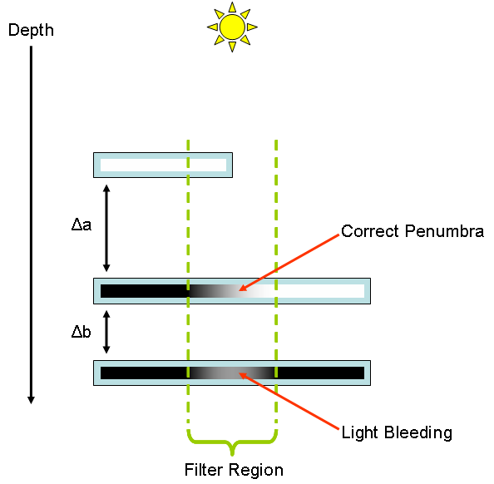
Light Bleeding
Notes:
Light bleeding gets worse as the ratio delta_a to delta_b increases.

Slide 58
Light Bleeding Reduction
Cannot be solved without taking more samples!
Can be reduced quite easily:
  Light bleeding regions never reach 100% illumination
  Cut off the tail of the function to eliminate light bleeding while over-darkening some penumbrae regions
  Effectively “free” performance-wise
  Artist editable “aggressiveness” parameter

Slide 59
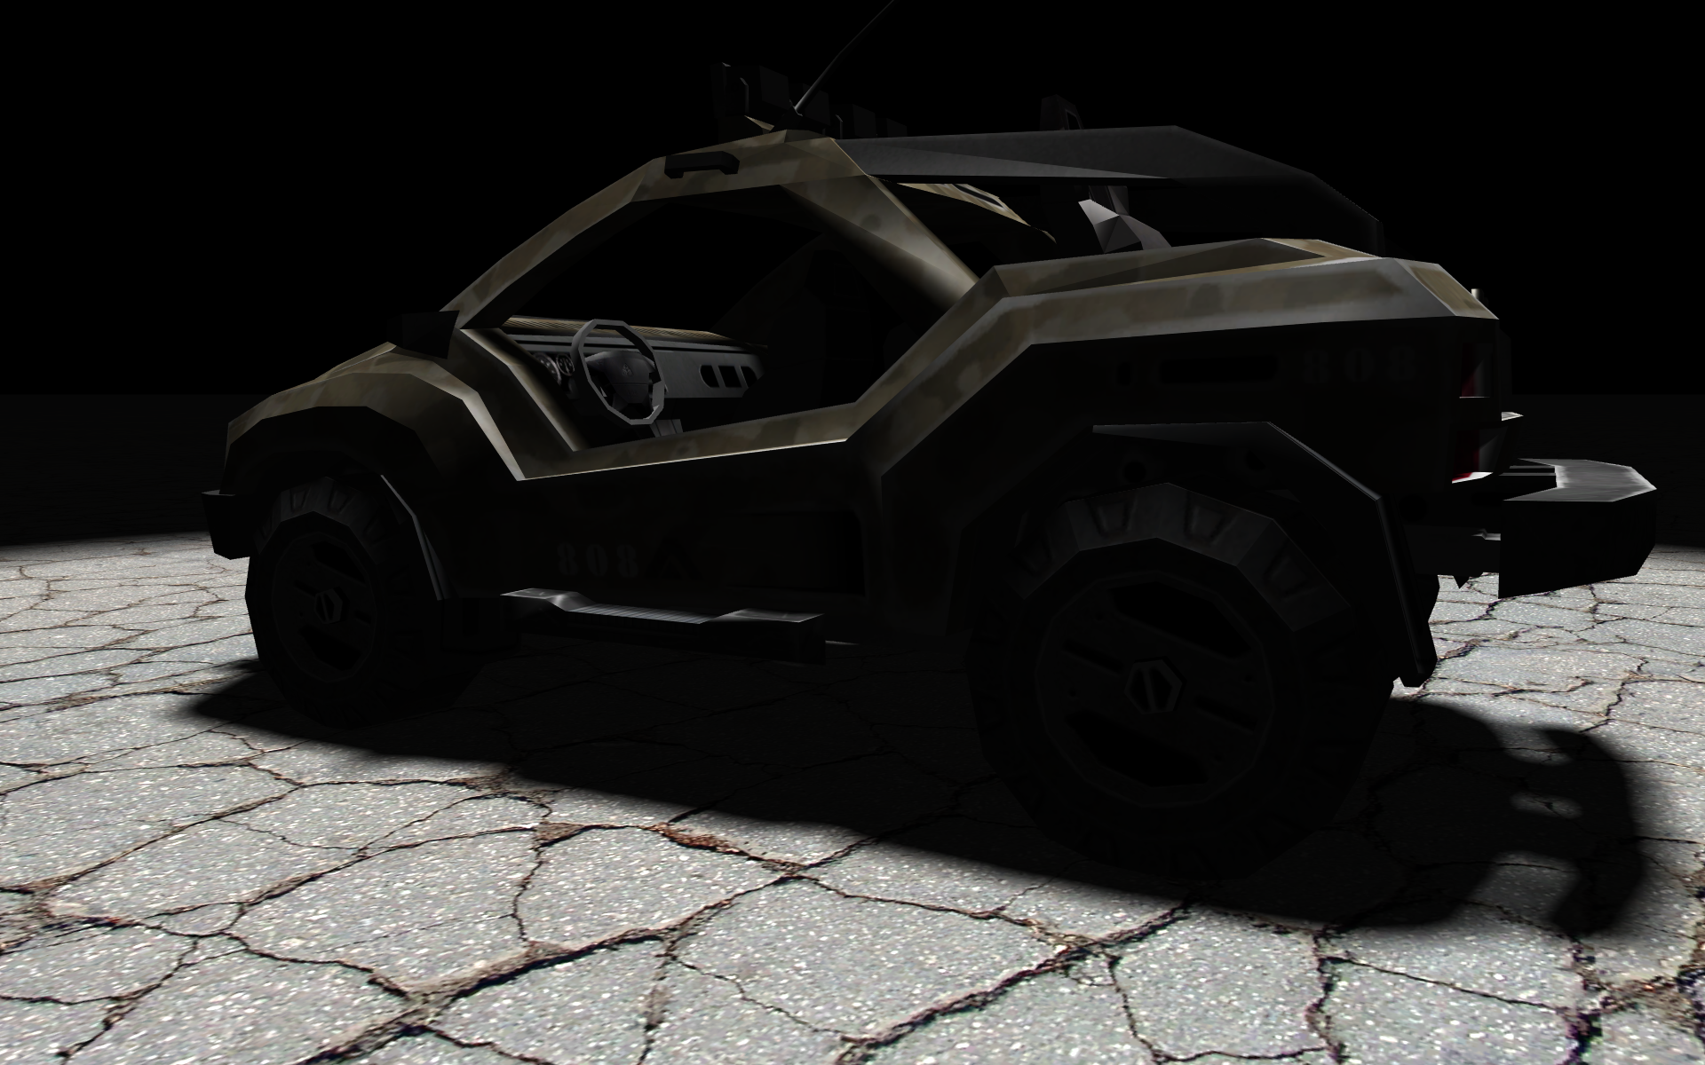
Light Bleeding Reduction
Notes:
Works really well in practice for all but the most stubborn scenes.
Stay tuned for efficient ways to scale up VSM to use more data and adaptively account for complex areas.

Slide 60
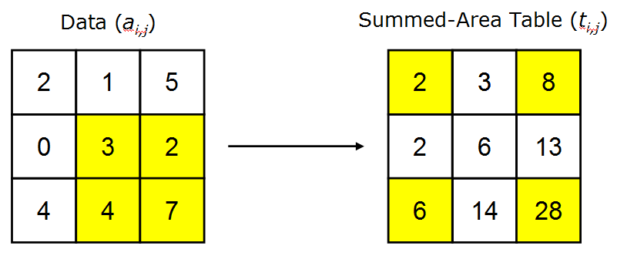
Efficient Soft Edges
Build a summed-area table from the shadow map
  Can be done efficiently on the GPU
Summing arbitrary rectangles is O(1)!
Notes:
28 – 8 – 6 + 2 = 16

Slide 61
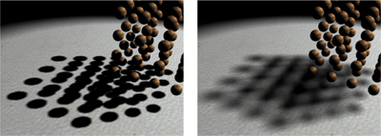
Percentage-Closer Soft Shadows
Replace filtering step with summed-area variance shadow maps (Fernando, 2005)
Notes:
25fps vs 40fps even with equalizing bottleneck of blocker search.

Slide 62
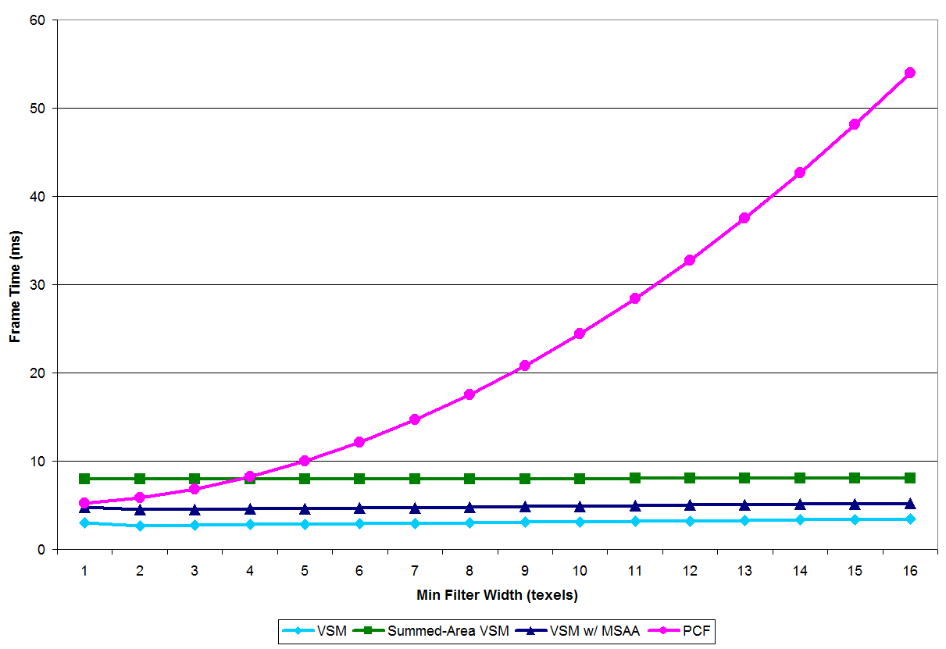
Performance
Notes:
On an 8800GTX @ 1600x1200, 4xMSAA.

Slide 63
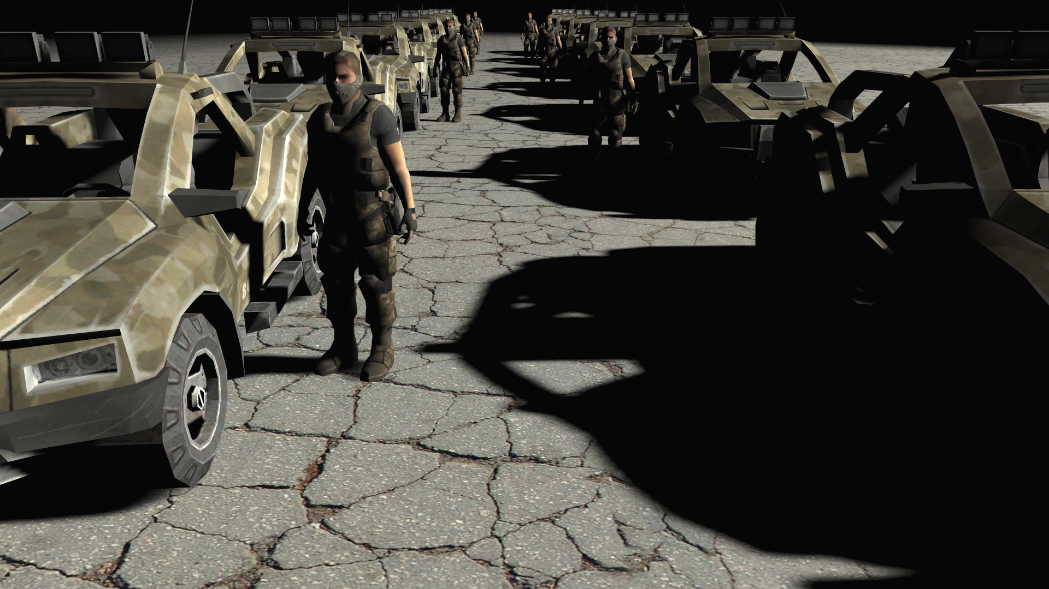
Demo

Slide 64
Conclusion
Variance shadow maps allow efficient filtering and solve many problems with standard shadow maps
Together with summed-area tables, they allow efficient plausible soft shadows
Light bleeding reduction eliminates all but the most stubborn artifacts
Notes:
Solve biasing, performance costs of PCF.

Slide 65
Real-time Rendering
Shadow Map Filtering
CSE 781
Prof. Roger Crawfis

Slide 66
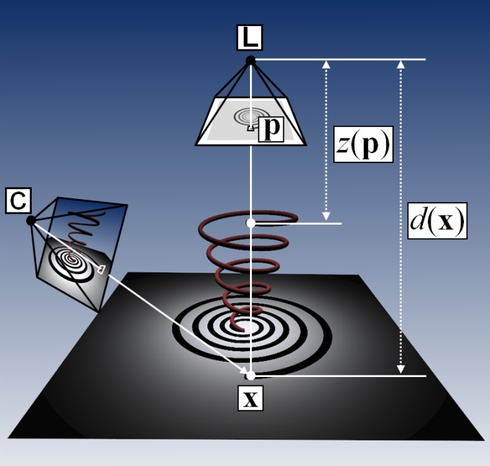
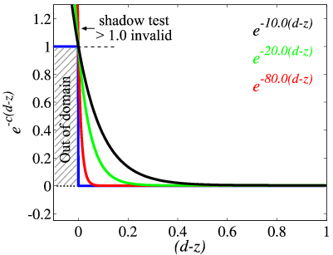
Exponential Shadow Maps
Non-linearity of the shadow test
Goal: ”linearize” the shadow test function!
How?
  Core idea: assume
  (d(x) - z(p)) >= 0
Why?
  Enables simple yet
  powerful solution!

Slide 67

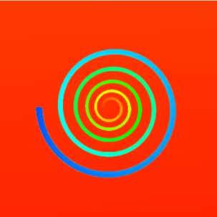

Exponential Expansion
Expand shadow test into exponentials
Show linearity for shadow map filtering:
s(x) = f(d(x), z(p)) e^{-c(d(x) – z(p))}
s_{f} (x) = [w * f(d(x), z) ](p)
≅ [w * e^{-c(d(x) – z)} ](p)
z(p)
e^{cz(p)}
≅ [w * e^{-cd(x)} e^{cz} ](p)
≅ e^{-cd(x)} [w * e^{cz} ](p)
Enables pre-filtering
[w*e^{cz}](p)

Slide 68
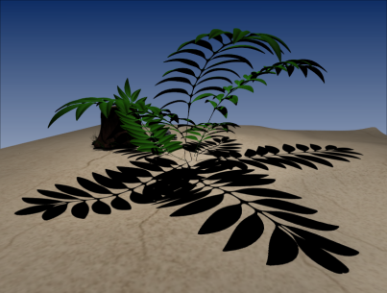
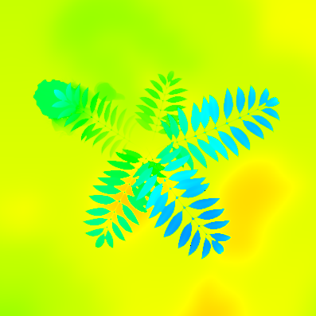
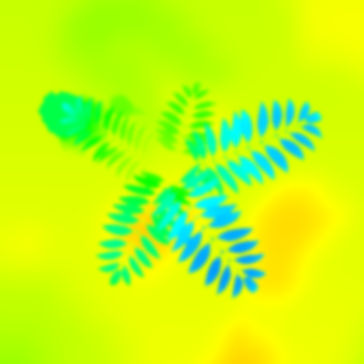
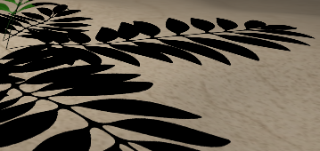
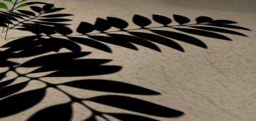
Filtering Example
Original e^{cz}
After filtering e^{cz}
[w*e^{cz}](p)

Slide 69
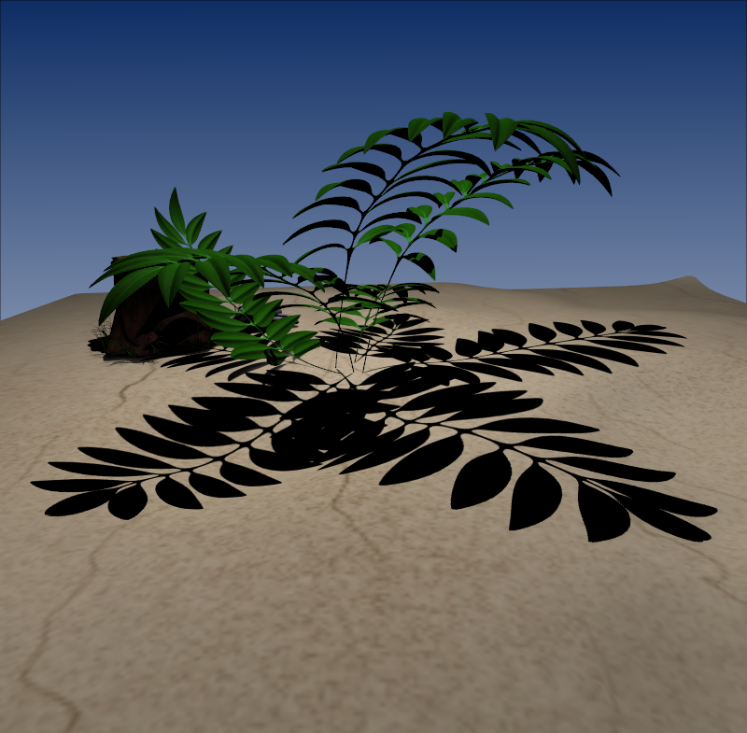

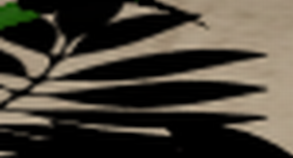
Results
ESM Trilinear
PCF (2x2)
SM resolution: 2Kx2K
ESM Trilinear

Slide 70
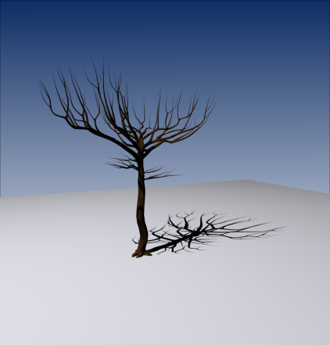






Results
Quality and performance comparison
ESM
Multi-Sample PCF
NC – 252 FPS
2x2– 399 FPS
7x7– 137 FPS
6x6– 142 FPS
23x23– 68 FPS
10x10– 67 FPS

Slide 71

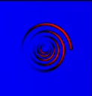
Convolution Shadow Maps
Transform depth map such that we can write the shadow test as a sum.
We can then filter the coefficients.
f(d,z) = a_{i}(d) B_{i}(z)
(1D function)
s(x) ≈ a_{i}(d(x)) B_{i}(z(p))
z(p)
B_{i}(z(p))

Slide 72
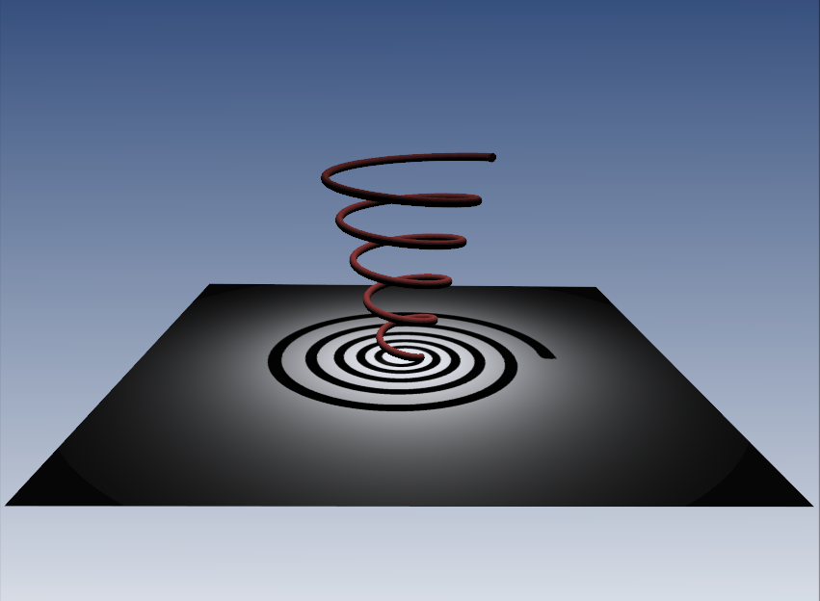





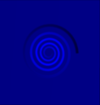
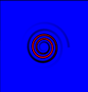
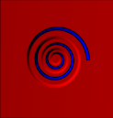
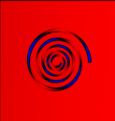
Reconstruction Example
s(x) ≈ a₁(d) +a₂(d) +..+ a₄(d)
+..+ a₈(d) +..+a₁₆(d)

Slide 73
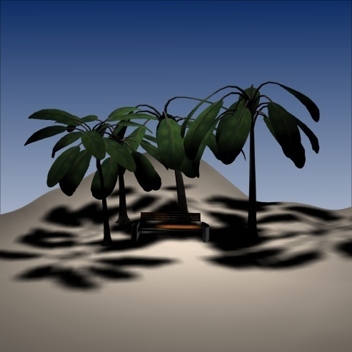
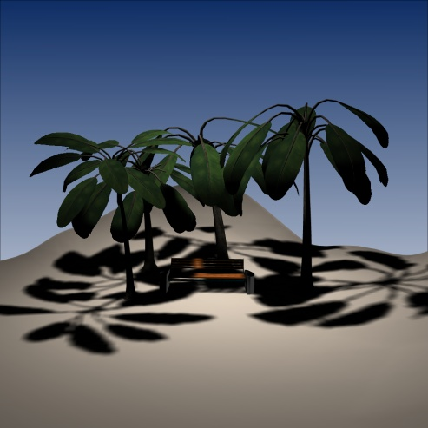
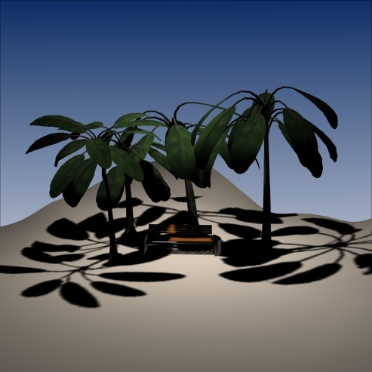
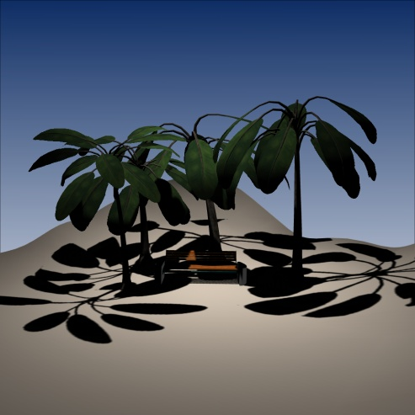
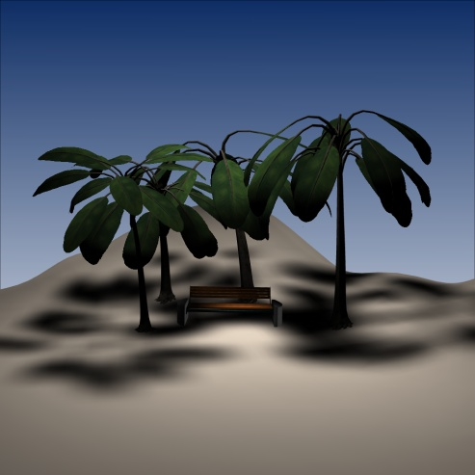


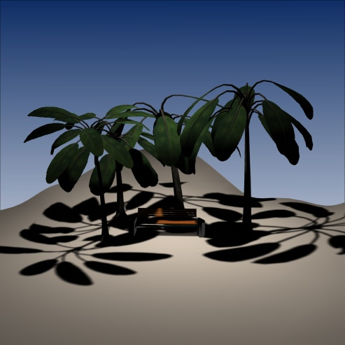
Blurred Shadows
Filter size: 3x3
SM:
128²
256²
512²
1024²
Filter size: 7x7
SM:
128²
256²
512²
1024²
Notes:
Shadows are just filtered not rendered according to their spatial relationship

Slide 74
Real-time Rendering
Shadow Map Projections
CSE 781
Prof. Roger Crawfis

Slide 75



Perspective Shadow Maps
Mitigate shadow map aliasing by composing perspective projection of camera into shadow map projection.
Uses resolution more effectively.
Must be recomputed each frame.

Slide 76
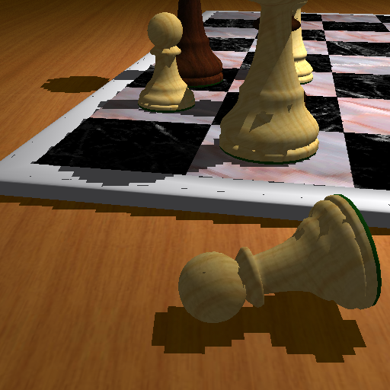
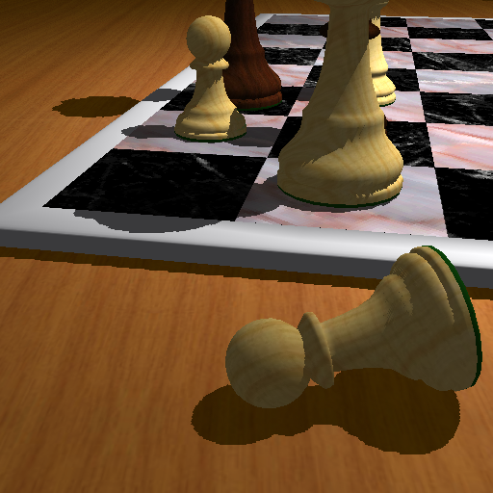
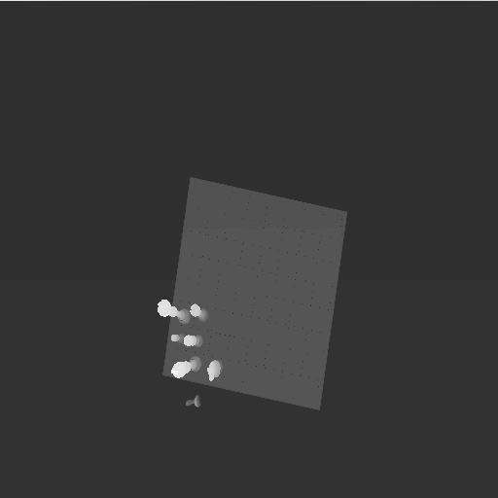
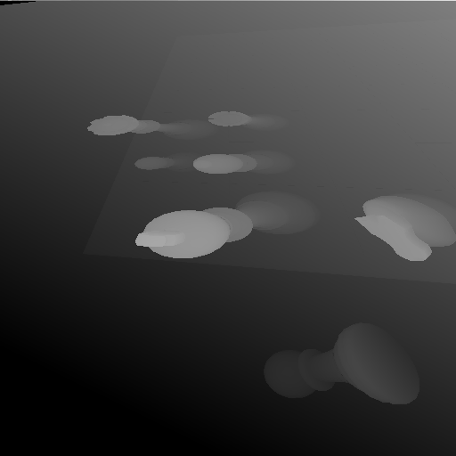
Perspective Shadow Maps
Perspective Shadow Maps,
Stamminger & Drettakis, SIGGRAPH 2002

Slide 77
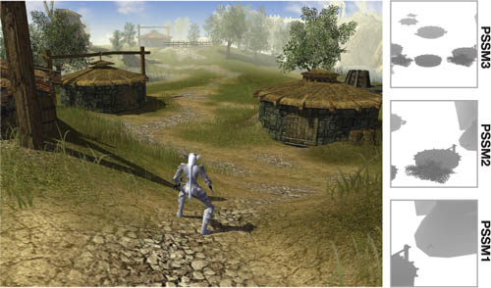
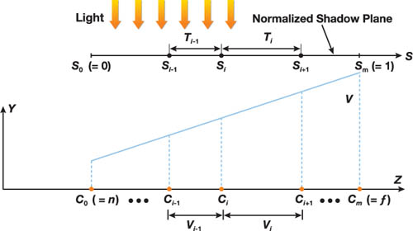
Parallel-Split Shadow Maps
Parallel-split shadow maps (PSSMs) (Zhang et al. 2007) split the view frustum into multiple segments according to depth and an independent shadow map is rendered for each segment.
Uses clip planes parallel to the view plane,

Slide 78
Parallel-Split Shadow Maps
Split the shadow map into several pieces
Provide a tighter fit on the viewing frustum.
z

Slide 79
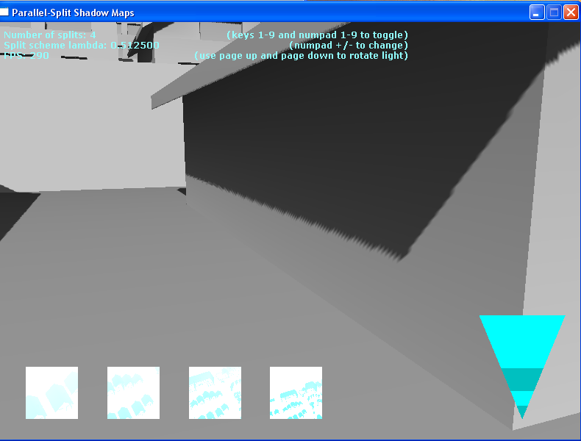
Parallel-Split Shadow Maps
Splits texture to minimize artifacts in the shadow due to magnification errors
  Increased cost in performance.
Camera frustum is split.

Slide 80

Cascaded Shadow Maps

Slide 81

Cascaded Shadow Maps
Similar to Parallel-Split Shadow Maps.

Slide 82


Adaptive Shadow Maps
Use a quad-tree to pack into a texture different resolutions (based on scene).

Slide 83

Trapezoidal Shadow Maps
Provide a non-linear warping of the shadow map to tightly fit the intersection of the light’s frustum, the eye’s frustum and the scene’s bounding box.
light
eye
scene’s bounding box

Slide 84







Trapezoidal Shadow Maps
frustum
of light
A
N_{T}
trapezoidal space
Shadow map resolution
is increased
Shadow aliasing
is reduced
Notes:
Basically our approach works like that:
We approximate the eye’s frustum in the PPS of the light with a trapezoid and map this by applying NT to the trapezoidal space.
We generate a shadow map, called a trapezoidal shadow map from this space and use it later for shadow comparison.
By doing that we increase the shadow map resolution and reduce shadow aliasing.

Slide 85
Trapezoidal Shadow Maps
Side Lines: 80% rule governs the choices
0%
Focus region of the eye
80% line
Trapezoidal approximation in L
Trapezoidal space due to 80% rule

Slide 86









Results: Quality Comparison
ESM
CSM
VSM
66 FPS, 21 MB
21 FPS, 170 MB
60 FPS, 42 MB
Faces: 365K, SM resolution: 2Kx2K

