Slide 1
Real-Time Rendering Self-Shadowing
CSE 781
Prof. Roger Crawfis

Slide 2
Self-Shadow Algorithms
Many of the shadow techniques can have receivers and occluders from the same set.
Self-shadowing implies that the occluder is equal to the receiver.
In this section, we will only be interested in the case where a single occluder is equal to a single receiver.

Slide 3
Self-Shadowing
Note, our definition of a model can be a scene graph, so we can have self-occlusion on an object level.
http://plugins.angstraum.at/vrayao/gargoyle.jpg

Slide 4
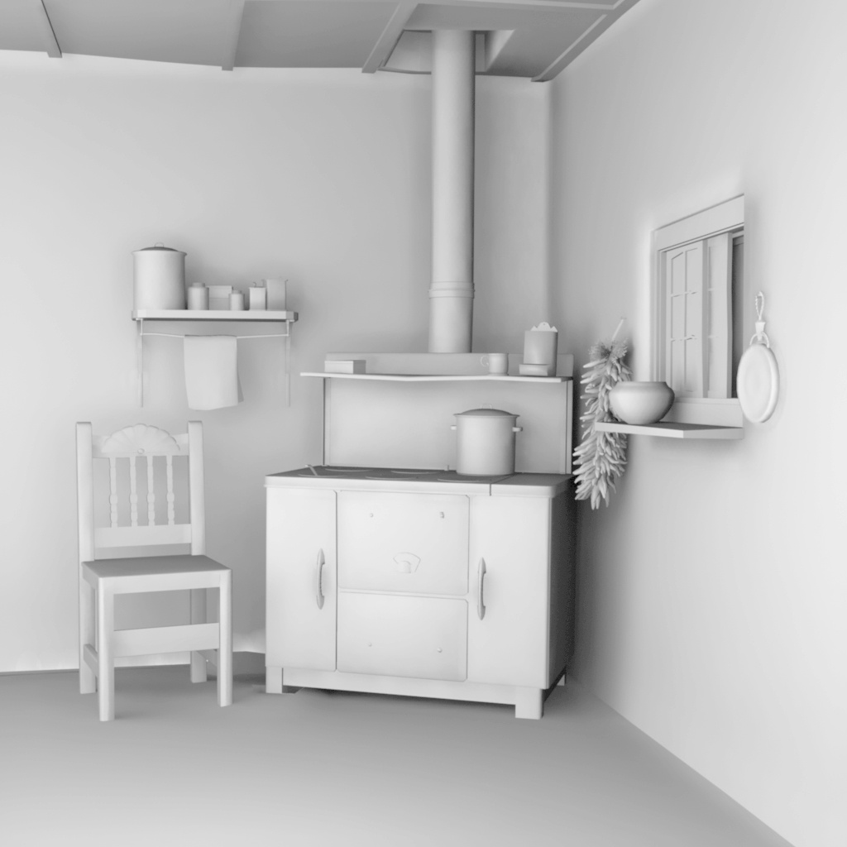
Self-Shadowing
Or we can have self-shadowing on a scene level.
http://www.bjaramillo.com/renders/kitchen_fg_ambientOcclusion.JPG

Slide 5
Self-Shadowing
Light-maps
Ambient Occlusion

Slide 6
Pre-computed Illumination
For static scenes and lighting, the illumination can be precomputed.
Store the illumination at each vertex or as a texture map (light-map) across the model.
Usually this is done for the entire scene using photon-tracing, radiosity or other advanced light transport models.

Slide 7
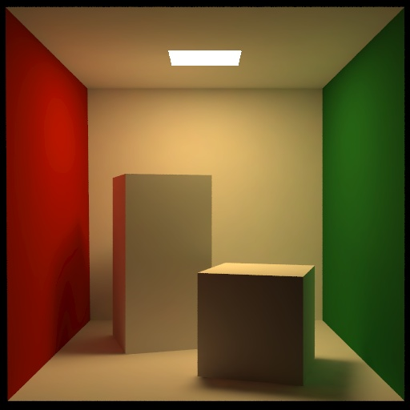
Radiosity
Radiosity precomputes the light interaction between multiple diffuse surfaces.
Not covered in this class.
The Cornell Box test

Slide 8
Radiosity
http://forums.3dtotal.com/attachment.php?attachmentid=115312&stc=1&d=1210750917

Slide 9
Pre-computed Illumination
With pre-computed illumination, you have the additional benefit of very simple and fast shaders. No lighting calculations need to be performed at the vertex or fragment level.
You can cheat some and add illumination from dynamic light sources.
You can also cheat and darken areas with fake shadows.

Slide 10
Ambient Occlusion
Pre-compute the visibility rather than the illumination.
Use this visibility to control the ambient illumination.
For a single static model we can pre-compute the visibility.
Initially just used as the ambient term.
Extended to have some control on the rest of the illumination as well as for dynamic models.

Slide 11
Ambient Occlusion
Point A is not occluded
Point B is darkened

Slide 12
General Idea

Slide 13
2-Hemisphere Lighting
Sky Color
θ
Ground Color

Slide 14
Area Light Shadows
Self occlusion not well represented
Representation is a scalar
At each point we want the area of the hemi-sphere that is visible (not occluded by self).
Use ray-casting to generate this information as a pre-process.

Slide 15
Ambient Occlusion
Integral of blocker function over the hemisphere

Slide 16
Occlusion Representations
Can store result in various ways
Compute ratio of hits / misses
Occlusion Factor
A single scalar parameter
Should weight with cosine
Use to blend in shadow color
Sufficient for hemisphere lighting

Slide 17
2-Hemisphere Lighting
Sky Color
Ground Color
Sphere Model
Object Color
Occlusion Factor
Final Color

Slide 18
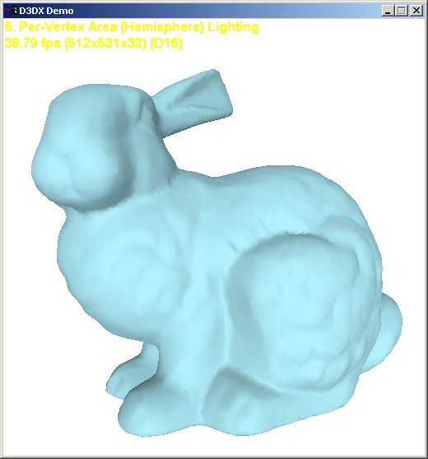
Occlusion Factor Absent

Slide 19
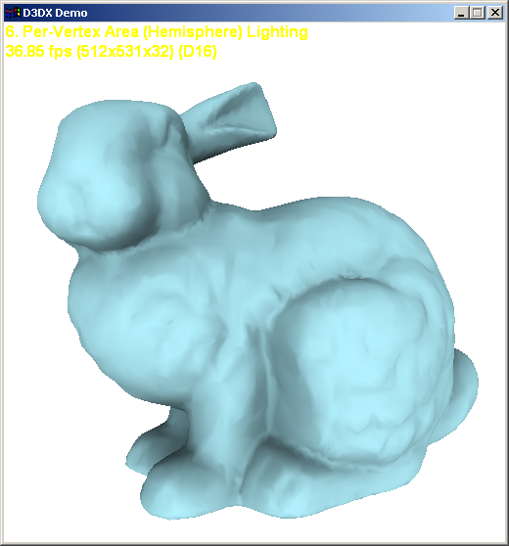
Occlusion Factor Present

Slide 20
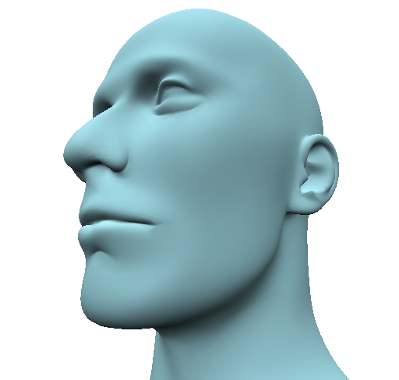
Occlusion Factor Absent

Slide 21
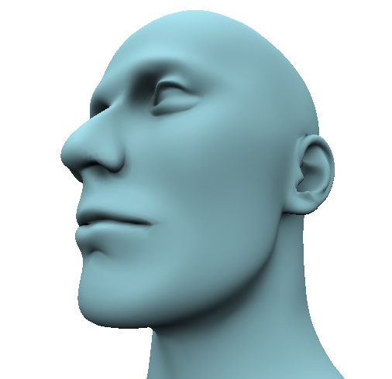
Occlusion Factor Present

Slide 22
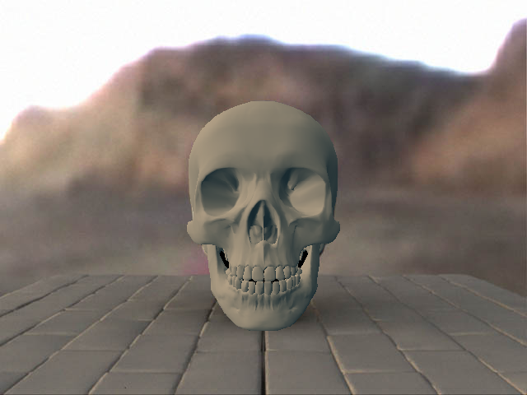
Occlusion Factor Absent

Slide 23
Occlusion Factor Present

Slide 24
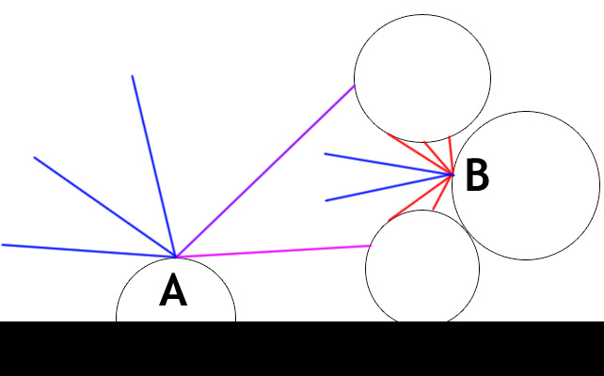
Occlusion Extensions
Ambient Occlusion only stores the percentage of the hemi-sphere visible.
Consider the example
What if the light is overhead, or slightly to the left of the scene?
Point B should be in shadow.

Slide 25
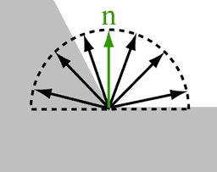
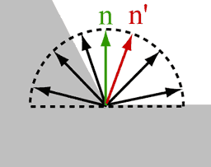
Occlusion Extensions
For many models, the portion of the hemisphere visible is contiguous.
A common trick is to bend the normal towards the center of the visible region.

Slide 26
Occlusion Extensions
Compute cone of visibility
Cone of un-occlusion
Store as more than a scalar
Store axis of the cone (xyz) and the cosine of the cone angle (8-bits per is fine).

Slide 27
Occlusion Cone Model
Axis
Ang
Surface Normal
Fit cone to horizon between hits and misses

Slide 28
Occlusion Cone Shadows
Each sample has a cone
Check to see if light ray is in it
If ( L dot Axis > cosAng )
If so then
It is lit
Else
It is in shadow
Need not be Boolean
For softer edged shadows

Slide 29
Surface Response
With Spherical Harmonic representation we can include:
Self-shadowing
Inter-reflection: glows, caustics
Subsurface scattering

Slide 30
No Shadow

Slide 31
Shadow

Slide 32
Shadow + Inter-Reflection

Slide 33
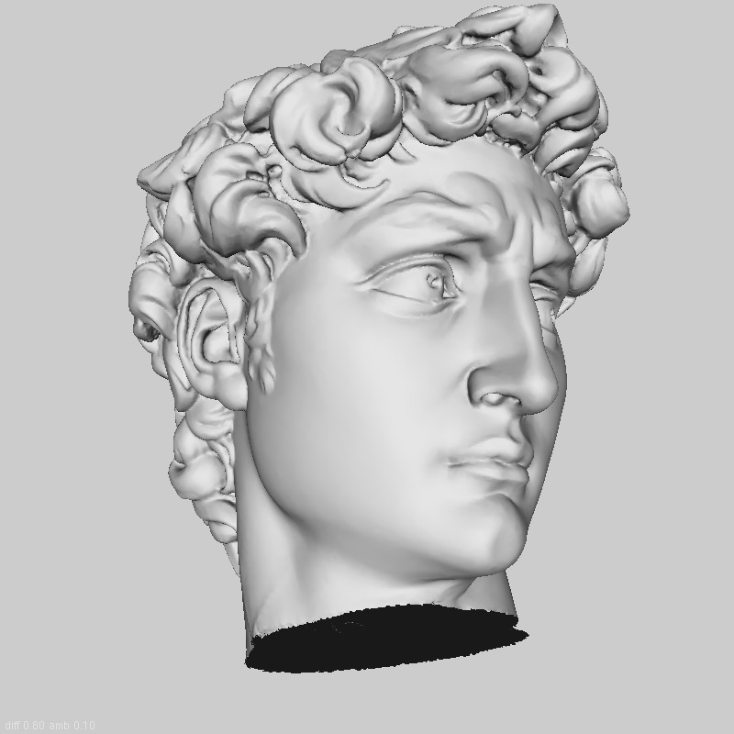
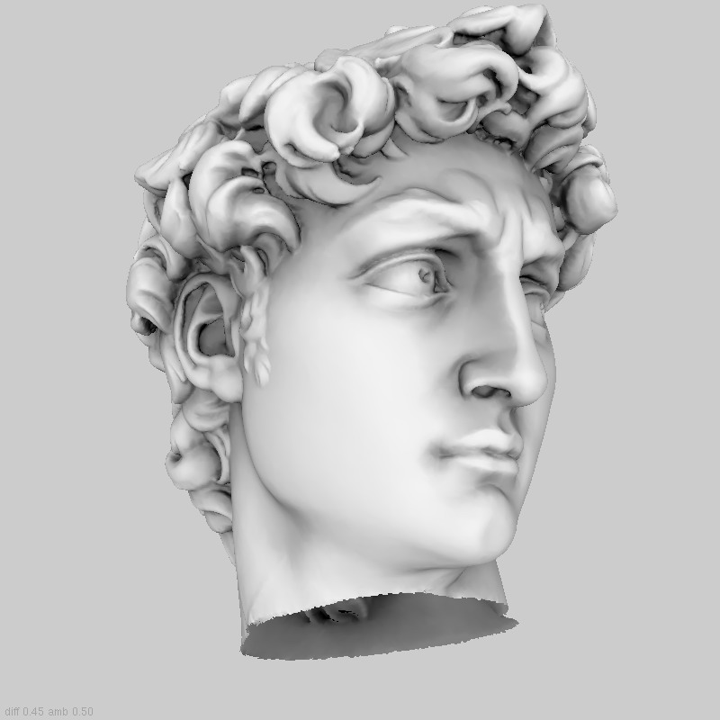
Ambient Occlusion Example
Local lighting
Ambient Occlusion
Notes:
Why do we need Ambient Occlusion?
Ambient occlusion is…. but….

Slide 34
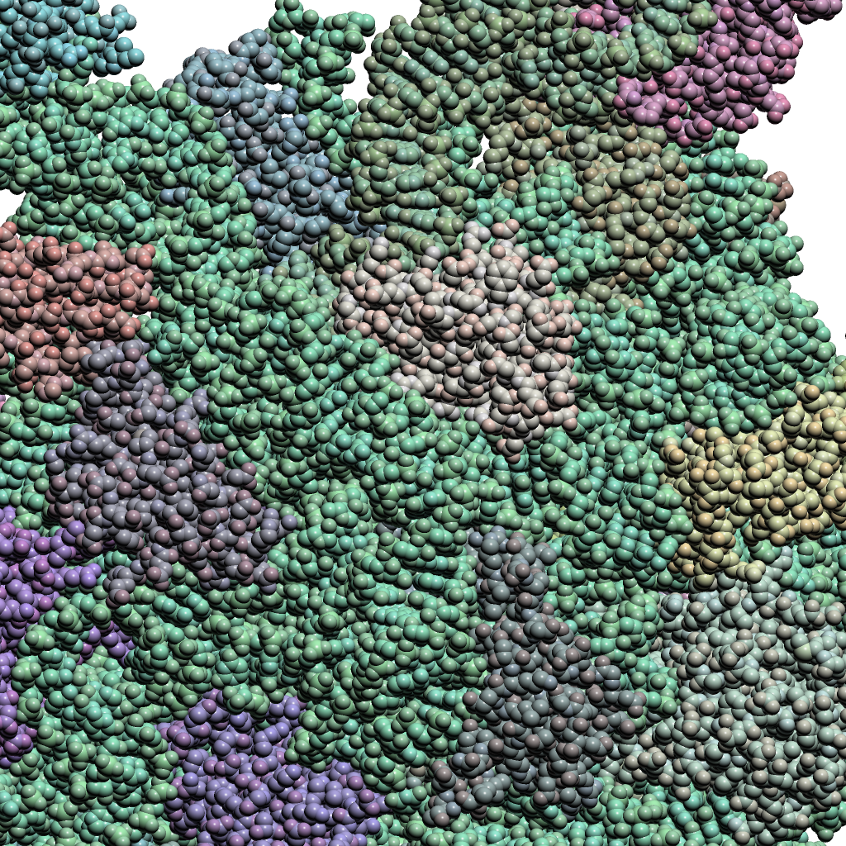
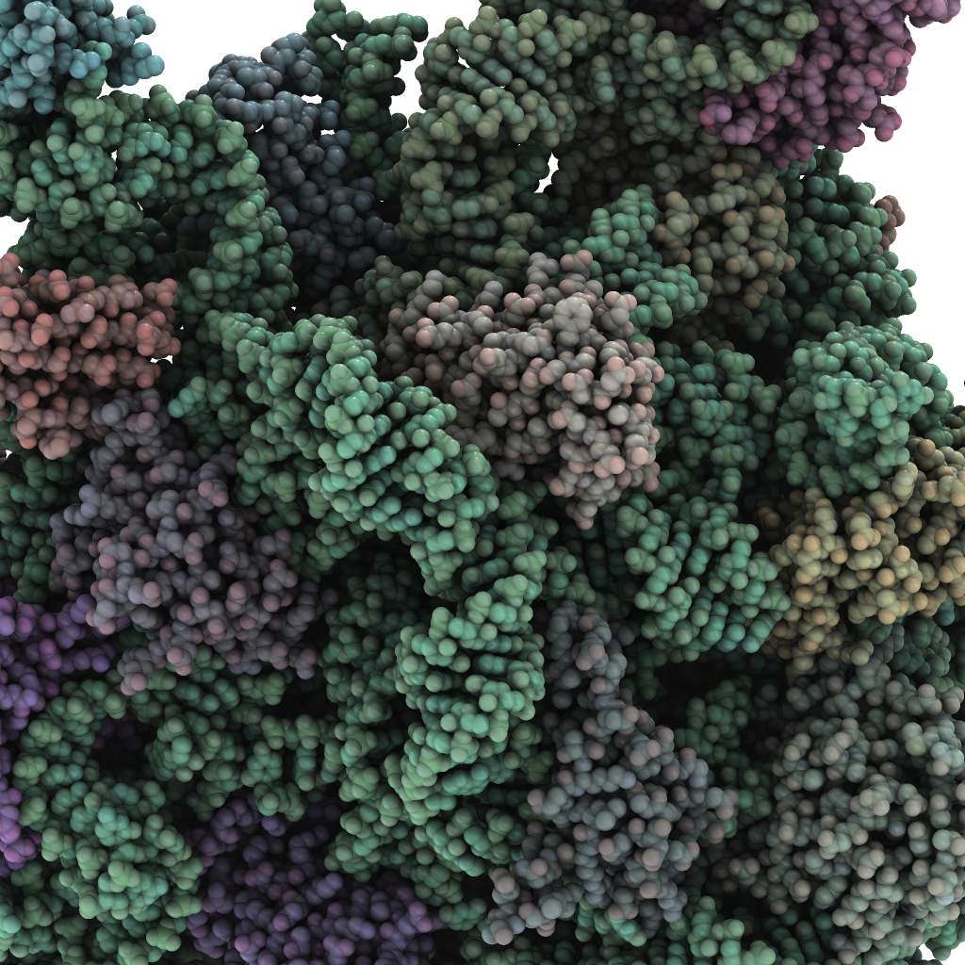
Ambient Occlusion Example
Local lighting
Ambient Occlusion
Notes:
can see hi level structures like alpha helixes!

Slide 35
Self-Occlusion Summary
These pre-computed strategies provide some of the most pleasant imagery.
Assumes static scenes, but can generally work well with dynamic scenes.
Should almost always be used in modern illumination settings.

