Slide 1
Real-Time Rendering
Intro to Shadows
CSE 781
Prof. Roger Crawfis

Slide 2
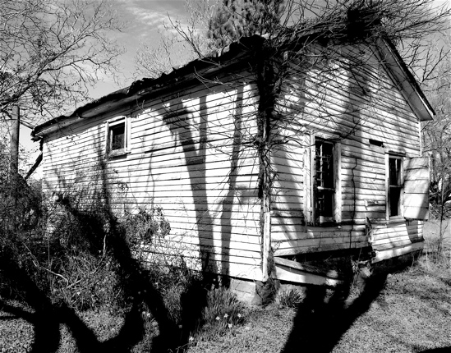
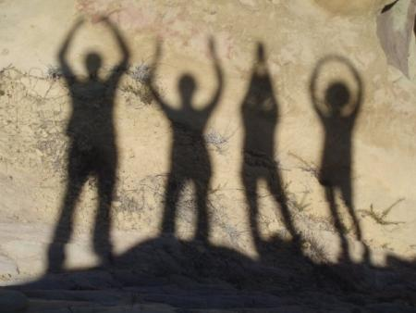
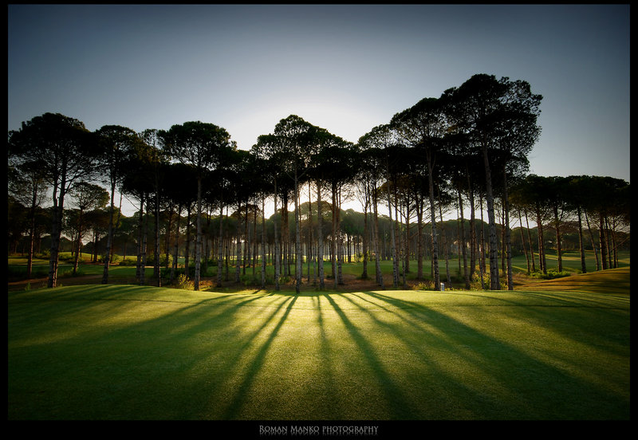
Shadows can be Wonderful!

Slide 3
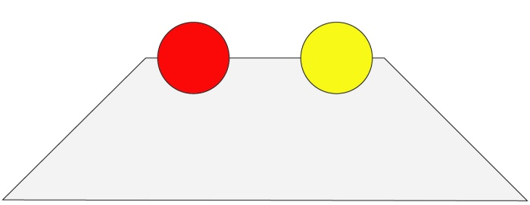
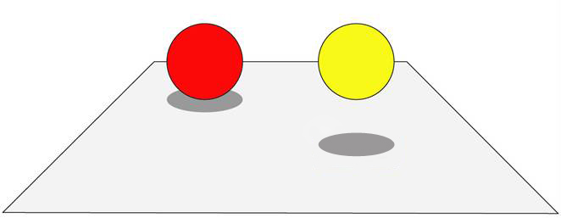
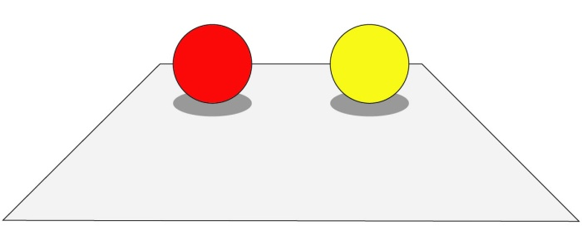
Importance of Shadows
Trapezoid?

Slide 4
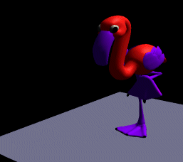
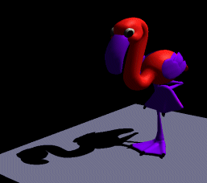
Importance of Shadows
Cue to object-object relationship.
Provides additional depth cue.

Slide 5
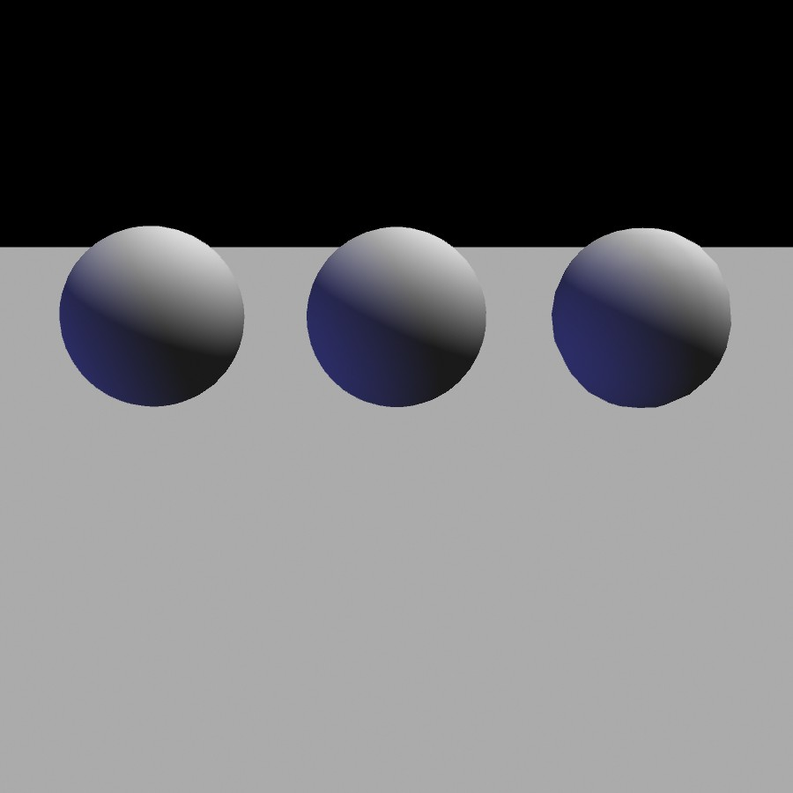
Importance of Shadows
Notes:
5

Slide 6
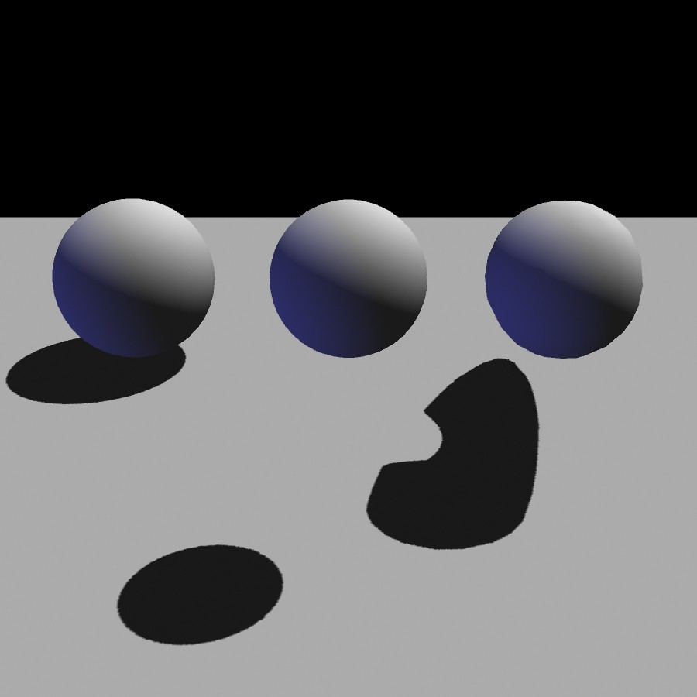
Importance of Shadows
Notes:
6

Slide 7
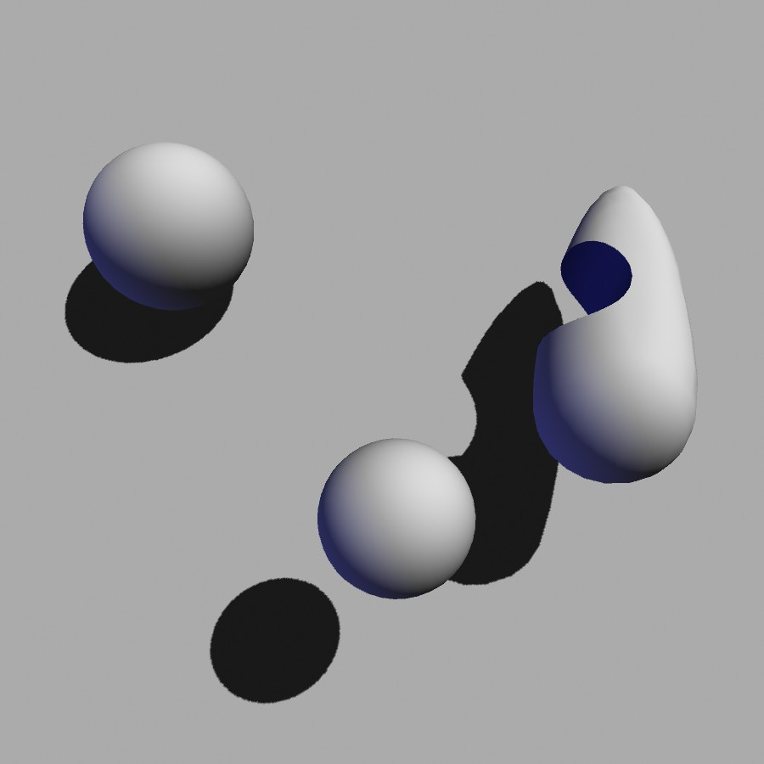
Importance of Shadows
Notes:
7

Slide 8
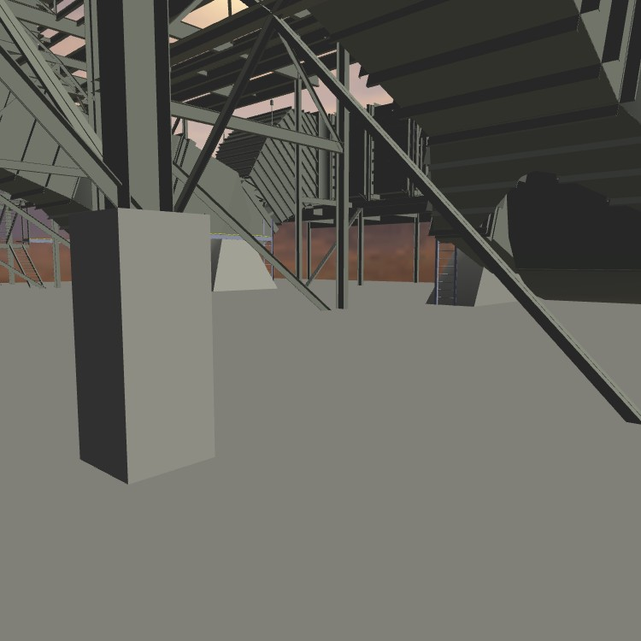
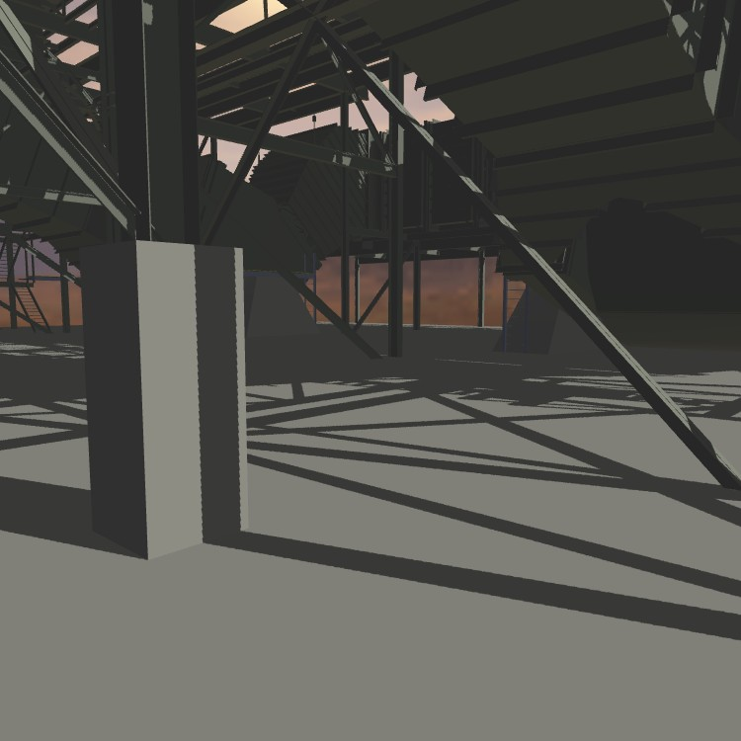
Importance of Shadows
Without shadows
With shadows
Notes:
8

Slide 9
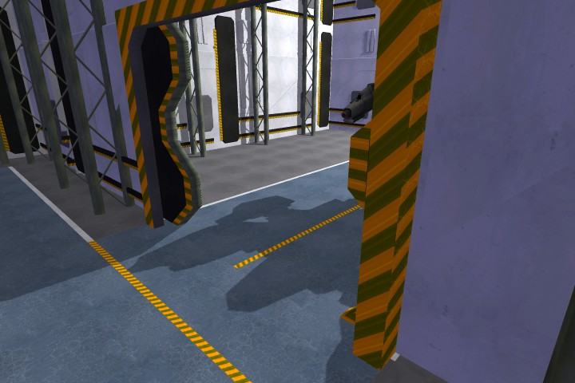
Importance of Shadows
Notes:
9

Slide 10
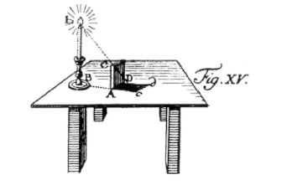
Definition
Shadow: Darkness caused when part or all of the illumination from a light source is blocked by an occluder.
light
occluder
shadow
Notes:
10

Slide 11
Terminology
(area) light source
occluder
penumbra
umbra
receiver
shadow
umbra – fully shadowed region
penumbra – partially shadowed region

Slide 12
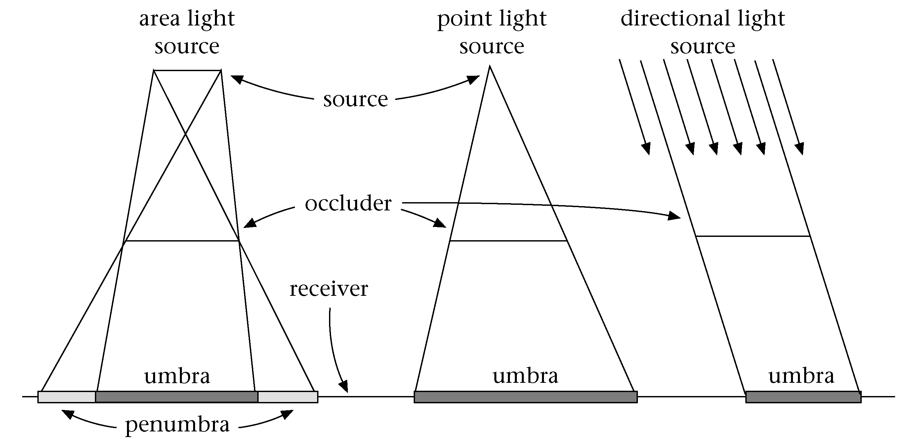
Terminology

Slide 13
Definition: Shadow Volume
Volume formed by extruding the occluder from the light source.
Open and infinite
Space inside the volume is in shadow.
Space outside the volume is not.

Slide 14
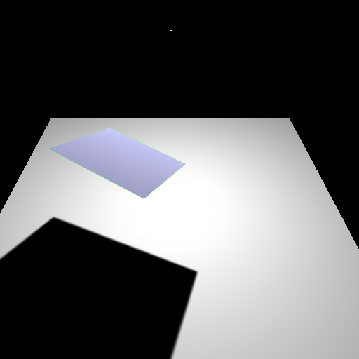
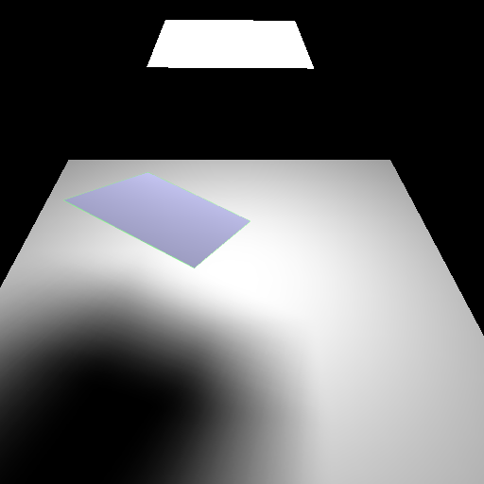
Hard and soft shadows
point
light
extended
light
penumbra
umbra
umbra
Hard shadow
Soft shadow
Notes:
14

Slide 15
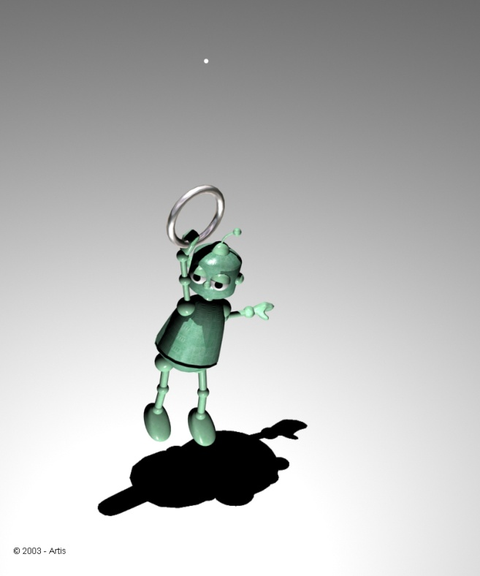
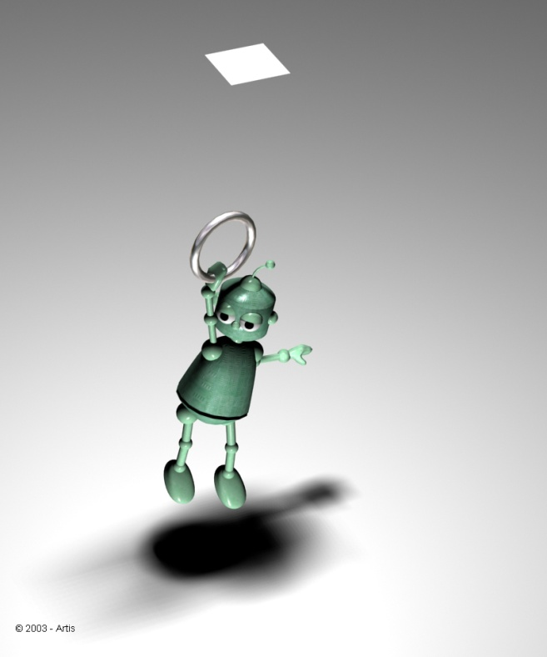
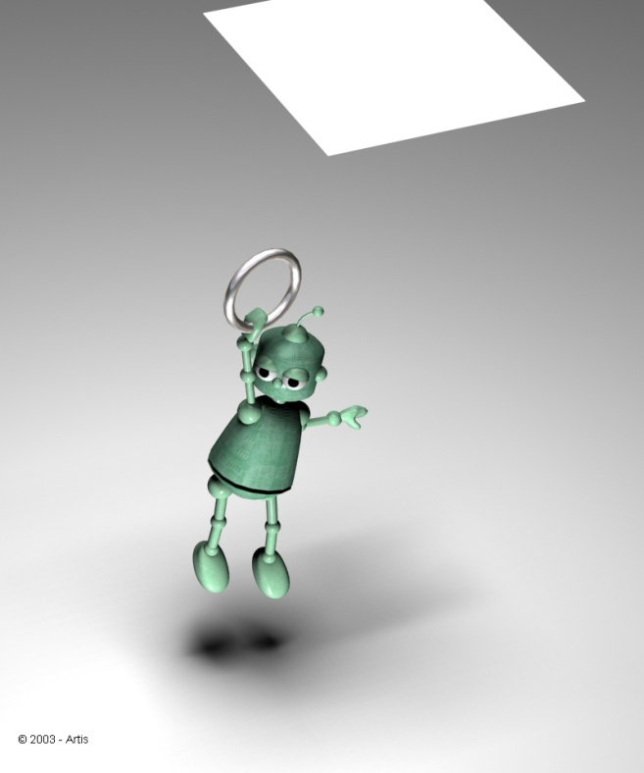
Soft Shadows
Shadow is a function of the area of the light source and the distance.

Slide 16
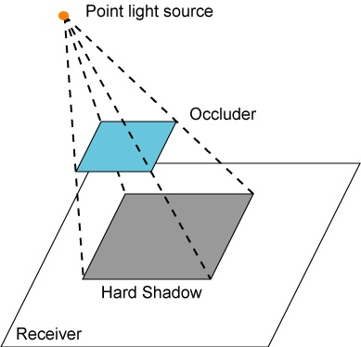

Hard shadow creation
For every pixel light source is either visible or occluded

Slide 17
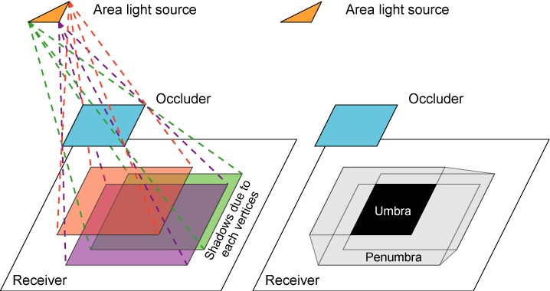
Soft shadow creation

Slide 18
Issues Affecting Shadows
Scene Complexity
  Number of light sources
  Types of light sources
  Number of occluders
  Number of receivers
  Position, size and strength of lights
Static vs. dynamic
  Objects
  Lighting
Self-shadowing
Opaque vs. transparent objects
Precision or realism of shadows

Slide 19
Current Shadow Methods
There exist a very large number of methods
We are interested in methods suitable for interactive walkthroughs, speed is crucial
We will classify them on complexity:
no shadows
Sharp shadows
Soft shadows
Special effects

Slide 20
Sharp Shadows
Point or directional light sources
Fake
Hardware Assisted
Pre-computed
Ray tracing
Fast but often
inadequate
Billboard
Projected object
Use of specialized
hardware to generate
shadows
• Shadow texture
• Shadow volumes
Shadows are
pre-computed
and stored for
repeated use
• Detail polygons
Rather slow
for large scenes

Slide 21
Soft Shadows
Area light sources
Hardware Assisted
Pre-computed
Radiosity
Ray-based
Mainly treat the
light source as a
collection of points
• Accumulation
buffer
• Shadow volumes
• Shadow textures
Mainly analytical
computation on
the geometry of
the source
• Light maps
• Discontinuity
Meshing
This is also
pre-computed
• Hemi-cube
• Ray casing
• Distributed
ray tracing
• Cone Tracing

Slide 22
Approaches
Ad-hoc / Custom
  Artist directed shadows
  Very simple and constrained conditions.
Analytical
  Find all boundaries within the umbra / penumbra. Precise.
Sampling
  Probabilistic sampling of whether a particular fragment is within the umbra / penumbra. With enough samples can be made precise.

Slide 23
Shadows and Illumination
Given a point is in shadow, how do we change the illumination?
Light Source
Viewer
Occluder
Point is in shadow
Point is lit

Slide 24
Shadows and Illumination
Illumination model with included visibility term:
Visibility term determines if a light can “see” the point
If point is in shadow, only ambient term applies
For all lights
Visibility Term: 0 or 1 for point/directional lights

Slide 25
Shadows and OpenGL
In OpenGL we send the geometry for a model through the pipeline.
The Visibility function, V, is not a constant in our illumination model.
  Per vertex information?
  Per fragment using a texture map?
  Some per-pixel masking function?
Recall that we need a V for each light.

Slide 26
Shadows and Illumination
Note, we can re-write our illumination equation:
Negative light.
c_{i}

Slide 27
Masking in OpenGL
OpenGL provides several ways of masking pixels
  Stencil buffer with stencil test
  Alpha test with fragment’s alpha values
  Blending with fragment’s and framebuffer’s alpha values.
  Texture sampling and shaders.

Slide 28
Negative Light
Algorithm (single light)
  Render receivers with full illumination
  For each occluder
    Project occluder from the light to the receivers
    Darken (set to black or ambient) the illumination.

Slide 29
Negative Light
With multiple light sources this technique does not work. If the algorithm simply sets the pixels to black (or ambient), then it will erases the contributions from all light sources.

Slide 30
Positive Light
Algorithm
  Render scene with ambient illumination only
  For each light source
    Render scene with illumination from this light only
    Scale illumination by shadow mask
    Add contribution to frame buffer

Slide 31
Real-Time Rendering
Ad-hoc Shadows
CSE 781
Prof. Roger Crawfis

Slide 32
Ad-Hoc and Custom Shadows
Fake proxy geometry.
Projection of model to a plane.
Projection of a texture to a plane.

Slide 33
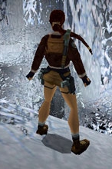
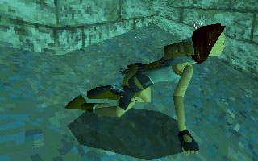
Fake Proxy Geometry
Shadows are simple hand-drawn polygons or textures.
Images from TombRaider. ©Eidos Interactive.

Slide 34
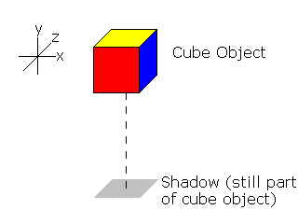
Fake Proxy Geometry
Approximation of shadow position and shape based on object’s typical use.
Typically assumes overhead lighting.
Typically assumes a single flat ground plane as a receiver.
E.g., draw the bottom of the bounding box.

Slide 35
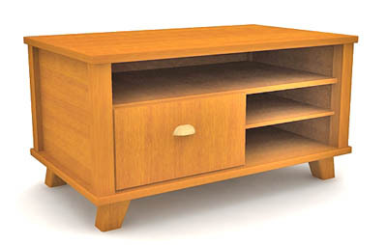
Fake Proxy Geometry
Consider this model
of a desk with a fake
shadow using an
ellipse:
Know where the shadow is going to be.
Will change some depending on the light placement in the room, but good enough!
The ellipse is part of the model.

Slide 36
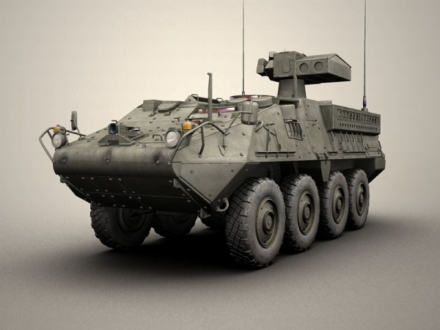
Fake Proxy Geometry

Slide 37
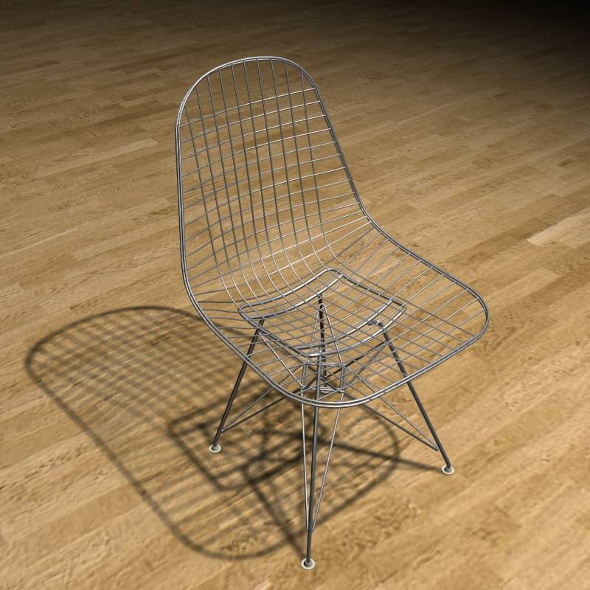
Fake Proxy Geometry
Quite complex model.
Know it will sit on a flat floor.
Will fail if we place another object behind or underneath it.

Slide 38
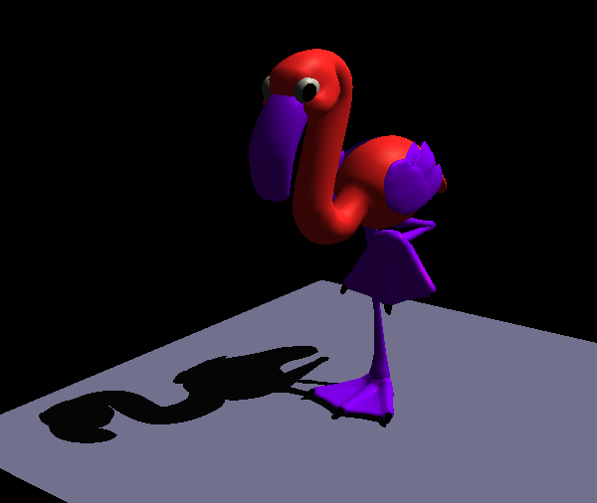
Projected Geometry
[Blinn88] Me and my fake shadow
  Shadows for selected large receiver polygons
    Ground plane
    Walls

Slide 39
Projected Geometry
Projection of a vertex, v, to a plane with normal, n, and coefficient d.
Could be done in shader, but also leads to a 4x4 matrix.

Slide 40
Projected Geometry
Example: xz plane at y=0
l=(l_{x},l_{y},l_{z})
y
v
p
y=0

Slide 41
Projected Geometry
Transformation as a 4 by 4 matrix

Slide 42
Projected Geometry
Basic algorithm
  Render scene (full lighting)
  For each receiver polygon
    Compute projection matrix M
    Multiply with actual transformation (modelview)
    Render selected (occluder) geometry
      Darken/Black

Slide 43
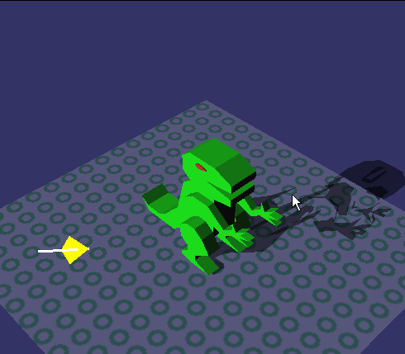
Projected Geometry Problems
Z-Fighting
  Use bias when rendering shadow polygons
  Use stencil buffer (no depth test)
Z fighting

Slide 44
Projected Geometry Problems
Bounded receiver polygon
  Use stencil buffer (restrict drawing to receiver area)
extends off ground region

Slide 45
Projected Geometry Problems
Shadow polygon overlap
  Use stencil count (only the first pixel gets through)
double blending

Slide 46
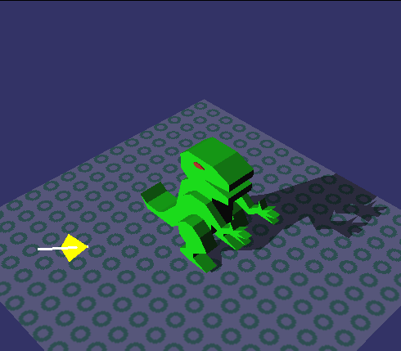
Projected Geometry - Fixed

Slide 47
Projected Geometry Algorithm
Stencil buffer algorithm (1bit stencil)
1. Render scene without receiver polygon
2. Clear stencil buffer
3. Render receiver polygon
- stencil operation ‘set’ (visible pixels)
4. Render shadow polygons
- without depth test
- stencil test ‘is set?’
- stencil operation ‘clear’
- blending e.g. ‘dest = dest * 0.2’ (darken)

Slide 48
Projected Geometry Problems
Wrong Shadows & Anti-Shadows
  Objects behind light source
  Objects behind receiver
light
light
receiver
receiver
occluder behind receiver
occluder behind light

Slide 49
Projected Geometry
Summary
  Only practical for very few, large receivers
  Easy to implement
  Use stencil buffer (z fighting, overlap, receiver)
  Efficiency can be improved by rendering
  shadow polygons to texture maps
    Occluders and receiver ‘static’ for some time

Slide 50
Projected Textures
Sky layers
Cast shadows

Slide 51
Projection Shadows
Render projected polygons to an image (render-to-texture)
Apply image as a texture onto the receivers
  Compute texture coords on the fly
  Use projective texturing
Advantage:
  Texture can be projected onto multiple shadow receivers
  Do not need to regenerate texture if static scene
Limitation: objects can either cast or receive a shadow, not both

Slide 52
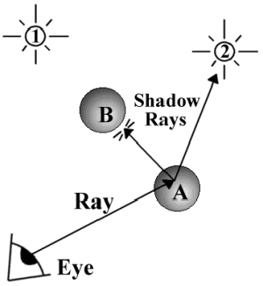
Simple Approach: Raytracing
Cast ray to light (shadow feeler)
Surface point in shadow if shadow feeler hits an occluder object.
Raytracing is slow, can we use OpenGL???

Slide 53
Two Common Shadow Approaches
Shadow Volumes
Shadow Map (Shadow Z-Buffer)
  Projective Textures

Slide 54
2-Hemisphere Model
Sky Color
θ
Ground Color

Slide 55
Area Light Shadows
Self occlusion not well represented
Representation is a scalar
  At each point
Ray-trace to generate

Slide 56
Distributed Light Model
Hemisphere of possible incident light directions
θ
Microfacets
Other facets can shadow this one: Occlusion

Slide 57
Approximating Occlusion
Need to determine extent of shadowing
Cast rays out from facet to see which ones intersect the object

Slide 58
Ray Cast Occlusion Model
Microfacet
Some rays hit this object, others miss it

Slide 59
Occlusion Representations
Can store result in various ways
Compute ratio of hits / misses
  Occlusion Factor
  A single scalar parameter
  Should weight with cosine
Use to blend in shadow color
Sufficient for hemisphere lighting

Slide 60
Model Elements
Sky Color
Ground Color
Object Color
Sphere Model
Occlusion Factor
Final Color

Slide 61
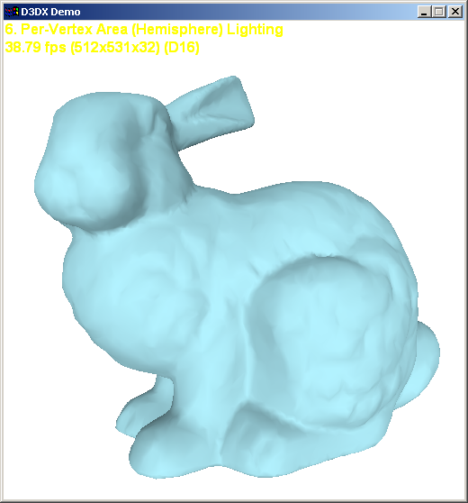
Occlusion Factor Absent

Slide 62
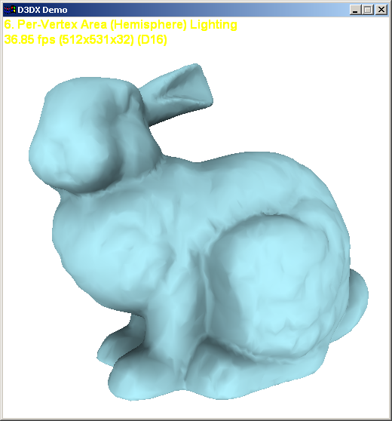
Occlusion Factor Present

Slide 63
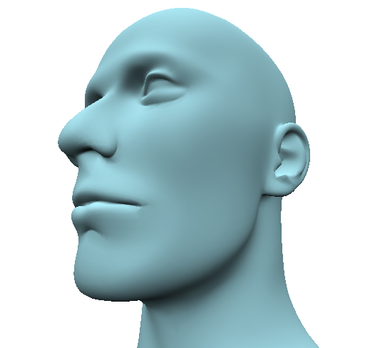
Occlusion Factor Absent

Slide 64
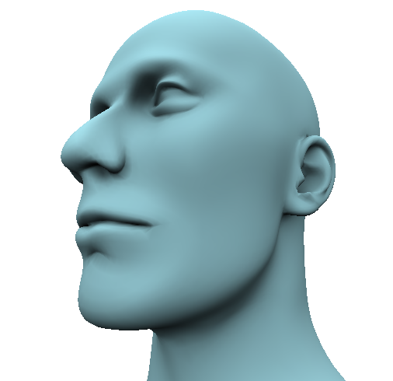
Occlusion Factor Present

Slide 65
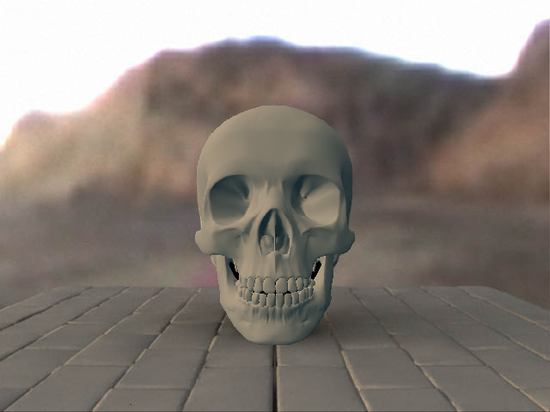
Occlusion Factor Absent

Slide 66
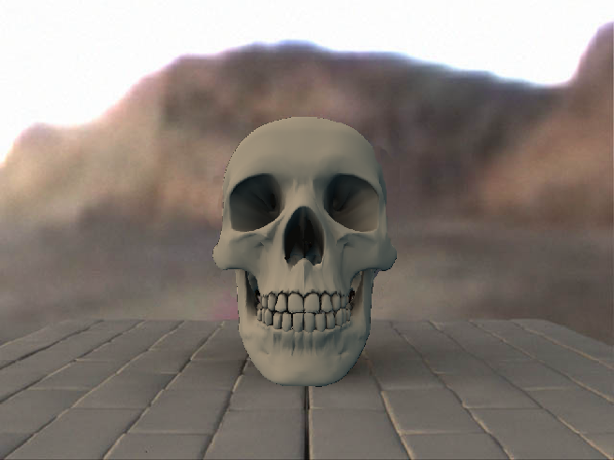
Occlusion Factor Present

Slide 67
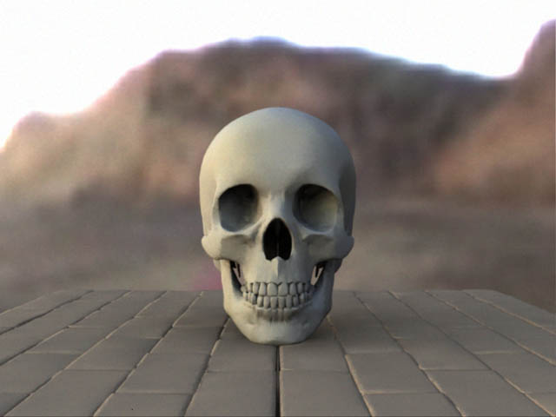
Lightwave Image

Slide 68
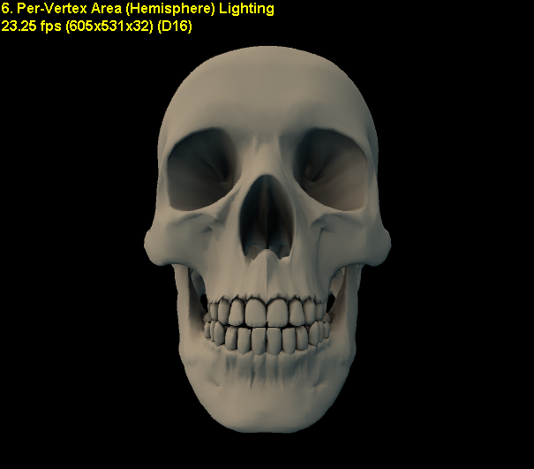
Hi-Res

Slide 69
Per Pixel Occlusion Factor
Estimate area based on adjacent pixels in height field
Should cast to all pixels in image
Should ray-cast bumps and pixels at the same time

Slide 70
Other Occlusion Methods
What if we need to produce sharp shadows?
  e.g. to model effect of compact lights
Compute cone of visibility
  = cone of unocclusion
Store as more than a scalar
  put axis of cone (xyz) + cos cone angle in alpha
  There are other representations
    C. F. Heidrichs et al. “Ellipses”

Slide 71
Occlusion Cone Model
Axis
Ang
Surface Normal
Fit cone to horizon between hits and misses

Slide 72
Occlusion Cone Shadows
Each sample has a cone
Check to see if light ray is in it
  If ( L dot Axis > cosAng )
If so then
  It is lit
Else
  It is in shadow
Need not be Boolean
  For softer edged shadows

Slide 73
Surface Response
Environment Map + Surface Response
Due to power of SH representation
Surface Response can include:
  Self-shadowing
  Inter-reflection: glows, caustics
  Subsurface scattering

Slide 74
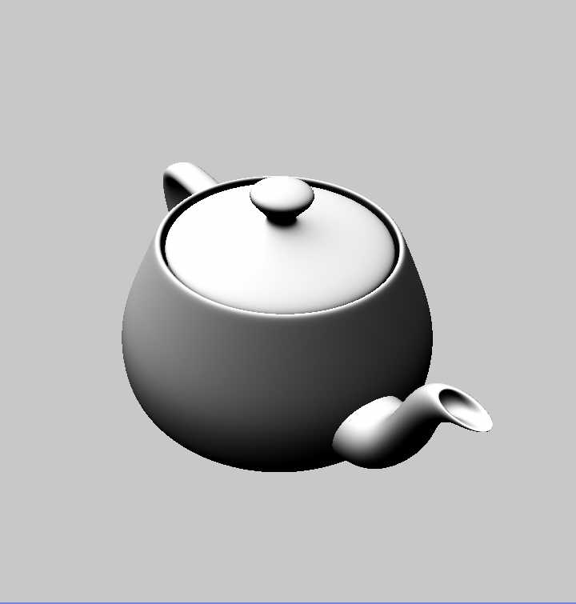
No Shadow

Slide 75
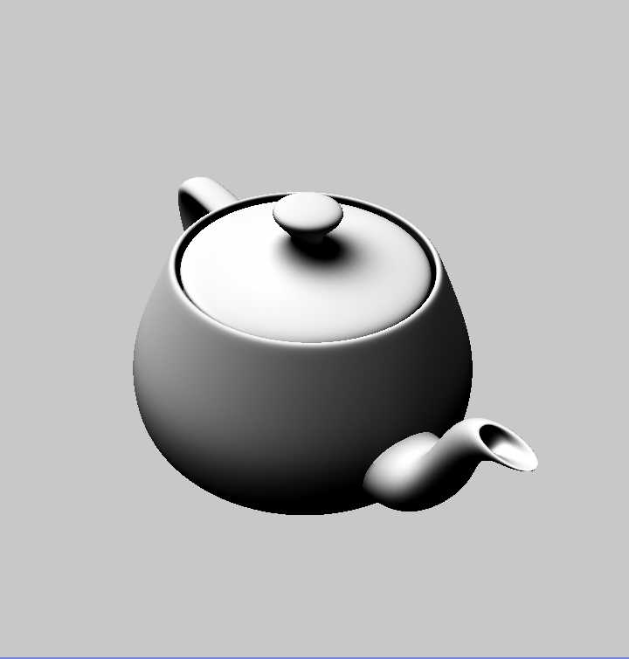
Shadow

Slide 76
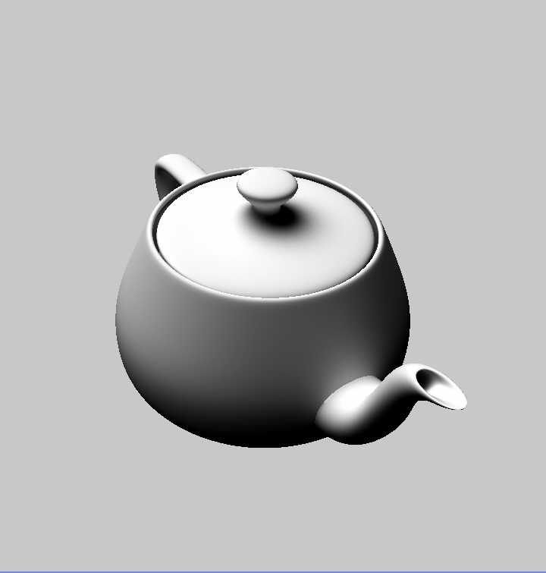
Shadow + Inter-Reflection

Slide 77
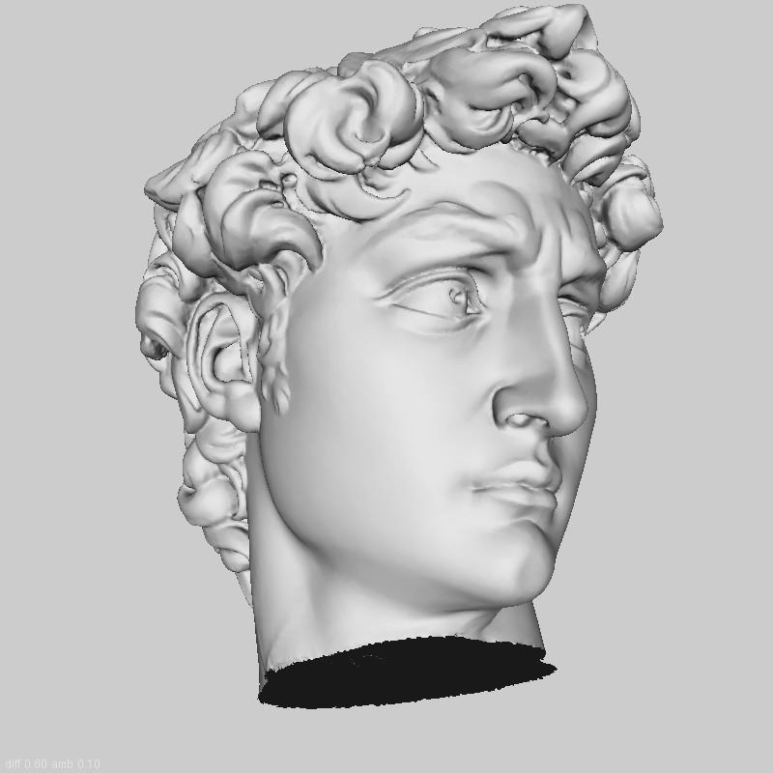
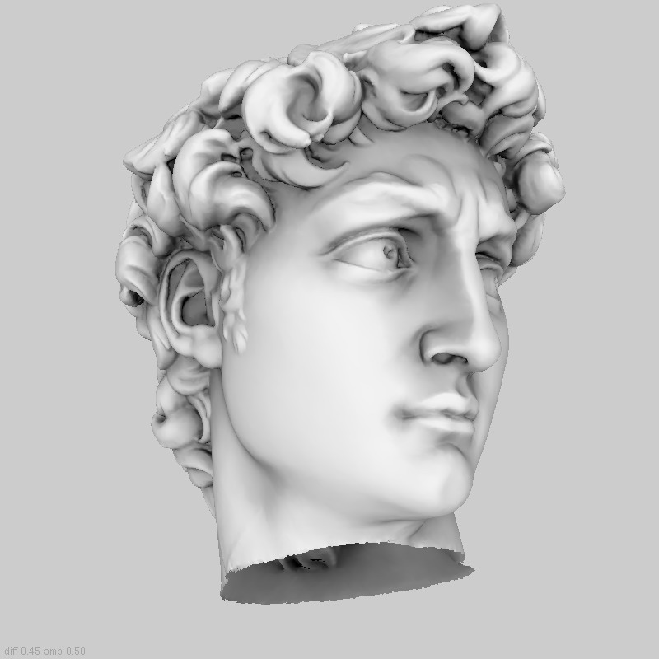
Ambient Occlusion Example
Local lighting
Ambient Occlusion
Notes:
Why do we need Ambient Occlusion?
Ambient occlusion is…. but….

Slide 78
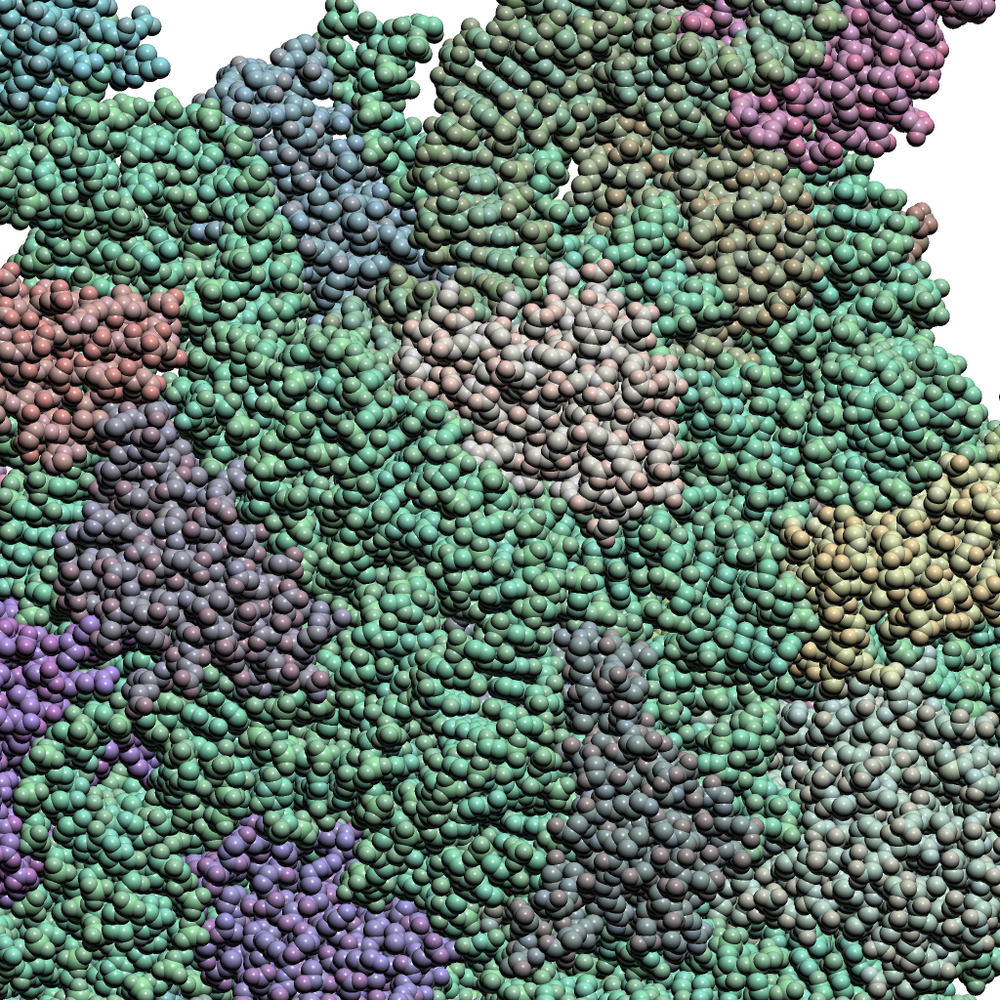
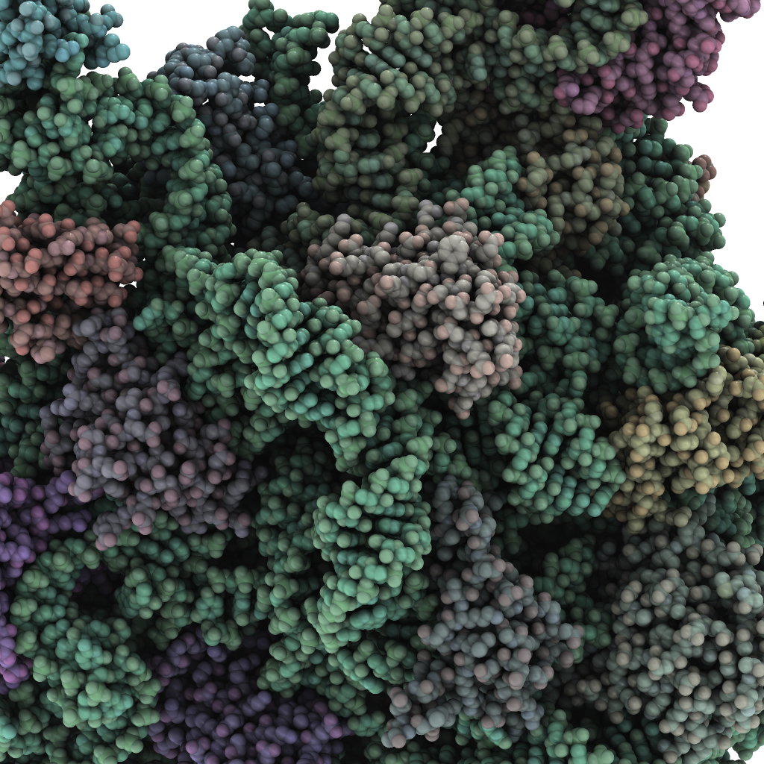
Ambient Occlusion Example
Local lighting
Ambient Occlusion
Notes:
can see hi level structures like alpha helixes!

Slide 79
Real-Time Rendering
Shadow Volumes
CSE 781
Prof. Roger Crawfis

Slide 80
Shadow Volumes
A volume of space formed by an occluder
Bounded by the edges of the occluder
point light
Notice that the “far” end of the volume goes to infinity
  Need to cap it
occluding triangle
3D shadow volume

Slide 81
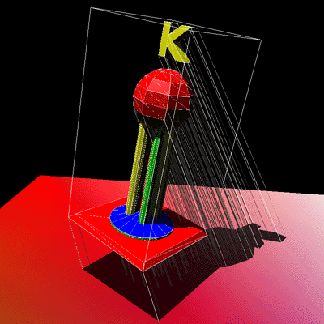
Shadow Volumes
Compute shadow volume for all visible polygons from the light source
Add the shadow volume polygons to your scene database
  Tag them as shadow polygons
  Assign its associated light source

Slide 82
2D Cutaway of a Shadow Volume
Surface outside
shadow volume
(illuminated)
Shadowing
object
Light
source
Shadow
volume
(infinite extent)
Eye position
(note that shadows are independent of the eye position)
Partially
Surface inside
shadow volume
(shadowed)
shadowed
object

Slide 83
Shadow Volume Advantages
Omni-directional approach
  Not just spotlight frustums as with shadow maps
Automatic self-shadowing
  Everything can shadow everything, including self
  Without shadow acne artifacts as with shadow maps
Window-space shadow determination
  Shadows accurate to a pixel (Object method)
  Or sub-pixel if multisampling is available
Required stencil buffer broadly supported today
  OpenGL support since version 1.0 (1991)
  Direct3D support since DX6 (1998)

Slide 84
Shadow Volume Disadvantages
Ideal light sources only
  Limited to local point and directional lights
  No area light sources for soft shadows
Requires polygonal models with connectivity
  Models must be closed (2-manifold)
  Models must be free of non-planar polygons
Silhouette computations are required
  Can burden CPU
  Particularly for dynamic scenes
Inherently multi-pass algorithm
Consumes lots of GPU fill rate

Slide 85
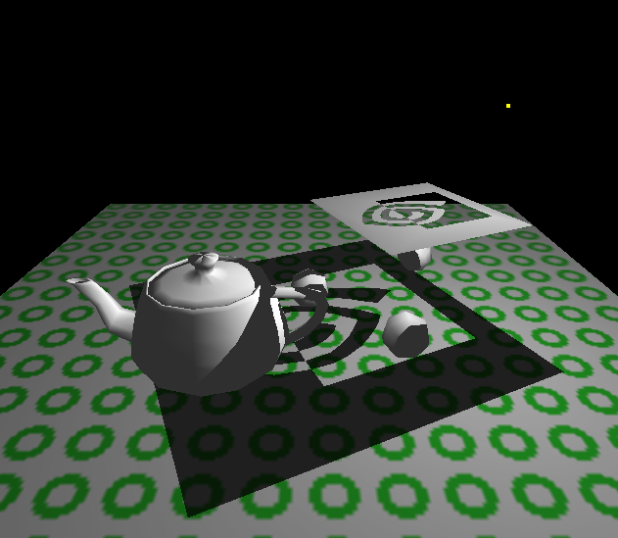


Visualizing Shadow Volumes in 3D
Occluders and light source cast out a shadow volume
  Objects within the volume should be shadowed
Light
source
Scene with shadows from an NVIDIA logo casting a shadow volume
Visualization of the shadow volume

Slide 86


Visualizing the Stencil Buffer Counts
Shadowed scene
Stencil buffer contents
Stencil counts beyond 1 are possible for multiple or complex occluders.
red = stencil value of 1
green = stencil value of 0
GLUT shadowvol example credit: Tom McReynolds

Slide 87
Shadow Volumes
Use a parity test similar to a “ray inside-outside” test
Initially set parity to 0 and shoot ray from eye to P
  Invert parity when ray crosses shadow volume boundary
  parity = 0, not in shadow,
  parity = 1, in shadow
When is a surface point inside shadow?
point light
eye
0
occluder
0
0
1
1
0
parity=0
parity=1
parity=0

Slide 88
Problems With Parity Test
Eye inside of shadow volume
Self-shadowing of visible occluders
Multiple overlapping shadow volumes
0
0
0
0
1
0
1
0
1
0

Slide 89
Better Solution : Counter
Light
source
Shadowing object
zero
+1
zero
+2
+2
Shadowed
object
Eye
position
+1
+3
Shadow Volume Count = 0

Slide 90
Better Solution : Counter
Light
source
Shadowing object
zero
+1
zero
+
+
+
-
+2
+2
Shadowed
object
Eye
position
+1
+3
Shadow Volume Count = +1+1+1-1 = 2

Slide 91
Better Solution : Counter
Light
source
Shadowing object
zero
+1
zero
+
+
+
-
-
-
Unshadowed
object
+2
+2
Eye
position
+1
+3
Shadow Volume Count = +1+1+1-1-1-1 = 0

Slide 92
Graphics Hardware Approach Using The Stencil Buffer
Zpass approach
  Render visible scene to depth buffer
  Turn off depth and color, turn on stencil
  Init. stencil buffer given viewpoint
  Draw shadow volume twice using face culling
    1st pass: render front faces and increment when depth test passes
    2nd pass: render back faces and decrement when depth test passes
stencil pixels != 0 in shadow, = 0 are lit

Slide 93
Zpass Problem
Missed shadow volume intersection due to near clip plane clipping; leads to mistaken count
Far clip
plane
zero
+1
+1
+2
zero
+3
+2
Object in shadow :-(
Near clip
plane

Slide 94
Zfail Approach
  Render visible scene to depth buffer
  Turn off depth and color, turn on stencil
  Init. stencil buffer given viewpoint
  Draw shadow volume twice using face culling
    1st pass: render back faces and increment when depth test fails
    2nd pass: render front faces and decrement when depth test fails
  stencil pixels != 0 in shadow, = 0 are lit

Slide 95
Clipping Plane Problem
Zpass : Near clipping plane
  Move near clipping plane closer to eye?
    Lose depth precision in perspective
Zfail : Far clipping plane
  Move far clipping plane closer to eye?
    Set far clipping plane to infinity.
    See “Practical & Robust Stenciled Shadow Volumes for Hardware-Accelerated Rendering” by Cass Everitt & Mark J. Kilgard, Nvidia

Slide 96
Zfail versus Zpass Comparison (1)
When stencil increment/decrements occur
  Zpass: on depth test pass
  Zfail: on depth test fail
Increment on
  Zpass: front faces
  Zfail: back faces
Decrement on
  Zpass: front faces
  Zfail: back faces

Slide 97
Zfail versus Zpass Comparison (2)
Both cases order passes based stencil operation
  First, render increment pass
  Second, render decrement pass
  Why?
    Because standard stencil operations saturate
    Wrapping stencil operations can avoid this
Which clip plane creates a problem
  Zpass: near clip plane
  Zfail: far clip plane
Either way is foiled by view frustum clipping
  Which clip plane (front or back) changes

Slide 98
Insight!
If we could avoid either near plane or far plane view frustum clipping, shadow volume rendering could be robust
Avoiding near plane clipping
  Not really possible
  Objects can always be behind you
  Moreover, depth precision in a perspective view goes to hell when the near plane is too near the eye
Avoiding far plane clipping
  Perspective make it possible to render at infinity
  Depth precision is terrible at infinity, but
  we just care about avoiding clipping

Slide 99
Avoiding Far Plane Clipping
Usual practice for perspective GL projection matrix
  Use glFrustum (or gluPerspective)
  Requires two values for near & far clip planes
    Near plane’s distance from the eye
    Far plane’s distance from the eye
  Assumes a finite far plane distance
Alternative projection matrix
  Still requires near plane’s distance from the eye
  But assume far plane is at infinity
What is the limit of the projection matrix when
the far plane distance goes to infinity?

Slide 100
Standard glFrustum Projection Matrix
Only third row depends on Far and Near

Slide 101
Limit of glFrustum Projection Matrix
First, second, and fourth rows are the same as in P
But third row no longer depends on Far
  Effectively, Far equals ∞

Slide 102
Verifying P_{inf} Will Not Clip
Infinitely Far Away Vertices (1)
What is the most distant possible vertex in front of the eye?
  Ok to use homogeneous coordinates
  OpenGL convention looks down the negative Z axis
  So most distant vertex is (0,0,-D,0) where D>0
Transform (0,0,-D,0) to window space
  Is such a vertex clipped by P_{inf}?
  No, it is not clipped, as explained on the next slide

Slide 103
Verifying P_{inf} Will Not Clip
Infinitely Far Away Vertices (2)
Transform eye-space (0,0,-D,0) to clip-space
Then, assuming glDepthRange(0,1), transform clip-space position to window-space position
So ∞ in front of eye transforms to the maximum
window-space Z value, but is still within
the valid depth range (i.e., not clipped)

Slide 104
Is P_{inf} Bad for Depth Buffer Precision?
Naïve question
  Wouldn’t moving the far clip plane to infinity waste depth buffer precision? Seems plausible, but
Answer: Not really
  Minimal depth buffer precision is wasted in practice
  This is due to projective nature of perspective
Say Near is 1.0 and Far is 100.0 (typical situation)
  P would transform eye-space infinity to only 1.01 in window space
  Only a 1% compression of the depth range
  is required to render infinity without clipping
  Moving near closer would hurt precision

Slide 105
P_{inf} Depth Precision Scale Factor
Using Pinf with Near instead of P with Near and Far compresses (scales) the depth precision by
The compression of depth precision is uniform, but the depth precision itself is already non-uniform on eye-space interval [Near,Far] due to perspective
  So the discrete loss of precision is more towards the far clip plane
Normally, Far >> Near so the scale factor
is usually less than but still nearly 1.0
  So the compression effect is minor

Slide 106
Robust Stenciled Shadow Volumes
Without Near (or Far) Plane Capping
Use Zfail Stenciling Approach
  Must render geometry to close shadow volume extrusion on the model and at infinity (explained later)
Use the P_{inf} Projection Matrix
  No worries about far plane clipping
  Losses some depth buffer precision (but not much)
Draw the infinite vertices of the shadow volume using homogeneous coordinates (w=0)

Slide 107
Rendering Closed, but Infinite,
Shadow Volumes
To be robust, the shadow volume geometry must be closed, even at infinity
Three sets of polygons close the shadow volume
  Possible silhouette edges extruded to infinity away from the light
  All of the occluder’s back-facing (w.r.t. the light) triangles projected away from the light to infinity
  All of the occluder’s front-facing (w.r.t. the light) triangles
We assume the object vertices and light position are homogeneous coordinates, i.e. (x,y,z,w)
  Where w≥0

Slide 108
1st Set of Shadow Volume Polygons
Assuming
  A and B are vertices of an occluder model’s possible silhouette edge
  And L is the light position
For all A and B on silhouette edges of the occluder model, render the quad
Homogenous vector differences
What is a possible silhouette edge?
  One polygon sharing an edge faces toward L
  Other faces away from L

Slide 109


Examples Silhouette Edges
An object viewed from the same basic direction that the light is shining on the object has an identifiable light-view silhouette
An object’s light-view silhouette appears quite jumbled when viewed form a point-of-view that does not correspond well with the light’s point-of-view

Slide 110
2nd and 3rd Set of
Shadow Volume Polygons
2nd set of polygons
  Assuming A, B, and C are each vertices of occluder model’s back-facing triangles w.r.t. light position L
Homogenous vector differences
  These vertices are effectively directions (w=0)
3rd set of polygons
  Assuming A, B, and C are each vertices of occluder model’s front-facing triangles w.r.t. light position L

Slide 111
Requirements for Stenciled Shadow Volumes
Models must be composed of triangles only (avoiding non-planar polygons)
Models must be closed (2-manifold) and have a consistent winding order
  Bergeron [’86] approach could be used to handle “open” models if necessary
Homogeneous object coordinates are permitted, assuming w≥0
  If not, (x, y, z, -1) = (-x, -y, -z, 1)
Ideal light sources only
  Directional or positional, assuming w≥0

Slide 112
Requirements for Stenciled Shadow Volumes
Connectivity information for occluding models must be available
  So silhouette edges w.r.t. light positions can be determined at shadow volume construction time
Projection matrix must be perspective
  Not orthographic
  NV_depth_clamp extension provides orthographic support (more later)
Render must guarantee “watertight” rasterization
  No double hitting pixels at shared polygon edges
  No missed pixels at shared polygon edges

Slide 113
Requirements for Stenciled Shadow Volumes
Enough stencil bits
  N stencil bits where 2^{N} is greater than the maximum shadow depth count ever encountered
  Scene dependent
  8-bits is usually quite adequate & what all recent stencil hardware provides
  Wrapping stencil increment/decrement operations (i.e. OpenGL’s EXT_stencil_wrap) permit deeper shadow counts, modulo aliasing with zero
  Realize that shadow depths > 255 imply too
  much fill rate for interactive applications

Slide 114
Requirements for Stenciled Shadow Volumes
Rendering features provided by OpenGL 1.0 or DirectX 6 (or subsequent versions)
  Transformation & clipping of homogenous positions
  Front- and back-face culling
  Masking color and depth buffer writes
  Depth buffering (i.e. conventional Z-buffering)
  Stencil-testing support
In practice, these are quite reasonable requirements for nearly any polygonal-based 3D game or application

Slide 115


Examples
Scene with shadows. Yellow light is embedded in the green three-holed object. P_{inf} is used for all the following scenes.
Same scene visualizing
the shadow volumes.

Slide 116
Examples
Details worth noting . . .
Fine details: Shadows
of the A, N, and T letters on
the knight’s armor and shield.
Hard case: The shadow volume from the front-facing hole
would definitely intersect
the near clip plane.

Slide 117


Examples
Alternate view of same scene with shadows. Yellow lines indicate previous view’s view frustum boundary. Recall shadows are view-independent.
Shadow volumes from the alternate view.

Slide 118


Examples
Clip-space view. Original view’s scene seen from clip space. The back plane is “at infinity” with very little effective depth precision near infinity.
Clip-space view of shadow volumes. Back-facing
triangles w.r.t. light are seen
projected onto far
plane at infinity.

Slide 119


Examples
Original eye’s view. Again, yellow light is embedded in the green three-holed object. P_{inf} is used for all the following scenes.
Eye-space view of previous eye’s view. Clipped to the previous eye’s P_{inf} view
frustum. Shows knight’s
projection to infinity.

Slide 120

Examples
Clip-space view of previous eye’s view. Shows shadow volume closed at infinity and other shadow volume’s intersection with the near clip plane.
Original eye’s far clip plane
Original eye’s near clip plane

Slide 121

Stenciled Shadow Volumes with
Multiple Lights
Three colored lights. Diffuse/specular bump mapped animated characters with shadows. 34 fps on GeForce4 Ti 4600;
80+ fps for one light.

Slide 122

Stenciled Shadow Volumes for
Simulating Soft Shadows
Cluster of 12 dim lights approximating an area light source. Generates a soft shadow effect; careful about banding. 8 fps on GeForce4 Ti 4600.
The cluster of point lights.

Slide 123
Issues With Shadow Volumes
The addition of shadow volume polygons can greatly increase your database size
Using the stencil buffer approach, pixel fill becomes a key speed factor
Create a shadow volume from the silhouette of an object instead of each polygon
Take care when coding the algorithm

Slide 124
Hardware Enhancements:
Wrapping Stencil Operations
Conventional OpenGL 1.0 stencil operations
  GL_INCR increments and clamps to 2^{N}-1
  GL_DECR decrements and clamps to zero
DirectX 6 introduced “wrapping” stencil operations
Exposed by OpenGL’s EXT_stencil_wrap extension
  GL_INCR_WRAP_EXT increments modulo 2^{N}
  GL_DECR_WRAP_EXT decrements modulo 2^{N}
Avoids saturation throwing off the shadow
volume depth count
  Still possible, though very rare, that 2^{N},
  2×2^{N}, 3×2^{N}, etc. can alias to zero

Slide 125
Hardware Enhancements:
Two-sided Stencil Testing (1)
Current stenciled shadow volumes required rendering shadow volume geometry twice
  First, rasterizing front-facing geometry
  Second, rasterizing back-facing geometry
Two-sided stencil testing requires only one pass
  Two sets of stencil state: front- and back-facing
  Boolean enable for two-sided stencil testing
  When enabled, back-facing stencil state is used for stencil testing back-facing polygons
  Otherwise, front-facing stencil state is used
  Rasterizes just as many fragments,
  but more efficient for CPU & GPU

Slide 126
Hardware Enhancements:
Two-sided Stencil Testing (2)
NV_stencil_two_side OpenGL extension
  Enable applies if GL_STENCIL_TEST also enabled
  glEnable(GL_STENCIL_TEST_TWO_SIDE_NV);
  glDisable(GL_STENCIL_TEST_TWO_SIDE_NV);
  Control of front- and back-facing stencil state update
  glActiveStencilFaceNV(GL_FRONT);
  glActiveStencilFaceNV(GL_BACK);
  Existing stencil routines (glStencilOp, glStencilMask, glStencilFunc) update the active stencil face state
  glClear and non-polygon primitives always
  use the front-facing stencil state
Expect on future GPUs

Slide 127
Usage of NV_stencil_two_side & EXT_stencil_wrap
OLD SCHOOL
glDepthMask(0);
glColorMask(0,0,0,0);
glEnable(GL_CULL_FACE);
glEnable(GL_STENCIL_TEST);
glStencilMask(~0);
glStencilFunc(GL_ALWAYS, 0, ~0);
// Increment for back faces
glCullFace(GL_BACK);
glStencilOp(GL_KEEP, // stencil test fail
GL_INCR, // depth test fail
GL_INCR); // depth test pass
renderShadowVolumePolygons();
// Decrement for front faces
glCullFace(GL_FRONT);
glStencilOp(GL_KEEP, // stencil test fail
GL_DECR, // depth test fail
GL_KEEP); // depth test pass
renderShadowVolumePolygons();
NEW SCHOOL
glDepthMask(0);
glColorMask(0,0,0,0);
glDisable(GL_CULL_FACE);
glEnable(GL_STENCIL_TEST);
glEnable(GL_STENCIL_TEST_TWO_SIDE_NV);
glActiveStencilFaceNV(GL_BACK);
glStencilOp(GL_KEEP, // stencil test fail
GL_INCR_WRAP_EXT, // depth test fail
GL_KEEP); // depth test pass
glStencilMask(~0);
glStencilFunc(GL_ALWAYS, 0, ~0);
glActiveStencilFaceNV(GL_FRONT);
glStencilOp(GL_KEEP, // stencil test fail
GL_DECR_WRAP_EXT, // depth test fail
GL_KEEP); // depth test pass
glStencilMask(~0);
glStencilFunc(GL_ALWAYS, 0, ~0);
renderShadowVolumePolygons();
New approach calls renderShadowVolumePolygons() just once.

Slide 128
Shadow Volume History (1)
Invented by Frank Crow [’77]
  Software rendering scan-line approach
Brotman and Badler [’84]
  Software-based depth-buffered approach
  Used lots of point lights to simulate soft shadows
Pixel-Planes [Fuchs, et.al. ’85] hardware
  First hardware approach
  Point within a volume, rather than ray intersection
Bergeron [’96] generalizations
  Explains how to handle open models
  And non-planar polygons

Slide 129
Shadow Volume History (2)
Fournier & Fussell [’88] theory
  Provides theory for shadow volume counting approach within a frame buffer
Akeley & Foran invent the stencil buffer
  IRIS GL functionality, later made part of OpenGL 1.0
  Patent filed in ’92
Heidmann [IRIS Universe article, ’91]
  IRIS GL stencil buffer-based approach
Deifenbach’s thesis [’96]
  Used stenciled volumes in multi-pass framework

Slide 130
Shadow Volume History (3)
Dietrich slides [March ’99] at GDC
  Proposes zfail based stenciled shadow volumes
Kilgard whitepaper [March ’99] at GDC
  Invert approach for planar cut-outs
Bilodeau slides [May ’99] at Creative seminar
  Proposes way around near plane clipping problems
  Reverses depth test function to reverse stencil volume ray intersection sense
Carmack [unpublished, early 2000]
  First detailed discussion of the equivalence of
  zpass and zfail stenciled shadow
  volume methods

Slide 131
Shadow Volume History (4)
Kilgard [2001] at GDC and CEDEC Japan
  Proposes zpass capping scheme
    Project back-facing (w.r.t. light) geometry to the near clip plane for capping
    Establishes near plane ledge for crack-free
    near plane capping
  Applies homogeneous coordinates (w=0) for rendering infinite shadow volume geometry
Cass and Kilgard [2001] presented most of these slides at GDC. See their papers on the nVidia web site.
Carmack’s Doom engine uses this technique.

Slide 132
Shadow Maps
Basic Theory
Several Implementations
  Hardware shadow maps
  Multi-texturing and shadow maps
  Object buffers

Slide 133
Z-Buffer Shadow Maps
Define a coordinate system (light space) such that the light is the center of projection
Render a depth buffer (z-buffer) of the visible scene, each pixel (x’, y’, z’)
For each visible surface point in eye space transform to light space
  (x_{c}, y_{c}, z_{c}) => (x_{l}, y_{l}, z_{l})
If z_{l} > z’ then point is in shadow

Slide 134
Shadow Map
Visible surface point E is in shadow and occluded by point L when transformed to light space
Light
Light-ray nearest intersection point
Eye
L
E
Eye-ray nearest intersection point
If L is closer to the light than E, then E is in shadow

Slide 135


Shadow Map : Two Pass Approach

Slide 136

1st Pass
View from light
Depth Buffer

Slide 137

2nd Pass
Visible surface depth

Slide 138

2nd Pass
Non-green in shadow
Final Image

Slide 139
Shadow Maps With Graphics Hardware
Render scene using the light as a camera
Read depth buffer out and copy to a 2D texture.
  Rather than Binary projected shadow, we now have a depth texture.
Fragment’s light position can be generated using eye-linear texture coordinate generation
    specifically OpenGL’s GL_EYE_LINEAR texgen
    generate homogenous (s, t, r, q) texture coordinates as light-space (x, y, z, w)

Slide 140
Introducing Another Technique:
Shadow Mapping
Image-space shadow determination
  Lance Williams published the basic idea in 1978
    By coincidence, same year Jim Blinn invented bump mapping (a great vintage year for graphics)
  Completely image-space algorithm
    means no knowledge of scene’s geometry is required
    must deal with aliasing artifacts
  Well known software rendering technique
    Pixar’s RenderMan uses the algorithm
    Basic shadowing technique for Toy Story, etc.

Slide 141
Shadow Mapping
References
Important SIGGRAPH papers
  Lance Williams, “Casting Curved Shadows on Curved Surfaces,” SIGGRAPH 78
  William Reeves, David Salesin, and Robert Cook (Pixar), “Rendering antialiased shadows with depth maps,” SIGGRAPH 87
  Mark Segal, et. al. (SGI), “Fast Shadows and Lighting Effects Using Texture Mapping,” SIGGRAPH 92

Slide 142
The Shadow Mapping
Concept (1)
Depth testing from the light’s point-of-view
  Two pass algorithm
  First, render depth buffer from the light’s point-of-view
    the result is a “depth map” or “shadow map”
    essentially a 2D function indicating the depth of the closest pixels to the light
  This depth map is used in the second pass

Slide 143
The Shadow Mapping
Concept (2)
Shadow determination with the depth map
  Second, render scene from the eye’s point-of-view
  For each rasterized fragment
    determine fragment’s XYZ position relative to the light
    this light position should be setup to match the frustum used to create the depth map
    compare the depth value at light position XY in the depth map to fragment’s light position Z

Slide 144
The Shadow Mapping
Concept (3)
The Shadow Map Comparison
  Two values
    A = Z value from depth map at fragment’s light XY position
    B = Z value of fragment’s XYZ light position
  If B is greater than A, then there must be something closer to the light than the fragment
    then the fragment is shadowed
  If A and B are approximately equal, the fragment is lit

Slide 145
Shadow Mapping with a Picture in 2D (1)
The A < B shadowed fragment case
depth map image plane
depth map Z = A
light
source
eye
position
eye view image plane,
a.k.a. the frame buffer
fragment’s
light Z = B

Slide 146
Shadow Mapping with a Picture in 2D (2)
The A ≅ B unshadowed fragment case
depth map image plane
depth map Z = A
light
source
eye
position
eye view image plane,
a.k.a. the frame buffer
fragment’s
light Z = B

Slide 147
Shadow Mapping
with a Picture in 2D (3)
Note image precision mismatch!
The depth map
could be at a
different resolution
from the framebuffer
This mismatch can
lead to artifacts

Slide 148
Visualizing the Shadow
Mapping Technique (1)
A fairly complex scene with shadows
the point
light source

Slide 149
Render Scene and
Access the Depth Texture
Realizing the theory in practice
  Fragment’s light position can be generated using eye-linear texture coordinate generation
    specifically OpenGL’s GL_EYE_LINEAR texgen
    generate homogenous (s, t, r, q) texture coordinates as light-space (x, y, z, w)
    T&L engines such as GeForce accelerate texgen!
    relies on projective texturing

Slide 150


Recall
Projective Texturing
A slide projector analogy
Source: Wolfgang Heidrich [99]

Slide 151



Projective Texture Shadows
Light’s point-of-view
Shadow projective texture (modulation image or light-map)
Eye’s point-of-view, projective texture applied to ground-plane
(self-shadowing is from another algorithm)

Slide 152
Projective Texture Shadows
Two-pass approach
For each light source:
  Create a light camera that encloses shadowed area
  Render shadow casting objects into light’s view
    only need to create a light map (1 in light, 0 in shadow)
  Create projective texture from light’s view
  Render fully-lit shadow receiving objects with applied modulation projective-textures (need additive blending for all light sources except first one)
Render fully-lit shadow casting objects

Slide 153
Perspective-Correct Texturing
First, what is perspective-correct texturing?
  Normal 2D texture mapping uses (s, t) coordinates
  2D perspective-correct texture mapping
    means (s, t) should be interpolated linearly in eye-space
    so compute per-vertex s/w, t/w, and 1/w
    linearly interpolate these three parameters over polygon
    per-fragment compute s’ = (s/w) / (1/w) and t’ = (t/w) / (1/w)
    results in per-fragment perspective correct (s’, t’)

Slide 154
Projective Texturing
So what is projective texturing?
  Now consider homogeneous texture coordinates
    (s, t, r, q) --> (s/q, t/q, r/q)
    Similar to homogeneous clip coordinates where
    (x, y, z, w) = (x/w, y/w, z/w)
  Idea is to have (s/q, t/q, r/q) be projected per-fragment
  This requires a per-fragment divider
    yikes, dividers in hardware are fairly expensive

Slide 155
Projective Texturing
Hardware designer’s view of texturing
  Perspective-correct texturing is a practical requirement
    otherwise, textures “swim”
    perspective-correct texturing already requires the hardware expense of a per-fragment divider
  Clever idea [Segal, et.al. ‘92]
    interpolate q/w instead of simply 1/w
    so projective texturing is practically free if you already do perspective-correct texturing!

Slide 156
Projective Texturing
Tricking hardware into doing projective textures
  By interpolating q/w, hardware computes per-fragment
    (s/w) / (q/w) = s/q
    (t/w) / (q/w) = t/q
  Net result: projective texturing
    OpenGL specifies projective texturing
    only overhead is multiplying 1/w by q
    but this is per-vertex

Slide 157
Projected Shadow Maps
Assign light-space texture coordinates via texgen
  Transform eye-space (x, y, z, w) coordinates to the light’s view frustum (match how the light’s depth map is generated)
  Further transform these coordinates to map directly into the light view’s depth map
  Expressible as a projective transform
    load this transform into the 4 eye linear plane equations for S, T, and Q coordinates
  (s/q, t/q) will map to light’s depth map texture

Slide 158
OpenGL’s Standard
Vertex Coordinate Transform
From object coordinates to window coordinates
object
coordinates
(x, y, z, w)
modelview
matrix
eye
coordinates
(x, y, z, w)
projection
matrix
clip
coordinates
(x, y, z, w)
divide
by w
normalized
device
coordinates
(x, y, z)
viewport &
depth range
window
coordinates
(x, y, z)
onward to
primitive
assembly

Slide 159
Eye Linear Texture
Coordinate Generation
Generating texture coordinates from eye-space
eye-linear
plane
equations
(s, t, r, q)
object
coordinates
modelview
matrix
eye
coordinates
projection
matrix
clip
coordinates
divide
by w
normalized
device
coordinates
viewport &
depth range
window
coordinates
(x, y, z)

Slide 160
Setting Up
Eye Linear Texgen
With OpenGL
  GLfloat Splane[4], Tplane[4], Rplane[4], Qplane[4];
  glTexGenfv(GL_S, GL_EYE_PLANE, Splane);
  glTexGenfv(GL_T, GL_EYE_PLANE, Tplane);
  glTexGenfv(GL_R, GL_EYE_PLANE, Rplane);
  glTexGenfv(GL_Q, GL_EYE_PLANE, Qplane);
  glEnable(GL_TEXTURE_GEN_S);
  glEnable(GL_TEXTURE_GEN_T);
  glEnable(GL_TEXTURE_GEN_R);
  glEnable(GL_TEXTURE_GEN_Q);
Each plane equation is transformed by current inverse modelview matrix (a very handy thing for us)

Slide 161
Eye Linear
Texgen Transform
Plane equations form a projective transform
The 4 eye linear plane equations form a 4x4 matrix
(No need for the texture matrix!)
s
t
r
q
Splane[0] Splane[1] Splane[2] Splane[3]
x_{e}
y_{e}
z_{e}
w_{e}
=
Tplane[0] Tplane[1] Tplane[2] Tplane[3]
Rplane[0] Rplane[1] Rplane[2] Rplane[3]
Qplane[0] Qplane[1] Qplane[2] Qplane[3]

Slide 162
Shadow Map Eye Linear
Texgen Transform
x_{e}
y_{e}
z_{e}
w_{e}
x_{o}
y_{o}
z_{o}
w_{o}
Eye
view
(look at)
matrix
glTexGen automatically applies this when modelview matrix contains just the eye view transform
=
Modeling
matrix
s
t
r
q
1/2
1/2
Inverse
eye
view
(look at)
matrix
x_{e}
y_{e}
z_{e}
w_{e}
Light
frustum
(projection)
matrix
Light
view
(look at)
matrix
=
1/2
1/2
1/2
1/2
1
Supply this combined transform to glTexGen

Slide 163
Shadow Map Operation
Automatic depth map lookups
  After the eye linear texgen with the proper transform loaded
    (s/q, t/q) is the fragment’s corresponding location within the light’s depth texture
    r/q is the Z planar distance of the fragment relative to the light’s frustum, scaled and biased to [0,1] range
  Next compare texture value at (s/q, t/q) to value r/q
    if texture[s/q, t/q] ≅ r/q then not shadowed
    if texture[s/q, t/q] < r/q then shadowed

Slide 164
Shadow Map Construction
  Set up your view matrix to be the light’s “LookAt” matrix
  Set up the projection matrix based on the light type
    For spotlights, use the penumbra angle for the FOV
    For directional lights, use an orthographic projection
    For point lights, use a cubemap
      And render once for each face with a 90 degree FOV

Slide 165
Shadow Map Construction
  Render your depth value into the texture
    As an Alpha or Color Value
      0 means at the light plane
      FF means at the edge of the light’s range
    Or into the depth buffer
      Extract it with glReadPixels
      Extract with new extensions (more later)
      Map it into a hi-precision texture.

Slide 166
Dedicated Hardware
Shadow Mapping Support
SGI RealityEngine, InfiniteReality, and GeForce3 Hardware
  Performs the shadow test as a texture filtering operation
    looks up texel at (s/q, t/q) in a 2D texture
    compares lookup value to r/q
    if texel is greater than or equal to r/q, then generate 1.0
    if texel is less than r/q, then generate 0.0
  Modulate color with result
    zero if fragment is shadowed or unchanged color if not

Slide 167
OpenGL Extensions for
Shadow Map Hardware
Two extensions work together
  SGIX_depth_texture
    supports high-precision depth texture formats
    copy from depth buffer to texture memory supported
  SGIX_shadow
    adds “shadow comparison” texture filtering mode
    compares r/q to texel value at (s/q, t/q)
  Multi-vendor support: SGI, NVIDIA, others?
    Brian Paul has implemented these extensions in Mesa!

Slide 168
New Depth Texture
Internal Texture Formats
SGIX_depth_texture supports textures containing depth values for shadow mapping
Three new internal formats
  GL_DEPTH_COMPONENT16_SGIX
  GL_DEPTH_COMPONENT24_SGIX
  GL_DEPTH_COMPONENT32_SGIX
  (same as 24-bit on GeForce3)
Use GL_DEPTH_COMPONENT for your external format
Work with glCopySubTexImage2D for fast copies from depth buffer to texture
  NVIDIA optimizes these copy texture paths

Slide 169
Depth Texture Details
Usage example:
glCopyTexImage2D(GL_TEXTURE_2D,level=0, internalfmt=GL_DEPTH_COMPONENT24_SGIX,
  x=0, y=0, w=256, h=256, border=0);
Then use glCopyTexSubImage2D for faster updates once texture internal format initially defined

Slide 170
Depth Texture Details
Hint: use GL_DEPTH_COMPONENT for your texture internal format
  Leaving off the “n_SGIX” precision specifier tells the driver to match your depth buffer’s precision
  Copy texture performance is optimum when depth buffer precision matches the depth texture precision

Slide 171
Texture Copy Performance
The more depth values you copy, the slower the performance
  512x512 takes 4 times longer to copy than 256x256
  Tradeoff: better defined shadows require higher resolution shadow maps, but slows copying
16-bit depth values copy twice as fast as 24-bit depth values (which are contained in 32-bit words)
  Requesting a 16-bit depth buffer (even with 32-bit color buffer) and copying to a 16-bit depth texture is faster than using a 24-bit depth buffer
  Note that using 16-bit depth buffer usually
  requires giving up stencil

Slide 172
Issues With Shadow Maps
Compute shadow maps for all light sources
Need space to store shadow maps
How do you filter the shadow map when indexing into it?
Does a mismatch in shadow map resolution and screen resolution matter?

Slide 173

Shadow-Maps
Depth Sampling Problems
Can we just use the nearest sample?
How would you anti-alias depth?
What is we move closer to the reciever?
  Opposite problem

Slide 174

Shadow-Maps
Depth sampling: normal filtering
Averaging depth doesn’t really make sense
(unrelated to surface, especially at shadow boundaries!)
Still a binary result, (no anti-aliased softer shadows)

Slide 175
Depth Values are not Blend-able
Traditional filtering is inappropriate
What pixel covers in
shadow map texture
Pixel depth = 0.57
eye
position
Texel sample
depth = 0.25
Texel sample
depth = 0.63
0.25
0.25
Average(0.25, 0.25, 0.63, 0.63) = 0.44
0.57 > 0.44 so pixel is wrongly “in shadow”
Truth: nothing is at 0.44, just 0.25 and 0.63
0.63
0.63

Slide 176

Shadow-Maps
Depth sampling: percentage closer filtering (Reeves87)
Could average binary results of all depth map pixels covered
Soft anti-aliased shadows
Very similar to point-sampling across an area light source in ray-traced shadow computation

Slide 177

Shadow-Maps
How do you choose the samples?
Quadrilateral represents the area covered by a pixel’s projection onto a polygon after being projected into the shadow-map

Slide 178
Hardware Shadow
Map Filtering
“Percentage Closer” filtering
  Provides anti-aliasing at shadow map edges
    Not soft shadows in the umbra/penumbra sense
Does not do full filtering
  Will lead to aliasing for picket-fence shadows.

Slide 179


Hardware Shadow Map
Filtering Example
GL_NEAREST: blocky
GL_LINEAR: antialiased edges
Low shadow map resolution
used to heighten filtering artifacts

Slide 180
Issues with Shadow Mapping
Not without its problems
  Prone to aliasing artifacts
    “percentage closer” filtering helps this
    normal color filtering does not work well
  Depth bias is not completely foolproof
  Requires extra shadow map rendering pass and texture loading
  Higher resolution shadow map reduces blockiness
    but also increases texture copying expense

Slide 181
Issues with Shadow Mapping
Not without its problems
  Shadows are limited to view frustums
    could use six view frustums for omni-directional light
  Objects outside or crossing the near and far clip planes are not properly accounted for by shadowing
    move near plane in as close as possible
    but too close throws away valuable depth map precision when using a projective frustum

Slide 182
Shadow Map Resolutions
Requires knowing how pixels (samples) in the light’s view compare to the size of pixels (samples) in the eye’s view
  A re-sampling problem
When light source frustum is reasonably well aligned with the eye’s view frustum, the ratio of sample sizes is close to 1.0
  Great match if eye and light frustum’s are nearly identical
  But that implies very few viewable shadows
  Consider a miner’s lamp (i.e., a light attached to your helmet)
  The chief reason for such a lamp is you don’t see shadows from the lamp while wearing it

Slide 183
Shadow Map Resolution
So best case is miner’s lamp
Worst case is shadows from light shining at the viewer
  “that deer in the headlights” problem – definitely worst case for the deer
  Also known as the “dueling frusta” problem
  (frusta, plural of frustum)
Let’s attempt to visualize what happens…

Slide 184




Dueling Frusta Case
Eye’s View with projection
of color-coded
mipmap levels
from light:
Blue = magnification
Red = minification
Eye’s
View
Light’s View with
re-projection
of above image
from the eye
Light’s
View

Slide 185
Dueling Frusta Case
Region that is smallest in the light’s view is a region that is very large in the eye’s view. This implies that it would require a very high-resolution shadow map to avoid obvious blocky shadow edge artifacts.
Eye’s
View
Light’s
View

Slide 186

Dueling Frusta
Notice that shadow edge is well defined in the distance.
Light position out here pointing towards the viewer.
Blocky shadow edge artifacts.

Slide 187




Good Situation, Close to the Miner’s Lamp
Note how the color-coded images share similar pattern and the coloration is uniform. Implies single depth map resolution would work well for most of the scene.
Eye’s
View
Very similar views
Ghosting is where projection would be in shadow.
Light’s
View

Slide 188

More Examples
Smooth surfaces with object self-shadowing
Note object self-shadowing

Slide 189

More Examples
Complex objects all shadow

Slide 190

More Examples
Even the floor casts shadow
Note shadow leakage due to
infinitely thin floor
Could be fixed by
giving floor thickness

Slide 191


Projective Texturing for Spotlight Shadows
Use a spotlight-style projected texture to give shadow maps a spotlight
falloff.

Slide 192
Multi-texturing Shadow Maps
Consumer 3D hardware solution
  Proposed by Wolfgang Heidrich in his 1999 Ph.D. thesis
  Leverages today’s consumer multi-texture hardware
    1st texture unit accesses 2D depth map texture
    2nd texture unit accesses 1D Z range texture
  Extended texture environment subtracts 2nd texture from 1st
    shadowed if greater than zero, unshadowed otherwise
    use alpha test to discard shadowed fragments

Slide 193
Dual-texture Shadow
Mapping Approach
Constructing the depth map texture
  Render scene from the light view (can disable color writes)
  Use projective textures and a shadow map as before.

Slide 194
Dual-texture Shadow
Mapping Approach
Two-pass shadow determination
  1st pass: draw everything shadowed
    render scene with light disabled -or- dimmed substantially and specular light color of zero
    with depth testing enabled
  2nd pass: draw unshadowed, rejecting shadowed fragments
    use glDepthFunc(GL_EQUAL) to match 1st pass pixels
    enable the light source, un-rejected pixels = unshadowed
    use dual-texture as described in subsequent slides

Slide 195
Dual-texture Shadow
Mapping Approach
Dual-texture configuration
  1st texture unit
    bind to 2D texture containing light’s depth map texture
    intensity texture format (same value in RGB and alpha)
  2nd texture unit
    bind to 1D texture containing a linear ramp from 0 to 1
    maps S texture coordinate in [0, 1] range to intensity value in [0, 1] range

Slide 196
Dual-texture Shadow
Mapping Approach
Texgen Configuration
  1st texture unit using 2D texture
    generate (s/q, t/q) to access depth map texture, ignore R
s
t
q
1/2
1/2
Inverse
eye
view
(look at)
matrix
x_{e}
y_{e}
z_{e}
w_{e}
Light
frustum
(projection)
matrix
Light
view
(look at)
matrix
=
1/2
1/2
1
glTexGen
automatically
applies this
Supply this combined transform to glTexGen

Slide 197
Dual-texture Shadow
Mapping Approach
Texgen Configuration
  2nd texture unit using 1D texture
    generate Z planar distance in S, flips what R is into S
s
q
0 0 1 0
1/2
1/2
Inverse
eye
view
(look at)
matrix
x_{e}
y_{e}
z_{e}
w_{e}
Light
frustum
(projection)
matrix
Light
view
(look at)
matrix
=
1/2
1/2
1/2
1/2
1
1
glTexGen
automatically
applies this
Supply this combined transform to glTexGen

Slide 198
Dual-texture Shadow
Mapping Approach
Texture environment (texenv) configuration
  Compute the difference between Tex0 from Tex1
    un-extended OpenGL texenv cannot subtract
  But can use standard EXT_texture_env_combine extension
    add signed operation
    compute fragment alpha as
    alpha(Tex0) + (1 - alpha(Tex1)) - 0.5
    result is greater or equal to 0.5 when Tex0 >= Tex1
    result is less than 0.5 when Tex0 < Tex1

Slide 199
Dual-texture Shadow
Mapping Approach
Texture environment (texenv) specifics
glActiveTextureARB(GL_TEXTURE0_ARB);
glTexEnvi(GL_TEXTURE_ENV, GL_TEXTURE_ENV_MODE, GL_COMBINE_EXT);
glTexEnvi(GL_TEXTURE_ENV, GL_COMBINE_RGB_EXT, GL_REPLACE);
glTexEnvi(GL_TEXTURE_ENV, GL_SOURCE0_RGB_EXT, GL_PRIMARY_COLOR_EXT);
glTexEnvi(GL_TEXTURE_ENV, GL_OPERAND0_RGB_EXT, GL_SRC_COLOR);
glTexEnvi(GL_TEXTURE_ENV, GL_COMBINE_ALPHA_EXT, GL_REPLACE);
glTexEnvi(GL_TEXTURE_ENV, GL_SOURCE0_ALPHA_EXT, GL_TEXTURE);
glTexEnvi(GL_TEXTURE_ENV, GL_OPERAND0_ALPHA_EXT, GL_SRC_ALPHA);
glActiveTextureARB(GL_TEXTURE1_ARB);
glTexEnvi(GL_TEXTURE_ENV, GL_TEXTURE_ENV_MODE, GL_COMBINE_EXT);
glTexEnvi(GL_TEXTURE_ENV, GL_COMBINE_RGB_EXT, GL_REPLACE);
glTexEnvi(GL_TEXTURE_ENV, GL_SOURCE0_RGB_EXT, GL_PREVIOUS_EXT);
glTexEnvi(GL_TEXTURE_ENV, GL_OPERAND0_RGB_EXT, GL_SRC_COLOR);
glTexEnvi(GL_TEXTURE_ENV, GL_COMBINE_ALPHA_EXT, GL_ADD_SIGNED_EXT);
glTexEnvi(GL_TEXTURE_ENV, GL_SOURCE0_ALPHA_EXT, GL_PREVIOUS_EXT);
glTexEnvi(GL_TEXTURE_ENV, GL_OPERAND0_ALPHA_EXT, GL_SRC_ALPHA);
glTexEnvi(GL_TEXTURE_ENV, GL_SOURCE1_ALPHA_EXT, GL_TEXTURE);
glTexEnvi(GL_TEXTURE_ENV, GL_OPERAND1_ALPHA_EXT, GL_ONE_MINUS_SRC_ALPHA);

Slide 200
Dual-texture Shadow
Mapping Approach
Post-texture environment result
  RGB is lit color (lighting is enabled during second pass)
  Alpha is the biased difference of T0 and T1
    unshadowed fragments have alpha >= 0.5
    shadowed fragments have an alpha of < 0.5

Slide 201
Dual-texture Shadow
Mapping Approach
Next, reject shadowed fragments
  shadowed or unshadowed depends on alpha value
    less than 0.5 means shadowed
  use the alpha test to rejected shadowed fragments
    glEnable(GL_ALPHA_TEST)
    glAlphaFunc(GL_GREATER, 0.5)

Slide 202
Dual-texture Shadow
Mapping Approach
Careful about self-shadowing
  fragments are likely to shadow themselves
    surface casting shadow
    must not shadow itself
    “near equality” common
    when comparing Tex0
    and Tex1

Slide 203
Dual-texture Shadow
Mapping Approach
Biasing values in depth map helps
  recall glPolygonOffset suggestion during the depth map construction pass
  this bias should be done during depth map construction
    biases in the texgen transform do not work
    problem is depth map has non-linear distribution due to projective frustum
  polygon offset scale keeps edge-on polygons from self-shadowing

Slide 204



Depth Map Bias
How much polygon offset bias depends
Too little bias,
everything begins to
shadow
Too little bias, shadow
starts too far back
Just right

Slide 205


Shadow Mapping Precision
Conserving your 8-bit depth map precision
Frustum confined to objects of interest
Frustum expanded out considerably
breaks down the shadows

Slide 206


More Precision Allows
Larger Lights Frustums
Compare 8-bit to 16-bit precision for large frustum
8-bit: Large frustum breaks down the shadows, not enough precision
16-bit: Shadow looks just fine

Slide 207
Object ID Buffers
ObjectID buffers are similar to Shadow Depth buffers in that both are per-pixel approaches
ObjectID Buffers work by identifying each “Object” in the light’s range and giving it a unique numerical ID
  An Object is defined as something that can’t shadow itself
  So, any convex object or piece of a convex object will do

Slide 208
Object ID Shadows
Each object in the light’s range has it’s ID rendered to a texture (with depth testing).
  After this step, the buffer contains the ID of the closest object for each pixel
Map this texture as a projective texture.
Render the scene from the eye-point.
  Compare the ID of the object you are drawing to the texture value.
    If they are the same, the pixel is lit
    If they are different, that means there must be some other object closer, so the pixel is in shadow.

Slide 209
Object ID Shadows
Some HW supports generating a unique ID for each polygon submitted
This is more convenient, but doesn’t solve the real issue
  Two adjacent coplanar polygons with different IDs can alias with each other
The only solutions are :
  Use per-object ID’s instead of per-triangle
  Perform multiple jittered tests and only shadow if all tests agree the pixel is in shadow

Slide 210
Object ID Shadows
Advantages of this Technique :
  Can support any light range with equal precision
  For convex objects, it works great
  Doesn’t suffer from 8 bit precision issues like the depth buffer approach
  Works better for point lights

Slide 211
Object ID Shadows
Disadvantages of this Technique :
  Objects must be convex or they won’t self-shadow
    To handle this, you can break objects into smaller convex pieces, each with their own ID
  Suffers from aliasing problems
    When shadow testing, you won’t always project exactly onto the same shadow buffer pixel, causing a different ID value to be found instead
  Hard, jaggy edges

Slide 212
Combining Shadow and Object Maps
ObjectIDs are great because they work at any light range at all – good for inter-object shadowing
Shadow Depth Buffers are great because they support self shadowing – good for intra-object shadowing

Slide 213
Combining Shadow and Object Maps
Combine the two:
  Projective texture contains both an ObjectID and a “depth” value for each texel.
    Each object has its own ID as before
    The Shadow Depth buffer is actually computed per-object.
      Depth range is limited to the object’s bounding box.
      Self-shadowing precision is thus, maximized

Slide 214

ObjectID & Depth Buffer Texture
Red Vertical Axis – ObjectID from 0 to ff
Green Horizontal Axis – Ramp from 0 to ff
Blue Horizontal Axis – Ramp from 0 to ff repeated 8 times – limited by max size of texture
Blue represents the 8 bits of depth.
Green distinguishes the proper shadow map (or shadow map range) to use.

Slide 215
Shadow Map Conclusions
Shadow mapping offers real-time shadowing effects
  Independent of scene complexity
  Very compatible with multi-texturing
    Does not mandate multi-pass as stenciled shadow volumes do
  Ideal for shadows from spotlights
Consumer hardware shadow map support here today
  GeForce3
  Dual-texturing technique supports legacy hardware
Same basic technique used by Pixar to generate shadows in their computer-generated movies

Slide 216

3.5 A Hybrid Approach
One more shadow algorithm which deserves mention is McCool’s clever idea shadow volume reconstruction from depth maps [McCool 2000].
This algorithm is a hybrid of the shadow map and shadow volume algorithms and does not require a polygonal representation of the scene.
Instead of finding the silhouette edges via a dot product per model edge (shadow volumes), a depth map of the scene from the light’s point of view is acquired (shadow map) from which the silhouette edges are extracted using computer vision techniques. From these edges the shadow volumes are constructed (silhouette edges are extruded)

