Slide 1
Real-time Rendering
Sub-Surface Scattering
CSE 781
Prof. Roger Crawfis

Slide 2
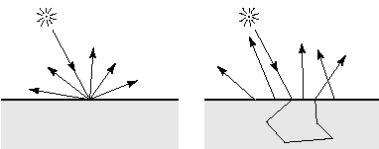
Subsurface Scattering: Translucency
Light enters and leaves at different locations on the surface
  bounces around (scatters) inside

Slide 3
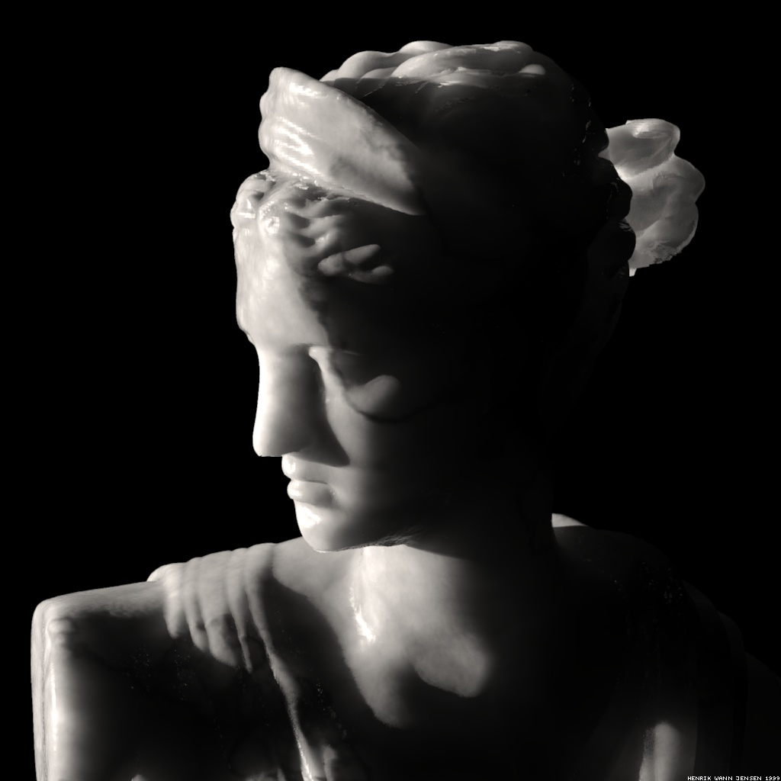
Subsurface Scattering: Marble

Slide 4
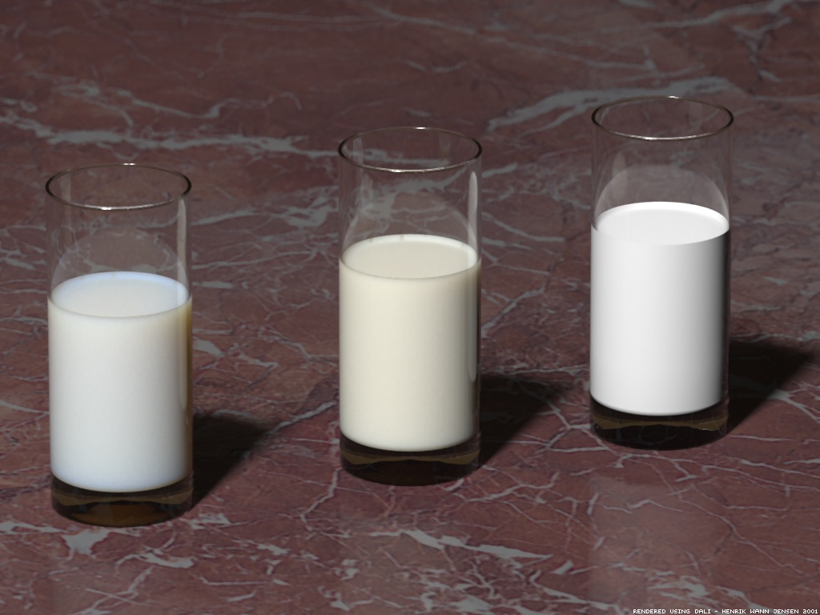
Milk vs. Paint

Slide 5

Skin

Slide 6

Skin

Slide 7
Real-time Rendering
Image-based Rendering
CSE 781
Prof. Roger Crawfis

Slide 8
The graphics pipeline
The traditional pipeline
modeling
animation
rendering
A possible IBR pipeline
3D
scanning
motion
capture
image-based
rendering

Slide 9
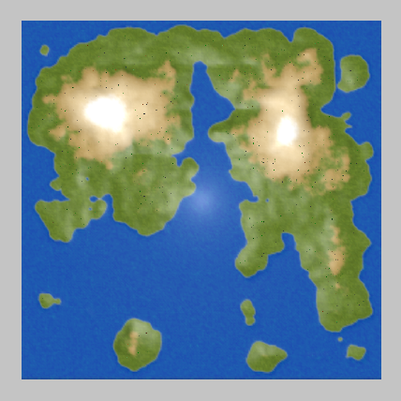
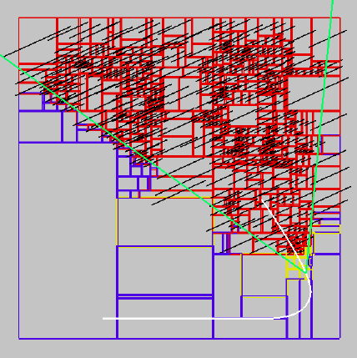
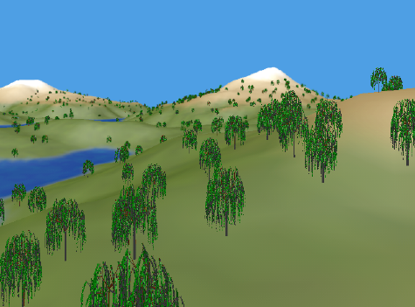
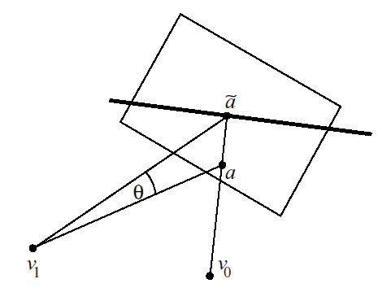
Image caching
[Shade et al., SIGGRAPH 1996]
Precompute BSP tree of scene (2D in this case)
  Draw nearby nodes (yellow) as geometry
  Render distant nodes (red) to RGBα images (black)
  Composite images together
As observer moves
  if disparity exceeds a threshold, re-render image
Notes:
1:30

Slide 10
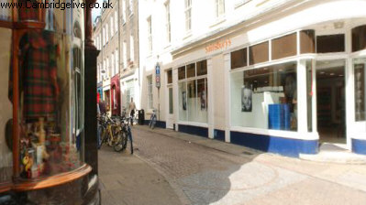
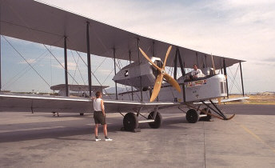
Apple QuickTime VR
[Chen, Siggraph ’95]
Outward-looking
  Panoramic views taken at regularly spaced points
Inward-looking
  Views taken at points on the surface of a sphere
Notes:
0:30

Slide 11
The Plenoptic Function
Radiance as a function of position and direction
in a static scene with fixed illumination
For general scenes
  ⇒ 5D function
L ( x, y, z, θ, φ )
Notes:
0:45

Slide 12
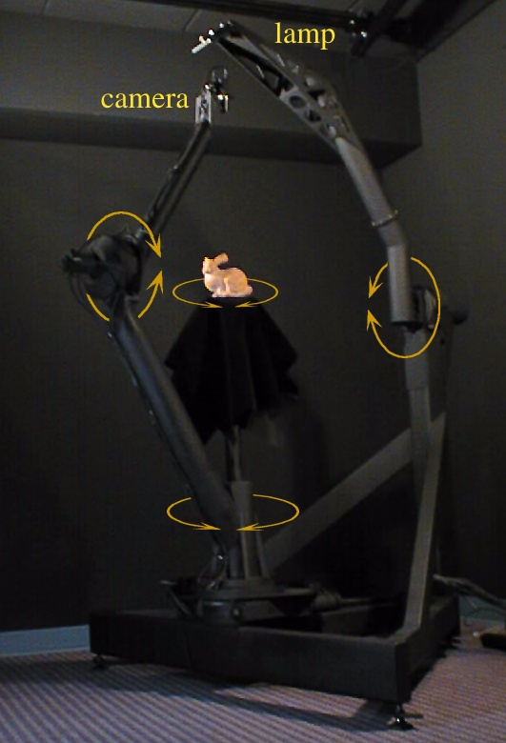
More parameterizations
Chords of a sphere
L ( θ₁, φ₁, θ₂, φ₂ )
convenient for spherical gantry
facilitates uniform sampling
Notes:
1:00

Slide 13
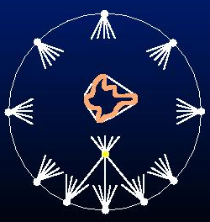
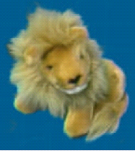
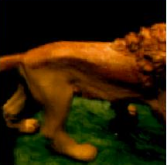
IBR Modelling and Rendering
Store and access only pixels
  No geometry, no light simulation, ...
  Input: set of images
  Output: image from new viewpoint
    Large set of possible new viewpoints
    Interpolation allows translation, not just rotation
      Lightfield, lumigraph: translate outside convex hull of object
      QuickTimeVR: camera rotates, no translation
    Can point camera in or out

