Slide 1
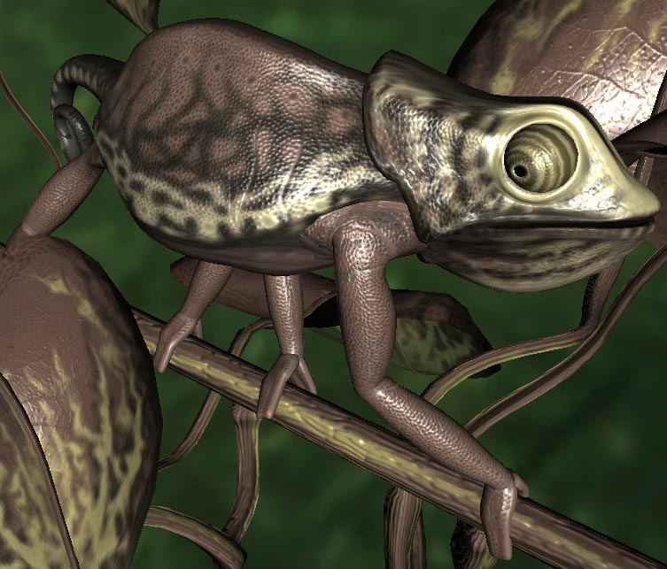
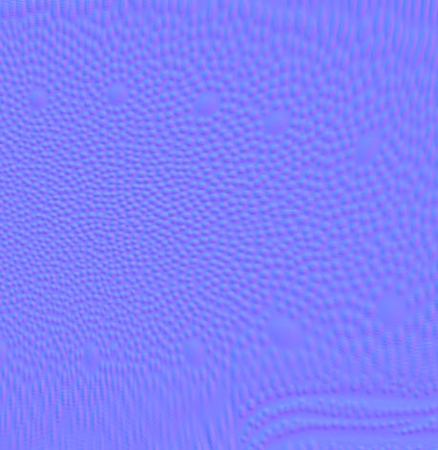
Bump Mapping
CSE 781
Roger Crawfis

Slide 2
Bump Mapping
Many textures are the result of small perturbations in the surface geometry
Modeling these changes would result in an explosion in the number of geometric primitives.
Bump mapping attempts to alter the lighting across a polygon to provide the illusion of texture.

Slide 3
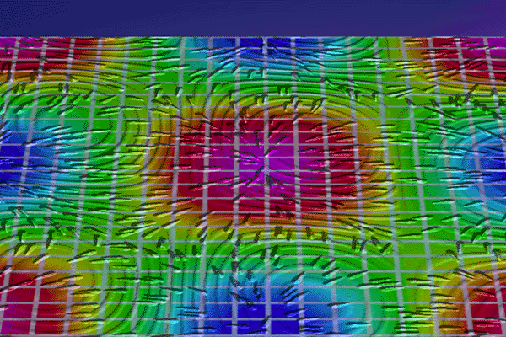
Bump Mapping
Example
Crawfis 1991

Slide 4
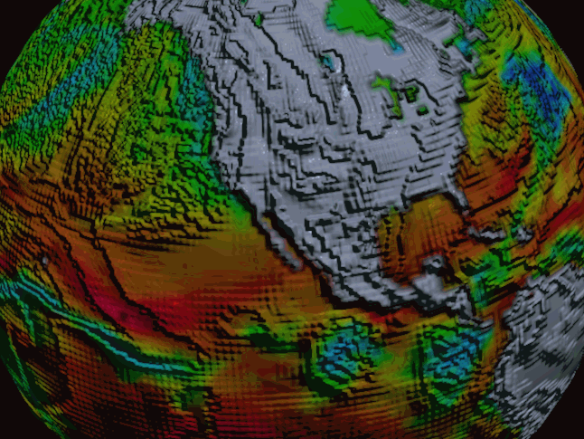
Bump Mapping
Crawfis 1991

Slide 5
Bump Mapping
Consider the lighting for a modeled surface.

Slide 6
Bump Mapping
We can model this as deviations from some base surface.
The question
is then how
these deviations
change the lighting.
N

Slide 7
Bump Mapping
Assumption: small deviations in the normal direction to the surface.
X = X + B N
Where B (our height field) is defined as a 2D function parameterized over the surface:
B = f(u,v)

Slide 8
Bump Mapping
Step 1: Putting everything into the same coordinate frame as B(u,v).
  x(u,v), y(u,v), z(u,v) – this is given for parametric surfaces, but easy to derive for other analytical surfaces.
  Or O(u,v)

Slide 9
Bump Mapping
Define the tangent plane to the surface at a point (u,v) by using the two vectors O_{u} and O_{v}, resulting from the partial derivatives.
The normal is then given by:
    N = O_{u} × O_{v}
N

Slide 10
Bump Mapping
The new surface positions are then given by:
    O’(u,v) = O(u,v) + B(u,v) N
    Where, N = N / |N|
Differentiating leads to:
    O’_{u} = O_{u} + B_{u} N + B (N)_{u} ≈ O’_{u} = O_{u} + B_{u} N
    O’_{v} = O_{v} + B_{v} N + B (N)_{v} ≈ O’_{v} = O_{v} + B_{v} N
  If B is small (remember it is a small height pertubation).

Slide 11
Bump Mapping
This leads to a new normal:
    N’(u,v) ≅ O’_{u} × O’_{v}
    = O_{u} × O_{v} - B_{u}(N × O_{v}) + B_{v}(N × O_{u})
        + B_{u} B_{v}(N × N)
        = N - B_{u}(N × O_{v}) + B_{v}(N × O_{u})
        = N + D
D
N’
N

Slide 12
Bump Mapping
For efficiency, can store B_{u} and B_{v} in a 2-component texture map.
  This is commonly called an offset vector map.
  Note: It is oriented in tangent-space, not object space.
The cross products are geometry terms only (we only care about the relative direction).
N’ will of course need to be normalized after the calculation and before lighting.

Slide 13
Bump Mapping
An alternative representation of bump maps can be viewed as a rotation of the normal.
The rotation axis is the cross-product of N and N’.

Slide 14
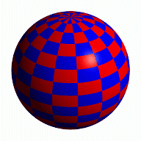
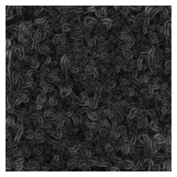
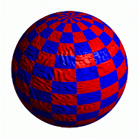
Bump Mapping
Store in a texture and use textures to alter the surface normal
  Does not change the shape of the surface
  Just shaded as if it were a different shape
Sphere w/Diffuse Texture
Swirly Bump Map
Sphere w/Diffuse Texture & Bump Map

Slide 15
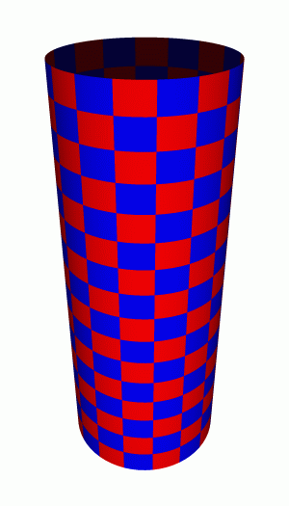
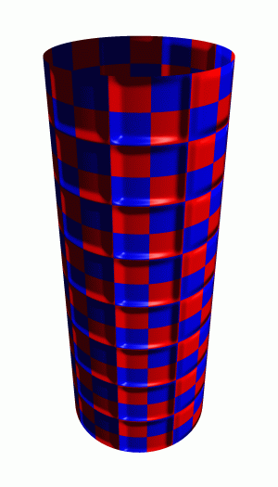

Simple textures work great
Bump Map
Cylinder w/Diffuse Texture Map
Cylinder w/Texture Map & Bump Map

Slide 16
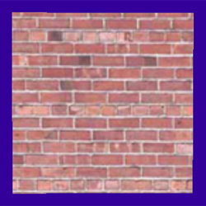
What's Missing?
There are no bumps on
the silhouette of a
bump-mapped object

Slide 17
Bump Mapping
We can store:
  The height displacement
  Model space normals
  Object space normals
  Tangent space normals
  The offset vectors in tangent space
  The rotations in tangent space
    Matrices
    Quaternians
    Euler angles
Model dependent (encoded for that specific model) versus reusable (same material).

Slide 18
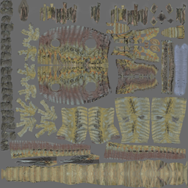
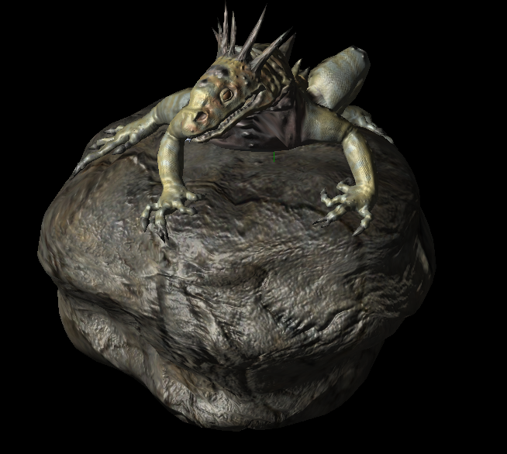
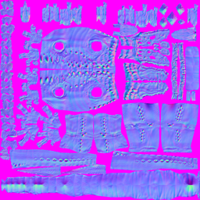
Normal Maps
Store the normal directly in the texture.

Slide 19
Normal Maps
Diffuse Color Texture Map
Normal Map
Each pixel RGB values is really a normal vector relative to the surface at that point.
-1 to 1 range is mapped to 0 to 1 for the texture so normals become colors.

Slide 20
Normal Map Operation
Vertex
Normal
Vertex
Normal
Normals from
Normal Map
For each pixel, determine the normal from a texture image. Use that to compute the color.

Slide 21
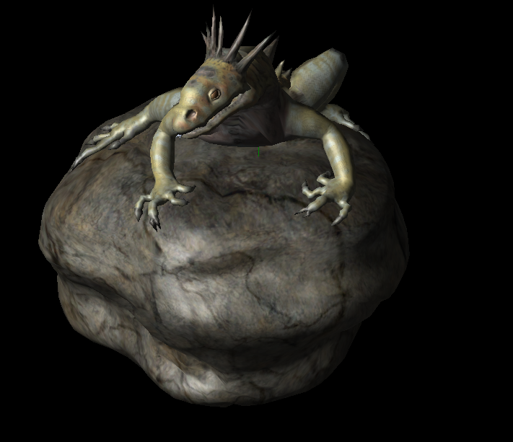
Does this make any difference?
Just texture mapped
Texture and normal maps
Notice: The geometry is unchanged. There’s the same number of vertices and triangles. This effect is entirely from the normal map.

Slide 22
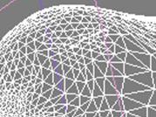
Some details
Normal maps are typically in object or model space
We have to rotate them to our world coordinate system.
What does it take to rotate something to a specific frame?

Slide 23
Normals, Tangents, and Binormals
Z: Normal
Y: Binormal
X: Tangent
The normal is given. The tangent is determined by which way u is for the texture map. The binormal (bitangent) is the cross product of the two.

Slide 24
HLSL code for normal mapping
struct VS_INPUT
{
float4 position : POSITION0;
float2 texCoord : TEXCOORD0;
float3 normal : NORMAL0;
float3 binormal : BINORMAL0;
float3 tangent : TANGENT0;
};
struct VS_OUTPUT
{
float4 position : POSITION0;
float2 texCoord : TEXCOORD0;
float4 worldPosition : TEXCOORD1;
// Note: tangentToWorld is actually
// TEXCOORD2, 3, and 4
float3x3 tangentToWorld : TEXCOORD2;
};
VS_OUTPUT VertexShader( VS_INPUT input )
{
VS_OUTPUT output;
// transform the position into projection space
float4 worldPosition = mul(input.position, World);
output.worldPosition = worldPosition;
output.position = mul(mul(worldPosition, View), Projection);
output.tangentToWorld[0] = mul(input.tangent, World);
output.tangentToWorld[1] = mul(input.binormal, World);
output.tangentToWorld[2] = mul(input.normal, World);
output.texCoord = input.texCoord;
return output;
}

Slide 25
Pixel Shader
float4 PixelShader( VS_OUTPUT input ) : COLOR0
{
float3 N = tex2D(NormalMapSampler, input.texCoord);
N = normalize(mul(N, input.tangentToWorld));
float3 V = normalize(Eye - input.worldPosition);
float3 L = normalize(LightPosition - input.worldPosition);
float3 H = normalize(V + L);
float4 diffuse = LightColor * max(dot(N, L), 0);
float4 specular = LightColor * pow(saturate(dot(N, H)), SpecularPower);
float4 diffuseTexture = tex2D(DiffuseTextureSampler, input.texCoord);
// return the combined result.
return (diffuse + LightAmbientColor) * diffuseTexture + specular * SpecularColor;
}

Slide 26
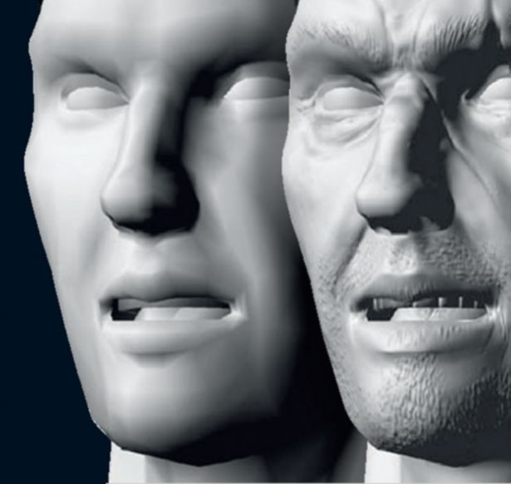
Normal Maps
Notes:
Can transform the light to tangent space.
  Saves computation at the fragment level.
  More expensive at the vertex level.
  Many lights?
Can bake the normals into world space and use them directly.
http://www.computerarts.co.uk/__data/assets/image/185268/varieties/7.jpg

Slide 27
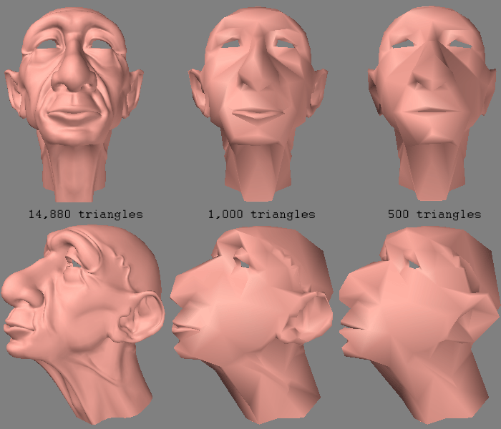
Normal Maps
http://amber.rc.arizona.edu/lw/normalmaps.html

Slide 28
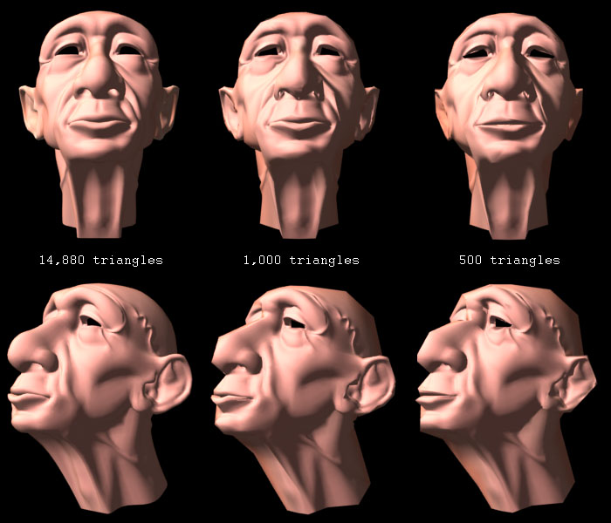
Normal Maps
http://amber.rc.arizona.edu/lw/normalmaps.html

Slide 29
Other Mappings
BDRF (minimizing the bumps)
Horizon maps (adding shadows)
Parallax mapping (adding occlusion)
Displacement mapping (changing the geometry)
Geometry images
  Not bump mapping, but an encoding of the geometry into a texture map.

Slide 30
Height Mapping
With the new power of programmable shaders, height maps are becoming fairly easy.
You do the math on the GPU.
This is required when you do displacement mapping unless you have two textures for the same thing (displacement map and normal map).

Slide 31
Comparison
View
Dependent
Displacement
Mapping
Bump
Mapping
Horizon
Mapping
(shadows)
Displacement
Mapping

Slide 32
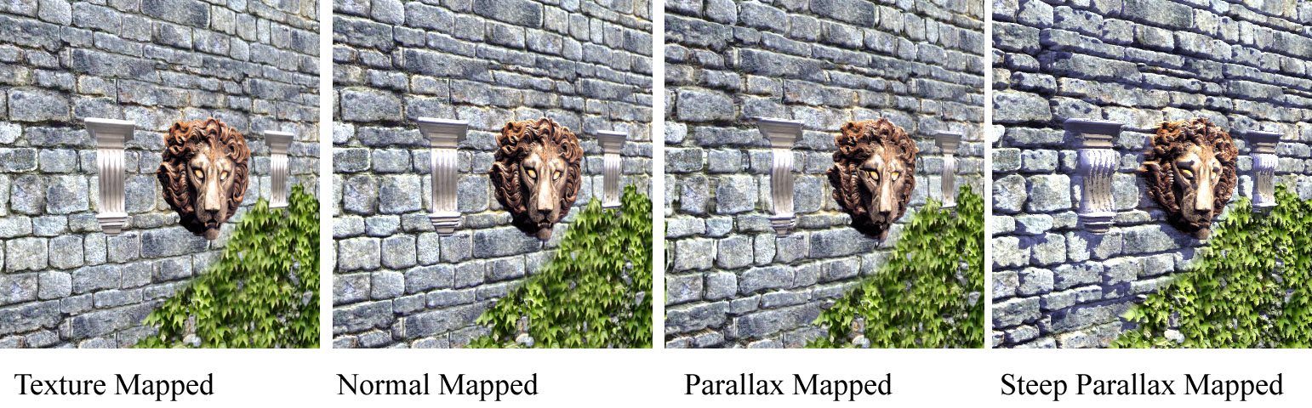

Slide 34
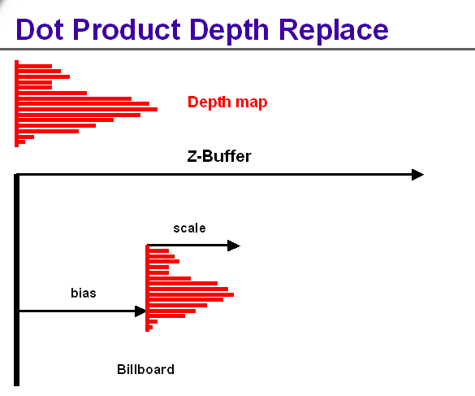
Depth Billboards
You can use pseudo-depth textures to model simple geometry or billboards
Notes:
Used for “depth sprites”, where a screen aligned image can also have correct depth
Previous stage must be Dot Product program
Best precision if source texture is unsigned HILO, though other formats may be used
If the new depth value is outside of the range of the near and far depth range values, the fragment is rejected (that is, it’s clipped to near/far planes)
Calculates two dot products, and replaces the fragment (window) depth with their quotient
Output color is always (0,0,0,0)

Slide 35
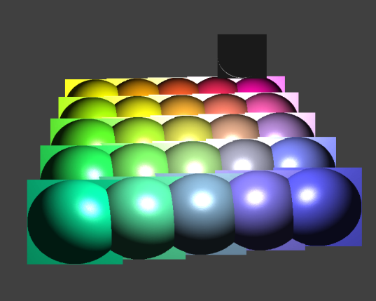
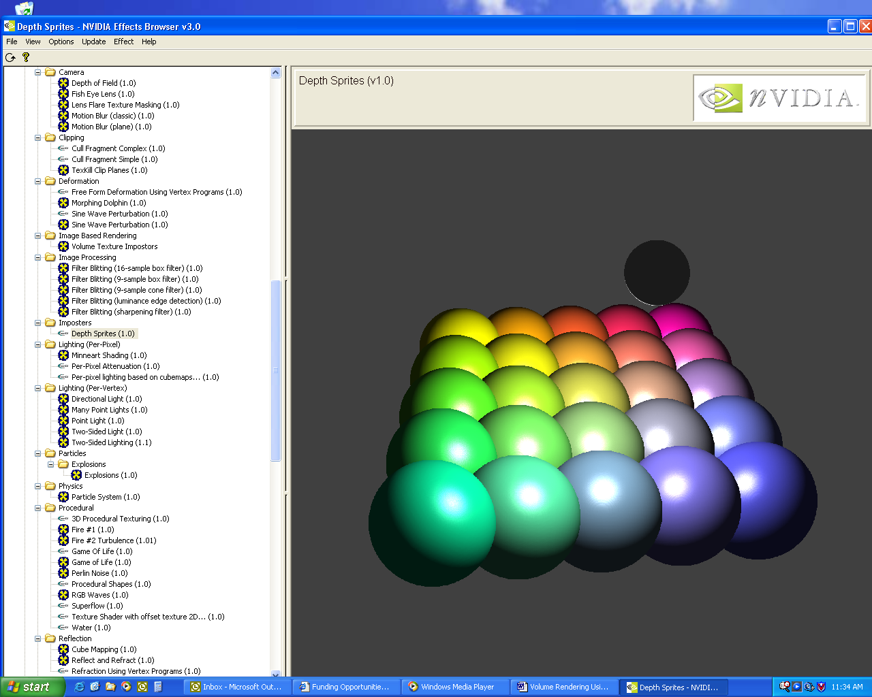
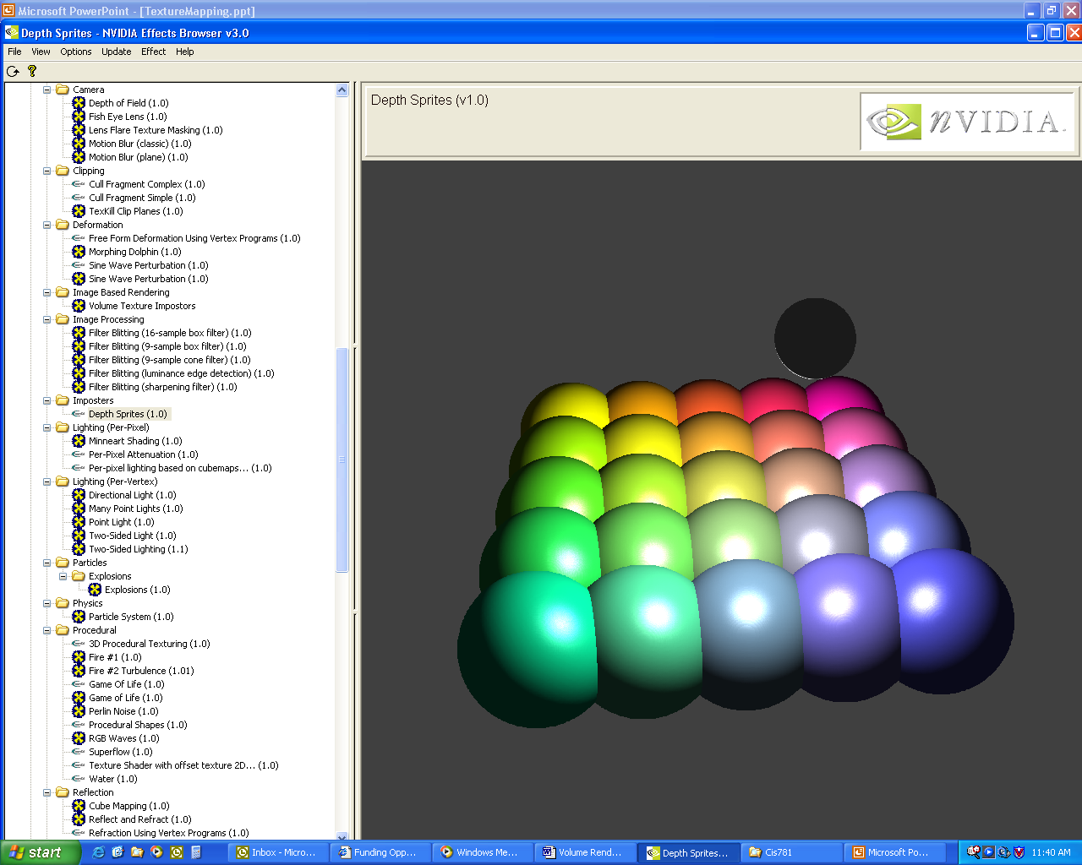
Imposters with Depth

