Slide 1
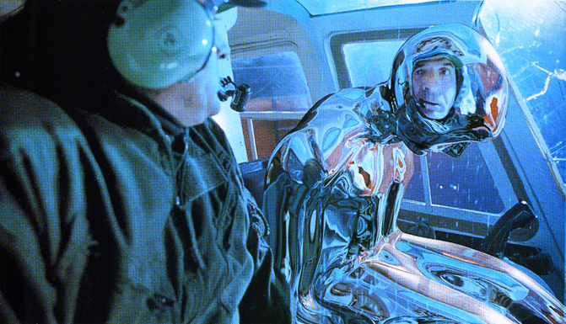
Environment Mapping
CSE 5542 – Roger Crawfis

Slide 2
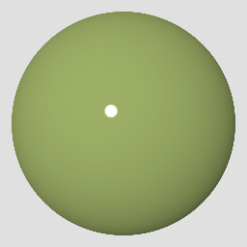
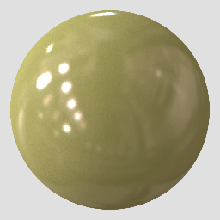
Natural illumination
People perceive materials more easily under natural illumination than simplified illumination.
Images courtesy Ron Dror and Ted Adelson

Slide 3
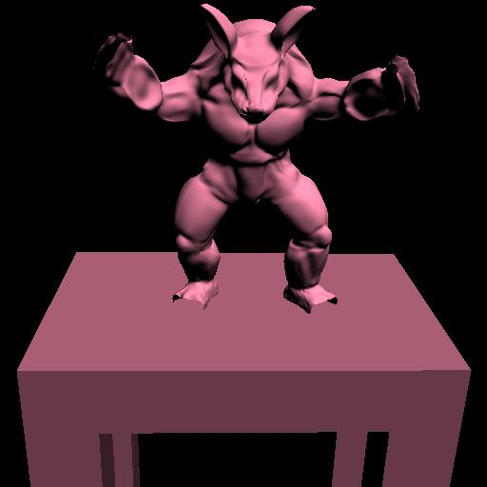
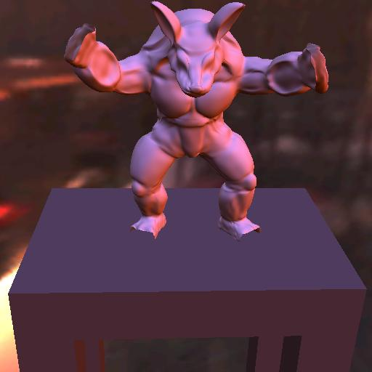
Natural illumination
Natural illumination is very expensive compared to using simplified illumination (take CSE 5543).
directional source
natural illumination

Slide 4
Environment Mapping
Determine reflected ray.
Look-up direction
from a sphere-map.
Reflection only depends
on the direction, not the position.

Slide 5
Environment Mapping
We can also encode
the reflected directions using several other formats.
Greene, et al suggested a cube. This has the advantage that it can be constructed by six normal renderings.

Slide 6
Environment Mapping
Create six views from the shiny object’s centroid.
When scan-converting the object, index into the appropriate view and pixel.
Use reflection vector to index.
Largest component of reflection vector will determine the face.

Slide 7
Environment Mapping
Problems:
  Reflection is about object’s centroid.
  Okay for small objects and
  and distant reflections.
N
N

Slide 8
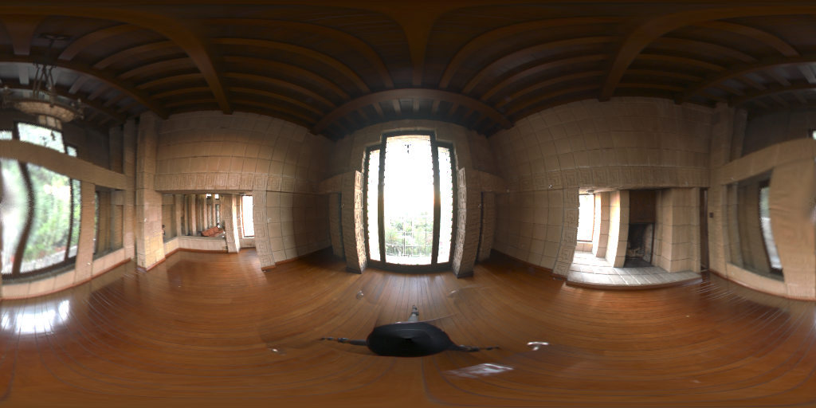
Environment Mapping
Latitude/Longitude
  Too much distortion at poles
Notes:
Makes rate of change from spherical to image vary greatly as a distance from the pole

Slide 9
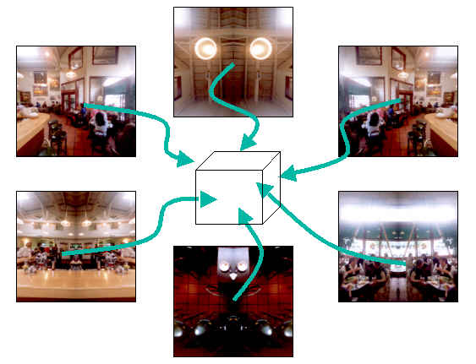
Environment Mapping
Cube Maps
  Can be created with GPU
  Low distortion
Notes:
Decimation/reconstruction is non-spherical (i.e. per face) causing filter region to

Slide 10
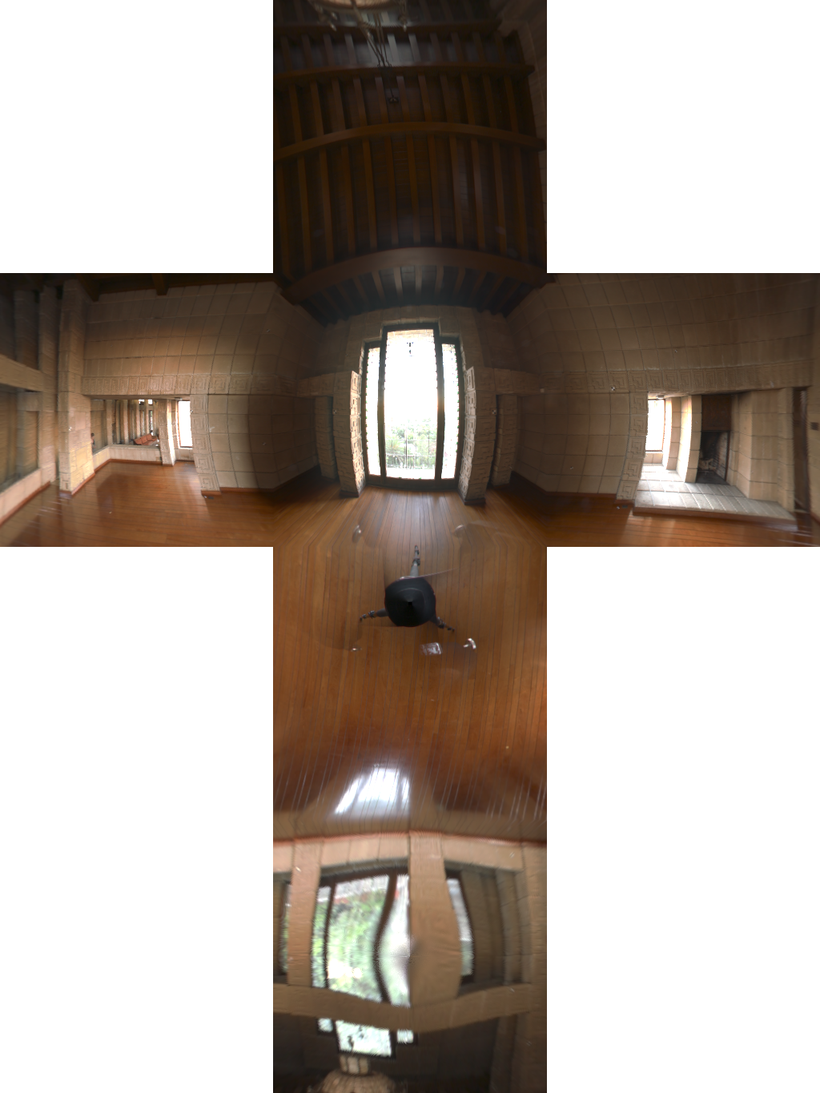
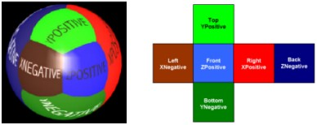
Environment Mapping
Cube Mapping

Slide 11
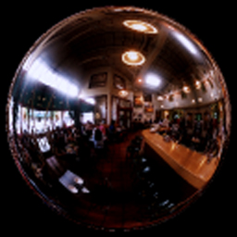
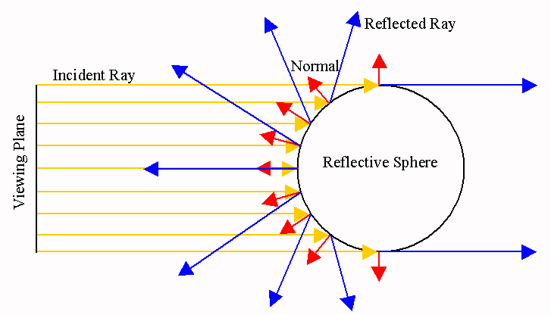
Sphere Mapping

Slide 12
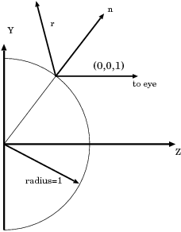
Indexing Sphere Maps
Given the reflection vector R
(s,t) on the spherical map
Problems:
  Highly non-uniform sampling
  Highly non-linear mapping

Slide 13
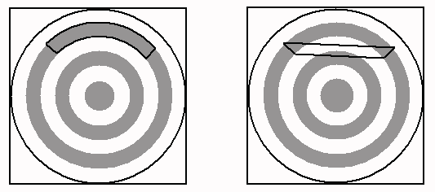
Non-linear Mapping
Linear interpolation of texture coordinates picks up the wrong texture pixels
  Use small polygons!
Correct
Linear

Slide 14
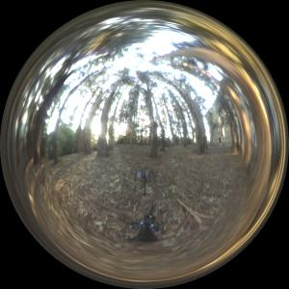
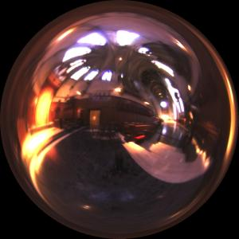
Sphere Mapping
Can be easily created by photographing a mirrored sphere.

Slide 15
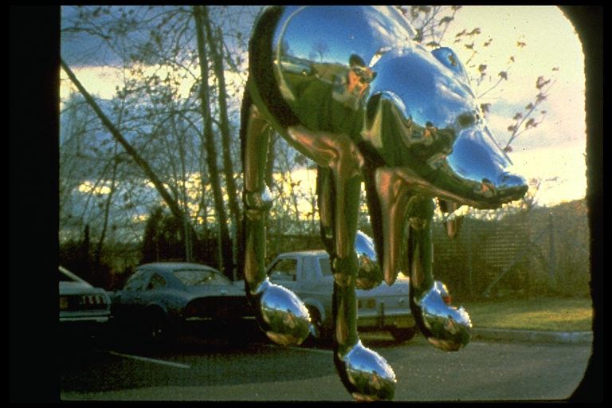
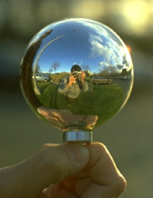
Sphere Mapping
Miller and Hoffman, 1984

Slide 16
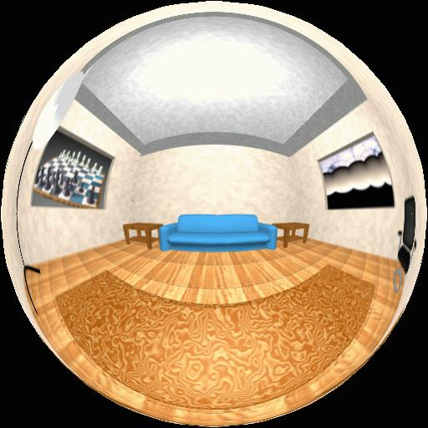
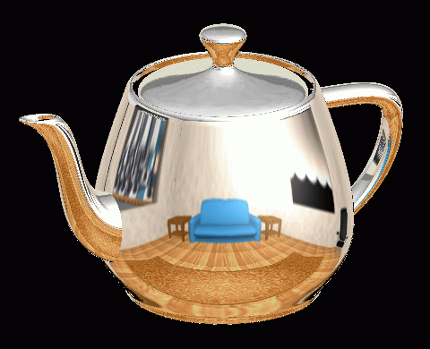
Sphere Mapping
Example

Slide 17
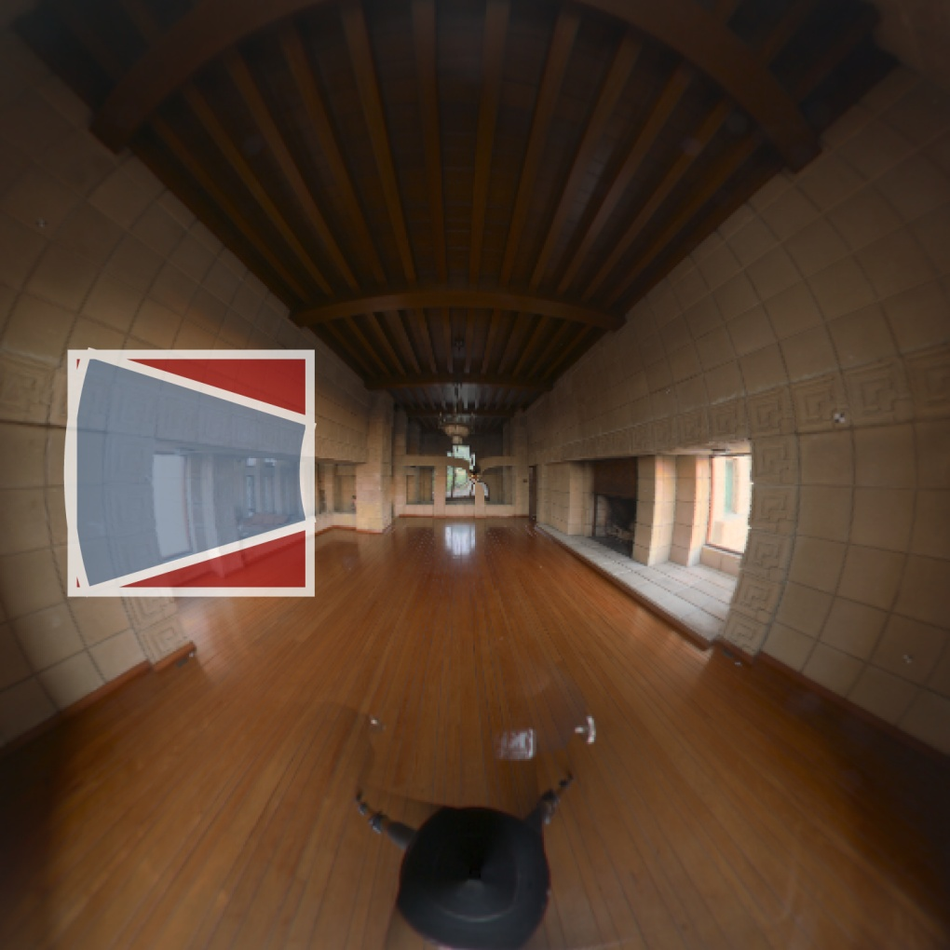
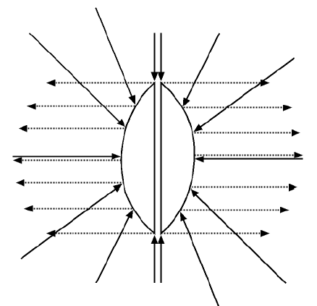
Parabolic Mapping
Dual Paraboloid
Error
Support Region
Notes:
Use because cube maps cause seams artifacts when using MIP-maps

Slide 18
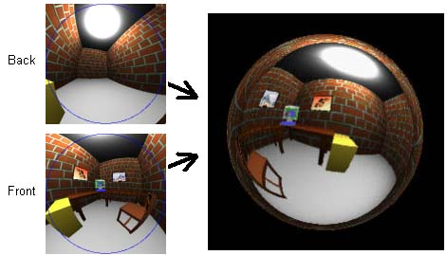
Parabolic Mapping

Slide 19
Environment Mapping
Applications
  Specular highlights
  Multiple light sources
  Reflections for shiny surfaces
  Irradiance for diffuse surfaces

Slide 20
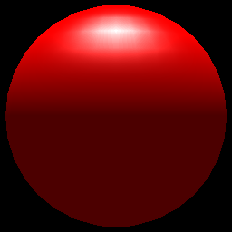
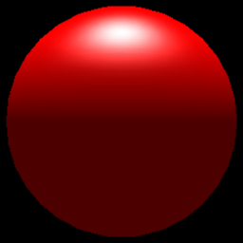

Specular Highlights
Sphere map on top
Result in the middle
Standard OpenGL lighting on the bottom.
Not needed with fragment shaders, … unless …
Still a nice technique for many lights.
View dependent.

Slide 21
Chrome Mapping
Cheap environment mapping
Material is very glossy, hence perfect reflections are not seen.
Index into a pre-computed view independent texture.
Reflection vectors are still view dependent.

Slide 22
Chrome Mapping
Usually, we set it to a very blurred landscape image.
  Brown or green on the bottom
  White and blue on the top.
  Normals facing up have a white/blue color
  Normals facing down on average have a brownish color.

Slide 23
Chrome Mapping
Also useful for things like fire.
The major point, is that it is not important what actually is shown in the reflection, only that it is view dependent.

Slide 24
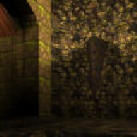
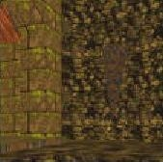
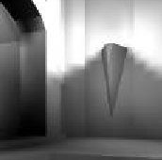
Diffuse Reflection
radiosity
(image intensity)
reflectance
(albedo/texture)
irradiance
(incoming light)
=
×
quake light map

Slide 25
Lambertian Surface
Diffuse Scattering
specular reflection
Light everywhere
diffuse reflection

Slide 26
2-Color Hemi-sphere Model
The 2-color hemi-sphere model from Lab1 was a very simple environment map for diffuse reflection.
Sky Color
θ
Ground Color

Slide 27
Model Elements
Sky Color
Ground Color
Hemisphere Model
Final Color

Slide 28
Distributed Light Model
Hemisphere of possible incident light directions
θ
Surface Normal
Microfacet Normal
- defines axis of hemisphere

Slide 29
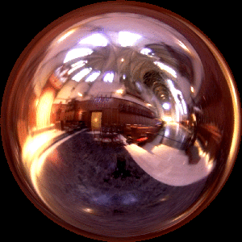
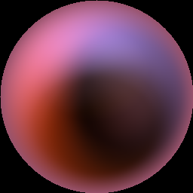
Irradiance environment maps
L
n
Illumination Environment Map
Irradiance Environment Map

Slide 30
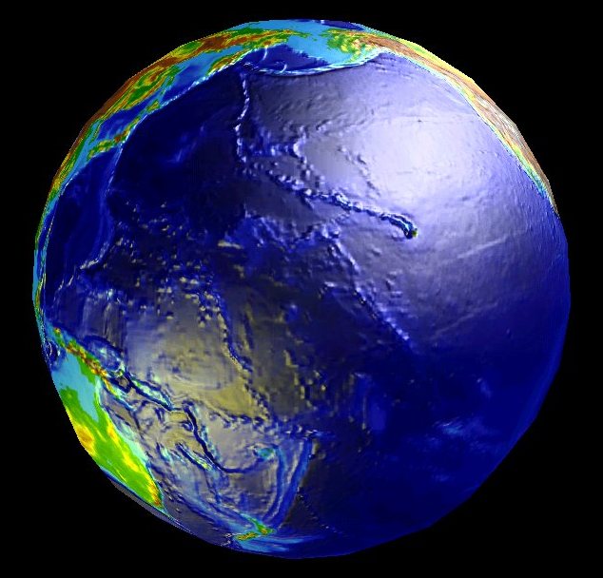
Example Hemi-sphere Map
Environment map
(longitude/latitude)
Irradiance map

Slide 31
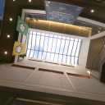

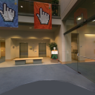
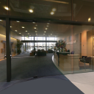
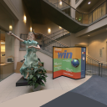



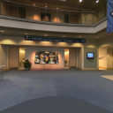



Cube Map And Its Integral

Slide 32
Spherical Harmonics
Roger Crawfis
CSE 781

Slide 33
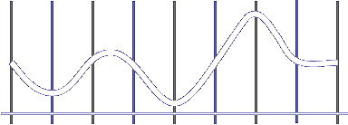
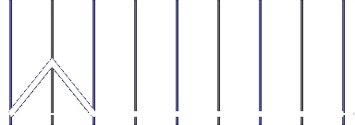

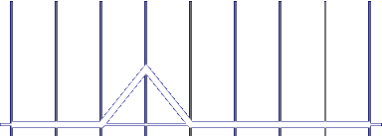
Basis functions
Basis Functions are pieces of signal that can be used to produce approximations to a function

Slide 34
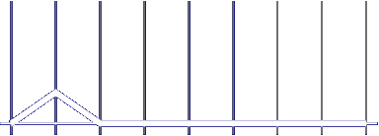
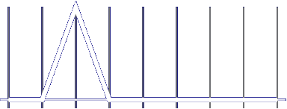
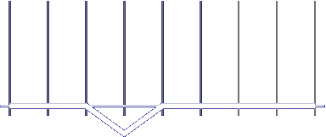
Basis functions
We can then use these coefficients to reconstruct an approximation to the original signal

Slide 35
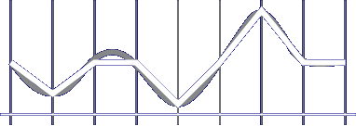
Basis functions
We can then use these coefficients to reconstruct an approximation to the original signal

Slide 36
Orthogonal Basis Functions
Orthogonal Basis Functions
  These are families of functions with special properties

Slide 37
Orthogonal Basis Functions
Space to represent data
Different spaces often allow for compression of coefficients
Lets look at one simple example of the following piece of data
Data

Slide 38
Orthogonal Basis Functions
Standard Basis
Coefficient for each discrete position

Slide 39
DCT
Discrete Cosine Transform
Use Cosine waves as basis functions
cos x
1
cos 2x
cos 3x

Slide 40
Function Reconstruction with DCT
k
cos x
0.15
+ 0.25
=
- 0.3
=
cos 3x

Slide 41
Function Reconstruction with DCT
Only needed 3 coefficients instead of 20!
  Remaining coefficients are all 0
Most of the time data not perfect
Obtain good reconstruction from few coefficients
Arbitrary function conversion requires projection

Slide 42
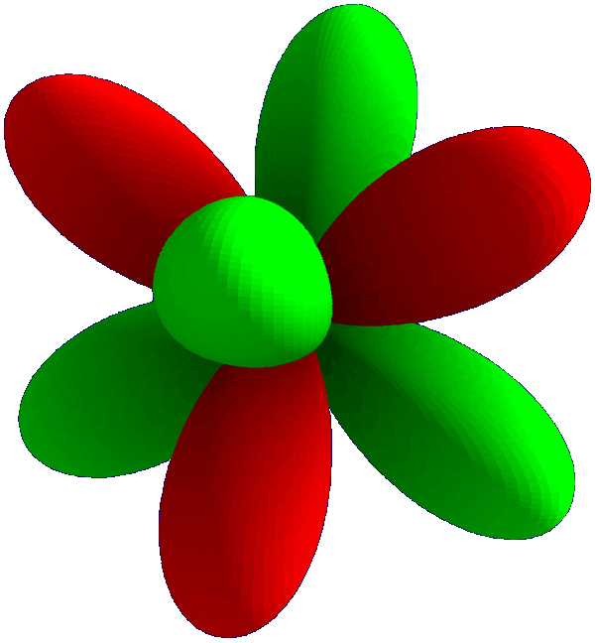
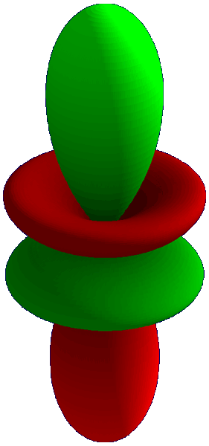
Real spherical harmonics

Slide 43
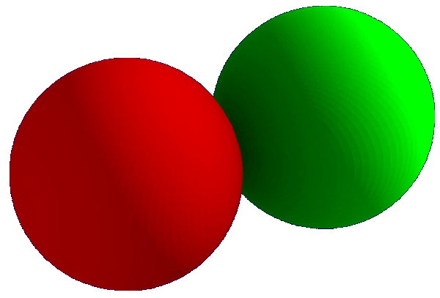
Reading SH diagrams
This
direction
+
–
Not this
direction

Slide 44
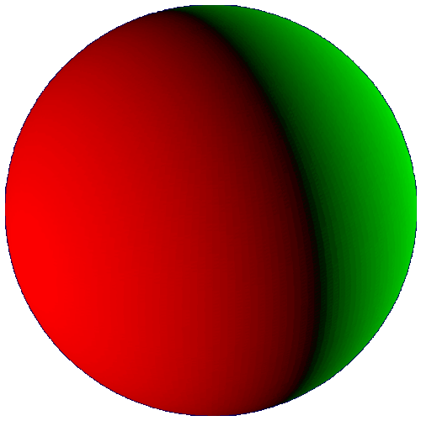
Reading SH diagrams
This
direction
+
–
Not this
direction

Slide 45
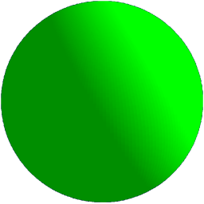
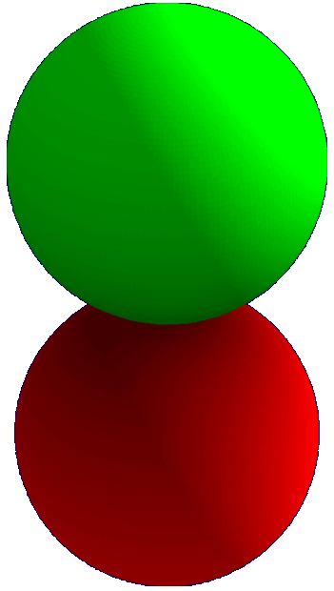
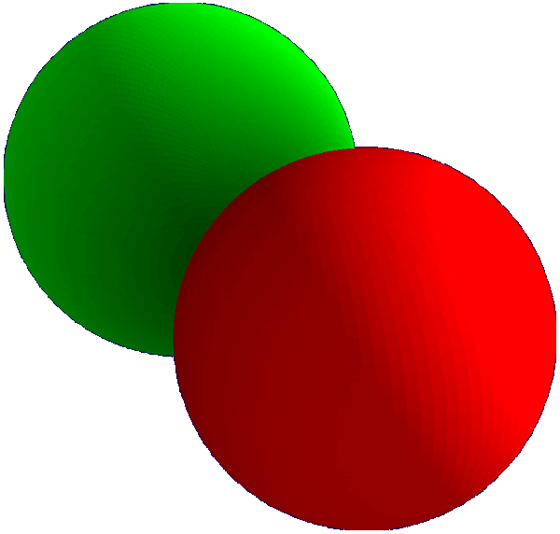
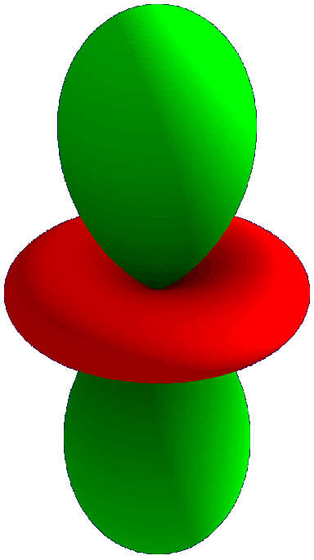




The SH functions

Slide 46

The SH functions

Slide 47









Spherical harmonics
m
0
l
1
2
-2
-1
0
1
2

Slide 48

Examples of reconstruction
Displacement mapping on the sphere

Slide 49

An example
Take a function comprised of two area light sources
  SH project them into 4 bands = 16 coefficients

Slide 50


Low frequency light source
We reconstruct the signal
  Using only these coefficients to find a low frequency approximation to the original light source

Slide 51
SH lighting for diffuse objects
An Efficient Representation for Irradiance Environment Maps, Ravi Ramamoorthi and Pat Hanrahan, SIGGRAPH 2001
Assumptions
  Diffuse surfaces
  Distant illumination
  No shadowing, interreflection
irradiance is a function of surface normal

Slide 52

Spherical harmonic expansion
Expand lighting (L), irradiance (E) in basis functions
= .67
+ .36
+ …

Slide 53

Analytic irradiance formula
Lambertian surface acts like low-pass filter
0
0
1
2
cosine term

Slide 54



9 parameter approximation
Order 0
1 term
Exact image
m
RMS error = 25 %
0
l
1
2
-2
-1
0
1
2

Slide 55

9 Parameter Approximation
Order 1
4 terms
Exact image
m
RMS Error = 8%
0
l
1
2
-2
-1
0
1
2

Slide 56

9 Parameter Approximation
Order 2
9 terms
Exact image
m
RMS Error = 1%
0
l
For any illumination, average
error < 3% [Basri Jacobs 01]
1
2
-2
-1
0
1
2

Slide 57


Comparison
Incident
illumination
300x300
Irradiance map
Texture: 256x256
Hemispherical
Integration 2Hrs
Irradiance map
Texture: 256x256
Spherical Harmonic
Coefficients 1sec

Slide 58
Rendering
Irradiance approximated by quadratic polynomial
4x4 matrix
(depends linearly
on coefficients L_{lm})
Surface Normal vector
column 4-vector

Slide 59
matrix form
c₁L₂₂ | c₁L₂₋₂ | c₁L₂₁ | c₂L₁₁
c₁L₂₋₂ | -c₁L₂₂ | c₁L₂₋₁ | c₂L₁₋₁
c₁L₂₁ | c₁L₂₋₁ | c₃L₂₀ | c₂L₁₀
c₂L₁₁ | c₂L₁₋₁ | c₂L₁₀ | c₄L_{00 –}c₅L₂₀
M =

Slide 60

Complex geometry
Assume no shadowing: Simply use surface normal

Slide 61

Cool!

Slide 63


Diffuse environment shading
Need integration over environment map
For diffuse reflection scaled by cosinus
Index in filtered versions of map
specular reflection
diffuse reflection
received radiance is function of accessability
ambient occlusion

Slide 64

A Skin Texture Shader
Skin appears softer than Lambertian reflectance because of subsurface scattering
Seeliger lighting model
I = (N⋅ L) / (N⋅ L + N⋅ V )
Implement as a texture shader
s = N⋅ L
t = N⋅ V
C = s/(s+t )

