Slide 1
A Fire-side Chat Fun and Effectiveness
Aka, an old fart!
Your Host,
Prof. Roger Crawfis
Computer Science & Engineering
The Ohio State University

Slide 2
Set-Up
Massive game worlds require enormous amounts of art (data).
Can we expect a human to create, fine-tune, play test all of this?
Large-scale visualization deals with enormous amounts of data to generate imagery (art).
Can we expect a human to create, fine-tune, interact with all of this?

Slide 3
Physical Therapy for Stroke
Modern strategies to aid recovery from stroke combine an intense regiment of physical exercise, to strengthen the muscles, along with transfer packages and positive reinforcement aimed to repair the brain.
6 hours of therapy for 2 weeks straight.
Difficult (for patient) and expensive to administer in a hospital.

Slide 4
My Passion

Slide 5
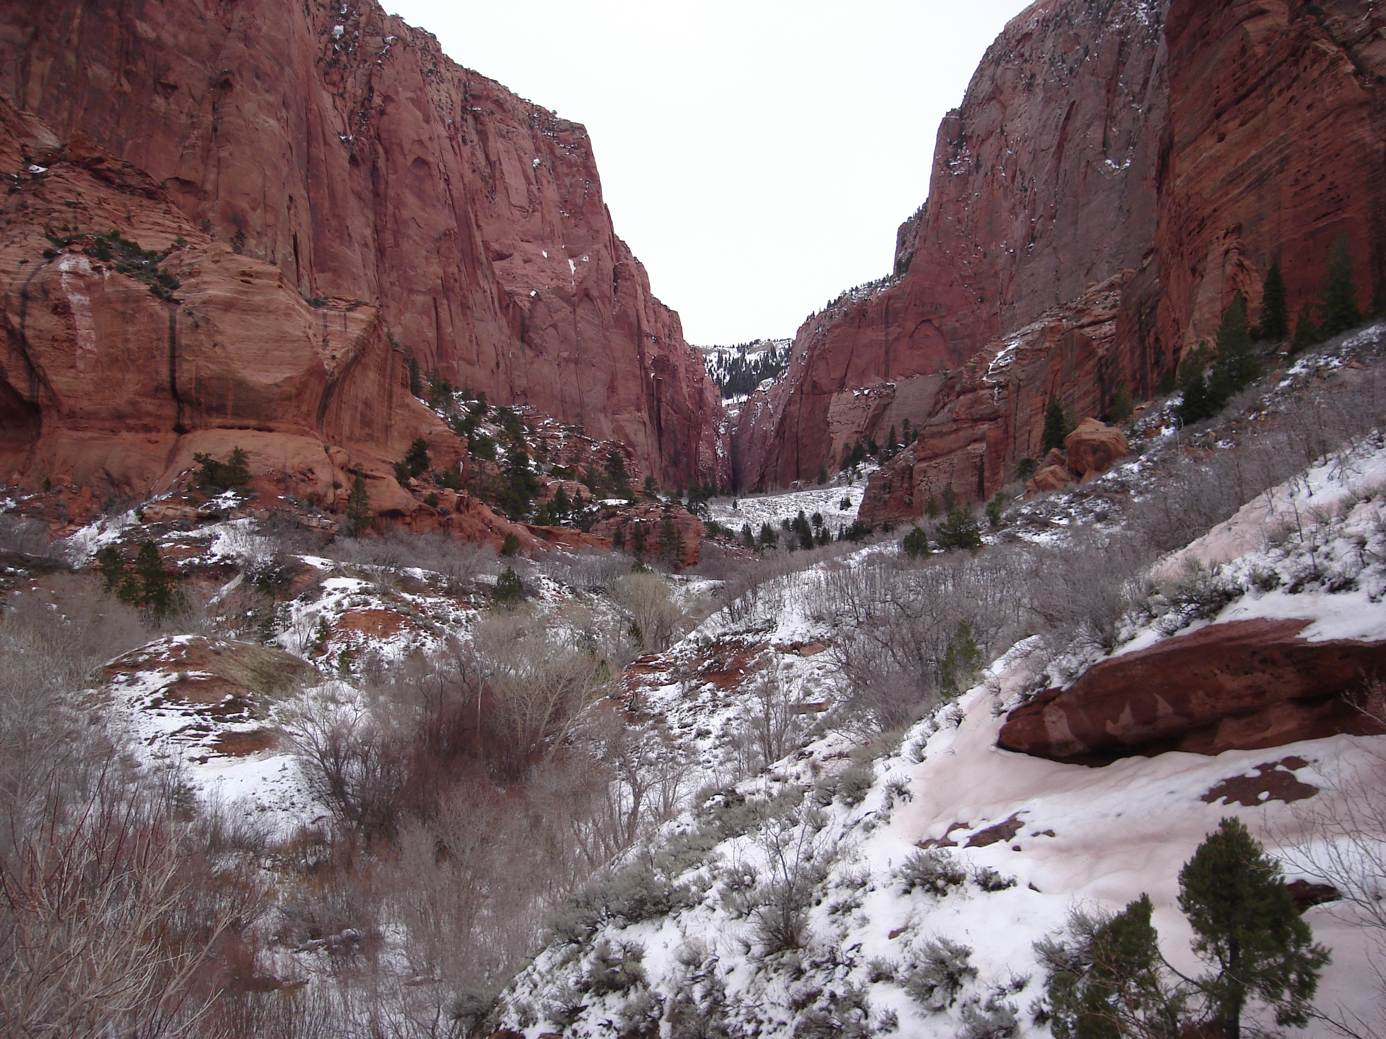
My Passion

Slide 6
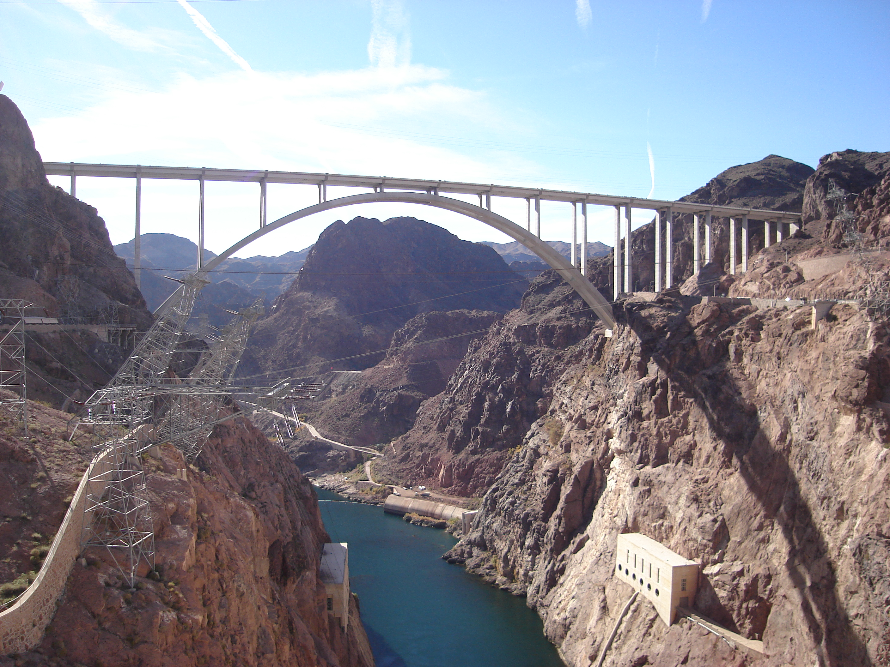

Slide 7
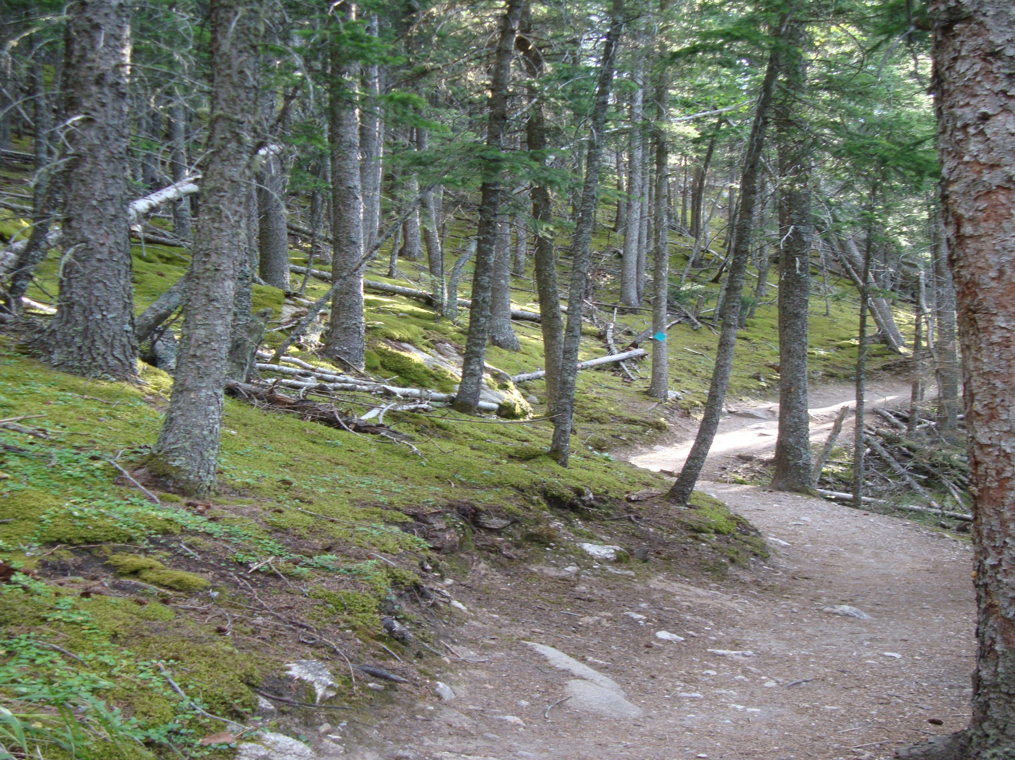

Slide 8
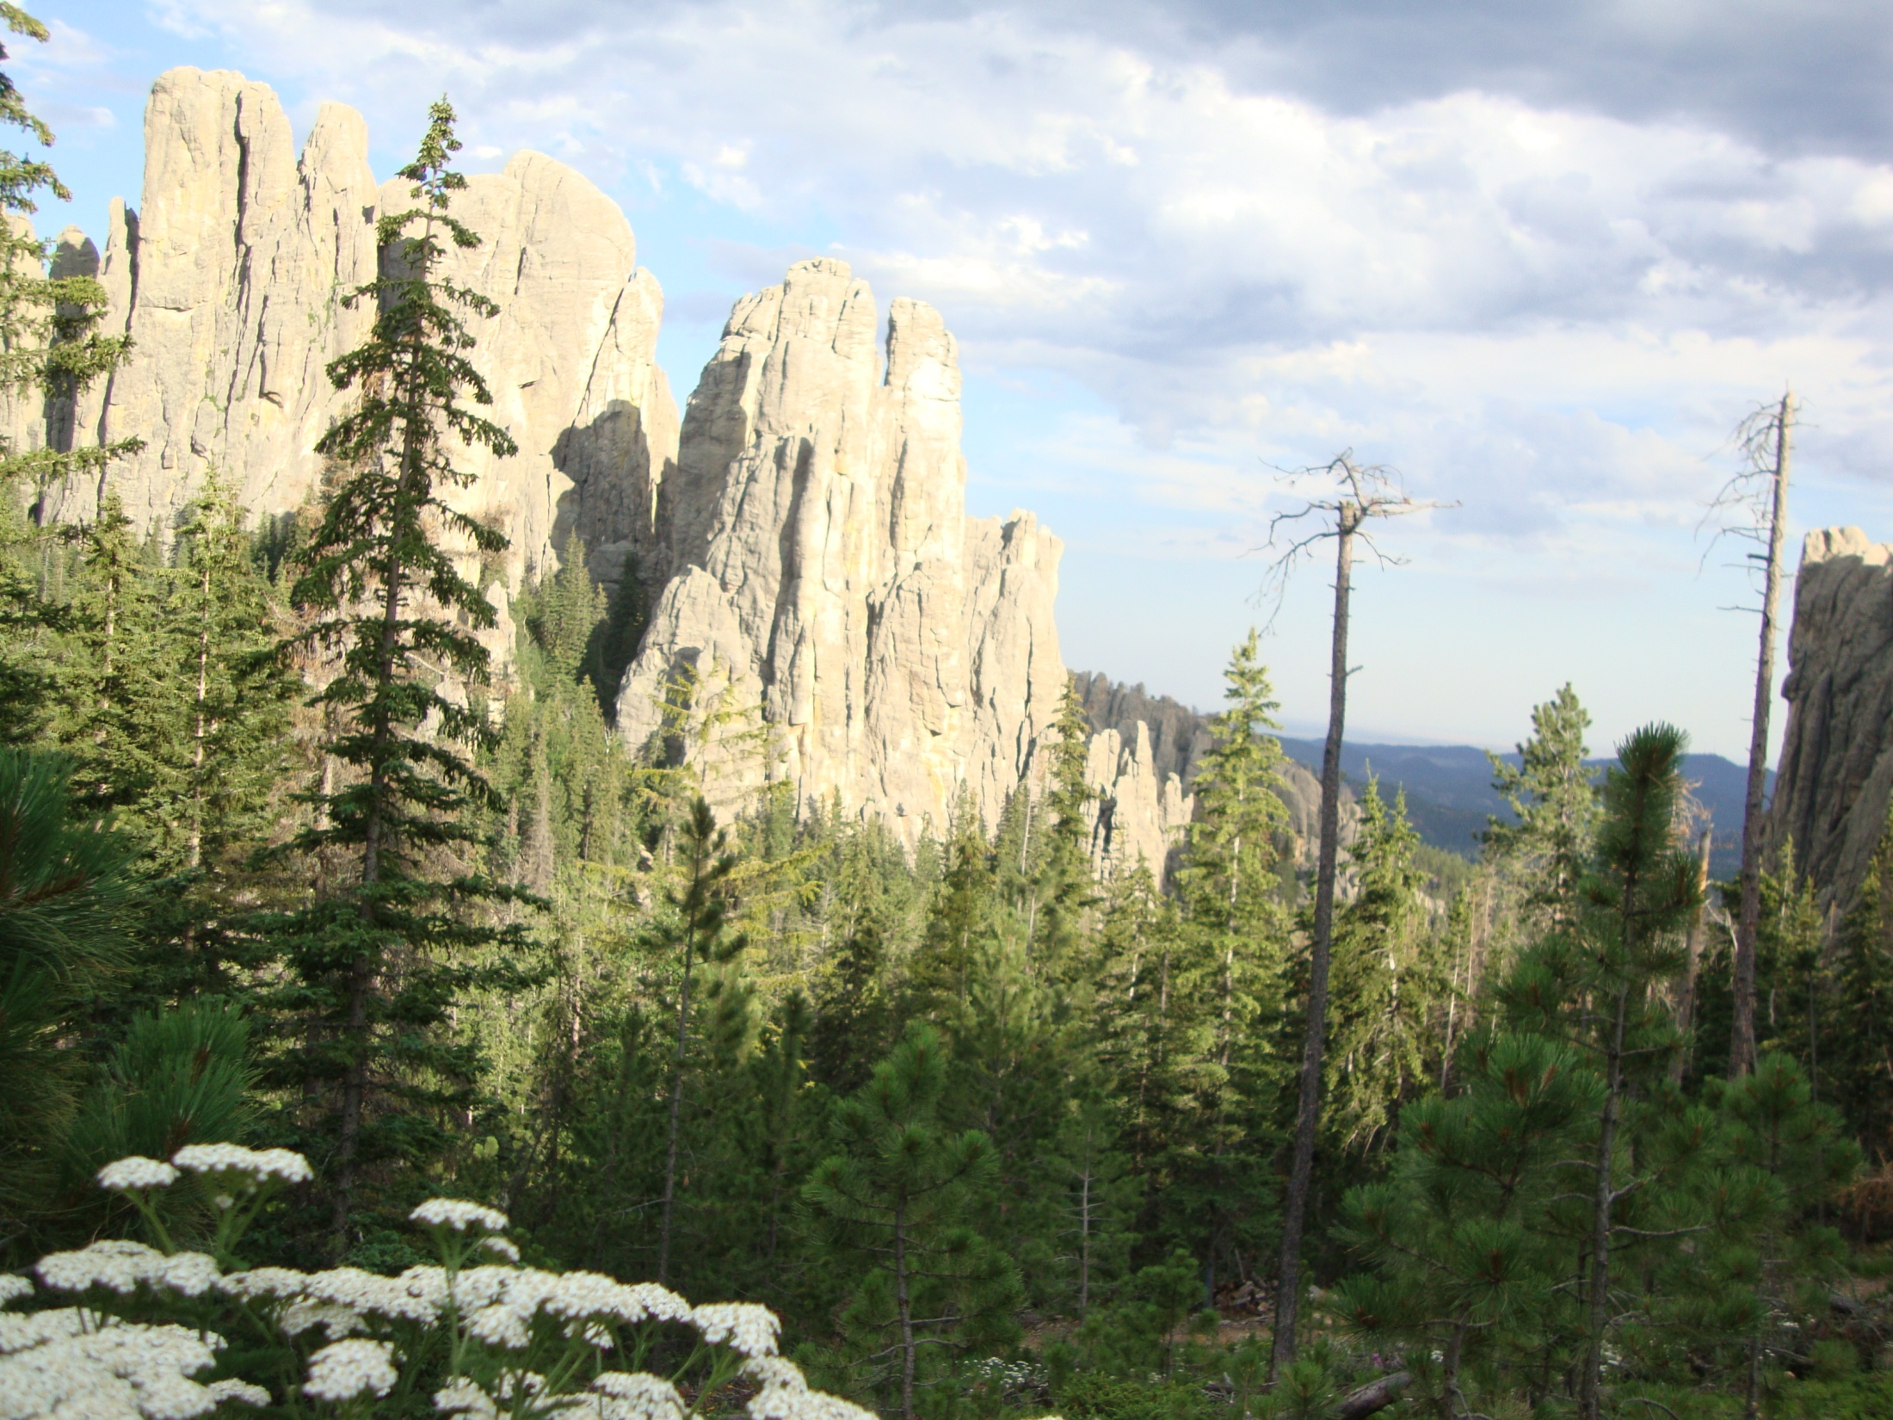

Slide 10
Far Cry 3

Slide 11
Game Levels
FarCry 2
I loved the scenery.
Did not necessarily enjoy going through it over and over again.
Diablo III ?

Slide 12
Fundamental Question
How to automatically create a level or game world that is “fun”?
Does making it bigger and bigger make it more “fun”?
What moments in a level induce a sense of awe or fear or …?

Slide 13
Secondary Questions
What role does the terrain or map play?
Does real-world terrain make a good level?
Can any terrain be made “fun” or are some terrains intrinsically more “fun” than others?

Slide 14
Related Work
Procedural Terrain generation
Procedural Levels in Infinite Super Mario
Procedurally Generated 2D Quake Arena levels.
Design Patterns for Game Levels

Slide 15
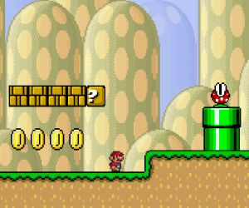
Super Mario
Nice problem as it is highly focused.
Terrain is a 1D function.
Coin and brick placement.

Slide 16
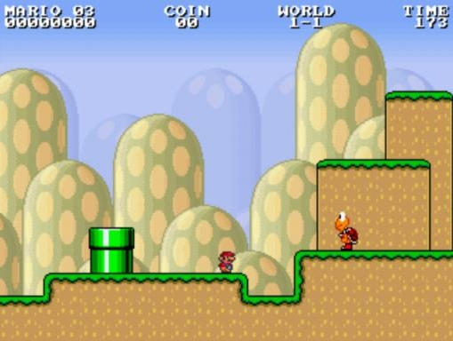
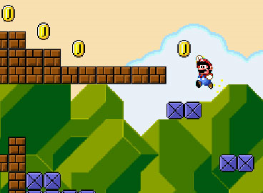
Infinite Super Mario
Can still get fairly complex.
Multiple platforms
Enemy placement

Slide 17
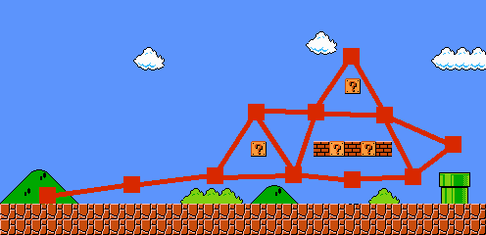
Infinite Super Mario
Previous work
Assumption that what the user did in the past, they want to do again.
Dissection of original into design patterns.
4-horde
Pillar gap
Etc.
Dahlskog and Togelius, 2012

Slide 18
More scoped question
How to control procedural terrain generation to better support games?
Problem with scoping:
Question may be misguided.

Slide 19
Procedural Terrain
Many papers.
General consensus:
Prettier implies better
Are they good for games?
Terrain examples generated by my students
Interactive Exploration

Slide 20
L3DT
Can I navigate across the terrain?
What could I do with this?
Can I embed a mission?

Slide 21
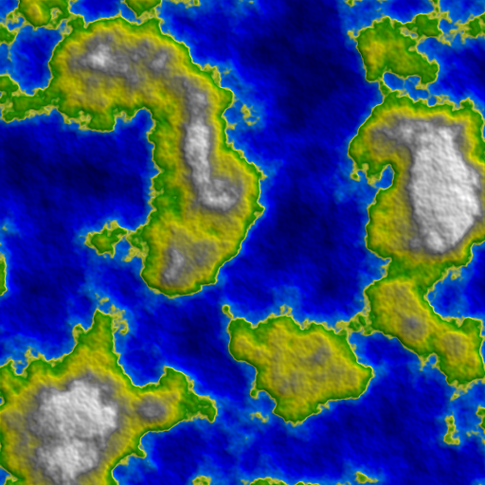
libNoise

Slide 22
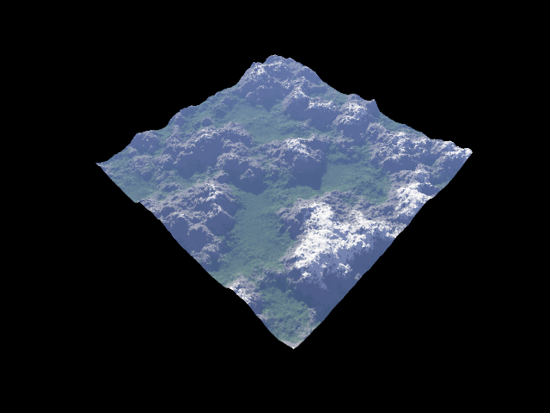
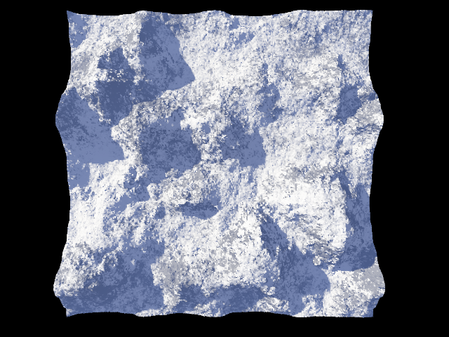
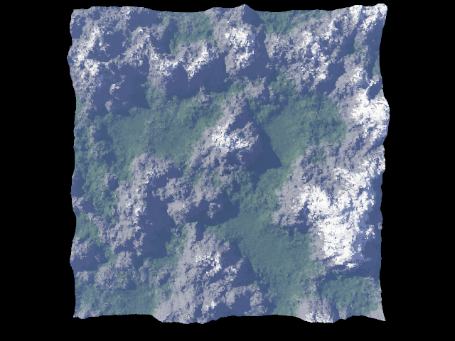
Terragen Classic
Can you control it?

Slide 23
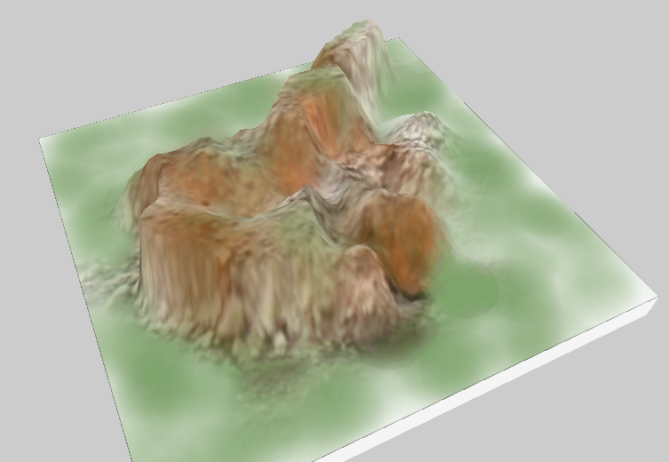
Earth Sculptor
Procedural only – no painting
A nice barricade.

Slide 24
Guess?

Slide 25
Minecraft

Slide 26
Criteria for Game Terrains
Did we come up with any guidelines?
If we did, so what?
What tools do we have?

Slide 27
Computerized Terrain Analysis
Mathematics
Accessibility
Statistics
Max/min slope, avg. slope, …
Geometric Computing
Scalar topology
Navigation graph
Simulation

Slide 28
Accessibility
Slope
Max height
Goal
100% ?
Age of Empires III
Only a curve?
Only a tree or graph?
Forces somewhat linear play

Slide 29
Simulation and AI
One attempt at designing 2D Quake Arena levels was to use AI bots to fight against each other.
Longer bots stayed alive => more complex => more fun.
?

Slide 30
Terrain Design Patterns
Hullett and Whitehead, 2010
Positional Advantage
Sniper Location
Gallery
Choke Point
Large Scale Combat
Arena
Stronghold
Alternative Routes
Flanking Route
Hidden Area
…

Slide 31
Creating Terrain
Synthesize it with the constraints needed?
Synthesize pretty and then modify?
Combination

Slide 32
AI and Search
Most of the work in the Gameplay area has been to devise a fitness function that tells you “fun”/”good”/”…” the level is.
We may be able to generate several million terrains in a rather short period of time.
Remember, goal is to get the human out of this labor intensive process.

Slide 33
Mathematical Definition
Mathematically, the problem takes the form:
Two problems:
Fitness is difficult to define and evaluate.
The set of height functions is infinite (or rather large).
Frade2008 has an interesting approach on selecting heights using a genetic algorithm.

Slide 34
Mazes
Let’s look at the problem from the perspective of a more constrained problem: perfect mazes

Slide 35
Perfect Maze
A perfect maze is just an embedding:
Spanning tree (tertiary)
Starting door
Ending door
Key point: Any wall / cell can be a starting or ending point.

Slide 36
Perfect Maze
Think of a typical RPG or FPS level as a maze or graph.
Typically forced to take a single path or corridor periodically.
Set of 10x10 possible mazes.
Can we enumerate all of them?
Can we evaluate / compare them or apply a meaningful fitness function.

Slide 37
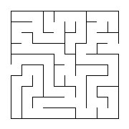
Perfect Mazes
Let’s actually make it simpler:
Given a maze:
Determine the doors that optimize it’s “fun”.
Any Ideas?
Put door here?

Slide 38
Maximizing Fun
Undergrad grad working on this.
Idea was to take a hierarchical approach:
Generate a NxN grid of mazes of size MxM
His solution was that the longest of the shortest paths (solution paths) would be the most fun.
# possibilities = 4N choose 2.

Slide 39
Maximizing Fun
Other Possibilities?
Minimize dead-end length
Maximize #turns
Comparisons or Fitness Function?
User Studies?
Tractability of problem

Slide 40
Visualization
Top Problems
Many suggestions
We have developed 100’s of algorithms / representations over the past 2+ decades.
I only have one Viz problem:
Effective Visualization
Getting back to basic science

Slide 41
Visualization
Quick question: What is larger, the set of all possible images or the size of your data set?
Sorry, random question, but …
Given the set of all possible visualizations, which 100 are the “best”?
…

Slide 42
3D Flow Viz Tools
Data Analysis
Mathematical analysis: magnitude, etc.
Geometric analysis: topology, vortices
Statistical analysis: histograms, clustering
Direct Volume Rendering
LIC / Spot Noise
Textured Splats
Mapping to Geometry
Streamlines
Hedgehog plots
Line Bundles
Stream surfaces
…

Slide 43
3D Streamlines
Casting effective as a problem:
Given an infinite set of streamlines
Determine the N “best”
Perhaps add the constraint that the total length of the streamlines is below some threshhold
Amount of ink is restricted.
Some attempts at this considered in the forward (greedy) direction: keep placing streamlines until no more.

Slide 44
Animated 3D Streamlines
For each streamline, what is the:
Transfer function (animation)
Phase
Problem: Consider I(x,y) and time, t
Determine I(x,y,t’) for all x, y, and t’=tmodλ, such that the effectiveness is optimized.
Separation of streamlines
Minimize occlussion

Slide 45
Conclusions
Consider brute-force approaches.
Try to clearly define why (or why not) something is effective or fun.
Have fun with it. It is complex, but wide open

Slide 46
Future Work
Maximizing the Fun in listening to a lecture / keynote.

Slide 47
Special Thanks
David Maung
Chloe Shi
Paul Kim
Oleg Mischenko
Evan DeLaubenfels
Josh Adams

