Slide 1
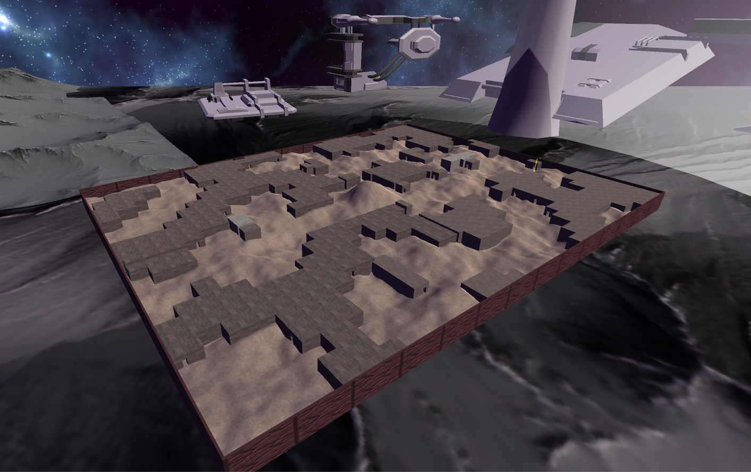
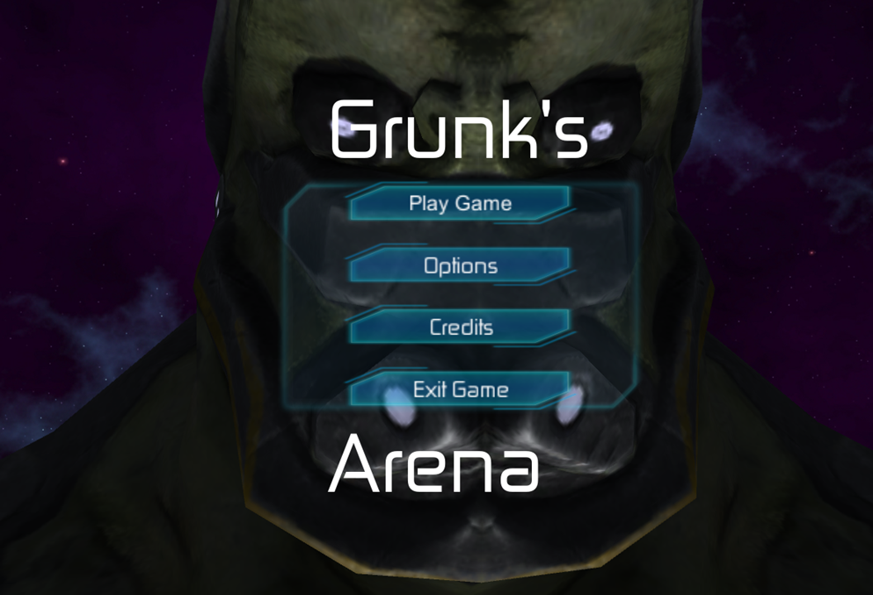
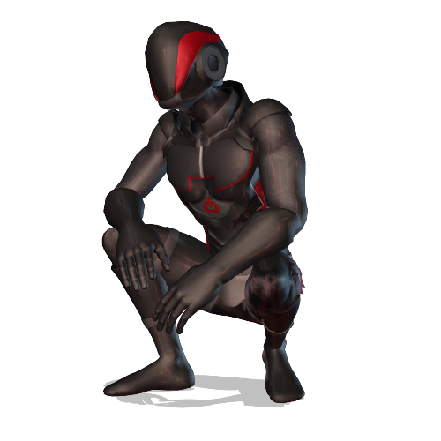
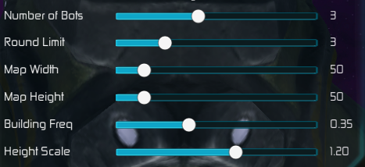
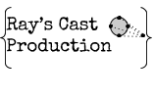
Grunk’s Arena
Aaron Camm, Jeff Huggins, Steve Moskal, Patrick Cardwell
Department of Computer Science & Engineering, The Ohio State University, 2015 Neil Avenue, Columbus, OH 43210
SUMMARY
How to Play
Controls
A Unique Map Every Time
Get ready to put your twitch shooter skills to the test! This Arena-style first-person shooter pits you against your friends and the deadly minions of Grunk! Adapt to new levels each round. Search the maps for devastating weapons to take down your foes, while trying to be the last one standing at the end of each round!
Do you have what it takes to win? Let’s find out in…...GRUNK”S ARENA!!!!!
To win Grunk’s Arena either be the last man standing for the most rounds, or if there is a tie have the most kills out of all the players. Players win rounds by destroying the other players using the weapons spread out across the level. Every gun is a 1 hit KO but certain guns have distinct advantages and disadvantages
Function | Input
Main Menu | Mouse
Running | Xbox 360 Left Stick
Looking Around | Xbox 360 Right Stick
Jump | Xbox 360 A Button
Drop Gun | Xbox 360 X Button
Fire Gun | Xbox 360 Right Bumper
Double Jump | Xbox 360 A Button
Join Game | Xbox 360 Start Button
Each randomly-generated level in Grunk’s arena features close-up, fast-paced action indoors as well as long-range, tactical combat out on the hilly battlefield.
Table 1: Game Controls
Guns
AK47
Fully Automatic
Moderate Accuracy
Figure 3: Shows a possible map configuration
Figure 1: Main menu screen
Single Player & Local Multiplayer
Main Menu
Guitar
Shotgun Blast of Sound
Large radius
Grunk’s Arena can support up to four player splitscreen co-op. If you can not play with a group of friends, though, that’s okay! Grunk’s Arena has smart AI that can challenge even the most veteran gamers. Take cover as the bots will try to contest the power weapons that are on the map.
Main menu consists of four options: play game, options, credits, and exit game.
Exit game – Quits out of the game.
Credits – Shows the game developers.
Options – Be able to change the music and sfx volumes.
Play game – Goes to the pre game lobby which includes different variables you can change. Those include map width, map height, number of buildings, and so on.
CONTACT
Bazooka
Fires Long-Range Explosives
Very Valuable
Aaron Camm – camm.10@buckeyemail.osu.edu
Jeff Huggins –
Huggins.65@osu.edu
Steve Moskal-
Moskal.11@osu.edu
Patrick Cardwell-
Cardwell.64@osu.edu
Bit Gun
Starting gun
Fires Slow and is Fairly inaccurate
M4
Fires in 3 Round Bursts
High Accuracy
UMP
Fully Automatic
Low Accuracy
Figure 4: Motus man, the character used for AI’s and players
Figure 2: Pre game lobby options

