Slide 1
Procedurally Generated Worlds in Early Games
By Kelsie Freshour, Kevin Miller, and Alex Stopar

Slide 2
Procedural Worlds: What and Why?
World space and structure created by algorithm, rather than by manual design
Often uses concepts such as fractal terrain, pseudo-random sequence to create world
Used primarily for seemingly unique gameplay experiences and memory conservation
Will be chronologically covering games that are notable for procedurally generated worlds from 1980 to the present time

Slide 3
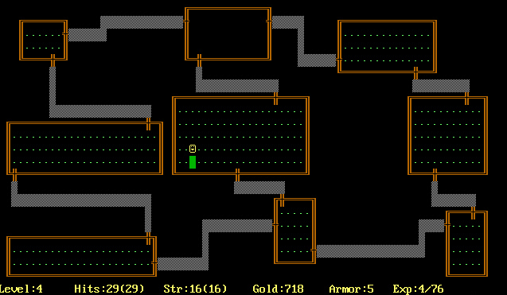
Rogue - Dungeon Crawling Game
Created 1980
Amiga, CD64, Various Unix Systems
0.16 KB / $
Released to moderately good reviews
Modern game historians consider it one of the most important games of all time
Hailed as highly addictive and unique

Slide 4
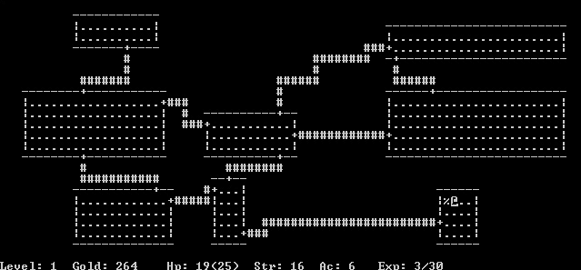
Rogue and Its Procedural Generation Algorithm
Created by Michael Toy and Glenn Wichman
Unix, DOS, and Atari ST
Uses placement of ASCII characters on the screen
From Glenn Wichman: "Aside from coin-op video games, no computer games had graphics in those days. What was "weird" about Rogue is that we were using the letters to create pictures instead of text."
Consists of an adventurer making his/her way through procedurally generated maps on the screen separated by staircases

Slide 5
The Rogue Algorithm
Divide game map into grid (Rogue uses a 3x3 grid)
Flags if grid sections are connected
Pick a random room and start it as connected
While neighbors are unconnected, connect it. Repeat.
While there are unconnected rooms, connect to a random neighbor
Use a random number (in this case for Rogue, up to three) for extra, random connections to other rooms
Draw rooms and draw a corridor from the center of each room to the center of each of its connected rooms,
Changing walls into corridors where appropriate
Stairs are flagged as the first and last rooms
Add extra corridor spaces instead of rooms and L-shaped corridors instead of rooms

Slide 6
Effects of Algorithm
Must not face same level twice
Thus, permanent death
Levels restricted graphically into a 3x3 pattern: “One thing we were never happy with was the way rooms were laid out on the dungeon level -- always between 6 and 9 rooms in a tic-tac-toe pattern. We wanted to have the levels much more free-form, but we just couldn't figure out how to do it.”
However, the algorithm is relatively quick, even with grids larger than 3x3.
https://archive.org/details/msdos_Rogue_1983

Slide 7
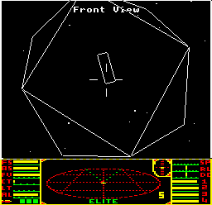
Elite - Space Trading and Exploration
Released 1984
BBC Micro, Commodore 64
1 KB / $
Very good initial reviews
600,000 total units sold
Dissenters retroactively gave the game less favorable ratings, calling the game excellent as a precursor to other space traders, but far too tedious for the formula.

Slide 8
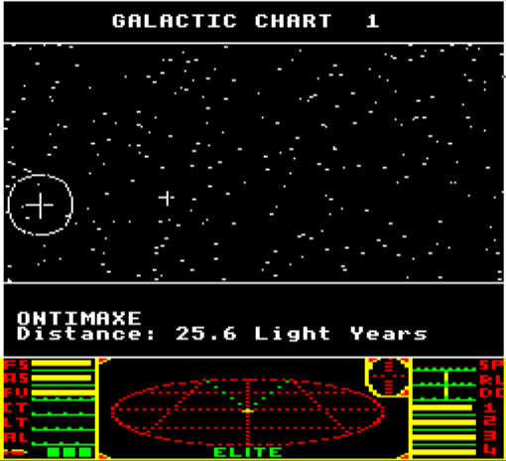
Elite: Open-Ended Procedural Generation
Developed by David Braben and Ian Bell
BBC Micro and Acorn Electron computers were first to implement
Procedural generation allowed up to trillions of different galaxies
Limited to eight galaxies with 256 planets each (2048 planets)
Allowed a free-form adventure with no specific locations to gain capital or set objectives
Sales of Elite initially reached 150,000, which actually matched the amount of BBC Micro computers in the world at that point

Slide 9
Elite’s Use of the Fibonacci Sequence
Originally thought of 10, well-thought out and elegant star systems, but the memory demand was impossible for the current system
Needed to build names, distances, and dimensions instantly and place them in a solid world
For the sequence, one can produce a pseudo-random sequence by of adding the last two numbers in the sequence and ignoring all but the ones place
However random, they are predictable.

Slide 10
Effects of Fibonacci Algorithm
Could track the world reliably, even though the game appears random
Could track, test, and experiment based on specified seed values
Adapted numbers into the size, location, and amount of planets
Also used a list of nouns and adjectives to describe planets, which also were subject to the pseudo-random generator
“...it was possible to land on a planet where all the inhabitants were, yes, carnivorous arts graduates...not random, but pseudo-random.”

Slide 11
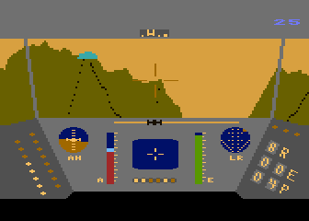
Rescue on Fractalus! - Flight Sim
Released 1984
Atari 8-bit, Atari 5200
1 KB / $
Mixed reviews; criticized for very little substance, but hailed for quick, addicting gameplay
Set a base upon which other flight sims and PCG would be developed

Slide 12
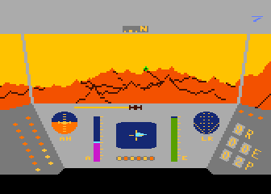
Rescue on Fractalus!
Released by LucasFilm Games from David Fox, Charlie Kellner, Peter Langston, and Gary Winnick
Gameplay shows flying around on an alien planet to pick up downed pilots
Inspired by the “Genesis Effect” sequence from Star Trek II: The Wrath of Khan
48K of memory
Written in 6502 assembly language

Slide 13
Algorithms for Fractal Terrain Generation
Use the random midpoint displacement algorithm-
A square is subdivided into four equal squares, and the center point is vertically offset by a random value
Also use the diamond algorithm-
Start with a large 2D array of empty points
Use iterative subdivision in two steps: diamond and square
Diamond: With a square of four points, generate a random value at the center (averaging the four corner values and adding a random amount)
Square: Taking each diamond, generate a random value at the center, while calculating the midpoint value by averaging the corners plus a random amount.

Slide 14
Fractal Terrain Generation Effects
Allowed the effect of self-similarity in landscapes, where the closest localized scale has the same complexity as a larger scale (i.e. flight to landing)
Allows for the generation of natural-looking landscapes
Ideal for fractal components that appear in nature (such as mountain ranges)
Gameplay would be optimal for a world that incorporates large amounts of that type of terrain
Entire game built around concept of fractal landscape

Slide 15
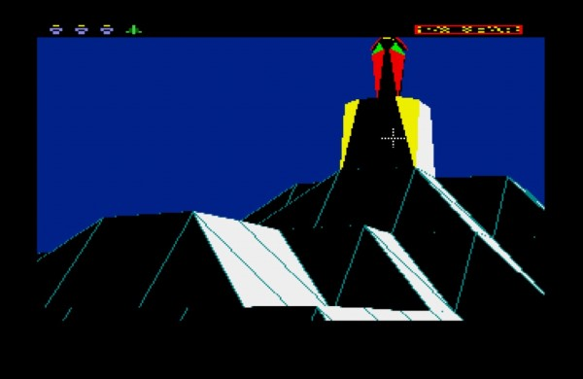
The Sentinel
Aka “The Sentry”, created by Geoff Crammond and published in 1986 by Firebird
First for BBC Micro, then converted to C64, Amstrad CPC, ZX Spectrum, Atari ST, Amiga, and PC
30KB/$
Player takes role of a robot that can absorb objects, create clones of itself, and transfer its mind to those clones
Must reach the top to the Sentinel, which absorbs the player if the player is seen
Known at the time for 10,000 unique levels stored in 48-64 KB
Successful in its place of origin (U.K.) due to simplicity and straightforward actions

Slide 16
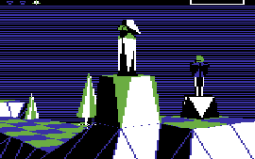
Sentinel and 10,000 Levels
Uses a four digit number and an eight digit password to procedurally generate the landscape
Generates a three-color landscape with flat lands, hills, and mountains
Polygon-based graphics for illusion of depth
Static view, however, to save memory, as one can only pan across each view instead of moving (360 degrees left/right, 80 degrees up/down)
Allows for more creation of levels with simple visual environment
However, perspective transforms usually cannot be rendered once and then rotated, or objects will not maintain a constant distance along the z-axis and appear smaller/larger with rotation
Probable that specified distance was used, where game scaled to 1/specified distance
Makes scene slightly warped during gameplay

Slide 17
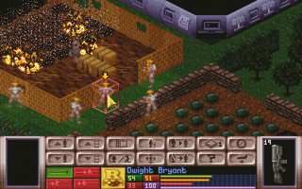
X-COM: UFO Defense and Incorporating Procedural Level Elements in Strategy Games
PC turn-based strategy game released in 1994 developed by Mythos Games
Mixes research and base development with tactical battles with aliens
Unique at the time for incorporating isometric areas with semi-randomly generated maps
Sold more than 600,000 units on the
DOS system alone, half of net sales in the United States
Notable from a European game company
500KB/$

Slide 18
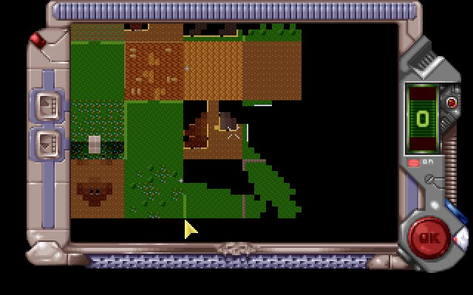
X-COM’s Semi-Random Levels
Small, square patches aggregating prefabricated terrain (based on global area)
Fit them together semi-randomly, so that the patches would somewhat match
Various parts such as UFOs fixed, regardless of random mission generation
Regardless of impact, the later remake, Enemy Unknown, eventually scrapped the idea
Jake Solomon responds in an interview:
“When you give up the control as a developer, you really run into problems. You certainly cannot balance the experience nearly as well”
Director of the original X-COM, Julian Gollop, noted the exact opposite in preference

Slide 19
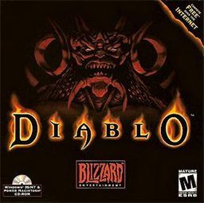
Diablo I
One of the first modern games to use tiling framework
Dungeons randomly generated from random tile sets
Pioneered the “random item drop”
Often called the first “truly replayable game”

Slide 20
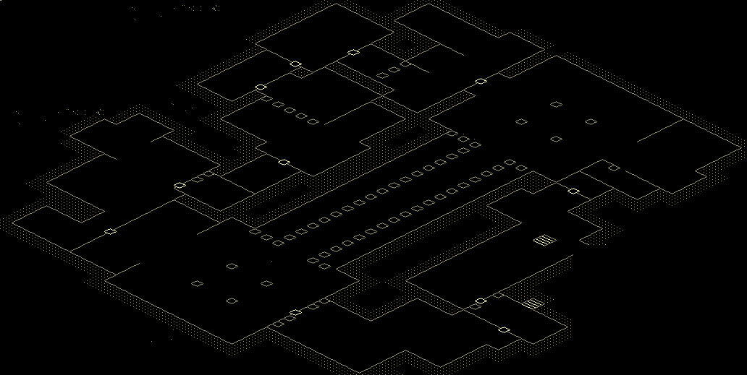
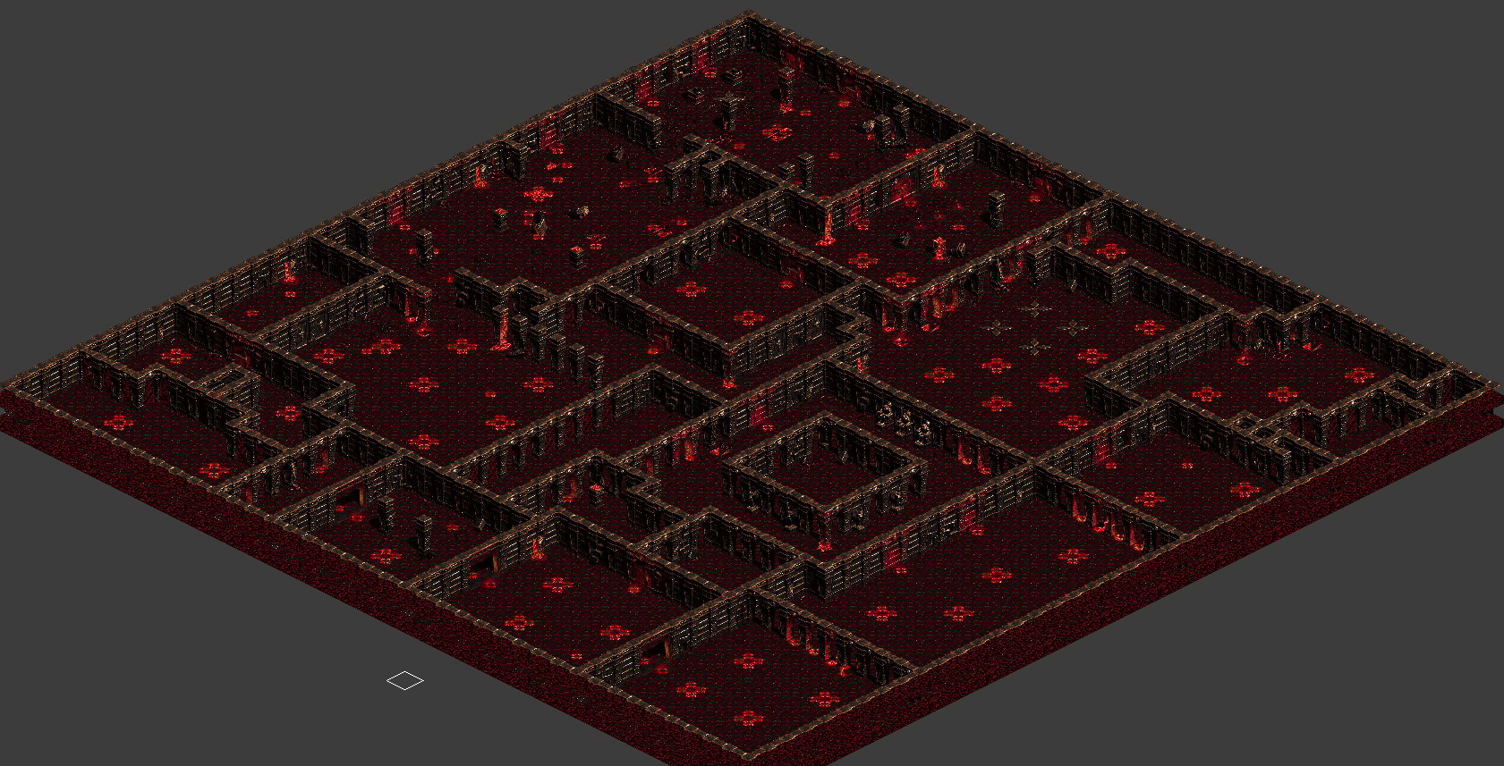
Diablo I Tiling

Slide 21
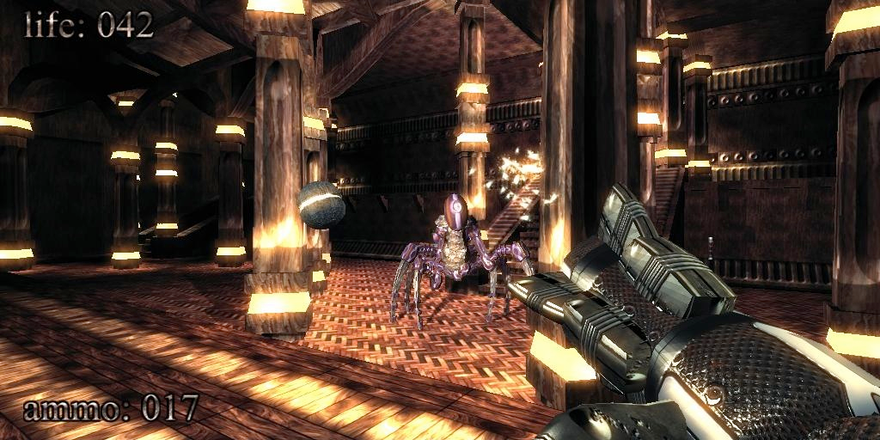
.kkrieger
FPS from .theprodukkt
Development began 2002
First place in 96k competition in April 2004
Still in Beta as of 2012
Can be downloaded for free
2004---$.90 per Gigabyte

Slide 22
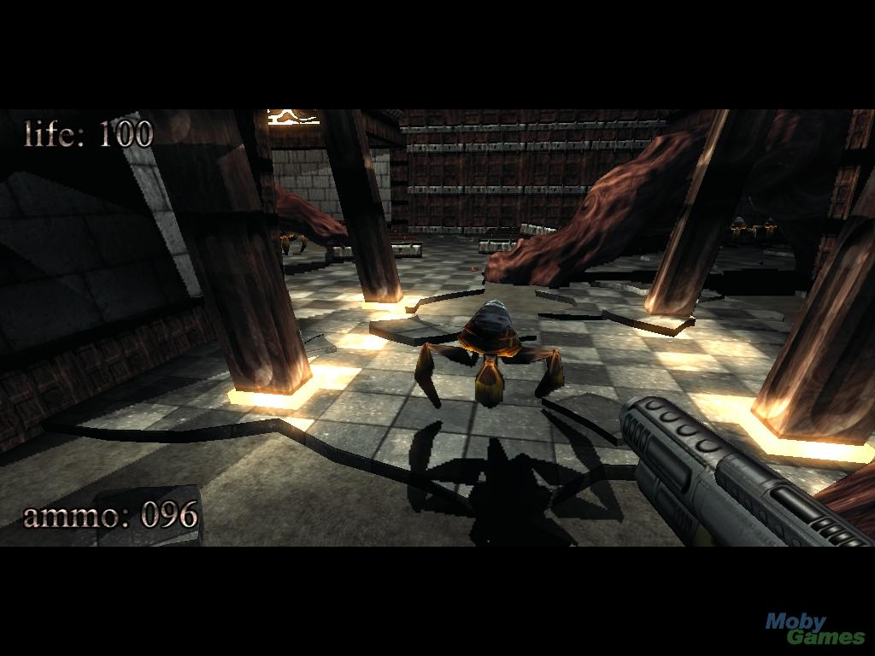
.kkrieger World Design
Textures stored via creation history
Eschews the per-pixel basis of most games
Primitive shapes created from boxes and cylinders with vertex deformations
All assets produced during the loading phase

Slide 23
.kkriger Size Comparison
97KB of space total
1/7000th of a movie
1/28th of an mp3
1/8th of a 1024x768 jpg
7 128x128 thumbnails
Stored by traditional methods, the game would be 300MB. (over 3000 times larger)

Slide 24
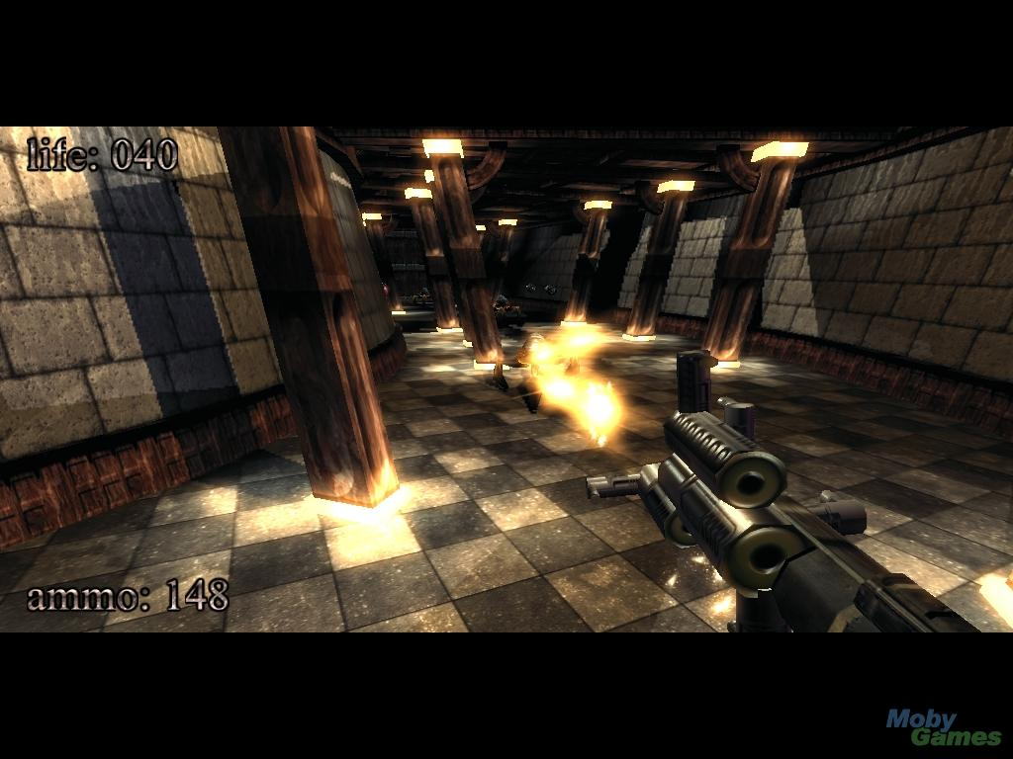
.kkrieger Sounds and Music
Background music is constant stream of MIDI data sent through a synthesizer
Sound effects are very basic and few in number

Slide 25
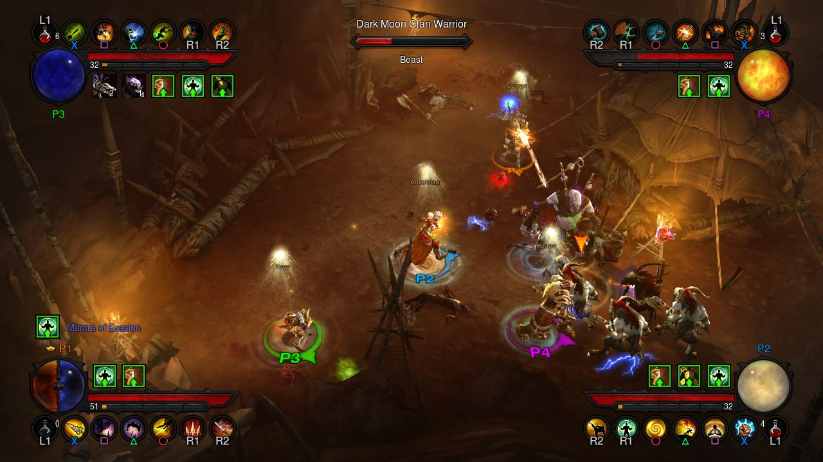
Diablo 3
Action RPG Released May 2012 by Blizzard Entertainment
Major expansion, Reaper of Souls, released March 2014 and sold 2.7 million copies within a week
Expansion fixed many user complaints and brought many back to game
Record setting sales with 3.5 million PC copies sold within 24 hours
Best selling of the Diablo series, with 20 million copies sold before console debut in Aug 2014
Drawback - Massive game - currently over 18 GB with the expansion

Slide 26
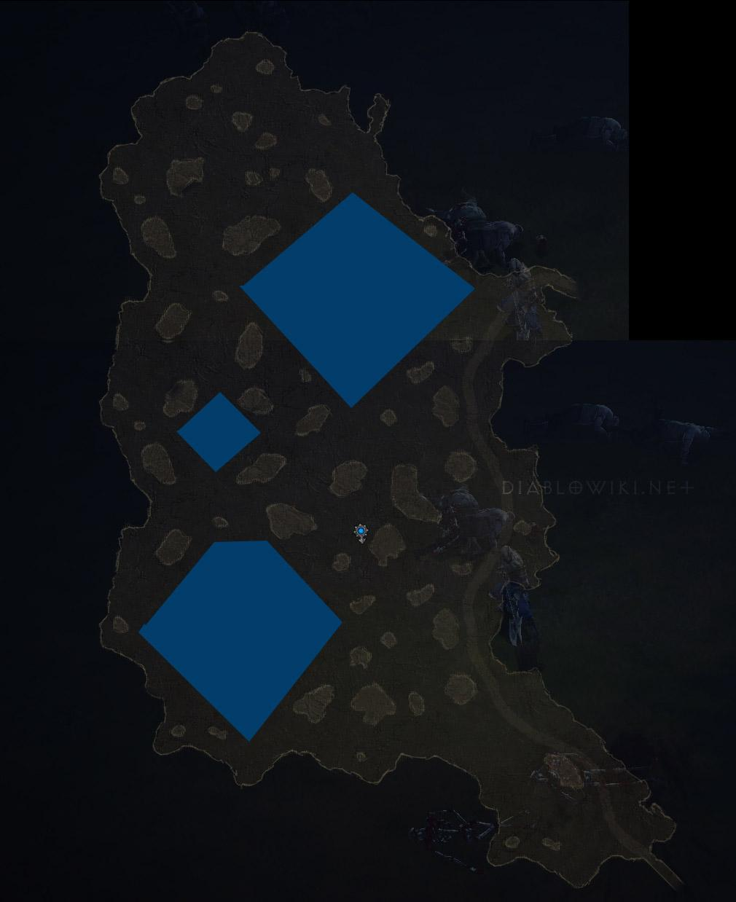
Diablo 3 Overworld Generation
Static Map with Randomized Tiles
All enemies and destructible items are randomized within map
Item drop randomized with random modifiers on dropped item

Slide 27
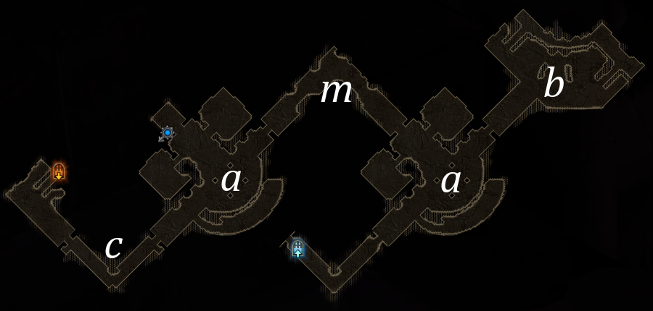
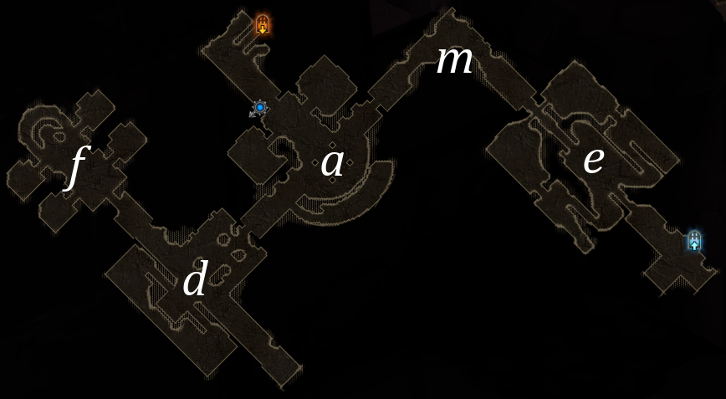
Diablo 3 Dungeon Generation
Most dungeons maps are made of a collection of map tiles
A tile is randomly chosen by the map generator, attached to the other tiles, which create the overall map

Slide 28
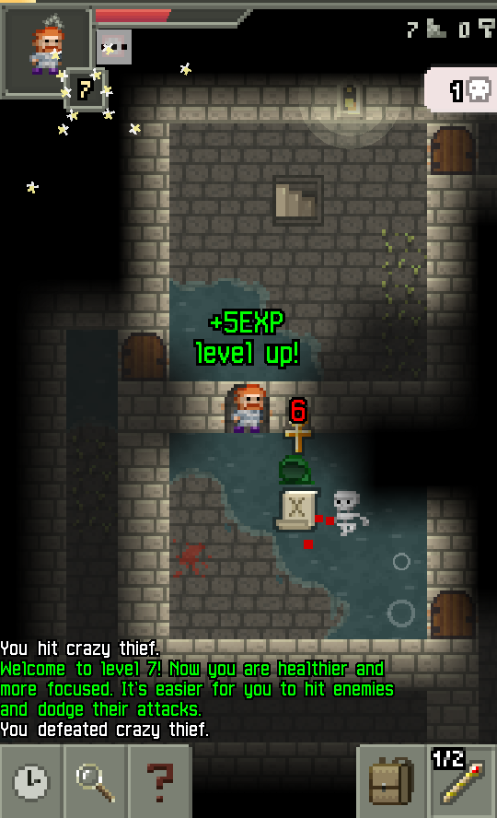
Pixel Dungeon
Free and Open Source Roguelike for Android based on the original Rogue
Over 1 million downloads with 4 stars from over 143k reviews
1.4 MB in size

Slide 29
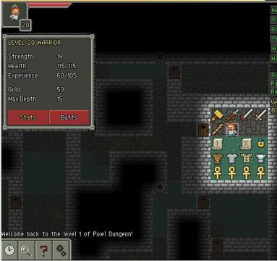
Pixel Dungeon Generation
Generates rooms of random size and uses distance graph to build paths
Generators vary by level type, to have more variance between sections
Code for game:
https://github.com/watabou/pixel-dungeon/tree/master/src/com/watabou/pixeldungeon

Slide 30
Pixel Dungeon Demo
http://watabou.itch.io/pixel-dungeon

Slide 31
Other Modern PGC Games
Roguelikes
Binding of Isaac
Rogue Legacy
Spelunky
Sandbox
Minecraft
Terraria
Starbound
No Man’s Sky
Eve Online
Map Generation
Civilization IV
Dwarf Fortress
Morrowind & Daggerfall
Item & Enemy Generation
Borderlands (Loot Generation)
Far Cry 2
Left 4 Dead
Skyrim & Oblivion (Adaptive Difficulty)

Slide 32
Questions?

