Slide 1
Uncovering Performance Problems in Java Applications with Reference Propagation Profiling
Dacong Yan¹, Guoqing Xu², Atanas Rountev¹
¹ Ohio State University
² University of California, Irvine
PRESTO: Program Analyses and Software Tools Research Group, Ohio State University

Slide 2
Overview
Performance inefficiencies
Often exist in Java applications
Excessive memory usage
Long running times, even for simple tasks
Challenges
Limited compiler optimizations
Complicated behavior
Large libraries and frameworks
Solution: manual tuning assisted with performance analysis tools

Slide 3
An Example
1 class Vec {
2 double x, y;
3 sub(v) {
4 res=new Vec(x-v.x, y-v.y);
5 return res;
6 }
7 }
8 for (i = 0; i < N; i++) {
9 t = in[i+2].sub(a[i-1]);
10 q[i] = t;
11 t = in[i+1].sub(a[i-2]);
12 // use of fields of t
13 }
… …
80 t=q[*];
81 // use of fields of t

Slide 4
An Example
1 class Vec {
2 double x, y;
3 sub(v) {
4 res=new Vec(x-v.x, y-v.y);
5 return res;
6 }
7 }
8 for (i = 0; i < N; i++) {
9 t = in[i+2].sub(a[i-1]);
10 q[i] = t;
11 t = in[i+1].sub(a[i-2]);
12 // use of fields of t
13 }
… …
80 t=q[*];
81 // use of fields of t

Slide 5
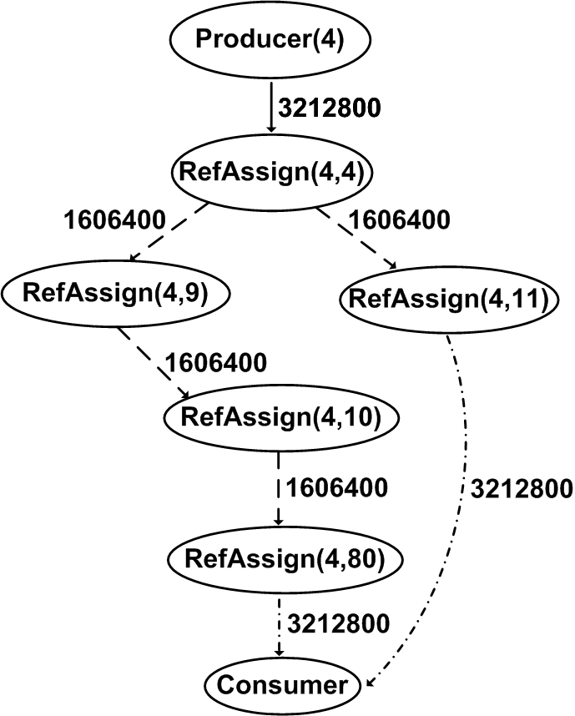
An Example
1 class Vec {
2 double x, y;
3 sub(v) {
4 res=new Vec(x-v.x, y-v.y);
5 return res;
6 }
7 }
8 for (i = 0; i < N; i++) {
9 t = in[i+2].sub(a[i-1]);
10 q[i] = t;
11 t = in[i+1].sub(a[i-2]);
12 // use of fields of t
13 }
… …
80 t=q[*];
81 // use of fields of t

Slide 6
An Example
1 class Vec {
2 double x, y;
3 sub(v) {
4 res=new Vec(x-v.x, y-v.y);
5 return res;
6 }
7 }
8 for (i = 0; i < N; i++) {
9 t = in[i+2].sub(a[i-1]);
10 q[i] = t;
11 t = in[i+1].sub(a[i-2]);
12 // use of fields of t
13 }
… …
80 t=q[*];
81 // use of fields of t

Slide 7
An Example
1 class Vec {
2 double x, y;
3 sub(v) {
4 res=new Vec(x-v.x, y-v.y);
5 return res;
6 }
7 }
8 for (i = 0; i < N; i++) {
9 t = in[i+2].sub(a[i-1]);
10 q[i] = t;
11 t = in[i+1].sub(a[i-2]);
12 // use of fields of t
13 }
… …
80 t=q[*];
81 // use of fields of t

Slide 8
Implementation
Reference propagation profiling
Implemented in Jikes RVM 3.1.1
Modify the runtime compiler for code instrumentation
Create shadow locations to track data dependence
Instrument method calls to track interprocedural propagation
Overheads
Space: 2-3×
Time: 30-50×

Slide 9
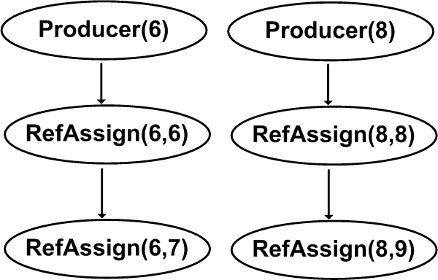
Reference Propagation Profiling
Intraprocedural propagation
Shadows for every memory location (stack and heap) to record last assignment that writes to it
Update shadows and the graph accordingly
Code Shadow Graph
6 a = new A; aʹ = RefAssign(6,6)
7 b = a; bʹ = RefAssign(6,7)
8 c = new C; cʹ = RefAssign(8, 8)
9 b.fld = c; b.fldʹ = RefAssign(8, 9)
Interprocedural propagation
Per-thread scratch space save and restore shadows for parameters and return variables

Slide 10
Client Analyses
Not-assigned-to-heap (NATH) analysis
Locate producer nodes that do not reach heap propagation nodes (heap reads and writes)
Variant: mostly-NATH analysis
Cost-benefit imbalance analysis
Detect imbalance between the cost of interesting operations, and the benefits they produce
For example, analysis of write read imbalance
Analysis of never-used allocations
Identify producer nodes that do not reach the consumer node
Variant: analysis of rarely-used allocations

Slide 11
A Real Tuning Session
1 class Vec {
2 double x, y;
3 sub(v) {
4 res=new Vec(x-v.x, y-v.y);
5 return res;
6 }
7 }
8 for (i = 0; i < N; i++) {
9 t = in[i+2].sub(a[i-1]);
10 q[i] = t;
11 t = in[i+1].sub(a[i-2]);
12 // use of fields of t
13 }
… …
80 t=q[*];
81 // use of fields of t

Slide 12
A Real Tuning Session
1 class Vec {
2 double x, y;
3 sub(v) {
4 res=new Vec(x-v.x, y-v.y);
5 return res;
6 }
7 }
1
2
8 for (i = 0; i < N; i++) {
9 t = in[i+2].sub(a[i-1]);
10 q[i] = t;
11 t = in[i+1].sub(a[i-2]);
12 // use of fields of t
13 }
… …
80 t=q[*];
81 // use of fields of t
1
2

Slide 13
A Real Tuning Session
1 class Vec {
2 double x, y;
3 sub(v) {
4 res=new Vec(x-v.x, y-v.y);
5 return res;
6 }
7 }
1 class Vec {
2 double x, y;
3 sub_rev(v, res) {
4 res.x = x-v.x;
5 res.y = y-v.y;
6 }
7 }
tuning
nt = new Vec; // reusable
8 for (i = 0; i < N; i++) {
9 t = in[i+2].sub(a[i-1]);
10 q[i] = t;
11 t = in[i+1].sub(a[i-2]);
12 // use of fields of t
13 }
… …
80 t=q[*];
81 // use of fields of t
8 for (i = 0; i < N; i++) {
9 t = in[i+2].sub(a[i-1]);
10 q[i] = t;
11 in[i+1].sub_rev(a[i-2], nt);
12 // use of fields of nt
13 }
… …
80 t=q[*];
81 // use of fields of t
Reductions: 13% in running time and
73% in #allocated objects

Slide 14
Examples of Inefficiency Patterns
Temporary objects for method returns
Reductions for euler: 13% in running time and 73% in #allocated objects
Redundant data representation
mst: 63% and 40%
Unnecessary eager object creation
chart: 8% and 8%
jflex: 3% and 27%
Expensive specialization for sanity checks
bloat: 10% and 11%

Slide 15
Conclusions
Reference propagation profiling in Jikes RVM
Understanding reference propagation is a good starting point for performance tuning
Client analyses can uncover performance inefficiencies, and lead to effective tuning solutions

Slide 16
Thank you

